Slide 1
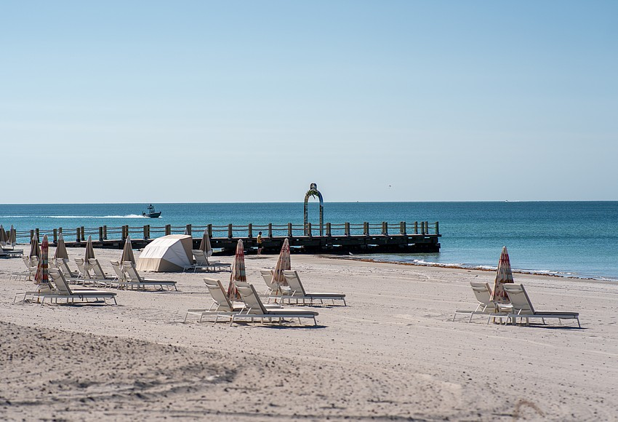
Publicly-Initiated Sign Code Amendment Ordinance 2026-08 Public Hearing
Planning & Zoning Board
March 17, 2026

Slide 2
Background
Sign Code Amendment authorized by the Town Commission on December 8, 2025.
Directed to staff to prepare an amendment to the Sign Code with staff supported language for public hearing consideration.
Commission did not indicate either support or opposition. Intent was to allow St. Regis property owner the opportunity to potentially allow for signage that was installed on their privately-owned groin.
Companion to privately-Initiated Zoning Text Amendment (Ord. 2026-07)
Application requests amendments to two sections of the Sign Code that regulate the location of structures relative to the Gulf

Slide 3
Background
Amendment would apply Townwide (Currently, there is only one privately owned groin with a pedestrian walkway. Should there be any additional such groins in the future, the Sign Code, if approved, would similarly allow for an archway structure that contains an embedded identifying sign).
Public purpose is to identify the entity responsible for both the private groins, with pedestrian walkways, and any accessory structures/signs thereon.
Staff supportive of amendments that allow private groin owners the ability to provide identifying information for location purposes and more quickly locating the structure in the event of future public safety responses at the private groin (walkway) by the Town’s police, firefighters and paramedics, along with identifying the responsible party for maintenance and liability as legitimate public purposes.

Slide 4
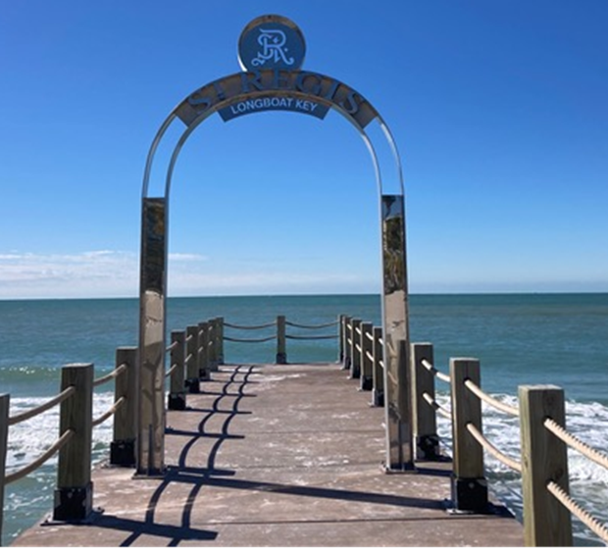
Nonconformities of Sign/Structure
The arched sign on the groin at St. Regis is currently a sign type that is not allowed: inconsistent with Sign Code & Zoning Code provisions.
Per Section 156.03 of the Sign Code:
Outdoor Advertising Signs are prohibited. On the adjacent tourism-zoned property only ground-mounted signs, flat wall signs, awning signs, and projecting signs are allowed.
A companion amendment to the Zoning Code (Ord. 2026-07) would be needed to allow the for the placement type of structure/sign (seaward of the ECL & as an allowable accessory structure type.
Current Sign Installed 08/25

Slide 5
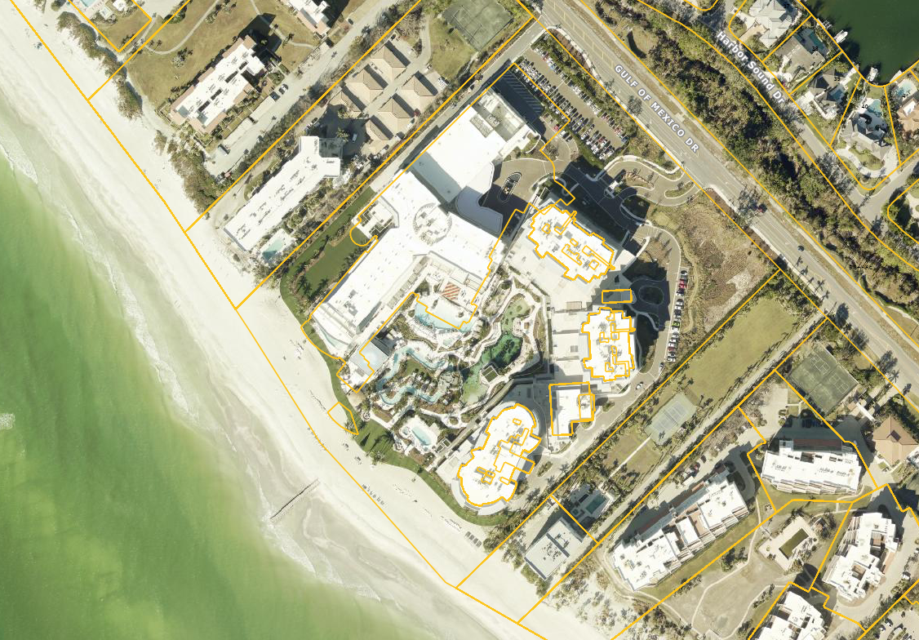
Nonconformities of Sign/Structure
Sign Code- Off-Site Sign Not Allowed
Per Section 156.03(C) of the Sign Code:
Outdoor Advertising Signs are prohibited.
Outdoor advertising sign: A sign that advertises goods, products, or services which are not sold, manufactured, or distributed on or from the premises or facilities on which the sign is located.

Slide 6
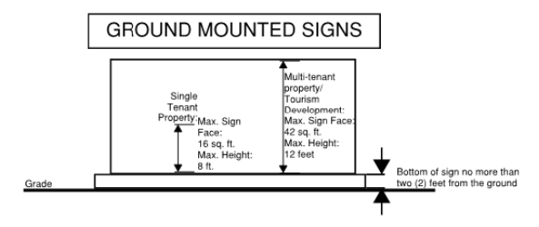
Nonconformities of Sign/Structure
Sign Code- Off-Site Sign Not Allowed
Per Section 156.07(C) of the Sign Code:
Commercial, tourism and institutional zoning districts currently only allow for Ground-Mounted type signs (as standalone type signs).

Slide 7
Ord. 2026-08: Amendments
New Sign Type Added to Definitions
Section 156.02, Definitions:
Private Groin sign. An archway-shaped sign erected and maintained on a privately owned and permitted groin that includes a pedestrian walkway that extends over sovereign submerged lands in the Gulf of America (formerly known as the Gulf of Mexico).

Slide 8
Ord. 2026-08: Amendments
Specific Sign Regulations: Private Groin Sign
New proposed Subsection 158.07(F) contains proposed standards for privately owned groins with pedestrian walkways:
(F) Allowance. A single Private Groin sign is authorized on a privately owned and permitted groin structure that includes a pedestrian walkway, and that extends from the public beach into the Gulf of America (formerly known as the Gulf of Mexico). The archway structure and embedded sign shall be limited to identifying the responsible entity for the structure and groin, so ownership and liability can be identified by the walkway users and the public from the public beach. The allowance is authorized when all of the following requirements are met:
(1) The archway structure, inclusive of a single embedded sign, shall not exceed a height of 14 feet above the surface of the private groin.
(2) The archway structure on the private groin walkway will create an open frame for pedestrian usage, and passage through the archway structure shall be constructed and consist of columns or posts made of wood, concrete, stainless steel, aluminum, or similar weather-resistant material not exceeding 8 inches by 8 inches thick. The archway structure shall not form a wall, roofed shelter, or enclosed structure.

Slide 9
Ord. 2026-08: Amendments
Specific Sign Regulations: Private Groin Sign
New proposed Subsection 156.07(F) contains proposed standards for privately owned groins with pedestrian walkways:
(3) The archway structure, including the embedded sign, shall be designed and installed to withstand winds up to 150 miles per hour.
(4) The archway and embedded sign shall not be illuminated.
(5) All other applicable state and federal requirements and permits for the private groin, archway, and sign are obtained and approved.
(6) The archway and embedded sign shall be maintained in good repair at the owner’s sole expense.

Slide 10
Companion ZTA
Ord. 2026-07
Ordinance 2026-08 contains a provision that the Ordinance’s adoption and effective date is contingent upon the Town Commission’s adoption of Ordinance 2026-07 (the companion Zoning Code Text amendment).
This Ordinance shall only take effect upon the Town Commission’s adoption of both this Ordinance 2026-08 and Ordinance 2026-07.

Slide 11
Staff Recommendations
Staff recommends approval of Ordinance 2026-08.
Town Commission Public Hearing: May 4th

