Slide 1
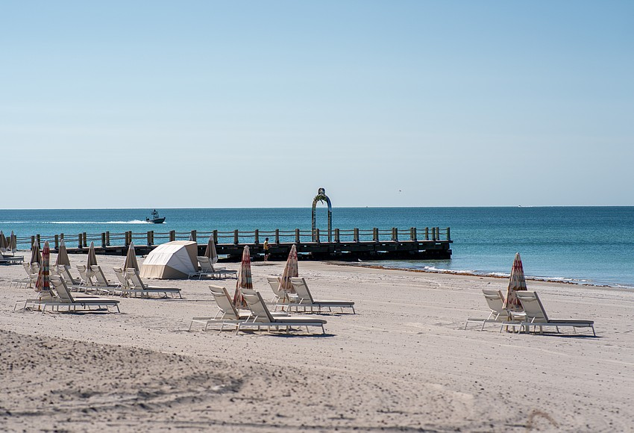
Privately-Initiated Zoning Text Amendment Ordinance 2026-07 Public Hearing
Planning & Zoning Board
March 17, 2026

Slide 2
Background
Application requests amendments to two sections of the Zoning Code that regulate the location of structures relative to the Gulf
Privately-Initiated Zoning Text Amendment
Zoning Code Sec. 158.021(A)(3) allows “fee simple owners of any property in the Town” to initiate proposals for Zoning Text Amendments.
Filed by: Owner of 1561, 1671, 1581, 1591, 1601, & 1621 GMD
Application has a companion amendment to the Town’ Sign Code (authorized by the Town Commission on December 8, 2025)

Slide 3
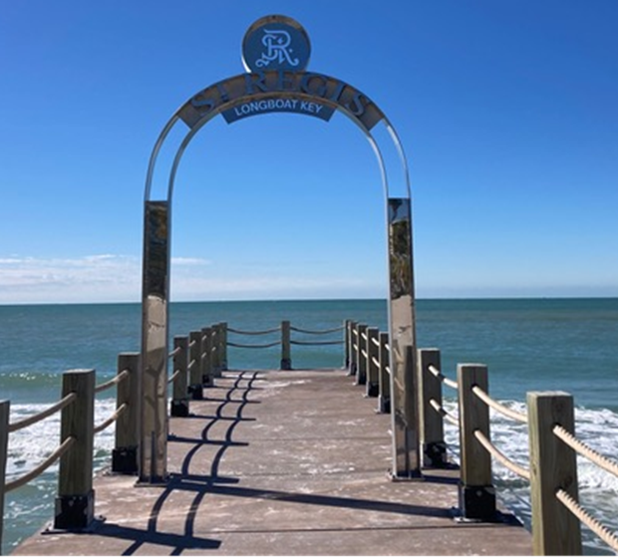
Nonconformities of Sign/Structure
Sign Code- Companion Ord. 2026-08
The arched sign on the groin at St. Regis is currently a sign type that is not allowed: inconsistent with Sign Code & Zoning Code provisions.
Per Section 156.03 of the Sign Code:
Outdoor Advertising Signs are prohibited. On the adjacent tourism-zoned property only ground-mounted signs, flat wall signs, awning signs, and projecting signs are allowed.
A companion amendment to the Sign Code (Ord. 2026-08) would be needed to allow the type of sign that was installed. No mechanism for privately-initiated amendments to the Sign Code.
Current Sign Installed 08/25

Slide 4
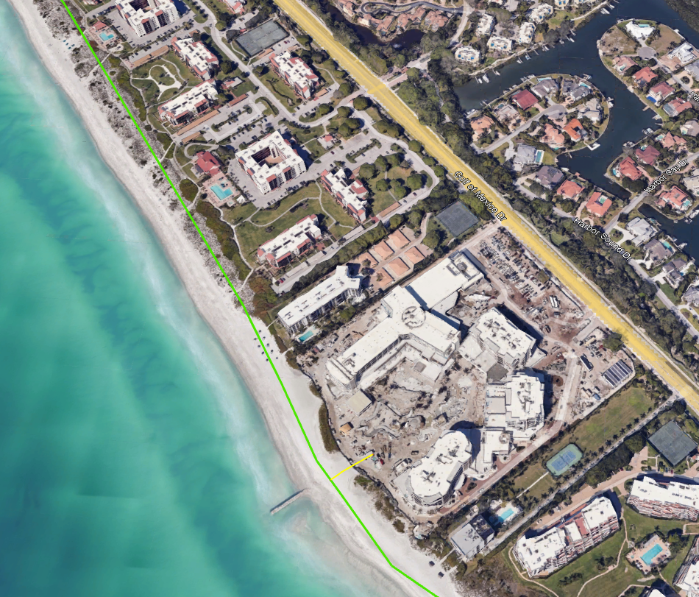
Nonconformities of Sign/Structure
Zoning Code- Location/Setback
Per Section 158.094(C) of the Zoning Code:
Gulf Waterfront Yard Setback Minimum setback requirement: 150 feet landward from the Erosion Control Line (ECL) for nearly all structures.

Slide 5
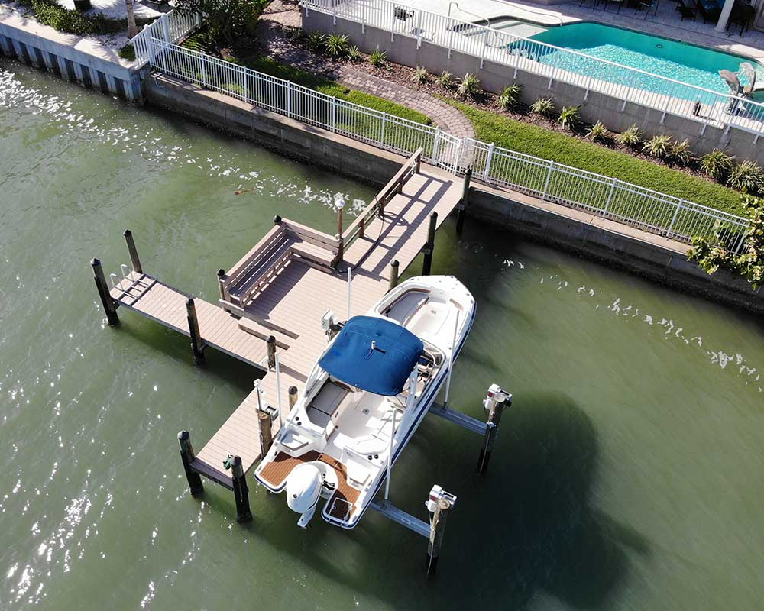
Nonconformities of Sign/Structure
Zoning Code- Structures Over Water
Per Section 158.099(A) of the Zoning Code:
Structures Over Water; Accessory Equipment is Limited to:
benches,
guard rails,
fish cleaning tables,
access ladders/equipment, and
equipment lockers.

Slide 6
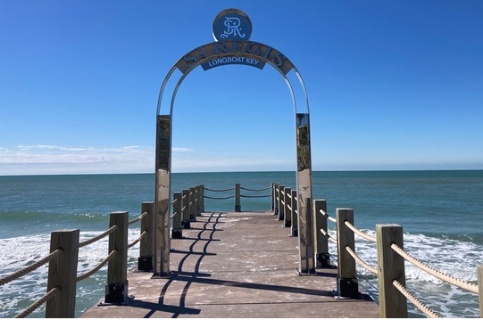
Applicant’s Request
Allow for an Archway Structure & Identifying Sign (Enhance Tourism)
On private groins in the Gulf (seaward of the ECL)
Adjacent to a hotel or motel
In the T-6 Zoning District
Applies Townwide

Slide 7
Staff Modifications
Public Purpose
Private Responsible Party
Public Safety Response
Allow for an Archway Structure & Identifying Sign (Enhance Tourism)
On private groins in the Gulf (seaward of the ECL)
Adjacent to a hotel or motel
In the T-6 Zoning District
Applies Townwide

Slide 8
Ord. 2026-07: Amendments
Gulf Waterfront Yard Setbacks
Per Section 158.094(C)(1):
Properties fronting on the Gulf generally have a 150 ft. setback (from the ECL) for structures.
The proposed amendment to this Section would include adding a Subsection “(d)” addition that reads:
158.094(C)(1)(d)
(d) Notwithstanding any provision of the Zoning Code to the contrary, on a privately owned and permitted groin structure that includes a pedestrian walkway and that extends from the public beach into the Gulf of America (formerly known as the Gulf of Mexico), a single archway structure with an embedded sign identifying the responsible entity for the structure and groin may be allowed seaward of the erosion control line, provided the structure and sign comply with the requirements of Section 158.099(A)(2)(f) and Chapter 156 of the Town Code.

Slide 9
Ord. 2026-07: Amendments
Structures Over Water- Accessory Structures
Per Section 158.099(A):
(New) Structures Over Water on properties fronting on the Gulf are not allowed.
Two proposed amendments to this Section. First adds an exception of the prohibition:
158.099(A)
Sec. 158.099(A) No structures other than boat docks, accessory dock structures including benches, guard rails, fish cleaning tables, a ladder or other device which provides a reasonable means of egress from the water to a boat dock, and equipment lockers, pilings, boat lifts or pile mounted davits shall be permitted to be constructed, reconstructed, or structurally altered beyond the mean high-water line. Except as specifically provided herein, Sstructures over water on properties abutting the Gulf of Mexico are prohibited. Permitted structures over water shall comply with the following standards:

Slide 10
Ord. 2026-07: Amendments
Structures Over Water- Accessory Structures
New proposed Subsection 158.099(A)(2)(f) contains proposed standards for privately owned groins with pedestrian walkways:
(f) Notwithstanding any provision of the Zoning Code to the contrary, on a privately owned and permitted groin structure that includes a pedestrian walkway and that extends from the public beach into the Gulf of America (formerly known as the Gulf of Mexico), a single archway structure with an embedded sign identifying the responsible entity for the structure and groin may be allowed, when all of the following requirements are met:
(1) The archway structure, inclusive of a single embedded sign, shall not exceed a height of 14 feet above the surface of the private groin.
(2) The archway structure on the private groin walkway will create an open frame for pedestrian usage, and passage through the archway structure shall be constructed and consist of columns or posts made of wood, concrete, stainless steel, aluminum, or similar weather-resistant material not exceeding 8 inches by 8 inches thick. The archway structure shall not form a wall, roofed shelter, or enclosed structure.

Slide 11
Ord. 2026-07: Amendments
Structures Over Water- Accessory Structures
New proposed Subsection 158.099(A)(2)(f) contains proposed standards for privately owned groins with pedestrian walkways:
(3) The archway structure, including the embedded sign, shall be designed and installed to withstand winds up to 150 miles per hour.
(4) The archway and embedded sign shall not be illuminated.
(5) All other applicable state and federal requirements and permits for the private groin, archway, and sign are obtained and approved.
(6) The archway and embedded sign shall be maintained in good repair at the owner’s sole expense.

Slide 12
ZTA Evaluation Criteria
Sec. 158.21(B)
P&Z Board’s recommendation is required to be based on competent & substantial evidence in relation to the following findings:
The need and justification for the change;
Response: The applicant is seeking the Zoning Text Amendment primarily from the perspective of adding a focal point to enhance an adjacent tourism property. Staff are supportive of allowing limited signage on a structure over water for purposes of assisting the public and first responders with an identifying marker and location to aid in public safety responses to the structure. Staff believe this could serve as a legitimate public purpose.
Applicability of the change Town-wide;
Response: This change would apply Town-wide along Gulf fronting properties. It would be currently limited to a single property that meets the criteria, however, it would apply to any future privately owned groins with pedestrian walkways.

Slide 13
ZTA Evaluation Criteria
Sec. 158.21(B)
P&Z Board’s recommendation is required to be based on competent & substantial evidence in relation to the following findings:
Consistency with the adopted goals, objectives, and policies contained the Town's Comprehensive Plan
Response: This amendment can be found consistent an overarching intent to “maintaining an environment that is conducive to the health, safety, welfare and property values of the community” (per Future Land Use {FLU} Goal 1) along with the following Comprehensive Plan policies:
FLU Policy 1.1.11: The Town will encourage design principles that accommodate healthy lifestyles, safety, and aging in place.
Conservation and Coastal Management (CCM) Element Goal 2: Provide infrastructure to ensure public health, safety, and welfare within the Coastal High Hazard Area (CHHA).
CCM Policy 3.1.1: Apply and enforce standards for the safety of structures.

Slide 14
ZTA Evaluation Criteria
Sec. 158.21(B)
P&Z Board’s recommendation is required to be based on competent & substantial evidence in relation to the following findings:
The proposed change will further the purposes of the Zoning Code and other Town codes, regulations, and actions designed to implement the Comprehensive Plan.
Response: As noted above, staff are supportive of allowing limited signage on a structure over water for purposes of assisting the public and first responders with an identifying marker and location to aid in public safety responses to the structure. Staff believe this could serve as a legitimate public purpose and further the purposes of the Zoning Code and actions designed to implement the Comprehensive Plan.

Slide 15
Companion Sign Code Amendment
Ord. 2026-08
Ordinance 2026-07 contains a provision that the Ordinance’s adoption and effective date is contingent upon the Town Commission’s adoption of Ordinance 2026-08 (the companion Sign Code amendment).
This Ordinance shall only take effect upon the Town Commission’s adoption of both this Ordinance 2026-07 and Ordinance 2026-08.
The Board may want to hold the public hearings for both ordinances prior to taking action. To do so, the Board could hold the public hearing for Ordinance 2026-07, including any public testimony and then Close the Public Hearing.
Before concluding deliberations on Ordinance 2026-07, the Board could open the public hearing for Ordinance 2026-08 and take all testimony and similarly close the public hearing for Ordinance 2026-08 and then take and act on a motion for the first public hearing on Ordinance 2026-07 before similarly taking and acting on a motion for Ordinance 2026-08.

Slide 16
Staff Recommendations
Staff recommends approval of Ordinance 2026-07.
Town Commission Public Hearing: May 4th

