Slide 2
Sunshine Law & Public Meetings
Elected Official Training
Michael Golen, CPM
Interim City Attorney for City of North Port, Florida

Slide 3
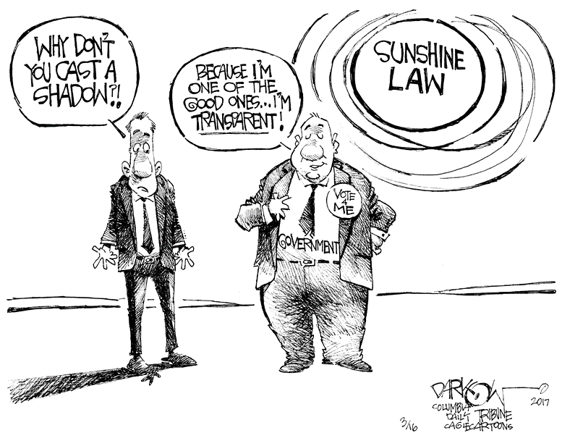
Sunshine Law Overview

Slide 4

What is Sunshine Law?
The constitutional and statutory right of access to governmental proceedings, discussions and deliberations at both the state and local levels.
Florida Constitution, Article I, Section 24(b)
Florida Statutes Section 286.011

Slide 5
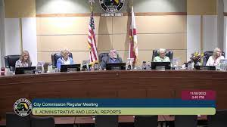
When Does the Sunshine Law Apply?
Any gathering, whether formal or casual
Of 2 or more members of the same board
Where they discuss a matter or topic on which foreseeable action will be taken by their board.
A voting item
A reasonably foreseeable voting item

Slide 6
Who is Subject to the Sunshine Law?
ALL collegial bodies [Commission, Advisory Boards (PZB, ZBA, and Pension) and Committees]
Existing board members and members-elect serving on future boards
Unopposed candidates are considered “members-elect” once the election is held
Members-elect can meet with the board member they are replacing

Slide 7
Sunshine Law Requirements
Meetings must be open to the public
Reasonable notice of the meetings must be provided
Minutes of the meetings must be taken and recorded

Slide 8
Sunshine Law Requirements
Meetings must be open to the public

Slide 9


The public has a right to view the meeting and hear all discussions.
Facilities: accessible, adequate, non-discriminatory
No inaudible discussions
No “confidential” votes
No “polling” or unofficial votes
Cross-talk and closed captioning

Slide 10
Meetings Occur Anywhere
Lunch, dinner, coffee
Social events, City events
City Hall
Parks
Publix
On a boat
Playing golf, tennis, etc.
Out of town
There is no requirement that a quorum be present for a meeting to be covered under the law. It only takes 2.

Slide 11

Social Gatherings
Members of a public board are not prohibited under the Sunshine Law from meeting socially, provided that matters which may come before the board are not discussed
While a violation may not be present for having a social gathering, to avoid the appearance of impropriety, it is advised that board members expend all efforts to conform to the spirit as well as the letter of the Sunshine Law

Slide 12

Other Potential Meetings
Any writing reflecting board member views on a particular action (i.e., emails, “position papers”, etc.)
Telephone conversations between board members
Text messages
Communications relayed through an individual or resident acting as a conduit between board members.

Slide 13




Social Media
A board member seeing another board member’s content reflecting their views on a particular action
Applies to posts AND comments (these will be public records)

Slide 14
Attorney General Opinions
City commissioners may not use an electronic newsletter to communicate among themselves on issues that foreseeably may come before the board. (Inf. AGO to Syrkus, October 31, 2000)
Members of a city board or commission may not engage on the City’s Facebook page in an exchange or discussion of matters that foreseeably will come before the board. (AGO 09-19)
Board members should discuss public business at publicly noticed meetings rather than in a series of letters between board members. (Inf. AGO to Martelli, July 20, 2009)
Member of a public board may not use computers to conduct private discussions among themselves about board business. [AGO 89-39; Linares v. Dist. Sch. Bd. of Pasco Co., No. 17-00230 (Fla. 6th DCA Jan. 10, 2018)]

Slide 15

Personal Devices
Communications on computers and phones may constitute a meeting, regardless of whether they occur on a private device or a City-issued device
This is also true of email accounts

Slide 16

Avoid the “Reply All” Trap

Slide 17

Staff Meetings
1:1 board member meetings with agency staff are not subject to the Sunshine Law
Internal meetings among staff are generally not subject to the Sunshine Law. However, when staff ceases to function in a staff capacity and is delegated authority from a board to act and make selections on the Board’s behalf
Examples: Staff performing bid review function, audit committee, or selection function

Slide 18
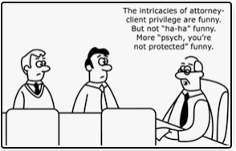
Meetings with the Agency Attorney
General rule: Discussions between the entire public board and its attorney are subject to the Sunshine Law, but individual meetings are not.

Slide 19

Sunshine Law Exception - Pending Litigation & Risk Management Claims
The Board and may meet in private with its Attorney in narrow circumstances
Topics:
To discuss settlement negotiations or strategy sessions related to litigation expenditures.
Applies to pending litigation and claims filed with the Risk Management Program.
Process:
Attorney advises at a public meeting that the attorney desires advice at a future meeting concerning the litigation;
Municipality provides reasonable public notice of the attorney-client session and names the attendees;
A court reporter records the entire session verbatim;
The transcript must be made part of the public record upon conclusion of the litigation.
Attendees – Limited to:
City Manager
City Attorney & litigation counsel
Not the City Clerk
Florida Statutes Section 768.28

Slide 20

Sunshine Law Exemption – Collective Bargaining Discussions
All discussions between the City Manager (or designee) and the Board related to collective bargaining shall be closed and are exempt from the Sunshine Law.
Applies when the purpose is to update the board or when seeking input from the board
Attendees may include key members of manager’s staff and the negotiator, but should be restricted to those persons absolutely necessary
Because the Sunshine Law does not apply, there are no requirements for a notice or meeting minutes.
Participants should not disclose anything related to or discussed in these closed meetings.
“Participants in [collective bargaining] meetings that are closed . . . should be sensitive to the stated denial of public access when matters discussed at such meetings subsequently arise.” AGO Fla. 2003-09 (2009).
Florida Statutes Section 447.605

Slide 21
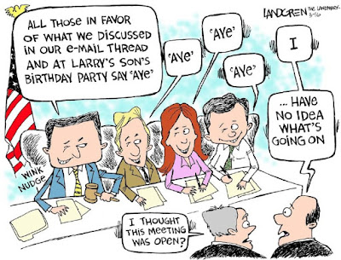
May a board vote by secret ballot?
Sunshine Law requires that meetings of public boards or commissions be “open to the public.” Any use of preassigned numbers, codes or secret ballots would violate the law.

Slide 22
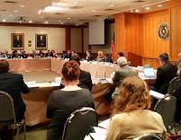
Curing Sunshine Law Violations
Must conduct a full, open public hearing with independent, final action in the sunshine that is “not merely a ceremonial acceptance… and… a perfunctory ratification of secret decisions.”
Full deliberations and discussion must take place at the public meeting.
Avoid the need to cure by following the law

Slide 23

Public’s Right to Speak
The public must be provided with a “reasonable opportunity” to be heard on a matter before the board takes official action.
Florida Statutes Section 286.0114
A “reasonable opportunity” does not mean unfettered.
Difference between “public comments” during meetings and “public hearings.”
Public is sometimes allocated more time in public hearings to provide additional due process.
Some city codes recognize different allotments of time to the public depending on the proceedings. For example, 3 minutes for public meetings as compared to 5 minutes for quasi-judicial hearings.

Slide 24

Limitations on Public Comment
The Sunshine Law does not prevent:
Adopting laws relating to the orderly conduct of public participation
Structuring meeting agendas in such a way that affords the public one or more timeframes to provide public comment
Adopting time limits on public comment and hearings

Slide 25
Sunshine Law Requirements
Reasonable notice of the meetings must be provided

Slide 26

What is Reasonable Notice?
According to the Florida Attorney General, the definition of “reasonable” depends on the facts of the situation and board involved
Check your city codes and policies – some include a time frame for posting notice
Notice period can be reduced for a “bone fide emergency”
This Photo by Unknown Author is licensed under CC BY-SA

Slide 27
Reasonable Notice continued…
Notice is required even though meetings of the board are “of general knowledge” and are not conducted in a closed-door manner
Sunshine Law does not define what is appropriate for reasonable notice, the type of notice required depends on:
Purpose for the notice;
Character of the event ; and
Nature of the rights affected

Slide 28

Does “Reasonable Notice” Apply to Agenda Items?
Sunshine Law does not prevent local governments from adding items to an agenda after publication.
Best practice is to properly notice all agenda items to allow for full public participation
The public should always be provided a reasonable opportunity to be heard before voting on any “newly” added items.

Slide 29
Sunshine Law Requirements
Minutes of the meetings must be taken and recorded

Slide 30

“Minutes” Requirements
Definition: A “brief summary or series of brief notes reflecting the events of the meeting.”
Should reflect any board action on resolutions or motions.
Does not need to be a transcript of who said what to whom.
Must be promptly recorded and open to the public for inspection (includes drafts).
Must be approved by the board

Slide 31
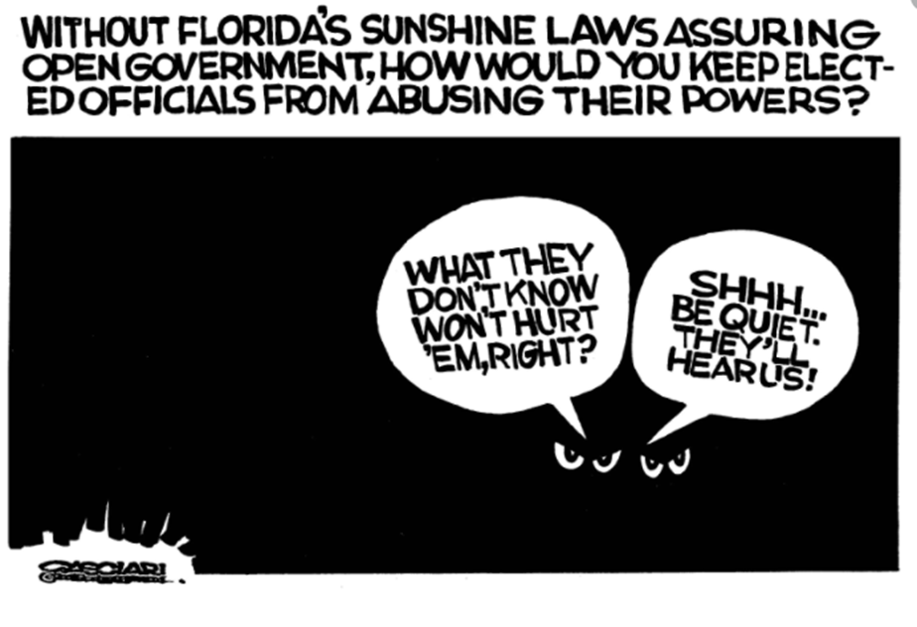
Sunshine Law Penalties

Slide 32


Penalties
Criminal prosecution - 2nd degree misdemeanor, up to 60 days in jail and/or maximum $500.00 fine
Non-criminal infractions – maximum $500.00 fine
Voids official action - Any action taken in violation of Sunshine Law is void ab initio
Civil actions – May recover of attorney’s fees for violations
Removal from office – by governor

Slide 33
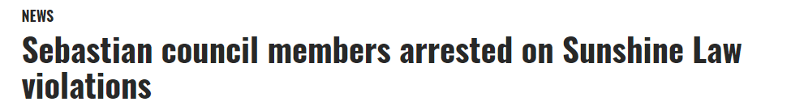
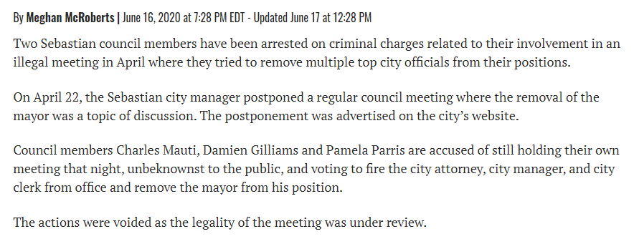
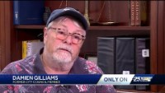

Slide 34
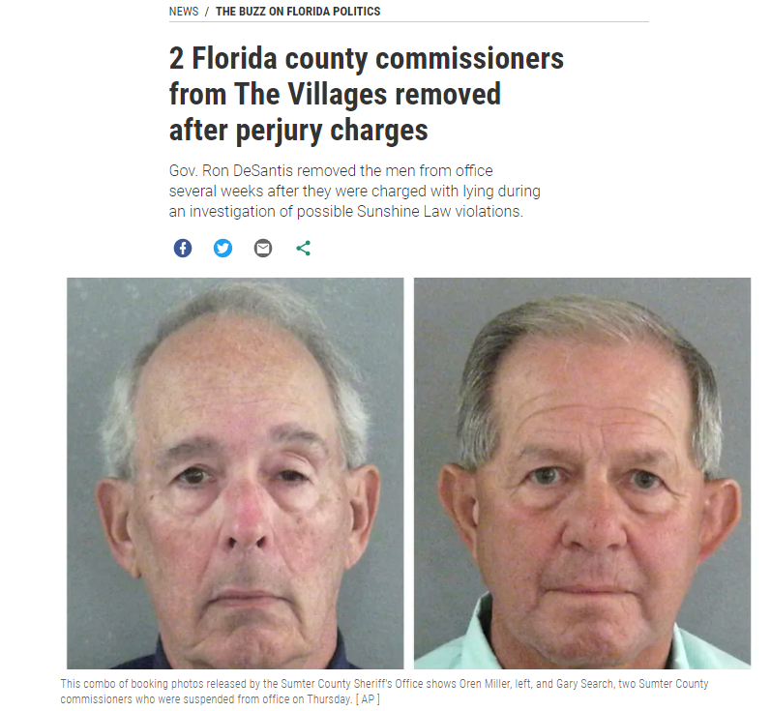
Phone records showed Miller and Search contacted each other directly over 40 times between November 2020, when they were both elected, and July 2021, prosecutors said…
Arrest affidavits didn’t say what Miller and Search were discussing, but many of the calls were made just before or just after scheduled county commission meetings, prosecutors said.
Source: Tampa Bay Times, Jan. 7, 2022 - https://www.tampabay.com/news/florida-politics/2022/01/07/2-florida-county-commissioners-from-the-villages-removed-after-perjury-charges/

Slide 35
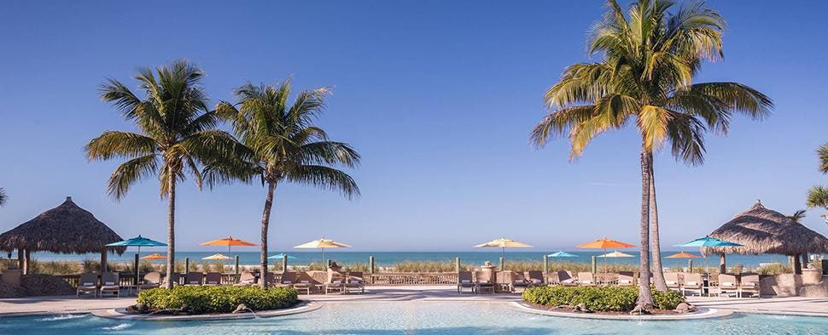
Citizens for Sunshine v. City of Sarasota
2 Sarasota City Commissioners were alleged to have violated the Sunshine law while attending a luncheon where local business owners discussed the issue of homelessness in the downtown area.
One settled; Commissioner Susan Chapman went to trial. After a 2-day trial, the court found that the Commissioner’s decision to attend the meeting with another serving commissioner did not technically violate the Sunshine law, but that those holding public office should, “always endeavor to avoid even the appearance of impropriety.”
The City prevailed, but spent $400,000+ in attorney’s fees defending Chapman in this litigation and appeal.
Citizens for Sunshine v. City of Sarasota, 2016 WL 4140524, 2013 CA 007532 NC (Fla. Cir. Ct. 2016).

Slide 36

Lorenzo v. City of Venice
The court determined that Venice City Council members violated the Sunshine law through emails and entered a judgment against the City of $777,114.42 in attorney’s fees and costs to Plaintiff.
The City also paid attorneys fees for the five (5) individual City Council members who had to individually defend the case.
The total amount paid by the City of Venice including the judgement and their own attorney fees was over $2,000,000
Lorenzo v. City of Venice, 2009 WL 2626294, 2008 CA 8108 SC (Fla. Cir. Ct. 2008).

Slide 37
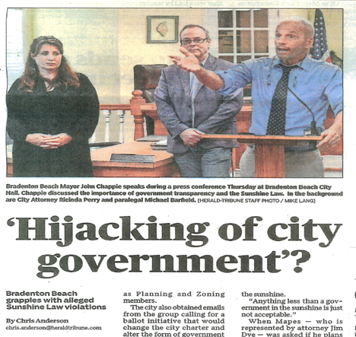
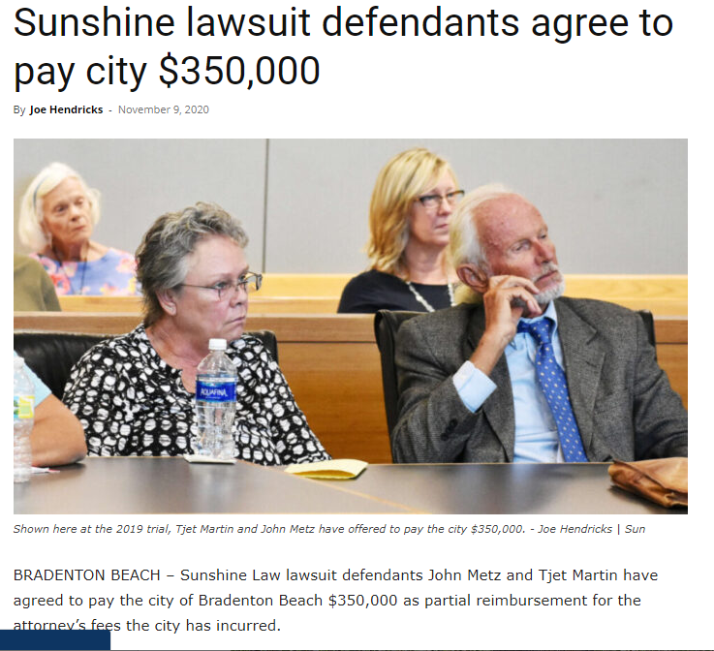
Mapes v. City of Bradenton Beach
Lawsuit filed against individual PZAB and Scenic Board members seeking a ruling on whether there was a violation to the Sunshine Law regarding open meetings and requirements to discuss official public business in properly noticed public meetings.
After a 4-day trial, the court ruled the board members violated the Sunshine law during their non-city-affiliated Concerned Neighbors of Bradenton Beach meetings. The city prevailed, but the individual board members did not.
Judge issued an order that the city recover $369,498 for attorney fees spent defending the individual member. The parties agreed to a settlement of $350,000.
Mapes v. City of Bradenton Beach, et al., 348 So. 3d 1130 (Fla. Dist. Ct. App. 2022).
Source: Anna Maria Island Sun, November 9, 2020; https://www.amisun.com/2020/11/09/sunshine-lawsuit-defendants-agree-to-pay-city-350000/

Slide 38
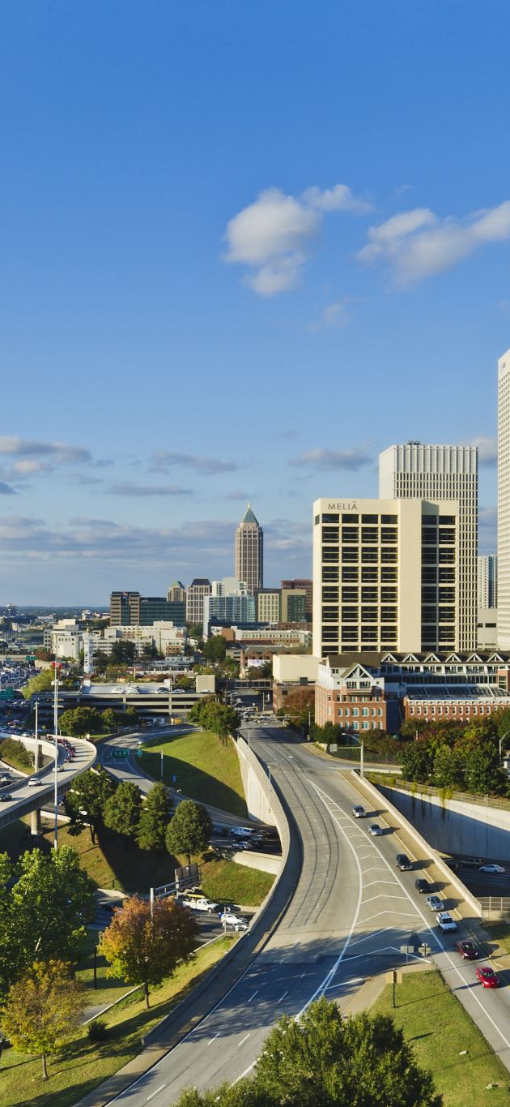
Kneapler v. City of Miami
A member of a selection committee that was created to review bids submitted pursuant to an RFP for the development of waterfront land filed this lawsuit.
After receiving two bids in response to the RFP, the City scheduled a public meeting to hear oral presentations from the bidders. However, the City subsequently rescheduled the meeting for an earlier date and time without notice to the public. The complaint also alleged that the City refused access to the media and members of the public at the meeting.
At the meeting, the Assistant City Attorney announced that the meeting was being held pursuant to an exception to Florida’s Sunshine Law which permits meetings to be closed where only members of the selections committee and bidders are present.
Court granted Summary Judgment in favor of the City stating that Kneapler did not have standing to bring the suit. The Appellate Court affirmed the trial court’s decision.
Kneapler v. City of Miami, 173 So. 3d 1002 (Fla.3d DCA 2015).

Slide 39





Questions?

Slide 40
Michael Golen, CPM
Interim City Attorney for City of North Port, Florida
4970 City Hall Blvd.
North Port, FL 34286
(941) 429-7260
mgolen@northportfl.gov

