Slide 1
Canal Navigation Maintenance Program Update
Town Commission Workshop
January 21, 2025

Slide 2
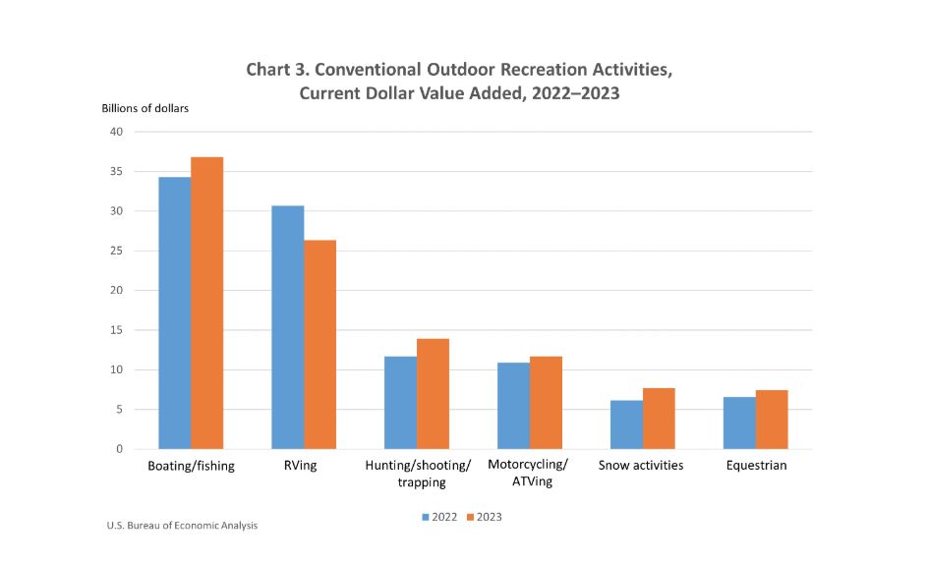
Economics Of Boating
$31.3 Billion Annual Economic Impact In Florida (2023)
1,004,240 Registered Boats in Florida (2021)
26,599 in Manatee County (2023 FL Highway Safety and Motor Vehicles)
24,760 in Sarasota County (2023 FL Highway Safety and Motor Vehicles)
95% are Smaller than 26ft (Boat Survey indicates same trend on Longboat Key)
Support Local Marinas, Waterfront Restaurants, Parks, Charters and Guides

Slide 3
Order of Brief
Programmatic Updates
Will include brief discussion of apportionment at the end
BUDM Updates
3. Public Outreach Development
4. Future Tasks and Assignments

Slide 4
Programmatic Updates

Slide 5
Programmatic Updates
Tasks | Status
Continued Program Development
Maintenance OPCC | Complete
Seagrass Mitigation Inventory | Underway
District Delineation | Complete
Website Development & Public Tool Hosting | Initiated
Assessment Program Formulation
Assessment Program | Underway
Technical Support | Underway
Subaqueous Pipeline Support (BUDM)
Canal BUDM for Force Main Install | Underway

Slide 6
Website Development
Initial stages of website development for public use.
Tools to be included:
General project information and updates
Basic program statistics & definitions
Interactive map
Canal sheets
May be included in the future:
Project timelines & construction schedule
Assessment calculator
Boat view

Slide 7
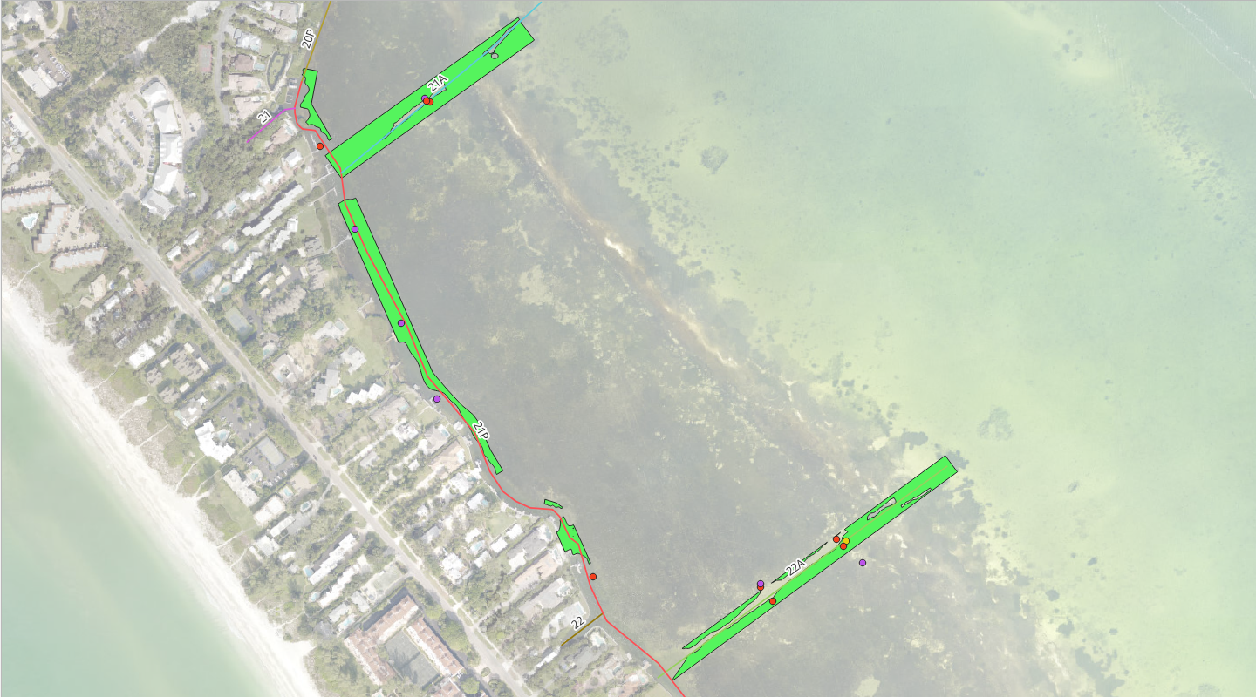
Seagrass Mitigation Inventory
Important to understand which canals have been mitigated for and which still require mitigation.
Note: Once seagrass mitigation for a canal has been completed, maintenance dredging can occur without mitigating again.
Suitable dredge material in previously mitigated canals can be used for BUDM material on the Force Main project.
Seagrass mitigation inventory is underway and will directly affect BUDM volume for the Force Main project.

Slide 8
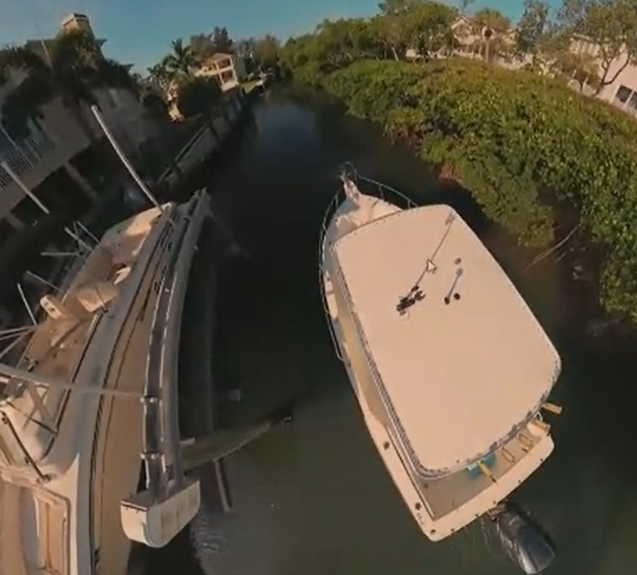
Boat View
FLC is continuing to collect boat view (360 video) throughout the waterways.
To date roughly 75% of the waterways have been captured.
Initial effort completed from 3/12/2024 – 3/14/2024
Continued efforts underway from 12/08/2024 to current

Slide 9
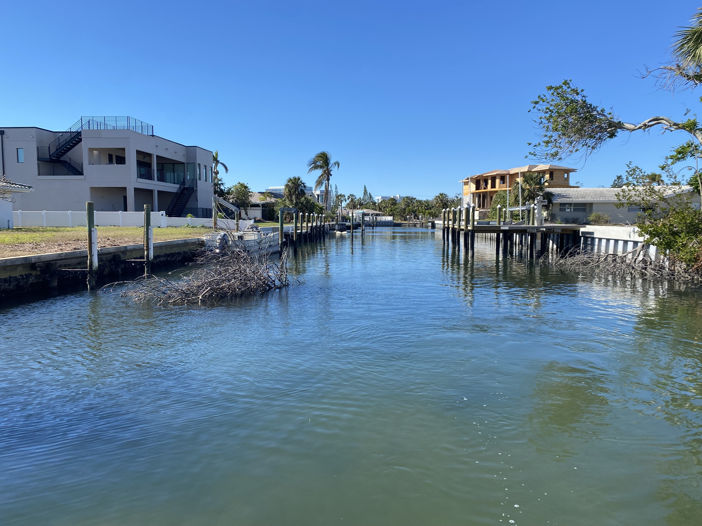
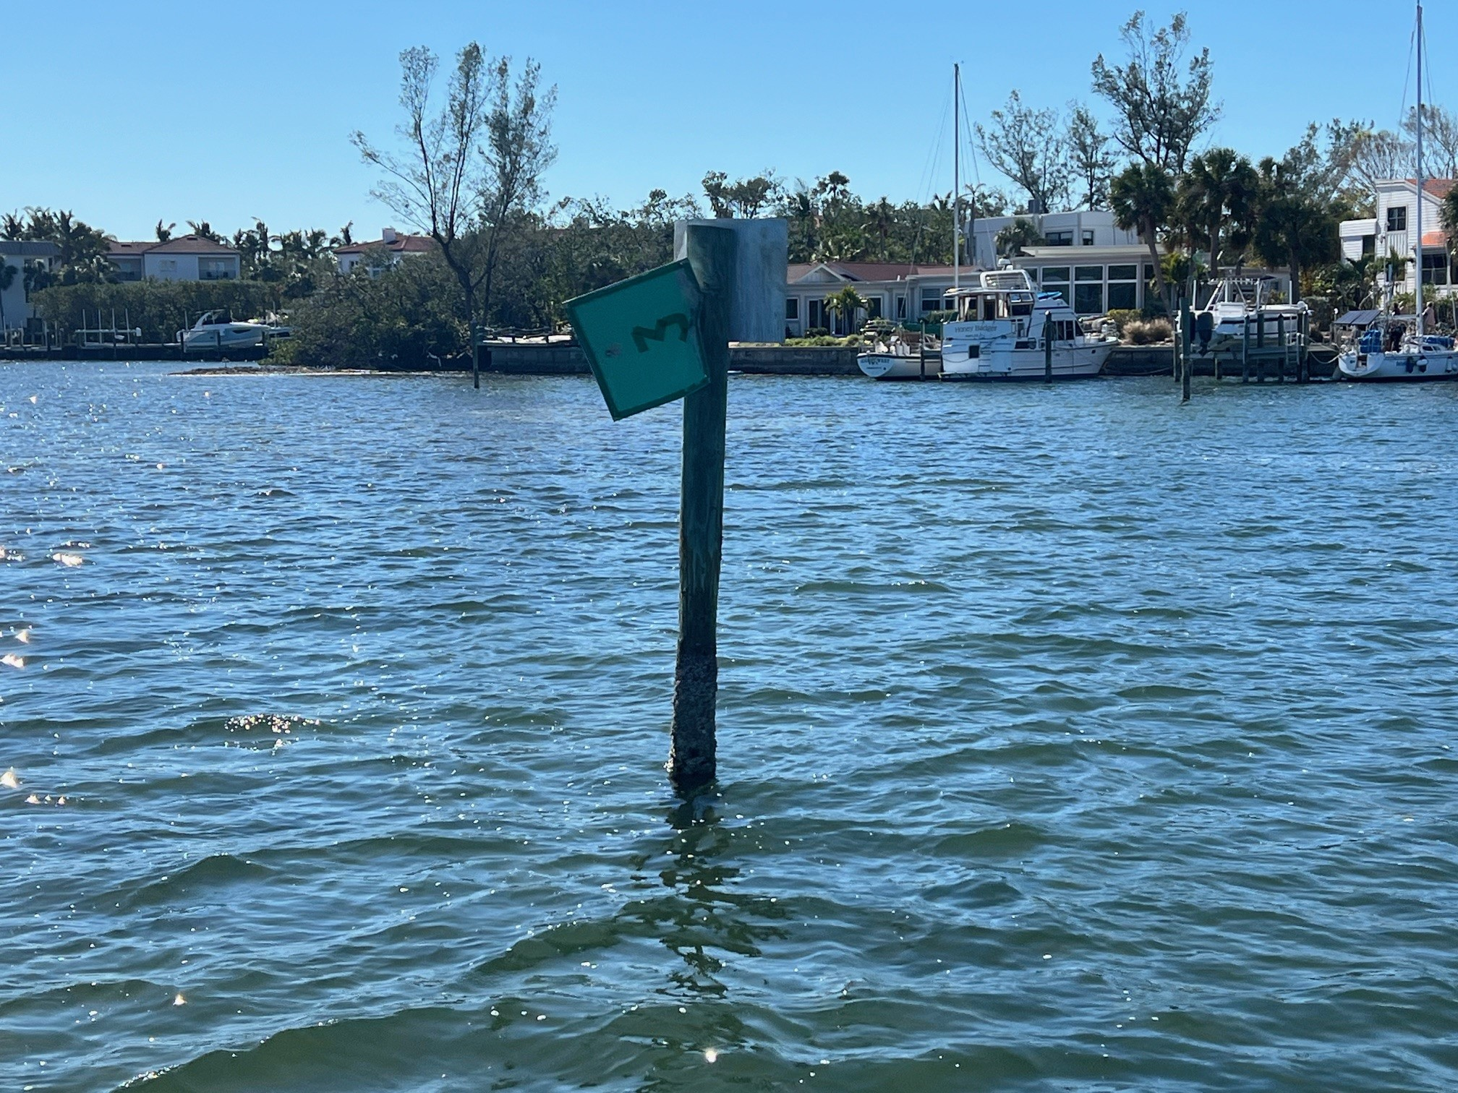
Observed Post Storm Canal Conditions
High level of natural and man-made debris
Shifted shoals
Missing navigational signage
Damage to mooring structures
Sunken or derelict vessels

Slide 10
Administrative Progress
Ad-Valorem District Mechanism
Passed at the December meeting and submitted to the respective Counties.
Non–Ad Valorem District Delineation (Direct Benefit Groups)
Development of meets and bounds - Underway
Funding Methodology Report
Beginning development soon

Slide 11
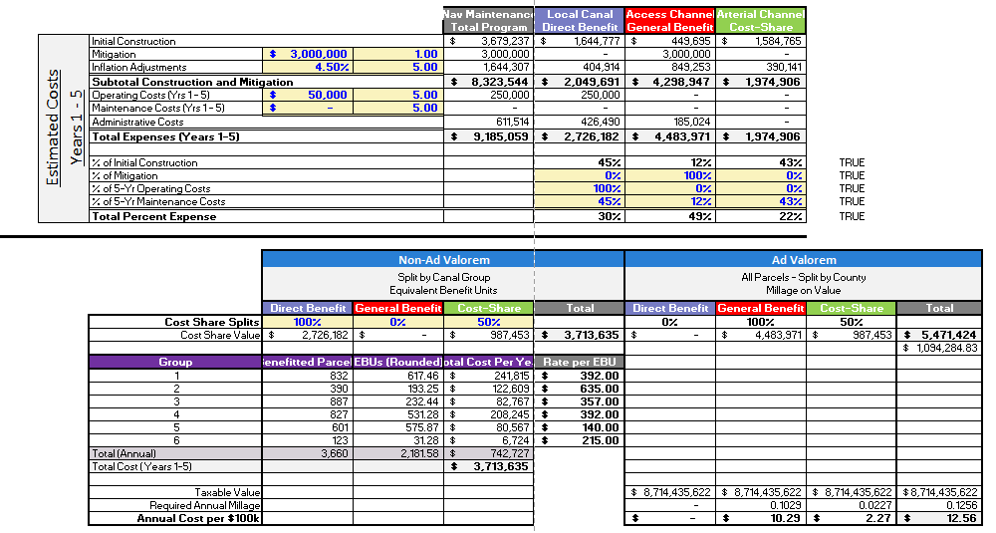
Assessment Calculations
Initial Assessment Rolls assembled
Apportionment Methodology – Costs still being refined as program develops
Dashboard tool developed to assess how different cost allocations effect cost splits
Allowed us to identify the fixed and variable parameters.
Variables
Results

Slide 12
Variable Parameters for Assessment Apportionment
The variable parameters ultimately shift the percent cost from each funding source (Ad Valorem and Non-Ad Valorem).
Variable Parameters include:
Parameter | Currently born by Ad Valorem | Currently born by Non-Ad Valorem
General Benefit Canal | 100% | --
Direct Benefit Canals | -- | 100%
Shared Benefit Canals | 50% | 50%
Seagrass Mitigation | 100% | --
5-year Operating Costs |  | 100%
5-year Maintenance Costs | Distributed equally based on Initial Construction Cost

Slide 13
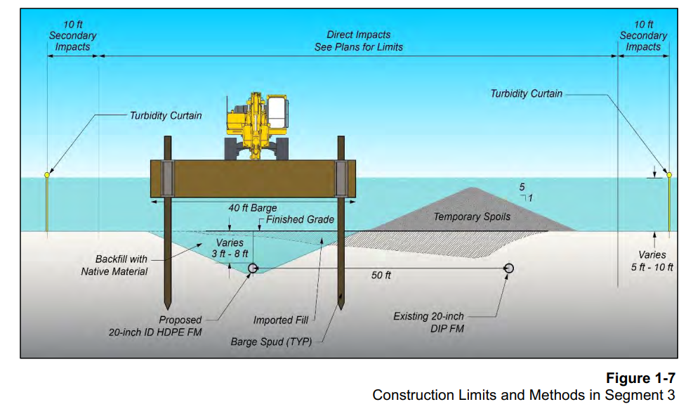
BUDM Updates
Subaqueous Force Main
Imported fill (BUDM)

Slide 14
BUDM Volume Updates
Max available dredge volume | 62,000 CY
Target Volume Presented in 6/2024 | 40,000 CY
Fill Volume Required by Force Main Project | Approx. 10,000 CY
Total Volume Available for BUDM | Under Development
Update Surveys (Carollo and ESA)
Test Dredge Material (First Line)
Update Usable Quantities Available (First Line)
Update Permits (Carollo. ESA, First Line)
Align Effort for Future Construction Needs (All)
Prioritizing General Benefit and Shared Benefit Canals for Ad Valorum Cost Reduction

Slide 15
Dredge Material Sampling and Testing
Material sampling efforts throughout the island have been completed.
Sample analysis is in progress.
Lab testing of select samples are underway.
Notes:
Approximately 80 grab samples throughout 38 canals

Slide 16
Public Outreach Development

Slide 17
Public Outreach Material Development
Waterways Protection Program: Longboat Key Navigation Maintenance Program
Informative Utility Inserts: Using bill inserts to direct residents to the Longboat Key website for updates and details on community events, explaining the Navigation Program’s role in the Waterways Protection Program.
Community Engagement Focus: Building stronger relationships through targeted outreach with Bay Isles, The Condo Federation, and the North-end Coalition.
District Specific Engagement Focus: Educate each of the 6 Districts of the benefits and costs of district specific program elements.
Community Participation Event: Organizing a site-neutral event for all Longboat Key community members to engage, learn, and provide feedback.
Inclusive Outreach: Collaborating with local clubs and organizations for widespread understanding and support.
Emphasizing Community Benefits: Showcasing safety, property value, and lifestyle improvements during public outreach, as part of a comprehensive community initiative.

Slide 18
Future Tasks and Assignments
Continued refinement of program costs
Conduct public outreach
Receive and incorporate feedback
Continue to refine allocation

Slide 19
Thank You

