Slide 1
Citizen Tax Oversight Committee and Infrastructure Surtax
April 10, 2023 9AM

Slide 2
Infrastructure Surtax

Slide 3
Overview
The infrastructure surtax is a one-cent sales tax that funds many capital improvement projects.
Expenditures shall comply with Florida Statutes Section 212.055 (2)
It’s imposed by most Florida counties, is also called local option county sales tax
The rate varies in each county
  Sarasota County 1%
  Manatee County .5% ( Effective Jan 1, 2017)
Proceeds are distributed to municipalities based on population

Slide 4
Background
Sarasota County established the 1% Tax by Referendum
  Ordinance 89-040 – Term of 10 years (Fiscal Year 1989-1998)
  Ordinance 97-083 – 10 Year Renewal (Fiscal Year 1999-2009)
  Ordinance 2007-087 – 15 Year Renewal (Fiscal Year 2010-2024)
  Ordinance 2022-001 – 15 Year Renewal (Fiscal Year 2025-2039)
Sarasota County Ordinances provide an estimate of revenues and proposed Project Lists for the County and all municipalities in a 15 year budget
Longboat Key’s Project List is shown as “Exhibit F” in Ordinance
Any Amendments to “Exhibit F” are approved through Town Resolutions
Manatee County established .5% Tax by Referendum
  Ordinance 16-35 – Term of 15 years (Jan 1, 2017-Dec 31, 2031)

Slide 5
Citizens Tax Oversight Committee
Formed in 1998 (Resolution 98-04 and renewed Resolution 2010-13) in accordance with requirements of Sarasota County Ordinance
Committee shall act solely in an oversight capacity to conduct:
  Annual Review of expenditures from sales tax proceeds to ensure they are in accordance with the project list and any changes thereto;
  Review any changes made by the Town to the project list or to the allocation of the sales tax proceeds, to ensure all procedural requirements have been followed;
  Report the Committee’s findings to the Town Commission by May Regular Workshop

Slide 6
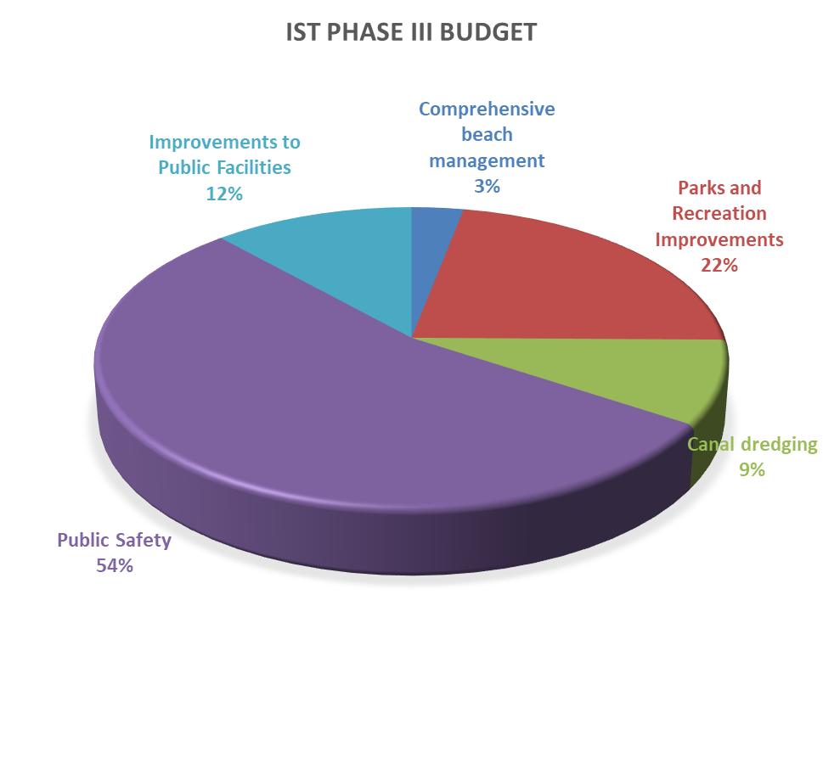
Infrastructure Surtax III Categories and Current Budget (as Amended)
Functional categories
Current 15 Year Budget for functional areas-Phase III:
1. Comprehensive beach management $ 300,000
2. Parks and Recreation Improvements $2,202,494
3. Canal dredging $ 900,000
4. Public Safety Vehicles and Equipment $5,366,773
5. Improvements to Public Facilities $1,160,601
Total $9,929,868
Phase III began September 2009 and ends December 31, 2024
Updated Projected Revenue could reach $10.7 million by Dec 2024.

Slide 7
Infrastructure Surtax Phase III
History of Budget Amendments

Slide 8
Infrastructure Surtax Fund
Audited Expenditures
Last Five Years (FY2018-FY2022)

Slide 9
General Permitted Uses of Funds
F.S. Section 212.055
To acquire land for public recreation, land conservation or for the protection of natural resources
To finance, plan and construct capital assets and infrastructure with a life expectancy of 5 or more years.
A fire department vehicle, an emergency medical service vehicle, a sheriff’s office vehicle, a police department vehicle, or any other vehicle, and the equipment necessary to outfit the vehicle for its official use or equipment that has a life expectancy of at least 5 years.
Energy efficiency improvements including insulation, energy efficient heating cooling or ventilation systems, replacement windows, EV charging equipment
“Infrastructure” means: Any fixed capital expenditure or fixed capital outlay associated with the construction, reconstruction, or improvement of public facilities that have a life expectancy of 5 or more years, any related land acquisition, land improvement, design, and engineering costs, and all other professional and related costs required to bring the public facilities into service.

Slide 10
FY23 Budgeted Use of Funds
(As Amended)
* $110,000 added in subsequent amendment, Resolution 2022-02 (January 2022), and $80,000 added in subsequent amendment Resolution 2023-04 (March 2023) due to broader scope and inflation.

Slide 11
FY23 Budgeted Use of Funds
(As Amended)

Slide 12
Future Phase IV
Voters approved by Referendum Nov 8, 2022, Phase IV extending the surtax to 2039
Additional information may be found at: https://www.sarasotacountysurtax.net/
Resolution 2023-11 to be presented to Town Commission in May Providing for the Continuance of the Citizen Tax Oversight Committee, Providing for Appointments and Terms; Providing for Annual Meetings and Reports

Slide 13

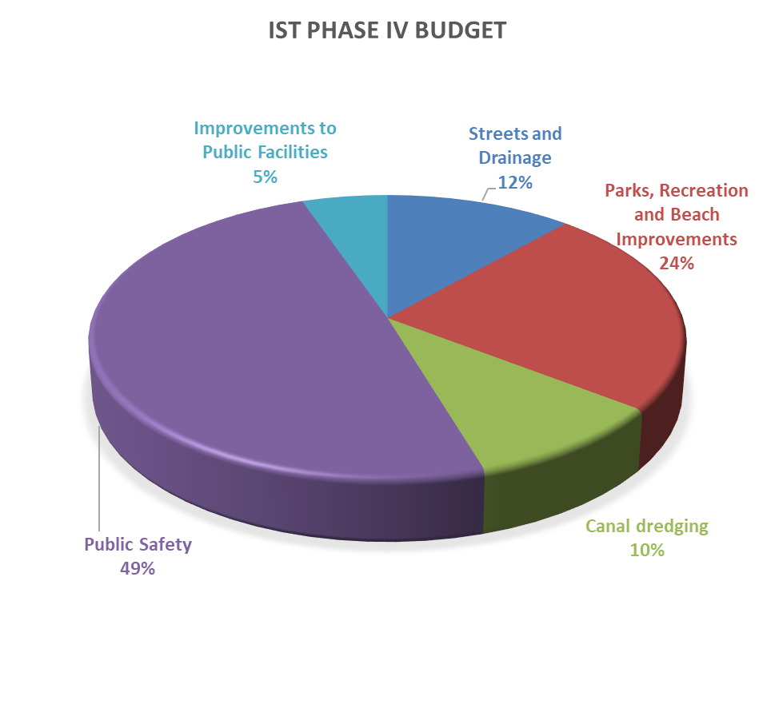
Infrastructure Surtax (Phase IV 2025-2039)
Functional categories
Adopted
Proposed 15 Year Budget for functional areas-Phase IV:
1. Streets and Drainage $1,750,000
2. Parks, Recreation and Beach Improvements $3,608,000
3. Canal dredging $1,500,000
4. Public Safety Vehicles and Equipment $7,469,000
5. Improvements to Public Facilities $ 800,000
Total $15,127,000
13

Slide 14
Questions?

