Slide 1
Citizen Tax Oversight Committee and Infrastructure Surtax
March 11, 2022

Slide 2
Infrastructure Surtax

Slide 3
Overview
The infrastructure surtax is a one-cent sales tax that funds many capital improvement projects.
Expenditures shall comply with Florida Statutes Section 212.055 (2)
It’s imposed by most Florida counties, is also called local option county sales tax
The rates varies in each county
  Sarasota County 1%
  Manatee County .5% ( Effective Jan 1, 2017)
Proceeds are distributed based on population

Slide 4
Background
Sarasota County established the 1% Tax by Referendum
  Ordinance 89-040 – Term of 10 years (Fiscal Year 1989-1998)
  Ordinance 97-083 – Renewal - Term of 10 years (Fiscal Year 1999-2009)
  Ordinance 2007-087 – Renewal - Term of 15 years (Fiscal Year 2010-2024)
Manatee County established .5% Tax by Referendum
  Ordinance 16-35 – Term of 15 years (Jan 1, 2017-Dec 31, 2031)
Sarasota County provided an estimate of revenues for all municipalities in a 15 year budget
Referendum to extend the Sarasota County Surtax from 2025-2039 (Phase IV) will be on the November 8th 2022 ballot.

Slide 5
Citizens Tax Oversight Committee
Formed in 1998 (Resolution 98-04) in Accordance with Sarasota County Ordinance 97-083 and 2007-087
Committee shall act solely in an oversight capacity to conduct:
  Annual Review of expenditures from sales tax proceeds to ensure they are in accordance with the project list and any changes thereto;
  Review any changes made by the Town to the project list or to the allocation of the sales tax proceeds, to ensure all procedural requirements have been followed;
  Report the Committee’s findings to the Town Commission

Slide 6
Infrastructure Surtax Phase III
Phase III Revenue collections began September, 2009 and end December 31, 2024 and are estimated at $9,929,868.
The Town sets aside all revenue in a special revenue fund.
An Expenditure Budget was put in place for certain functional areas:
  Comprehensive Beach Management
  Streets and Drainage
  Parks and Recreation Improvements
  Canal Dredging
  Public Safety
  Improvements to Public Facilities

Slide 7
Permitted Uses of Funds
To acquire land for public recreation, land conservation or for the protection of natural resources
To finance, plan and construct capital assets and infrastructure.
To finance the closure of government owned solid waste landfills
Infrastructure are costs associated with the construction, reconstruction or improvement of public facilities having a life expectancy of five or more years and any related land acquisition, land improvement, design and engineering costs.

Slide 8
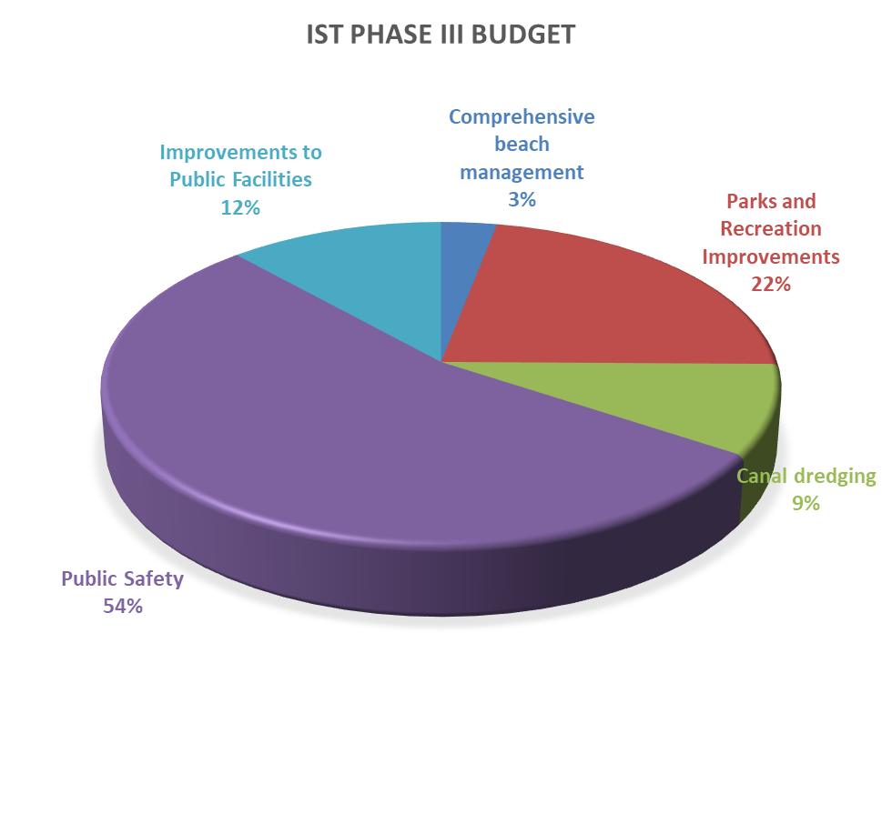
Infrastructure Surtax III Categories
Functional categories
Current 15 Year Budget for functional areas-Phase III:
1. Comprehensive beach management $ 300,000
2. Parks and Recreation Improvements $2,202,494
3. Canal dredging $ 900,000
4. Public Safety Vehicles and Equipment $5,366,773
5. Improvements to Public Facilities $1,160,601
Total $9,929,868

Slide 9
FY22 Uses of Funds
PUBLIC SAFETY
Fire Battalion/Command Vehicles Budget Amount $116,000
Scheduled replacement.
Fire ATV and Trailer Budget Amount $22,000
ATV used for Beach Rescue Operations
Defibrillators Budget Amount $35,000
Scheduled replacement and upgrade of heart monitors and defibrillators used on the ALS units.
Fire Video Airway Budget Amount $6,000
Enhances the airway placement during a medical emergency.

Slide 10
FY22 Uses of Funds Continued
PUBLIC SAFETY Continued
Fire Extrication Equipment Budget Amount $15,000
Scheduled replacement of “Jaws of Life”
Police Tasers Budget Amount $53,200
Scheduled replacement of 20 tasers
Police In-Car Cameras Budget Amount $60,000
Scheduled replacement for the collection and preservation of evidence and to reduce liability.
Police ATV Budget Amount $22,000
Scheduled replacement of Beach/Emergency Response Patrol Vehicle.

Slide 11
FY22 Uses of Funds (Continued)
PARKS AND RECREATION
Tennis Center Fencing (*) Budget Amount $10,000
Replacement of fencing at courts 7-10, built in 2003.
Tennis Center Canopies Budget Amount $15,000
Replacement of six canopies.
PUBLIC FACILITIES
HVAC Upgrades/Replacement Budget Amount $25,000
Ongoing replacement/upgrade of facilities HVAC Systems as necessary
* $110,000 subsequent amendment, Resolution 2022-02 (January 2022), added to Tennis Fencing in lieu of doing sections over time.
Notes:
SLS Notes: two new pickleball-only courts in Bayfront Park recently completed.
The additions bring the total number of pickleball courts at Bayfront Park to five: three pickleball-only and two tennis courts that have lines and portable nets for pickleball.
The change came at the expense of the full-court basketball area, which has been converted to a half court. There are still two additional hoops along the sideline.

Slide 12
History of Audited Expenditures
FY2017-FY2021

Slide 13
Future Phase IV
Sarasota County will ask the voters to approve Phase IV which would extend the surtax to 2039 on November 8, 2022.
Additional information may be found at: https://www.sarasotacountysurtax.net/

Slide 14
Questions?

