Slide 1
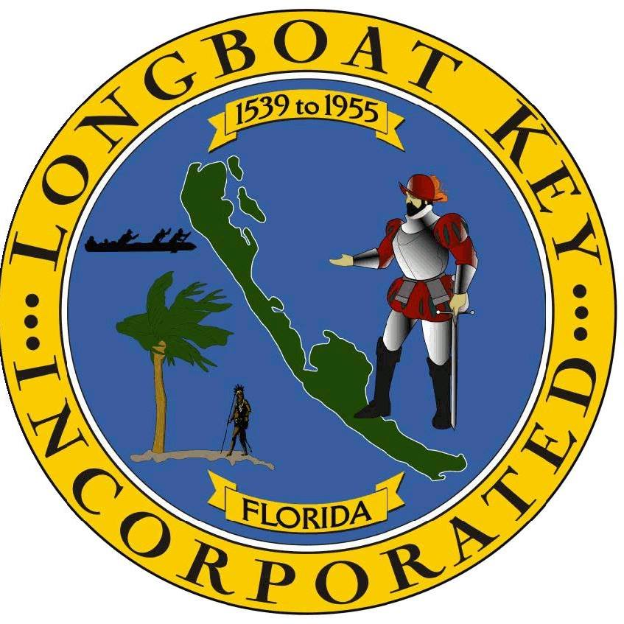
Strategic Planning: Our Progress
April 2024

Slide 2
Agenda
Strategic Plan Scope
LBK-Strategic Planning Framework
LBK-Plan on a Page
Strategic Advantages, Challenges, and Opportunities
Public Dashboard Measures
Sleepless Nights Exercise
Next Steps
April 15 2024
Town of Longboat Key: Commissioner Retreat April 2024

Slide 3
Strategic Plan Scope
In November We Discussed:
The Sterling Council/Baldrige Framework
The Stratex Strategic Planning Framework
Intersection of the Framework with Longboat Key’s current framework
Setting a Foundation-The roles of problem analysis and solution development in strategic planning
Plan Development and Execution
Town of Longboat Key: Commissioner Retreat April 2024

Slide 4
Strategic Plan Scope
Employee and Citizen Survey
Organizational Assessment
Long-Term Plan Development
Tactical Plan Development
Prepare for and Launch Plan
Key inputs to strategic planning process.
Employee Report delivered and is being reviewed.
Citizen survey reviewed for key inputs into the strategic planning process.
SWOT and Placemat information entered into Ascend.
Key themes reviewed and entered for Citizen Survey.
Review of Mission and Vision.
Identification of Strategic Advantages, Challenges, and Opportunities.
Development of Goals, Objectives, and Objective Measures.
Through analysis of Assessment and Long-Term Plan Development in conjunction with Placemat information, key tactical strategies will be identified and built into an executable plan.
Town of Longboat Key: Commissioner Retreat April 2024

Slide 5
Town of Longboat Key Strategic Planning Framework
Goals Areas of strategic focus with 2-3 objectives, typically constant across the strategic planning period.
Strategic Plan
Objectives Strategic Measures (3-5 years) high-level statements of what is to be achieved, typically constant across the planning period.
Strategic Measures 3-5 Years
Strategies A tactical method, chosen to bring about a desired future condition, reach a specific target or move organizational performance against specific objectives. Typically, 1 year in duration.
Tactical Measures Annual
Financial Resources
Milestones A collection of high-level actions within a strategy marking completion of a stage within a strategy.
Tactical Plan
Actions The specific sequence of steps which must be taken to complete a milestone.
Workforce Resource Utilization
© 2023 Stratex Solutions
Town of Longboat Key: Commissioner Retreat April 2024

Slide 6
Mapping of Longboat Key Plan to Strategic Planning Hierarchy
Goals Areas of strategic focus with 2-3 objectives, typically constant across the strategic planning period.
Objectives Strategic Measures (3-5 years) high-level statements of what is to be achieved, typically constant across the planning period.
Strategies A tactical method, chosen to bring about a desired future condition, reach a specific target or move organizational performance against specific objectives. Typically, 1 year in duration.
Town of Longboat Key: Commissioner Retreat April 2024

Slide 7
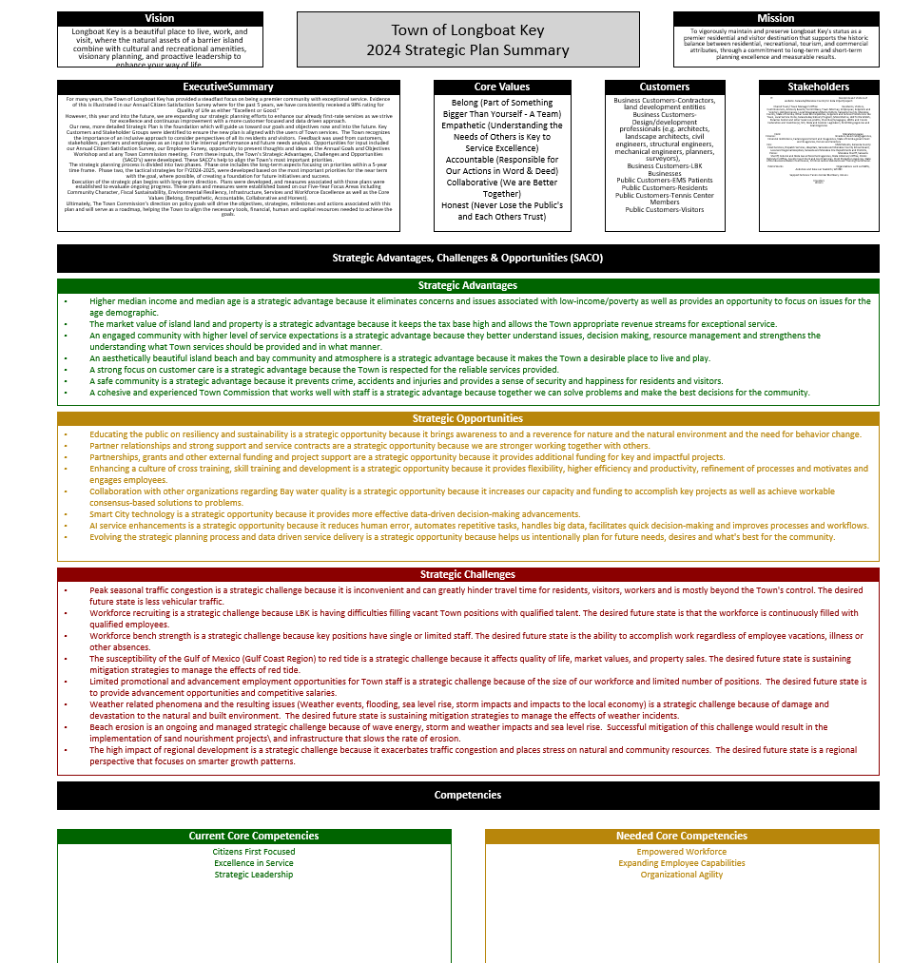
Town of Longboat Key-Plan on a Page
Town of Longboat Key: Commissioner Retreat April 2024

Slide 8
Strategic Plan Scope-Long-Term Plan Development Strategic Advantages
Strategic Advantages: | Higher median income and median age is a strategic advantage because it eliminates concerns and issues associated with low-income/poverty as well as provides an opportunity to focus on issues for the age demographic. The market value of island land and property is a strategic advantage because it keeps the tax base high and allows the Town appropriate revenue streams for exceptional service. An engaged community with higher level of service expectations is a strategic advantage because they better understand issues, decision making, resource management and strengthens the understanding what Town services should be provided and in what manner. An aesthetically beautiful island beach and bay community and atmosphere is a strategic advantage because it makes the Town a desirable place to live and play. A strong focus on customer care is a strategic advantage because the Town is respected for the reliable services provided. A safe community is a strategic advantage because it prevents crime, accidents and injuries and provides a sense of security and happiness for residents and visitors.
Town of Longboat Key: Commissioner Retreat April 2024

Slide 9
Strategic Plan Scope-Long-Term Plan Development Strategic Opportunities
Strategic Opportunities: | Educating the public on resiliency and sustainability is a strategic opportunity because it brings awareness to and a reverence for nature and the natural environment and the need for behavior change. Partner relationships and strong support and service contracts are a strategic opportunity because we are stronger working together with others. Partnerships, grants and other external funding and project support are a strategic opportunity because it provides additional funding for key and impactful projects. Enhancing a culture of cross training, skill training and development is a strategic opportunity because it provides flexibility, higher efficiency and productivity, refinement of processes and motivates and engages employees. Collaboration with other organizations regarding Bay water quality is a strategic opportunity because it increases our capacity and funding to accomplish key projects as well as achieve workable consensus-based solutions to problems. Smart City technology is a strategic opportunity because it provides more effective data-driven decision-making advancements. AI service enhancements is a strategic opportunity because it reduces human error, automates repetitive tasks, handles big data, facilitates quick decision-making and improves processes and workflows. Evolving the strategic planning process and data driven service delivery is a strategic opportunity because helps us intentionally plan for future needs, desires and what's best for the community.
Town of Longboat Key: Commissioner Retreat April 2024

Slide 10
Strategic Plan Scope-Long-Term Plan Development Strategic Challenges
Strategic Challenges | Peak seasonal traffic congestion is a strategic challenge because it is inconvenient and can greatly hinder travel time for residents, visitors, workers and is mostly beyond the Town's control. The desired future state is less vehicular traffic. Workforce recruiting is a strategic challenge because LBK is having difficulties filling vacant Town positions with qualified talent. The desired future state is that the workforce is continuously filled with qualified employees. Workforce bench strength is a strategic challenge because key positions have single or limited staff. The desired future state is the ability to accomplish work regardless of employee vacations, illness or other absences. The susceptibility of the Gulf of Mexico (Gulf Coast Region) to red tide is a strategic challenge because it affects quality of life, market values, and property sales. The desired future state is sustaining mitigation strategies to manage the effects of red tide. Limited promotional and advancement employment opportunities for Town staff is a strategic challenge because of the size of our workforce and limited number of positions. The desired future state is to provide advancement opportunities and competitive salaries. Weather related phenomena and the resulting issues (Weather events, flooding, sea level rise, storm impacts and impacts to the local economy) is a strategic challenge because of damage and devastation to the natural and built environment. The desired future state is sustaining mitigation strategies to manage the effects of weather incidents. Beach erosion is an ongoing and managed strategic challenge because of wave energy, storm and weather impacts and sea level rise. Successful mitigation of this challenge would result in the implementation of sand nourishment projects\ and infrastructure that slows the rate of erosion. The high impact of regional development is a strategic challenge because it exacerbates traffic congestion and places stress on natural and community resources. The desired future state is a regional perspective that focuses on smarter growth patterns.
Town of Longboat Key: Commissioner Retreat April 2024

Slide 11
Measures-Public Dashboard
Overall Reputation of the Community
96
98
97
98
2021
2022
2023
2024
Town of Longboat Key: Commissioner Retreat April 2024

Slide 12
Measures-Public Dashboard
Residents Satisfied with Overall Aesthetics of the Community
96
97
96
96
2021
2022
2023
2024
Town of Longboat Key: Commissioner Retreat April 2024

Slide 13
Sleepless Nights Analysis
Instructions:
Using the information used as prework as a foundation-identify the things that “keep you up at night” when considering the present and the future for the Town of Longboat Key
We will do this popcorn style-you identify the items and we will capture as you work.
Town of Longboat Key: Commissioner Retreat April 2024

Slide 14
Next Steps
Town of Longboat Key: Commissioner Retreat April 2024

