Slide 1


Department Directors
Strategic Planning
Retreat
April 2, 2024
Premier Community, Exceptional Service

Slide 2
Agenda
Breakfast ☺
Agenda Overview
What is working well?
What are the Threats to Continuing to Do Well?
What Could We Do Better
What’s Keeping Us from Doing Better?
If We Want To Be Exceptional In Service, What’s Missing?
Values – B.E.A.C.H.
Sleepless Nights (review)
BREAK – Team Photo
Employee Survey – OFI’s
Review Citizen Survey Feedback and Citizen Goals/Objectives Input
FY2025/26 Strategic Planning Goals, Objectives Initiatives Review
14. Key Priorities - Next 5 Years
Draft Agenda for Commission Retreat
Action Plan / Next Steps / Wrap Up

Slide 3

#3
What is
Working Well?
Internal
External
Other

Slide 4

#4
What are the Threats to Continuing to Do Well?
What Can We Do About Them?

Slide 5

#5
What Could We Do Better?
Internal
External
Other

Slide 6
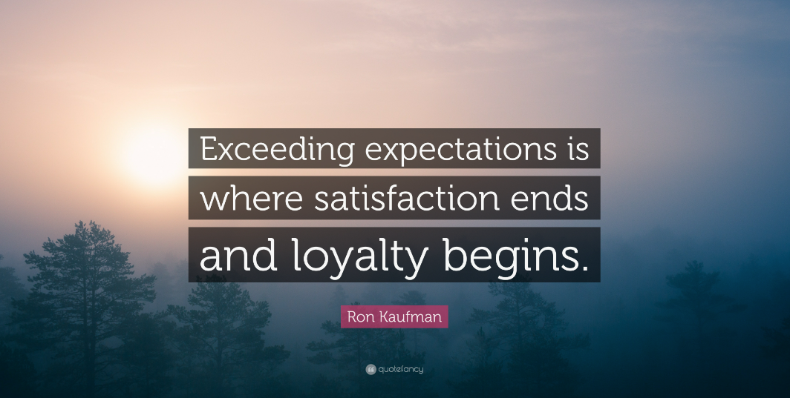
#6
What’s Keeping Us from Doing Better?

Slide 7

#7
If We Want to Be Exceptional In Service, What’s Missing?
The Size of Our Thinking Determines Everything

Slide 8

Values – B.E.A.C.H
Belong (Part of Something Bigger Than Yourself – A Town Family)
Empathetic (Understanding the Needs of Others is Key to Service Excellence)
Accountable (Responsible for Our Actions in Word & Deed)
Collaborative (We are Better Together)
Honest (Never Lose the Public’s or Each Other’s Trust)

Slide 9

#9
Sleepless Nights
Near Term
Battery Fires as it relates to high rise fires
Canal Navigation System – Complexity
Ransom ware
Hurricanes (Business Continuity – water, bridges, electric….
Recession
Major event with water / wastewater
Red tide
Unable to fill positions/ losing positions
Police – minimum staffing at night and a major crime
Police radios and challenges of being in two counties
Implementation of Planning software
New commissioners
Legislation / Politics
Long Term
Flooding
Succession Planning
Aging Town Facilities and infrastructure (20+ yrs…)
Global Warming and adaptation
Increasing software costs
Police Technology Integration
Recession
Increasing Operational Costs
Managing customer expectations (immediate response…)
Employee housing costs

Slide 10


Take a Break
#10
Team Photo

Slide 11

#11
Employee Survey – OFI’s
Communication
Workforce Accountability
Compensation and Benefits
Training, Education and Professional Development
Workforce Capacity

Slide 12
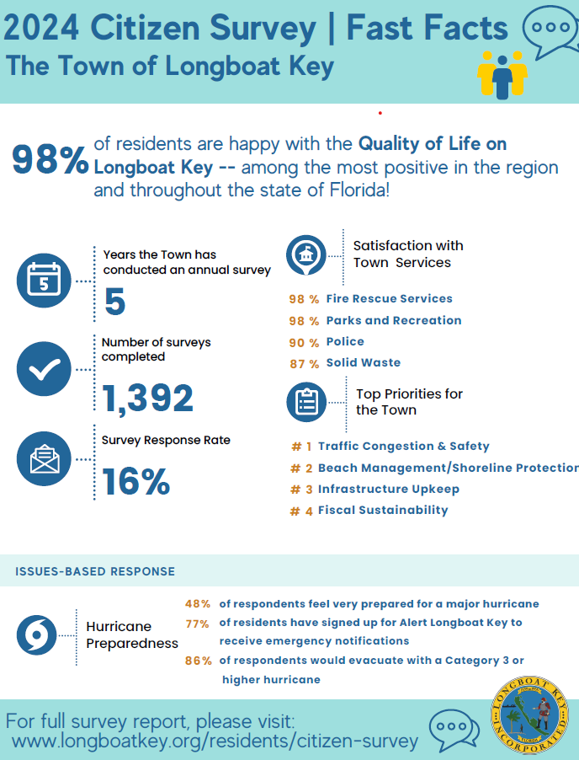
#12A
Does the survey impact any current or future initiatives?
  Internal
  Commission level- Placemat
What did we learn from reading the open ended responses?

Slide 13

Goals & Objectives Input
Street drainage / Street flooding
Reengineering road surfaces and drainage infrastructure
Accelerate Sleepy Lagoon street and drainage projects
Advance concept of public library, adult education center and multipurpose space at Town Center. Evaluate Parking
Work with Manatee County on N. Island Community Center
Identify and support healthcare providers, adult education resources and aging in place facilities
Encourage seawall construction / Mangrove Maintenance
Complete Undergrounding
Beach re-nourishment / long-term solutions to Ohana
Green initiatives – charging stations, solar power, phase out gas powered garden equipment. Updates – Environmental Matrix
Water Quality projects (living seawalls, VOGS, Education) / Turtle protection
Code enforcement, nighttime beach patrols, Flip Switch campaign…
Mitigate red tide
Traffic Transportation and safety
Broadway roundabout / Complete streets
GMD and General Harris intersection
Fully participate in Longboat Pass bridge replacement
Explore other forms of transport
Coquina parking egress
Maintain control of Jewfish Key
Deal with Traffic Issues
Structural Integrity of LBK’s Residential Buildings
Deal with sea level rise / climate change
One-County Initiative
Open-air venue – Bayfront Park
Canal / Waterway Management
#12B

Slide 14
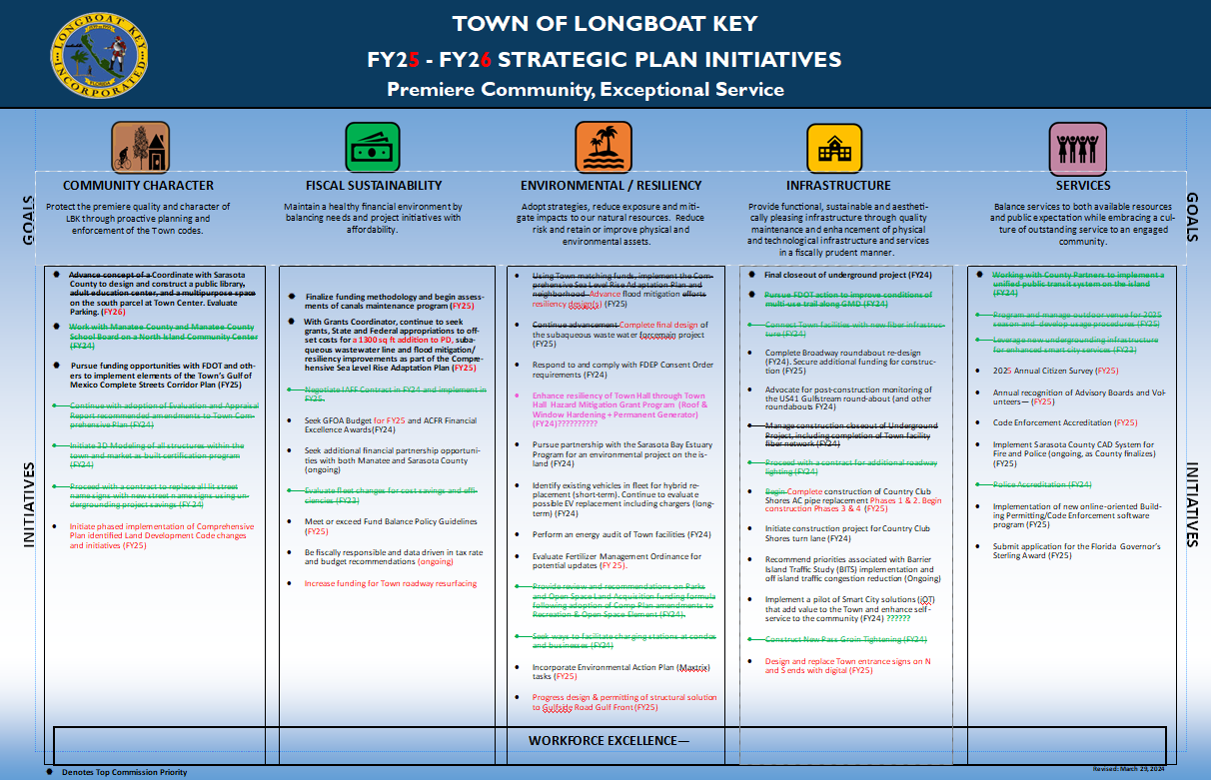
Switch to Publisher
#13

Slide 15

#14
Sea Level Rise / Resiliency
Smart City Enhancements
Staff Retention / Training
Canal Dredging Program
Leadership / Advocacy Role Environmental Stewardship
Florida Sterling Award (2025)
GMD Complete Streets
Key Priorities for the Next 5 Years
What ELSE???

Slide 16

#15
Draft Agenda for Commission Workshop

Slide 17

#16
Action Plan,
Next Steps &
Wrap Up

