Slide 1
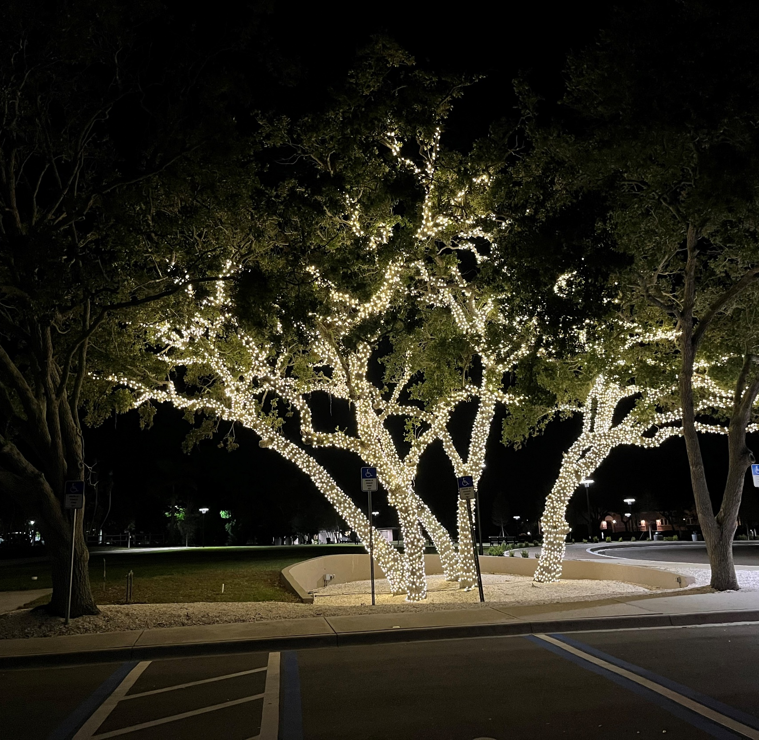
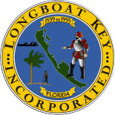
Town Commission
Strategic Planning Retreat
April 15, 2024
Premier Community, Exceptional Service

Slide 2


Good Morning!

Slide 3
#1
Agenda for the day….
and Town Manager Intro

Slide 4

Agenda
Overview of the day and Introductions
Celebrating the Past Year
Strategic Planning
  Vision/Mission/Community Expectations/Values
  Planning Process
  Summary of Public Input
Strategic Planning Progress
  Strategic Planning Scope, Framework, Plan on a Page, SACO’s, Dashboard
  Sleepless Nights Exercise
FY25 Budget Prep
Draft FY25-FY26 Workplan
Next Steps/Wrap Up

Slide 5

#2

Slide 6
#3
Strategic Planning

Slide 7
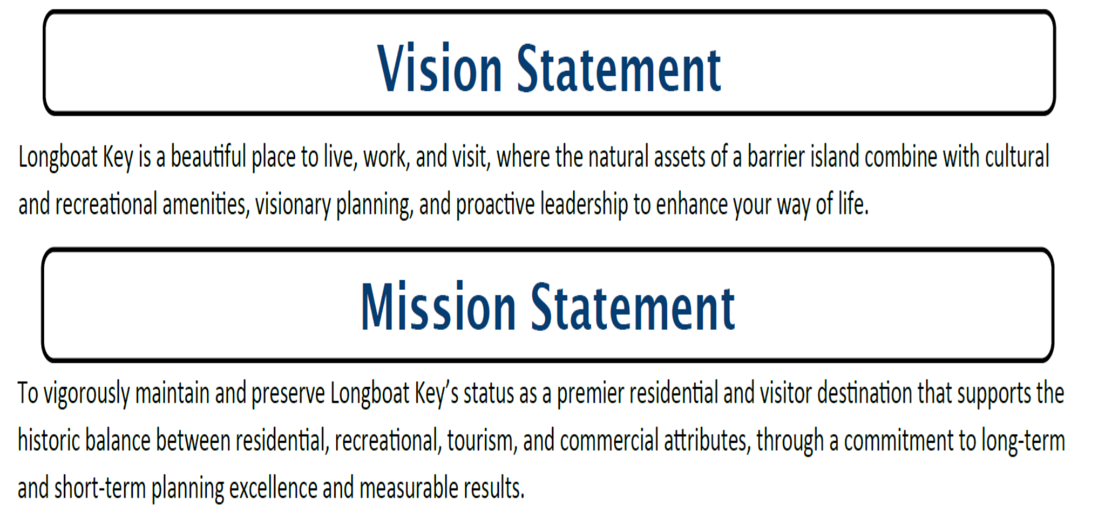
Current Vision and Mission Statements

Slide 8
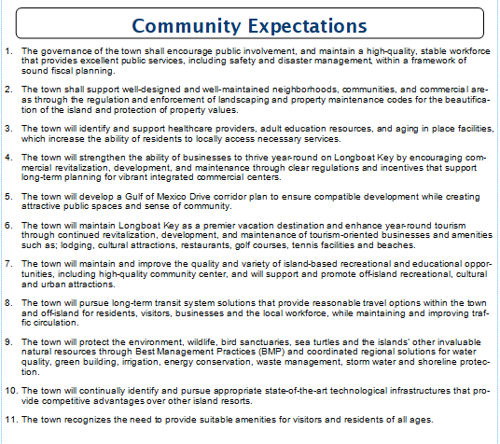

Slide 9
Values – B.E.A.C.H
Belong (Part of Something Bigger Than Yourself – A Team)
Empathetic (Understanding the Needs of Others is Key to Service Excellence)
Accountable (Responsible for Our Actions in Word & Deed)
Collaborative (We are Better Together)
Honest (Never Lose the Public’s or Each Other’s Trust)

Slide 10
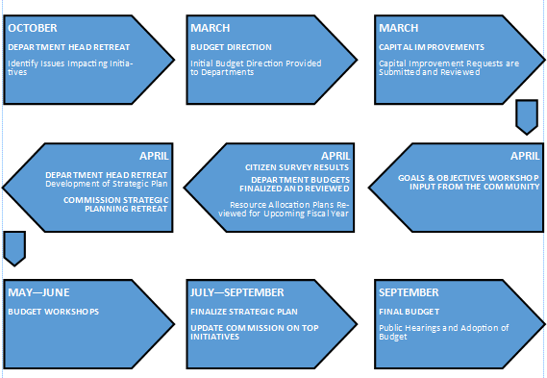

Slide 11
Public Input
Annual Citizen Survey
Goals and Objectives Annual Feedback From Organizations

Slide 12
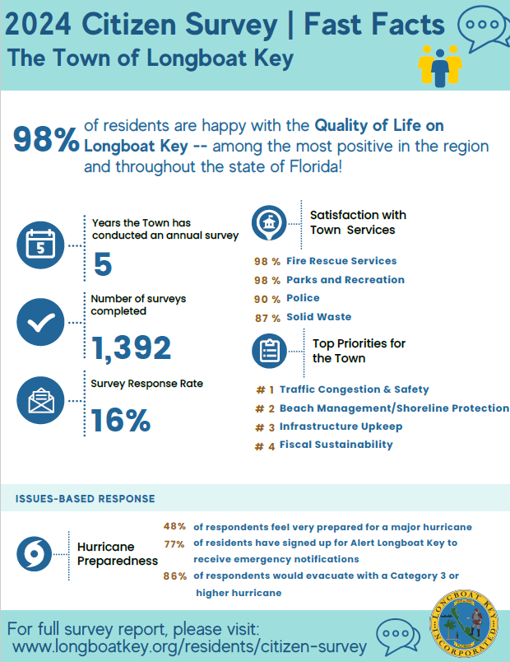
Survey - Town Priorities
The issues that respondents see as most important to address in the coming years include:
  Beach management/shoreline protection
  Sea-level Rise
  Canal Dredging
  Street flooding
The three most commonly cited issues facing the town” included:
  Traffic Congestion
  Property Insurance Costs
  Beach Erosion

Slide 13

2024 G&O Input
Street drainage / Street flooding
Reengineering road surfaces and drainage infrastructure
Accelerate Sleepy Lagoon street and drainage projects
Advance concept of public library, adult education center and multipurpose space at Town Center. Evaluate Parking
Work with Manatee County on N. Island Community Center
Identify and support healthcare providers, adult education resources and aging in place facilities
Encourage seawall construction / Mangrove Maintenance
Complete Undergrounding
Beach re-nourishment / long-term solutions to Ohana
Green initiatives – charging stations, solar power, phase out gas powered garden equipment. Updates – Environmental Matrix
Water Quality projects (living seawalls, VOGS, Education) / Turtle protection
Code enforcement, nighttime beach patrols, Flip Switch campaign…
Mitigate red tide
Traffic Transportation and safety
Broadway roundabout / Complete streets
GMD and General Harris intersection
Fully participate in Longboat Pass bridge replacement
Explore other forms of transport
Coquina parking egress
Maintain control of Jewfish Key
Deal with Traffic Issues
Structural Integrity of LBK’s Residential Buildings
Deal with sea level rise / climate change
One-County Initiative
Open-air venue – Bayfront Park
Canal / Waterway Management

Slide 14
#4
Strategic Planning Progress

Slide 15
#5
FY25 Budget Prep

Slide 16
FY25 Budget Schedule
May 20
First Budget Workshop
  Capital and Preliminary Discussion
June 1
Town Receives Preliminary Taxable Values from Property Appraisers
June 17
Second Budget Workshop
  General Fund and All Other Funds
June 28
Set Maximum Millage Rate
July 1
Finance Receives Certified Taxable Values From Property Appraisers
September 9
Adopt Annual Non Ad-Valorem Assessment Resolutions at September Regular Meeting
September 9
First Public Hearing for FY24 Budget
September 23
Second Public Hearing for FY24 Budget
October 1, 2024 begins FY25 Fiscal Year

Slide 17
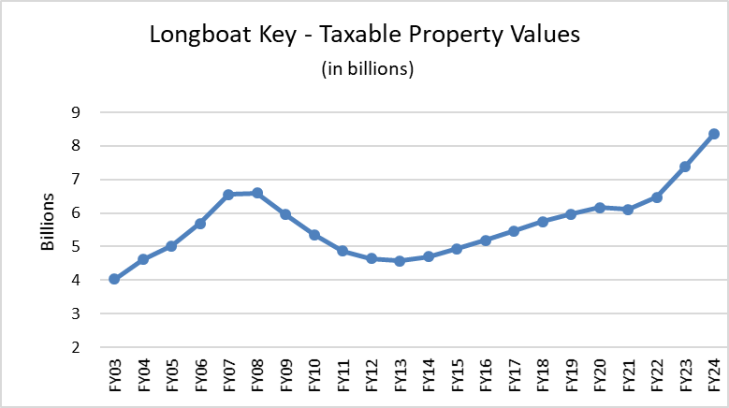
Budget Positives
Economy still strong
Property values still rising
FY23 Change in Fund Balance up $2.9M
Interest Rates remain elevated
Actively pursuing grants
St. Regis (FY26)
Fund Balance reserves using FY24 Budget ($56,426 cost per day) = 315 days
Audited Total Fund Balance $17.8M
$4.6 M used for FY24 Budget
$2.2M Excess Reserves + $750K capital

Slide 18
Budget Challenges
New Canal Funding Assessments
Beach Nourishment requires future debt issuance
Cost increase of Subaqueous – Larger debt issuance
Inflation in General
  Maintaining Infrastructure
  Surtax IV (2025-2039) Project List Set, but Underfunded
  Competitive Wages and Benefits / IAFF
  FRS
Insurance rates
New Positions

Slide 19
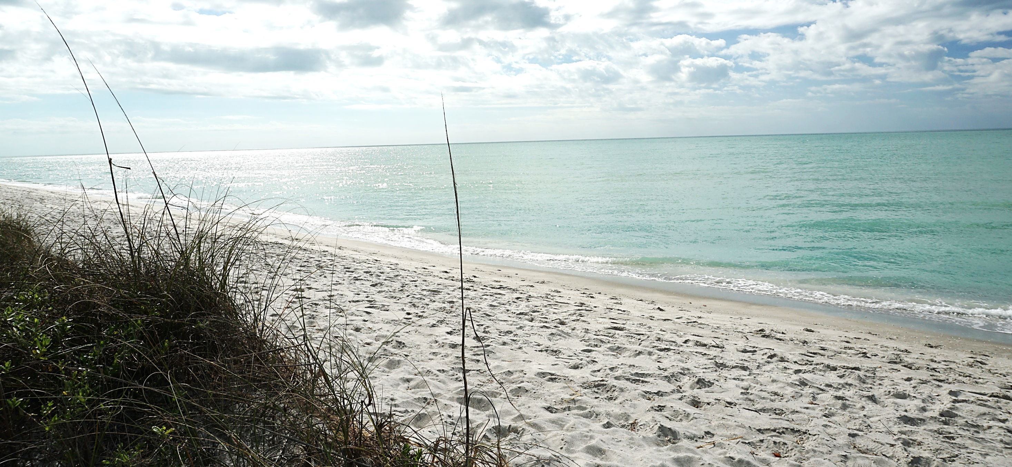
On the Horizon…

Slide 20

Many Projects and Initiatives
Undergrounding
Subaqueous Wastewater Line
Budget
Smart City Solutions
Police Re-Accreditation
Jewfish Key Contraction Study
Existing Infrastructure
Town Center Phase 3
Update Codes
Library For LBK
Infrastructure Hardening
(Resiliency)
PD&E for GMD Complete Streets
Beach Management
Whitney Plaza Community Center
Traffic Congestion
Energy Audit
Canal Maintenance
Dredging
Sea Level Rise
Street Name Signs
Rec Center
Citizen Survey
Keep Community Safe
Broadway Roundabout
Program Outdoor Venue
Recruitment & Retention

Slide 21
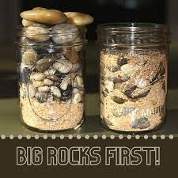
Major Projects in Pipeline
Undergrounding
Subaqueous Wastewater Line Project
Sea Level Rise/Drainage Assessments
Town Center Complete Phase 2/Initiate Phase 3
Canal Dredging – adopt methodology and advance dredging plans
GMD Corridor Study- complete study and implementation plan
Remaining Beach Projects
Town Hall facility hardening
Remaining CCS Water Line Replacement
Accelerate design for low-lying area infrastructure
Broadway Roundabout

Slide 22
Long- Term Issues
Beach Management
Sea Level Rise
Subaqueous Force Main
GMD Complete Streets
Canal Maintenance Dredging
Town Center Phase 3/ Public Library
Barrier Island Traffic Study
Smart City Opportunities
Rec Center at Bayfront Park
Commercial & Tourism Balance
Evaluation of Electric Vehicle Charging Infrastructure & Mobility alternatives
Environmental Matrix
Employee Retention and Benefits
Evaluation of Future Space Needs
Internal Capacity and Outsourcing

Slide 23
Long-Term Issues
Issue | 2024 | 2025 | 2026 | 2027 - 2032
Market and Economic Conditions | Assess economic conditions. Evaluate and adjust CIP and Operating Budget for future years. Assess real estate market conditions and tourist and resort related activity every 2-3 years
Beach Management | Hot Spot Nourishment- as needed. consider inclusion of structural solution to Gulfside Rd area. Gulfside Road hot spot nourishment. Begin preliminary design of Gulfside Road structural solution | Update Beach Management Plan to acccount for City of Sataosta and Manatee County inlet management stidies, respectively. |  | Update and adopt Comprehensive Beach Management Plan ahead of next nourishment cycle. Design, permit and Implement next nourishment cycle. Implement Gulfside Road structural solution, as appropriate.
Sea Level Rise | Update Comprehensive Adaptaion Plan using new state projecton requirements. Progress Norton Street design to completion. | Pending funding, reconstruct Norton Street. Begin engineering design all other areas of Sleepy Lagoon, Buttonwood and the Village. | Continue engineering design all other areas of Sleepy Lagoon, Buttonwood and the Village. Pursue construciton funding and begin incremental construction. | Initiate potential revisions to stormwater LOS (Resilience Plan Action Item #7). Improve Community Rating System Grade (Resilience Plan Action Item #20). Continue construciton of roadway resiliency/flood miitgation improvements.
Please see full document in your folder

Slide 24
Funding Initiatives
Water/Waste Water Infrastructure
$43 Million + (TBD) in Critical Capital Needs Identified through Fiscal Year 2030
  Subaqueous Force Main Project FY22 to FY25 - $21.9 Million +
    (Contracted with two companies to determine a credible budget range)
  Asbestos Cement Pipe Replacement (Design/Construction) FY 22 to FY26 for Country Club Shores - $9.5 Million
  Continue Rehabilitation of Sewer Lines
  Continue Lift Station Rehabilitations
  Water Distribution Rehabilitations
  Vehicles and Equipment
Assumed Financing of $27.1 Million (63%), With the Remainder Funded Through Cash Reserves and User Rate Revenue Collections
Third Year Review of the Five Year Rate Increase being updated now

Slide 25
Funding Initiatives
Water/Waste Water Infrastructure
Subaqueous Force Main (FY24-FY26) $25.6 M - $28.7 M
Funding Sources
  General Fund transfer of one-half of ARPA funds $1.8 M
  2023 Omnibus Community Grant Program sponsored $3.0 M
  by Congressman Buchanan $4.8 M
Funding needed $20.8 M - $23.9 M
  Continue to seek Grants and Appropriations
  Utility Rate increases passed in 2021
  Utilize Utility Fund Reserves and Short-term financing, then
  Issue Long term bonds when feasible TBD

Slide 26
Funding Initiatives
Water/Waste Water Infrastructure
Asbestos Pipe Replacement Country Club Shores (FY23-FY26)
  Current Phase 1 and 2 (Design & Construction) $6.0 M
  Phase 3 and 4 (FY25-FY26) $3.5 M
  Total $9.5 M
Funding Sources
  State appropriation $1.5 M
Funding needed $8.0 M
  Continue to seek Grants and Appropriations
  Utility Rate increases passed in 2021
  Utilize Utility Fund Reserves and Short-term financing, then
  Issue Long term bonds when feasible TBD

Slide 27
Funding Initiatives
Resiliency / Sea Level Rise
Buttonwood Phase 1 through 6 Cost $5.0 M
  Hurricane Ian HMGP Grant application submitted $3,635,594
  Hurricane Idalia HMGP Preparing application $1,000,000
  $4,635,594
Sleepy Lagoon Phase 1 through 4 Cost $8.5 M
  Hurricane Ian HMGP Grant application submitted $1,465,573
  Hurricane Idalia HMGP Preparing Application $791,173
  $2,256 746
Village – A 4 Phase strategy under development Cost TBD
  Hurricane Ian HMGP Grant application submitted $2,800,000
  Hurricane Idalia HMGP Preparing Application $500,000
  $3,300,000

Slide 28
Funding Initiatives
Resiliency/Sea Level Rise
Opportunities to Accelerate Projects
Existing Funds:
  General Fund transfer of ARPA Funds earmarked
  as matching funds for Grants $1.80 M
  Federal Appropriation for Norton Street Project .35 M
Other Funding:
  Resilient SRQ requested March 11, 2024 1.40 M
  HMGP Hurricane Ian Submitted (prior slide) 7.90 M
  HMGP Hurricane Idalia Preparing (prior slide) 2.30 M
  Reallocate Reserves appropriated last year:
    FPL Funds earmarked for Multi-path lighting in Streets Fund 2.60 M
    Funds earmarked for GMD Street Lights in Streets Fund 1.50 M
  Total Potential Funding Sources 17.85 M
Additional People Resources

Slide 29
Additional Discussion Items

Slide 30
#6
FY25 – FY26
Workplan

Slide 31
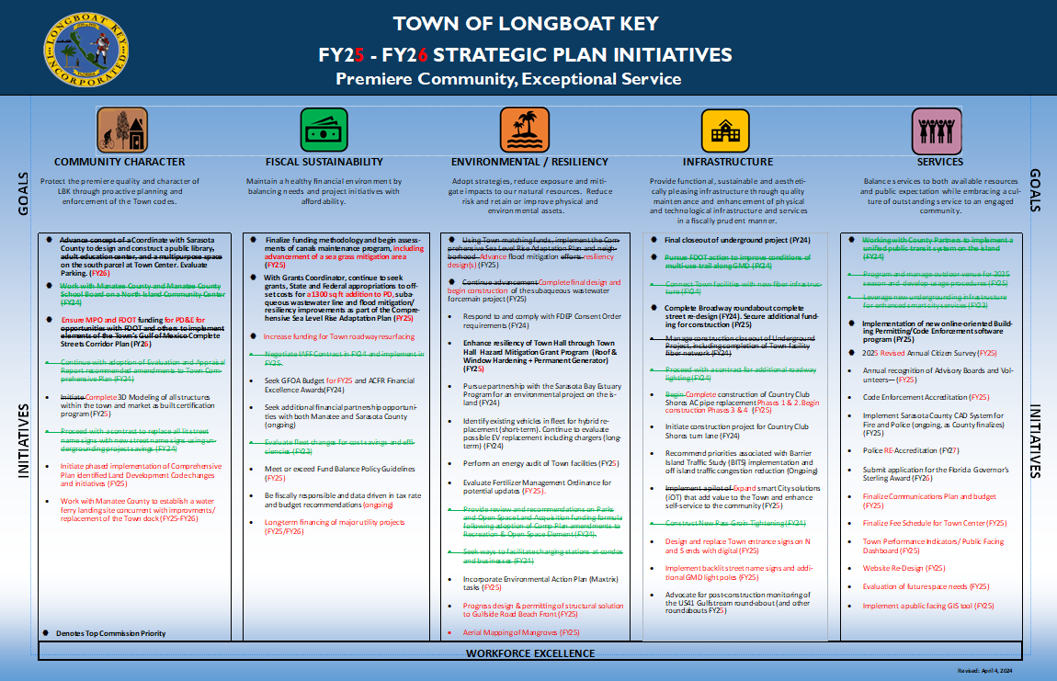
#2
DRAFT

Slide 32
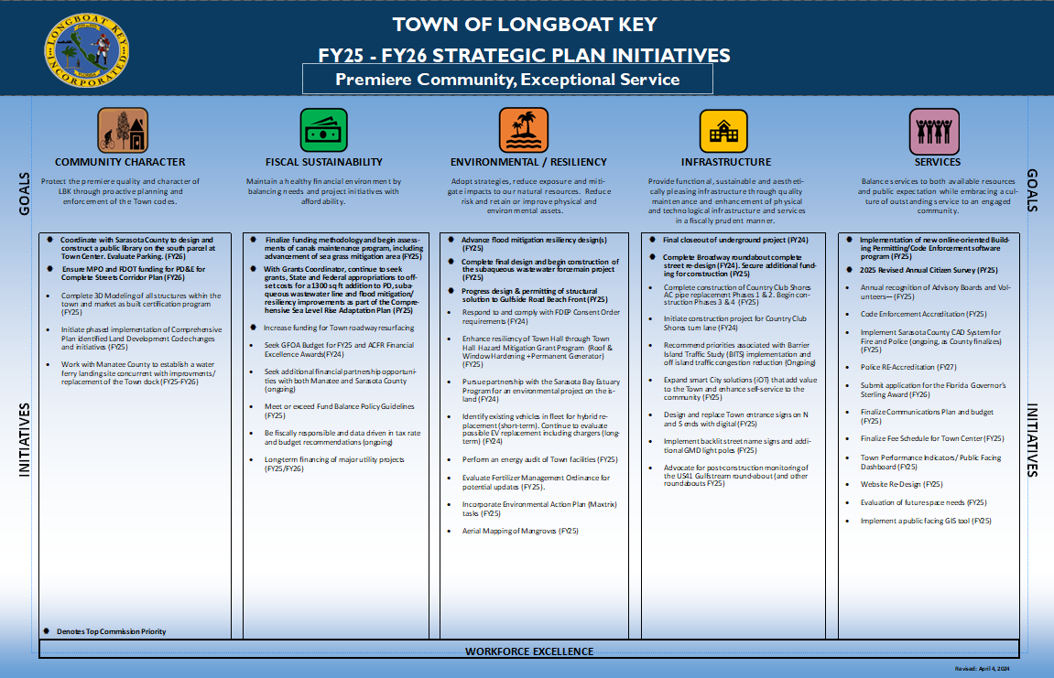
#2
DRAFT

Slide 33


Slide 34
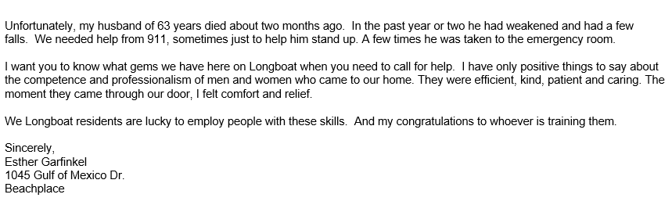
Notes of Thanks

Slide 35
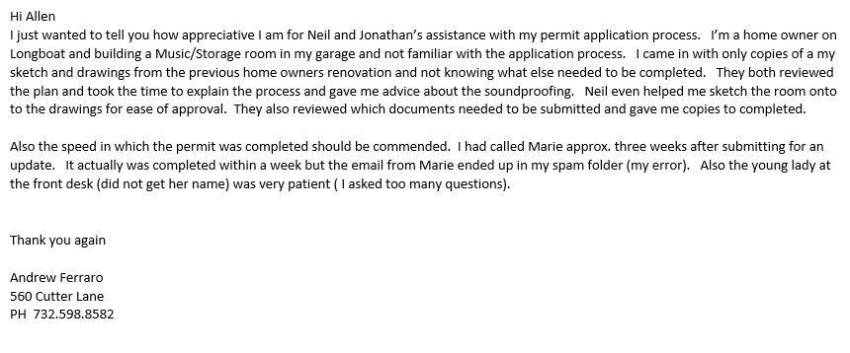
Notes of Thanks

Slide 36
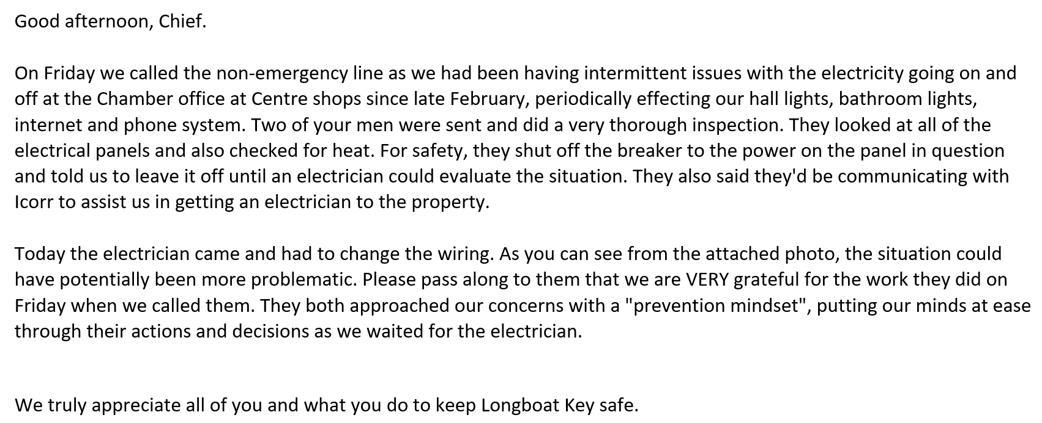
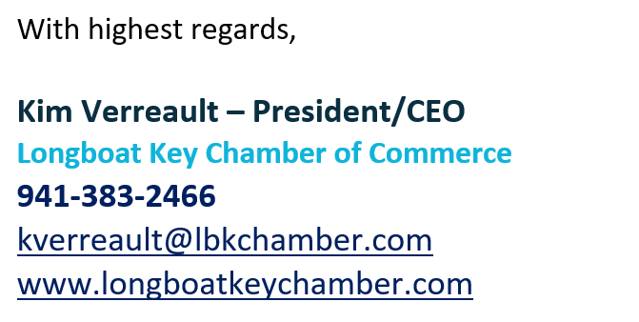

Slide 37
Thanks!
Thank You For Your Vision And Leadership!
Next Up:
5/6 - 1pm Regular Meeting Including FY24 Mid-Year Review
5/20 - 9am 1st Budget Workshop (Capital)
5/20 - 1pm Regular Workshop

Slide 38

Sleepless Nights – DH’s
Near Term
Hurricane season – this year’s forecast is particularly busy
Complexity of canal navigation maintenance system
Cyber security and ransom ware
Inability to fill positions and retain critical staff
Staff capacity issues
Ability to increase pace of infrastructure/resiliency improvements
Major event with water/wastewater
With increase in battery powered vehicles, dangers relating to battery fires as they relate to high rise fires
PD minimum staffing at night and a major crime
PD radios and challenges of operating in two counties
Red tide and cleanup efforts
Inflation/supply chain issues
Recession
Change in Commissioners (not for another year)
State and Federal legislation impacts/politics
Long Term
Seal level rise
Flooding
Global warming and adaptation
Aging Town facilities and infrastructure
Recession
Increasing operational costs/inflation pressures (software, insurance as examples)
Succession planning and staff capacity
Increased costs for employees (housing, home and auto insurance, healthcare, etc.)
Police technology integration
Managing increasing customer expectations
Erosion of home rule authority and ability to address issues locally
Future mobility options – what are we prepared to do
Environment champion – what are we prepared to do

