Slide 1


Department Directors
Strategic Planning
Retreat
April 4, 2023
Premier Community, Exceptional Service

Slide 2
Agenda
Breakfast ☺
Agenda Overview
Ice Breaker – 2 Truths & 1 Fib
What is working well?
What are the Threats to Continuing to Do Well?
What Could We Do Better
What’s Keeping Us from Doing Better?
If We Want To Be Exceptional In Service, What’s Missing?
Current Vision Statement Refinement
Current Mission Statement Refinement
Community Expectations vs Value Statement
Draft Values – B.E.A.C.H.
BREAK – Team Photo
Review Citizen Survey Feedback and Citizen Goals/Objectives Input
FY2023/24 Strategic Planning Goals, Objectives Initiatives Review
- Realignment of Duties
Key Priorities for the Next 5 Years
Draft Agenda for Commission Workshop
Action Plan / Next Steps / Wrap Up

Slide 3


#3
Ice Breaker -
Two Truths and 1 Fib
FIB

Slide 4
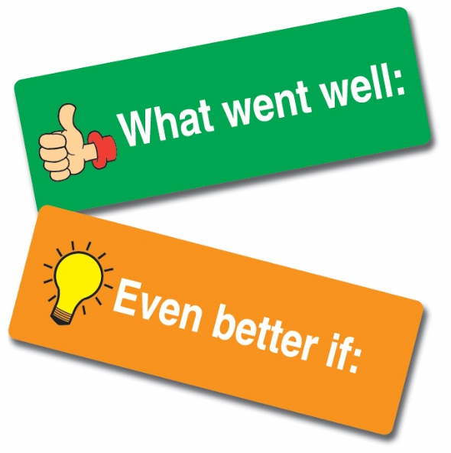
#4
What is
Working Well?
Internal
External
Other

Slide 5

#5
What are the Threats to Continuing to Do Well?
What Can We Do About Them?

Slide 6

#6
What’s Could We Do Better?
Internal
External
Other

Slide 7
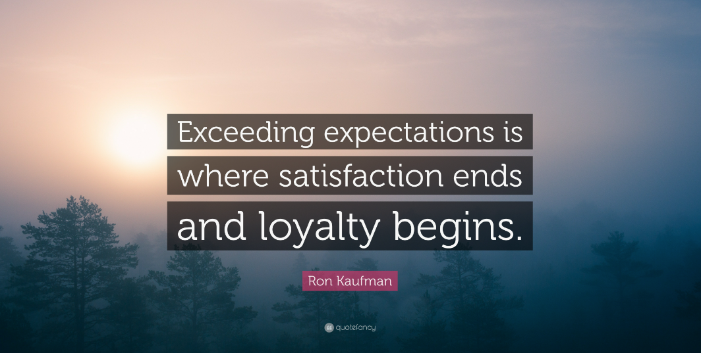
#7
What’s Keeping Us from Doing Better?

Slide 8

#8
If We Want to Be Exceptional In Service, What’s Missing?
The Size of Our Thinking Determines Everything

Slide 9
#9
Current Vision Statement Refinement

Slide 10
#10
Current Mission Statement Refinement

Slide 11
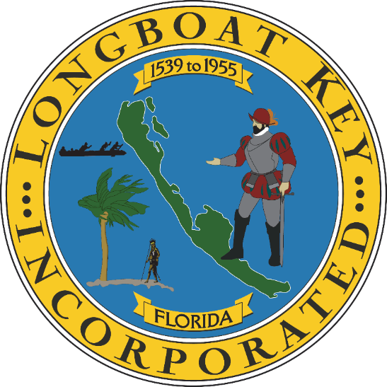
New Vision & New Mission
Vision – Lead a Premier Community through Exceptional Service
      #exceptional people serving exceptional people
Mission – To Preserve and Enhance Longboat Key’s Status as a Premiere Community

Slide 12
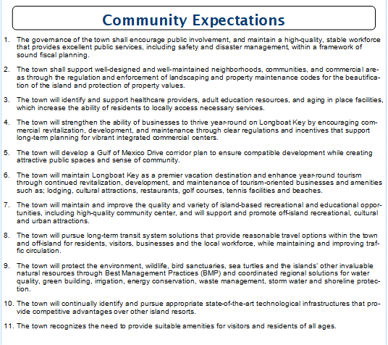
#11
Community Expectations vs. Value Statement

Slide 13
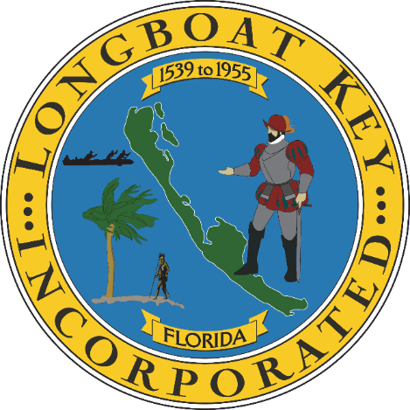
DRAFT Values – B.E.A.C.H
Belong (Part of Something Bigger Than Yourself – A Town Family)
Empathetic (Understanding the Needs of Others is Key to Service Excellence)
Accountable (Responsible for Our Actions in Word & Deed)
Collaborative (We are Better Together)
Honest (Never Lose the Public’s or Each Other’s Trust)

Slide 14


Take a Break
#13
Team Photo

Slide 15
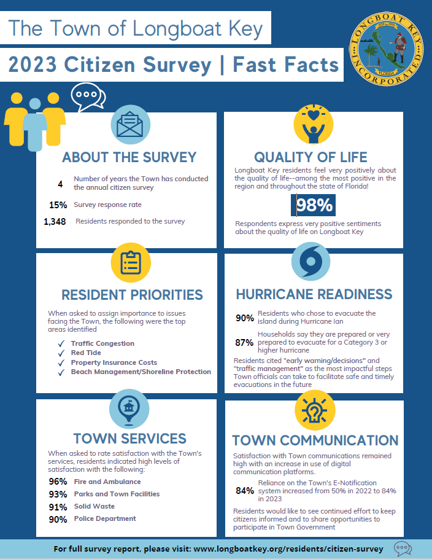
#14
Does the survey impact any current or future initiatives?
  Internal
  Commission level- Placemat
What did we learn from reading the open ended responses?

Slide 16

Goals & Objectives Input
Canal Management / Dredge
Drainage
Gas Powered Landscape Equip
Water Quality, Living Seawalls, Native Planted Areas, Vertical Oyster Gardens
Replace Impermeable Town Parking Lots
Improve Mangrove Protection
Print Fertilizer Ordin. In Spanish
Education on use of Fertilizer
Evaluate / incentives for Solar Power
Recycling Flyers to Associations and Individuals
Weekly Social Media during Nesting Season
Manage racoon and coyote populations
Reestablish Integrity of Contiguous Beach
Balance tourism w/ residential lifestyle
Policies to protect environment / sustainability / sea level rise/ red-tide
Provide Community Charging Stations
GMD Corridor Plans Broadway Roundabouts
Slow Broadway Traffic / improve landscape at end of Broadway
Manatee County Presence at Whitney Plaza
Work w / MPO to enhance traffic flow
One County
Mandate Structural Integrity Capital Projects
Beautification of Town properties
Replace Bayfront Park Rec Ctr.
Phase 3 Town Center / Library – Cultural Ctr. / Beautification
#14 continued

Slide 17
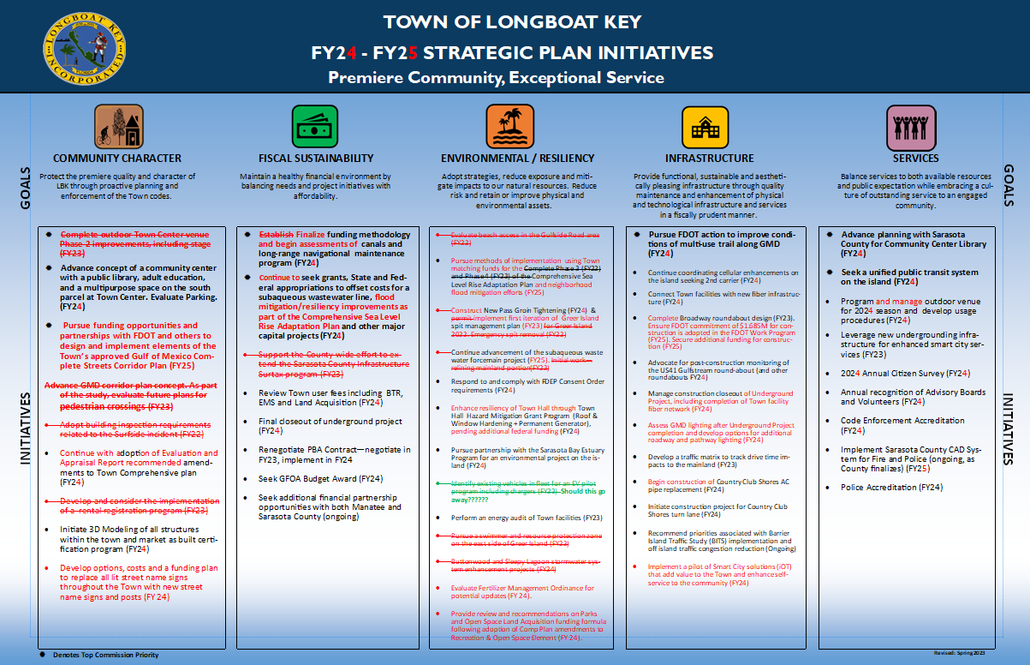
#2
#15
Switch to Publisher

Slide 18

#15
Realignment of Duties
Agenda Development & ADA
Communications
    Comp Communications Plan
    Primary PIO (Alert LBK, Facebook, Instagram, Twitter
    Town Hall lobby
    Expanded Annual Report
    Talk of the Town
    Community Open House
Sterling Award
Town Center/ Library/Community Ctr.
Performance Indicator Dashboard
Leadership Development Series
Smart City

Slide 19
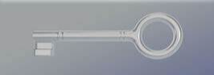
#16
Staff Retention / Training
Sea Level Rise / Resiliency
GMD Complete Streets
Smart City Enhancements
Canal Dredging Program
Leadership / Advocacy Role – Environmental Stewardship
Florida Sterling Award (2025)
Town Center Phase III
Key Priorities for the Next 5 Years

Slide 20
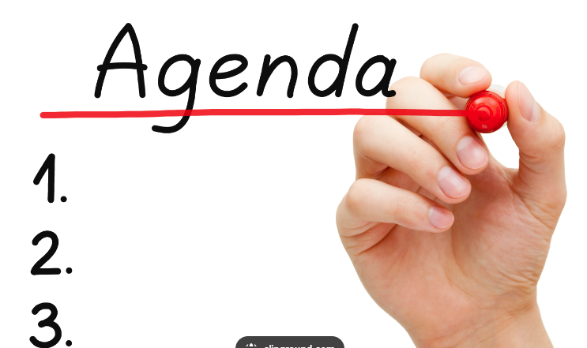
#17
Draft Agenda for Commission Workshop

Slide 21

#18
Action Plan,
Next Steps &
Wrap Up

Slide 22

Values
Think Big – What’s possible often starts with That’s Impossible
Act with Integrity – The Town’s currency is the Public’s Trust
Champion Respect – We do our best when we do it together with respect and humility
Equality – We may have different roles, however no one person is more important than anyone else
Listen Well – seek to understand before seeking to be understood
Building Today for Tomorrow – we live in the moment and build for the future
Care – about each other, our country, our planet
Make a Difference – your service can change lives
Embrace the Adventure – work, like life, is a journey…, so enjoy the ride
Move with Urgency – tomorrow isn’t guaranteed, so make today count

Slide 23

Take-aways from Environmental Initiatives Presentation to Town Commission
Chipping and Shredding during construction
Composting
Solar Power for new construction
Leaf Blowers for Town and Contractors
Ed Chiles – All Clams on Deck
Prior mentions – Charging stations on the island
This Photo by Unknown Author is licensed under CC BY-ND

