Slide 1
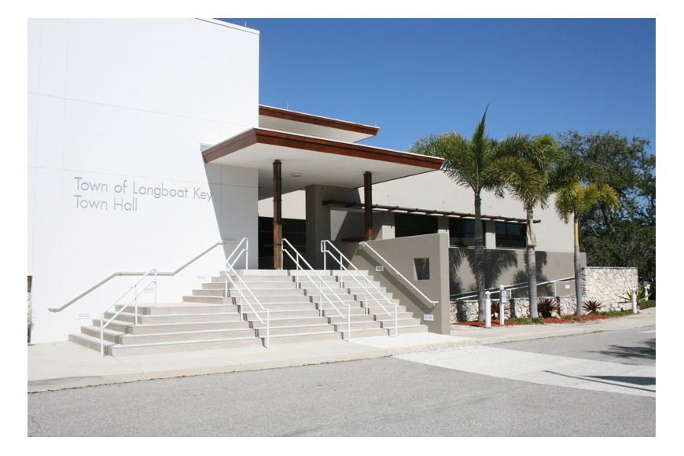
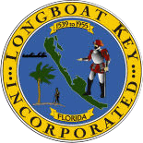
Department Directors
Strategic Planning Retreat
October 27, 2023
Premier Community, Exceptional Service

Slide 2
Agenda
Welcome
Employee Engagement Survey – Stratex
Review SWOT Analysis
Sleepless Nights & What’s Needed?
Near Term & Long Term
Strategic Planning (Placemat & Long-term Issues)
Environmental Matrix
FY23 Highlights Including 5 year CIP
Unfunded / Underfunded Issues
General Updates
Sterling Update – What’s next?
Training and Development (20 hours annually)
Discussion / Next Steps

Slide 3
#2
Employee Engagement
Survey

Slide 4
#3
S.W.O.T

Slide 6
#4
Sleepless Nights
Near Term
Long Term

Slide 7
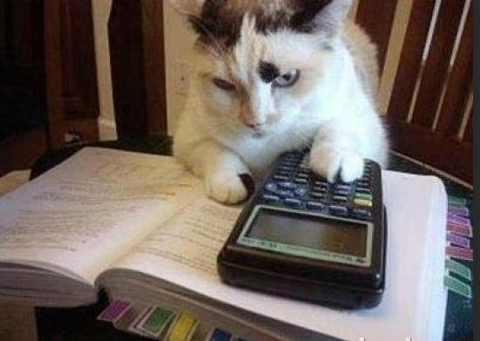
#5
Strategic Planning

Slide 8
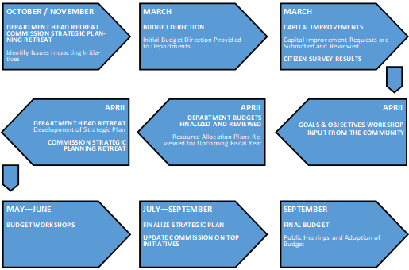
Strategic Planning Process

Slide 9
#2

Slide 10
Long-Term Issues

Slide 11
#6
Environmental Matrix

Slide 12
#7
FY24 Highlights Including 5 year CIP

Slide 13
FY24 Budget Highlights
Revenues:
July 1 Certified Real Estate Values - 13.11% increase from FY23 - $8,353,979,772 Taxable Value
$1,580,016 in new Ad Valorem Revenue using a mill rate of 1.9600
$1,040,261 in new Non Ad Valorem Revenue
Sales taxes and Franchise fees expected to remain elevated due to economic activity and inflation
Investment income to remain stable with Feds expected to reduce rates once inflation is under control
Operating Expenditures:
Total Operating Expense Budget of $20,595,614
Wages and Benefits approximately 81.5% of Operating Budget
Fire (IAFF) and Police (PBA) Contracts Ratified
General Employees Merit increases have been applied
7 New Positions (2.3 FTE’s paid outside of General Fund)
Health Insurance, Pension and FRS Contribution increases

Slide 14
FY24 Budget Highlights
Capital Plan Initiatives include:
Stormwater Management and Drainage Improvements
Traffic calming circles
Broadway Roundabout
Future Pathway lighting and Street lighting
Digital Display Boards
Building Permitting and Planning Software and implementation (Accela)
Asbestos Pipe Replacement and Subaqueous Force Main Replacement
Fire Truck and Public Safety Equipment
Town Hall hardening – Roof, Windows and Generator
Technology enhancements and smart city initiatives
Ongoing Fleet replacement including take home cars for Police
Station 91 Roof
Boardwalk replacement
Recreation Center Concept planning
Canal Assessment Program

Slide 15
#8
Unfunded/
Underfunded
Issues

Slide 16
Unfunded/Underfunded Capital
Funding Opportunities
Congressional Appropriations
American Rescue Act
Federal Infrastructure Act
Agency Funding at Federal Level
Florida Appropriations Request
Agency Funding at State Level
General Fund, Fund Balance Excess (Budget Process)
Agency Funding at County Level (WCIND, Neighborhood Parks, etc.)
Subaqueous Wastewater Line (Utility Fund – Rate Increases)
Sea level Rise Construction
GMD Corridor Study
Pedestrian Crossings (FDOT)
Broadway Roundabout
Construction (FDOT)
Longboat Club Road Roundabout
Design
Construction (FDOT)
Bayfront Park Recreation Center
Canal Dredging (Assessment Model in progress)

Slide 17
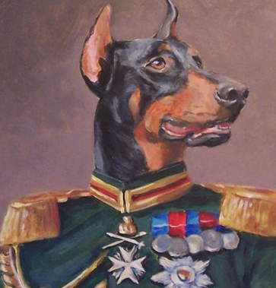
#9
General Updates For Commission Retreat
Canal Dredge
Town Center
Phase 3 Dog Park
Rec Center Design
Complete Streets
Repave Sidewalks
Subaqueous
Beach Evaluation

Slide 18
#10
Sterling Updates

Slide 19
#11
Training & Development

Slide 20
#12
Discussion &
Next Steps

