Slide 1

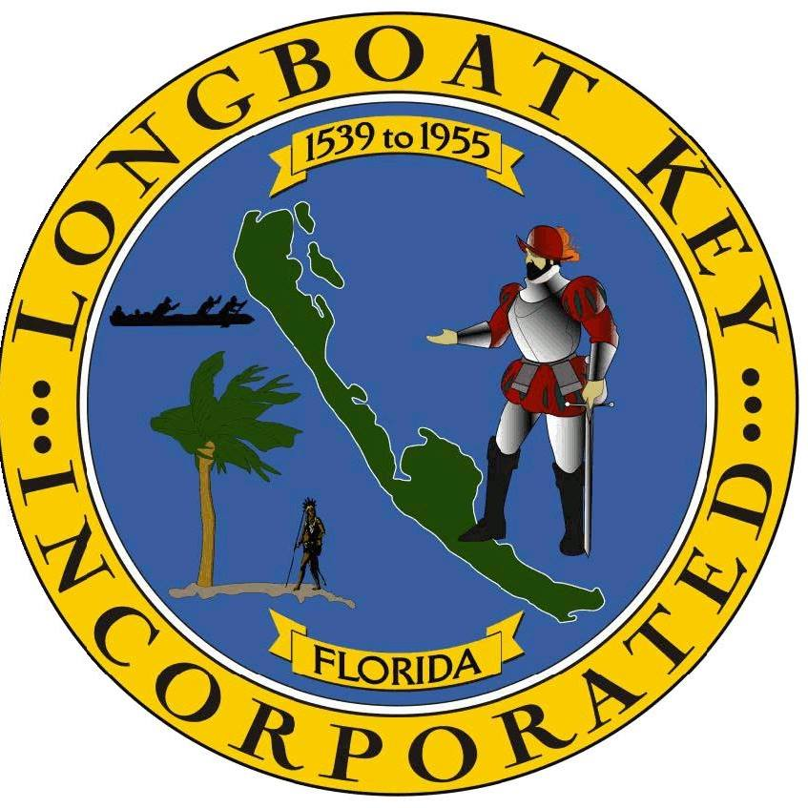

Employee Survey:
What we heard
Strategic Planning:
Where we are going
October 2023

Slide 2


Agenda
Methodology & Participants
What We Heard: Key Results
  Measures
  Strengths
  Opportunities for Improvement
Next Steps
  Process Feedback
  Prepare for Strategic Planning
Questions and Open Discussion
October 2023

Slide 3

Methods
For Town of Longboat Key Employees
Surveys were used to collect feedback.
Qualitative and Quantitative results were analyzed.
Individual question results reported.
Organizational key themes identified.

Slide 4

Survey Participation
For Town of Longboat Key Employees
Surveys sent to 134 employees
92 employees answered at least one question
88 employees completed the survey
66% total participation based on survey completion

Slide 5
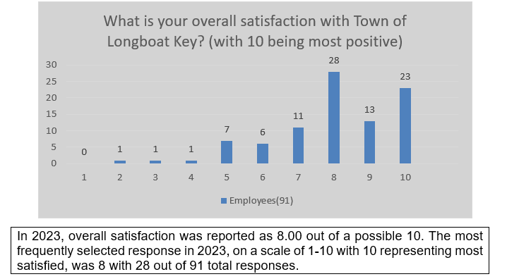
Results of Key Measures:
Overall Satisfaction with Town of Longboat Key

Slide 6
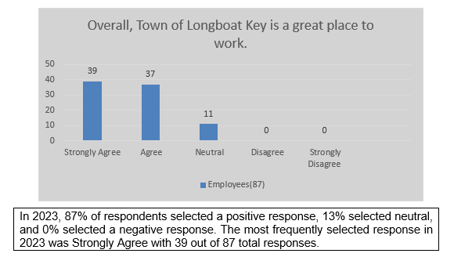
Results of Key Measures:
Overall, the Town of Longboat Key is a great place to work.
Positive responses were 76%

Slide 7
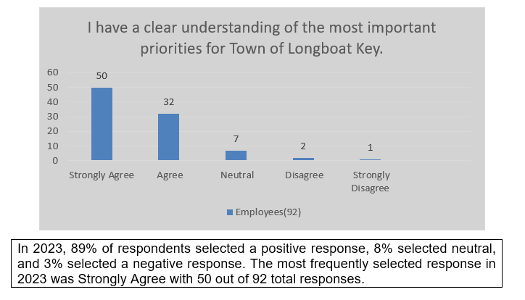
Results of Key Measures:
I have a clear understanding of the most important priorities for the Town of Longboat Key..
Positive responses were 76%

Slide 8
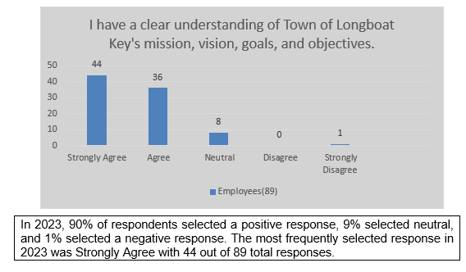
Results of Key Measures:
I have a clear understanding of Town of Longboat
Key’s mission, vision, goals and objectives.
Positive responses for 2023 were 80%

Slide 9
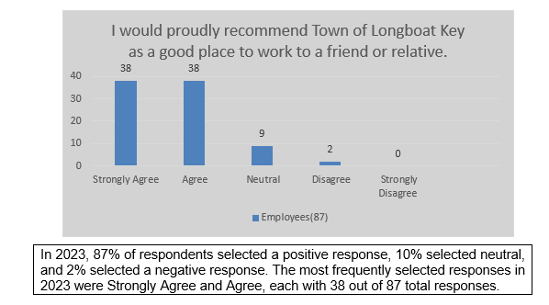
Results of Key Measures:
I would proudly recommend Town of Longboat Key as a good place to work to a friend or relative.
Positive responses for 2023 were 76%

Slide 10
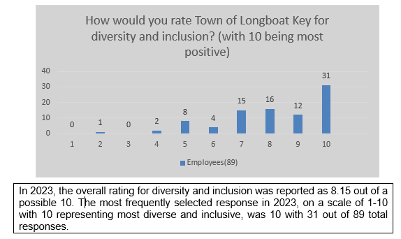
Results of Key Measures:
Diversity and Inclusion
The overall rating for diversity and inclusion for
2023 was X. The most frequently selected response was
X with X out of 89 total responses.

Slide 11

Key Findings
STRENGTHS

Slide 12
STRENGTH: Leadership
Leadership refers to the collaborative efforts of Town leadership in guiding the direction, growth, and well-being of the municipality. Together, they emphasize visionary planning, effective governance, and community engagement to address the unique challenges and opportunities within the Town. Their collective leadership ensures that the town operates efficiently, fosters innovation, and remains responsive to the evolving needs of its citizens
Qualitative
Quantitative
Good town Manager and director team. I believe the team really wants to see progress in the Town.
The Town’s Commission is comprised of individuals who came from larger corporations and firms. They are more involved than most and with a good manager keep a good pulse on the budget and quality of life of its residents, visitors, and employees.
I feel leadership is looking out for what is best for everyone.
Leadership is focused and always clear with accomplishing the Town’s goals and objectives.
82% of employees report having a clear understanding of the most important priorities for the Town of Longboat Key.
80% of employees report having a clear understanding of Town of Longboat Key’s mission, vision, goals, and objectives.
75% of employees report agreement with the statement “Town of Longboat Key’s leadership is appropriately concerned with accomplishing the Town’s goals and Objectives.”

Slide 13
STRENGTH: Workplace Environment
The workplace environment encompasses the physical, psychological, and cultural conditions that shape employees' experiences and well-being at work. It includes factors such as location and workspace, the tools and resources available, interpersonal relationships, organizational culture, and leadership styles. A positive workplace environment fosters collaboration, creativity, and productivity, while also promoting the health, satisfaction, and retention of employees.
Qualitative
Quantitative
Its natural environment for workplace location, its facilities, and its staff, the positive spirit of employees as a whole. Good governance.
Nimble; fiscally responsible; great tax base; friendly knowledgeable, and respectful community; great expertise within the community and within the Town; supportive and civil Commission; practical and common sense focused cost-effective solutions. Good, strong team.
The family atmosphere.
Friendliness of Town employees toward each other and the community. Everyone truly wants to make the community a better place.
76% of employees report they would proudly recommend the Town of Longboat Key as a good place to work to a friend or relative.
76% of employees feel the Town of Longboat Key is a great place to work.
72% of employees believe the Town of Longboat Key values their unique background and experiences.
75% of employees report “People of all cultures and backgrounds are valued at Town of Longboat Key”.

Slide 14
STRENGTH: Citizen Focus
Refers to the dedication and commitment of an organization to prioritize the needs, concerns, and aspirations of its citizens in its decision-making and service delivery. It emphasizes the importance of understanding and responding to the unique needs of the community, ensuring that policies and actions are aligned with their best interests.
Qualitative
Quantitative
The Town has employees who do in fact provide top notch service to the Town, both internally and externally.
The Town puts the citizens first.
Community focused. Service oriented
I have no doubt that the Town is focused on what is best for its residents.
Our customer service to our citizens is top notch.
85% of employees report that the Town of Longboat Key has a good reputation with the public.
76% of employees believe the Town of Longboat Key’s leadership is appropriately concerned with accomplishing the Town’s goals and objectives.
84% of employees report that the Town of Longboat Key is focused on what is best for the town and its residents.

Slide 15

Key Findings
OPPORTUNITIES for IMPROVEMENT

Slide 16
Opportunity for Improvement: COMMUNICATION
By effectively communicating with one another, an organization has greater assurance of mutual understanding of processes and roles and shared support of goals.
Qualitative
Quantitative
Listening and understanding issues that are happening in your department. To feel comfortable to express those needs or issues.
To honestly discuss issues and make a plan for improvement. Then follow up with the progress or regression of the plan.
Communication between staff and departments, especially when a process has changed and not been communicated to other staff/departments that may utilize that process.
Most departments tend to work in silos. Directors seem to only focus on what’s happening in their “world” and not paying attention to other departments.
64% of employees feel the organization supports an environment of open communication.
67% of employees report that the Town of Longboat Key communicates effectively with its employees.

Slide 17
Opportunity for Improvement: WORKFORCE ACCOUNTABILITY
Workforce accountability refers to the responsibility of employees to complete assigned tasks and duties in alignment with the organization's goals and standards. It emphasizes the importance of individuals owning their actions, decisions, and results, ensuring that they meet the expectations set by the organization. It underscores the commitment of public servants to serve the community efficiently, transparently, and with the highest level of integrity.
Qualitative
Quantitative
It would be beneficial to move away from “that’s how we always did it” and adopt current fiscal management and accountability methods.
Hold employees accountable for their actions/lack of work, etc.
At times it appears not everyone is interested in making sure everyone is moving forward. Some look out for themselves first which in the long run causes issues for the team as a whole.
No follow-through on concerns and problem-solving. Developing staff members’ growth, performance, and outcome goals. Delegating.
77% of employees report that their co-workers are committed to doing quality work.
69% of employees report that their opinions seem to count.

Slide 18
Opportunity for Improvement: COMPENSATION & BENEFITS
Benefits and compensation play a significant and influential role in employee satisfaction and motivation to perform well, both of which lead to increased organizational productivity.
Qualitative
Quantitative
I don’t feel my experience and education really makes a difference or is taken into consideration, particularly when it comes to salary.
This question is above my pay grade, but an annual Cost of Living Adjustment would be ideal as we all have to travel to LBK, and our residential areas are expensive, and costs are rising.
Align wages and benefits.
If you would have asked me a few months ago, I would have said a three. I’ve increased my rating based off the recent pay increases that have helped employees tremendously and were WAY past due. I think there is still room for improvement in providing employees with an actual sound and reliable retirement program similar to what other municipalities offer.
59% of employees report being satisfied that total compensation reflects the effort they put into their work.
76% of employees plan to be working for the Town of Longboat Key a year from now.

Slide 19
Opportunity for Improvement: TRAINING, EDUCATION & DEVELOPMENT
With employees being an organization’s greatest asset, investing in training, education, and development is key to sustaining business growth and success.
Qualitative
Quantitative
Unlike the other organizations I have worked for in the past, I have not witnessed a career pathing program within the Town.
I have received little to no training for my job, but have figured almost all of it out on my own.
Coming from the private sector, I feel more public sector training would have eased the transition.
We have no formal training program with goals or milestones reached.
Our trainings are outdated and repetitive each and every year. They are painful.
70% of employees report they are satisfied with the training received to perform their job.
59% of employees report that the Town of Longboat Key offers good opportunities for professional growth and development.
61% of employees report that the Town of Longboat Key provides effective on-the-job training and skill development.

Slide 20
Opportunity for Improvement: WORKFORCE CAPACITY
Workforce capacity is an organization’s ability to ensure sufficient staffing levels to accomplish its work and deliver its products and services to customers, including the ability to meet variable work demands.
Qualitative
Quantitative
The Town is making progress, but historically has not provided the resources to accomplish goals. Technology and personnel are desperately needed to complete the Town’s priorities. Since new Town management, it appears this is being addressed.
Staffing of our services remains an issue.
Hiring processes could be improved.
I believe the Town should increase staffing for Police, Fire, and Public Works. This is a great community that deserves the best services and additional staffing would ensure that by meeting recommended staffing levels.
Meeting recommended staffing for our departments. That comes at a cost, but if the residents are informed that we do not meet the minimum recommended levels, they would know where their money is being appropriated.
Workforce capacity is an opportunity that was organically identified by the employees through their comments to the following questions:
  What are the Town of Longboat Key’s most significant opportunities for improvement?
  Overall, Town of Longboat Key’s staff has the types of skills, knowledge, and experience necessary to fulfill its mission.
  How do you measure the success of Town of Longboat Key?
  I am satisfied with the training I have received to perform my job.
  As Town of Longboat Key is considering strategic initiatives for the next planning period, what would you recommend as potential focus areas based on your experience?

Slide 21

title
Let’s Hear What’s On Your Mind…

Slide 22
Next Steps?
Delivery of Full Feedback Report-Expected by November 3, 2023
Process Employee Report-Prioritization and development of improvement opportunities. Develop communication and feedback.
Organizational Assessment-SWOT and Placemat information entered into Ascend. Key themes reviewed and entered for Citizen Survey.
Long-Term Plan Development-Identification of Strategic Advantages, Challenges and Opportunities. Development of Goals, Objectives, and Objective Measures.
Tactical Plan Development-Through analysis of Assessment and Long-Term Plan Development in conjunction with Placemat information, key tactical strategies will be identified and built into an executable plan.
Prepare for and Launch Plan.
Town of Longboat Key: Feedback 2023

Slide 23

Intro to Key Concepts
Starting with the Beginning
The Stratex Strategic Planning Framework
Intersection of the Framework with Longboat Key’s current framework
Setting a Foundation-The roles of problem analysis and solution development in strategic planning
Stop Decorating the Fish

Slide 24

Strategic Planning Framework
Goals
Areas of strategic focus with 2-3 objectives, typically constant across the strategic planning period.
Strategic Plan
Objectives
Strategic Measures (3-5 years) high-level statements of what is to be achieved, typically constant across the planning period.
Strategic Measures
3-5 Years
Strategies
A tactical method, chosen to bring about a desired future condition, reach a specific target or move organizational performance against specific objectives. Typically, 1 year in duration.
Tactical Measures
Annual
Financial Resources
Milestones
A collection of high-level actions within a strategy marking completion of a stage within a strategy.
Tactical Plan
Actions
The specific sequence of steps which must be taken to complete a milestone.
Workforce
Resource Utilization

Slide 25
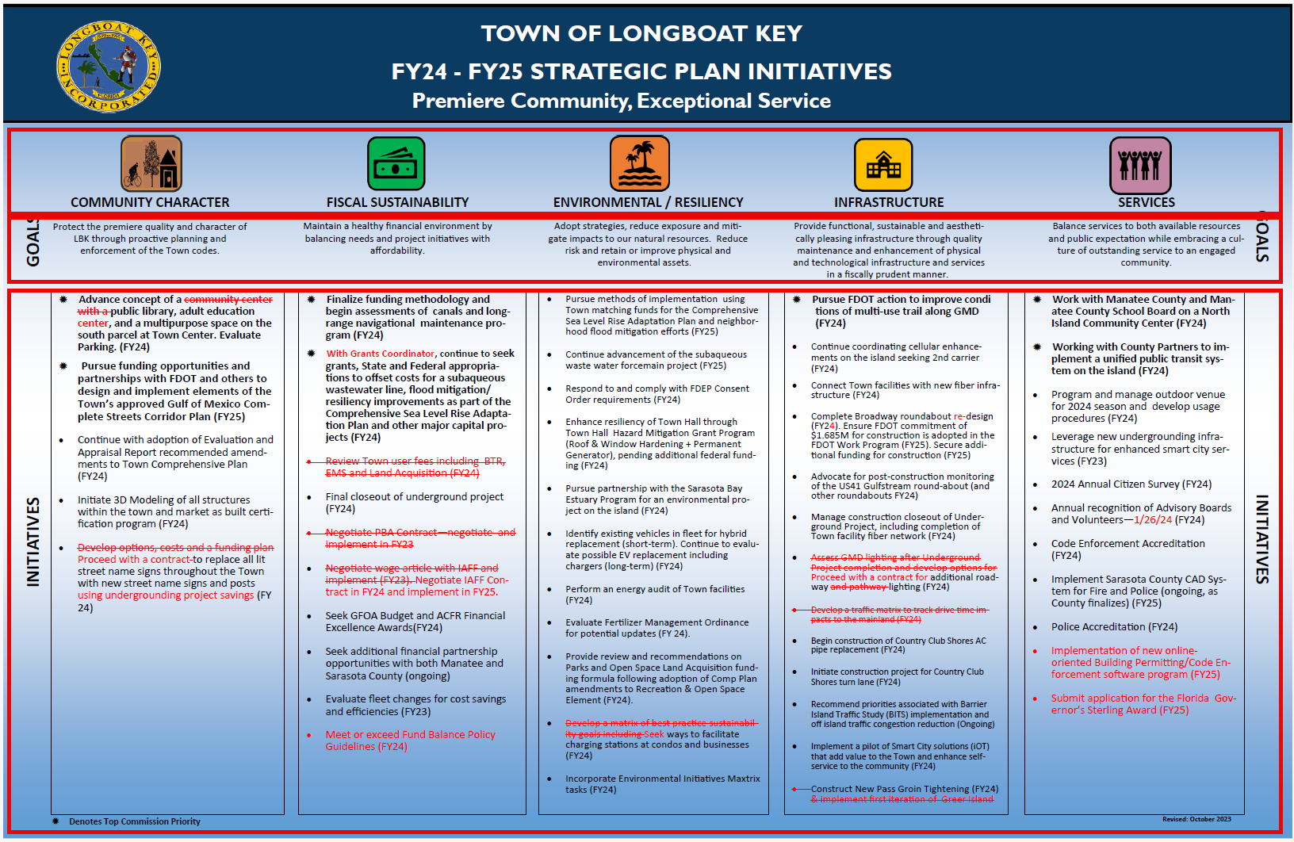
Mapping of LBK Current Framework to Stratex Framework
Goals
Areas of strategic focus with 2-3 objectives, typically constant across the strategic planning period.
Objectives
Strategic Measures (3-5 years) high-level statements of what is to be achieved, typically constant across the planning period.
Strategies
A tactical method, chosen to bring about a desired future condition, reach a specific target or move organizational performance against specific objectives. Typically, 1 year in duration.
Town of Longboat Key-October 2023

Slide 26

The Role of Problem Analysis and Solution Development in Strategic Planning
It is common to jump immediately to solutions. The framework focuses on solid problem development to ensure the most impactful problems are the focus.
Town of Longboat Key-October 2023

Slide 27


Stop Decorating the Fish
https://www.youtube.com/watch?v=yqSMp8jc3CE
Town of Longboat Key-October 2023
Notes:
Copy/Paste link into browser:
https://www.youtube.com/watch?v=yqSMp8jc3CE

Slide 28

What Does a Cartoon about Fish have to do with Strategic Planning?

Slide 29
Next Steps?
Delivery of Full Feedback Report-Expected by November 3, 2023
Process Employee Report-Prioritization and development of improvement opportunities. Develop communication and feedback.
Organizational Assessment-SWOT and Placemat information entered into Ascend. Key themes reviewed and entered for Citizen Survey.
Long-Term Plan Development-Identification of Strategic Advantages, Challenges and Opportunities. Development of Goals, Objectives, and Objective Measures.
Tactical Plan Development-Through analysis of Assessment and Long-Term Plan Development in conjunction with Placemat information, key tactical strategies will be identified and built into an executable plan.
Prepare for and Launch Plan.
Town of Longboat Key: Feedback 2023

Slide 30

+1 23 987 6554
Town of Longboat Key-October 2023

