Slide 1
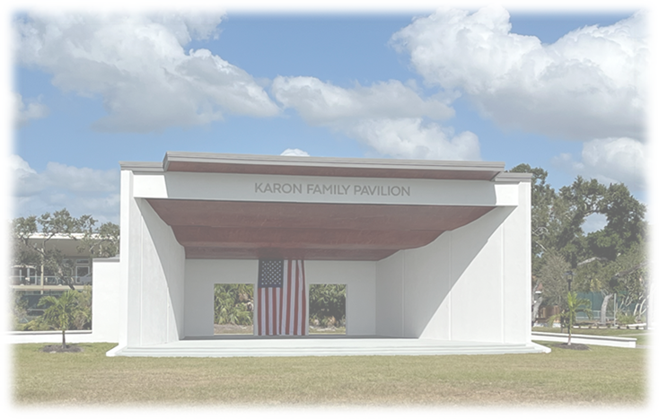
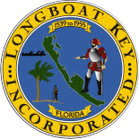
Town Commission
Strategic Planning Retreat
November 13, 2023
Premier Community, Exceptional Service

Slide 2
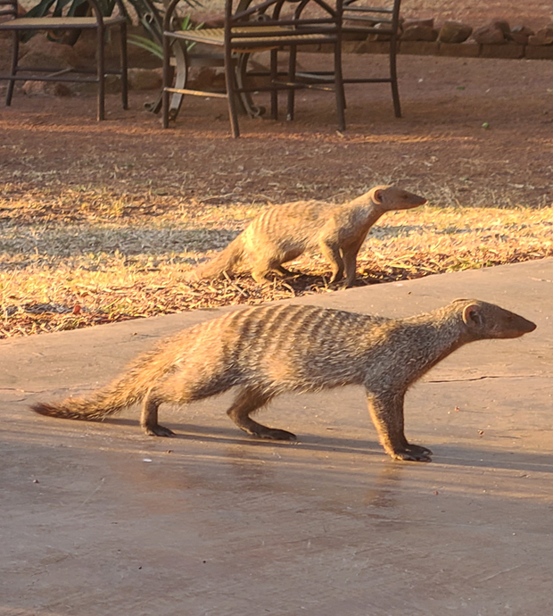
Good Morning!

Slide 3
Agenda
Review Goals for the Session
Environmental Action Plan (Matrix)
Sterling Criteria (Staff Update)
Presentation by Stratex – What’s ahead / alignment / key metrics
Strategic Planning
    Process, SWOT Analysis, Placemat, Long-term Issues
General Updates
Budget Highlights, Capital Plan Initiatives, Grants
Discussion and Direction
Next Steps

Slide 4
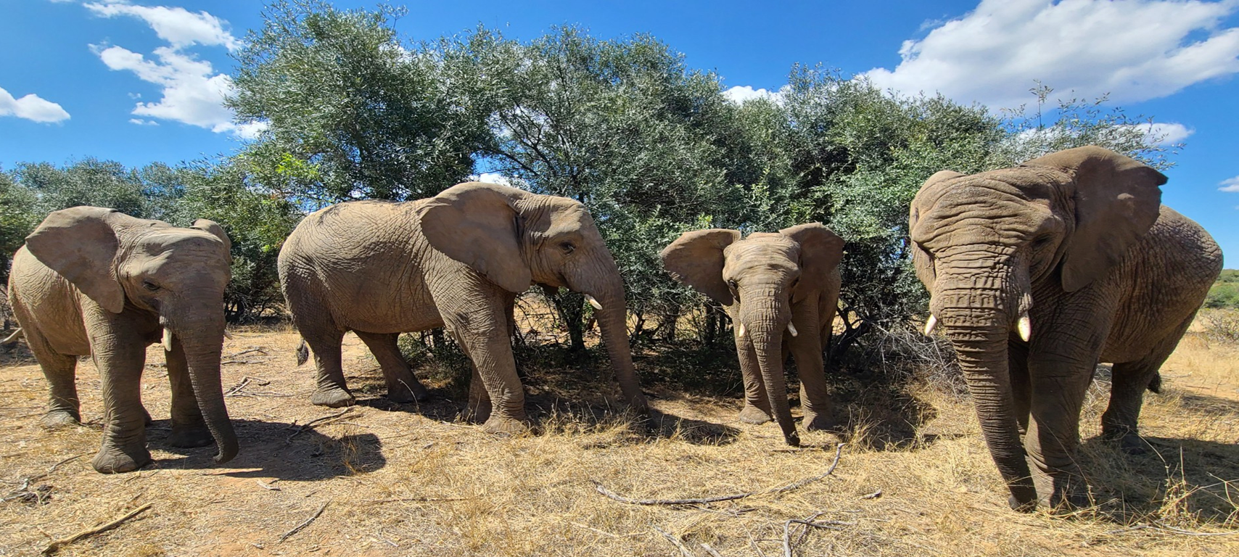
Goals for the Session

Slide 5
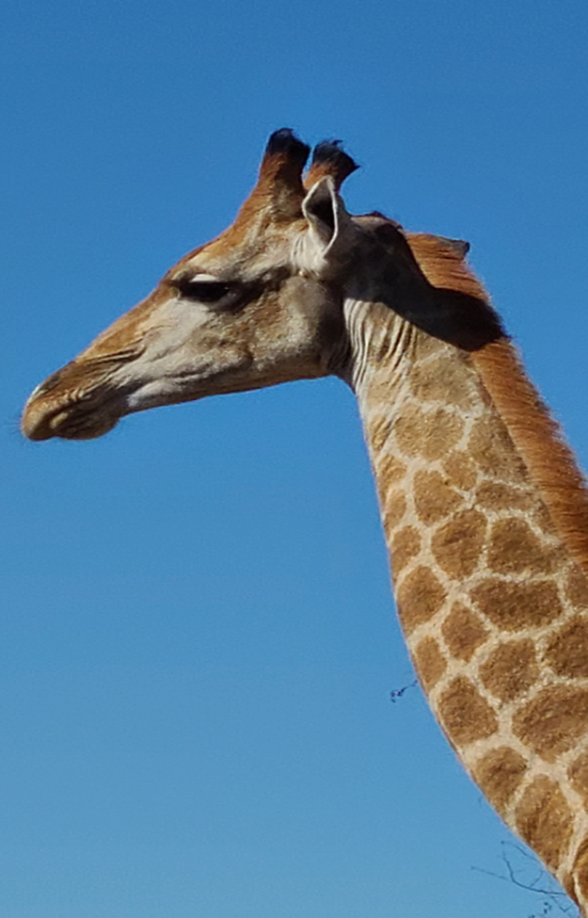
#2
Environmental
Action Plan
(Matrix)
Presentation by Jennifer & David Shafer

Slide 6
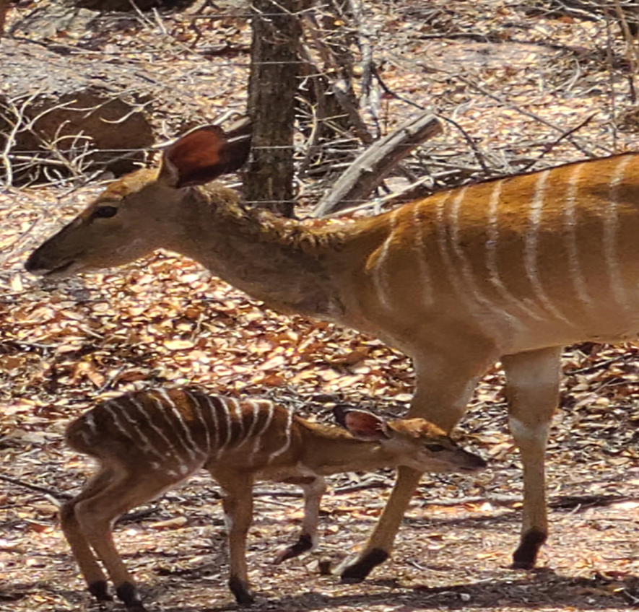
#3
Sterling Criteria
Staff Update

Slide 7
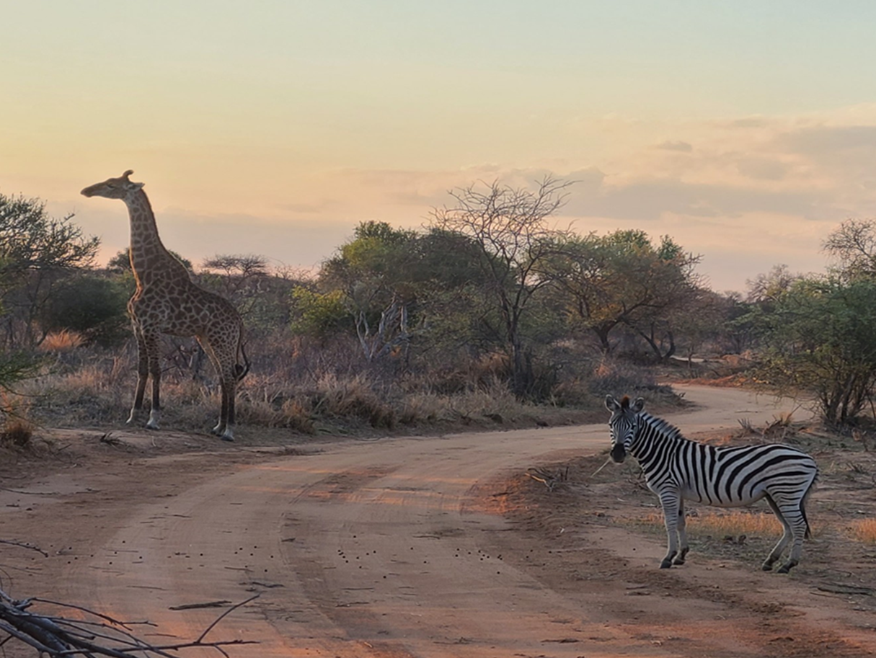
#4
Presentation by Stratex
What’s Ahead, Alignment, Key Metrics

Slide 8
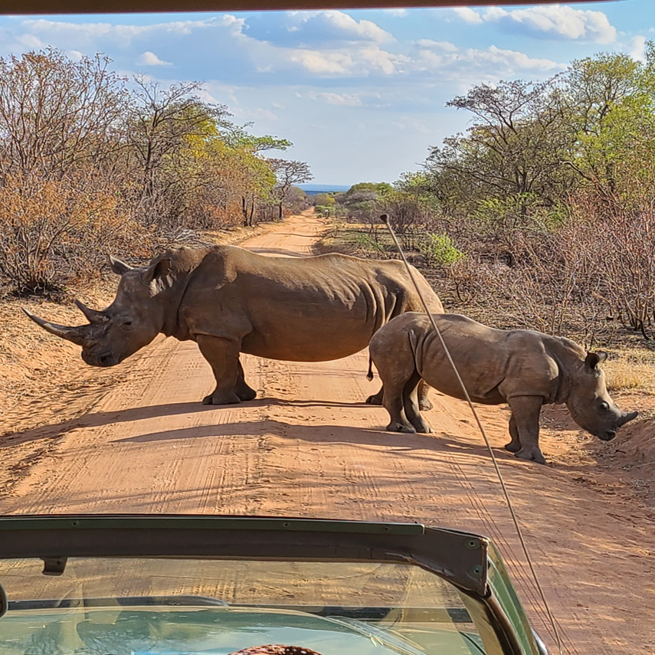
#5
Strategic Planning

Slide 9
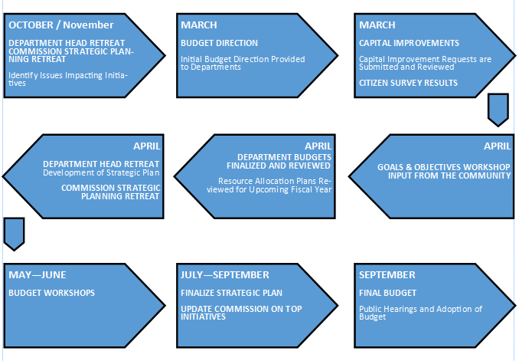
Strategic Planning Process

Slide 10
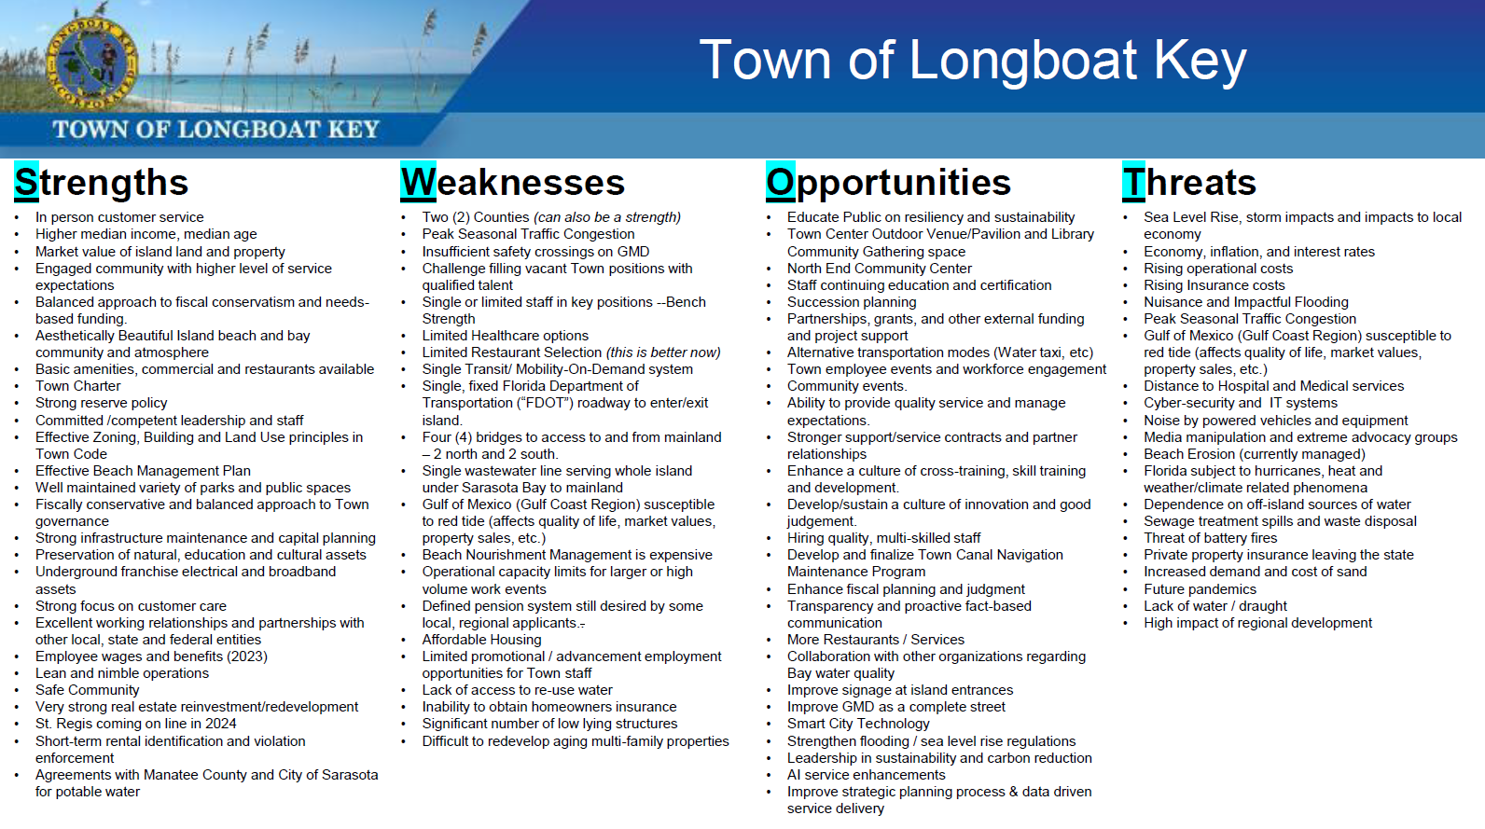
#2

Slide 11
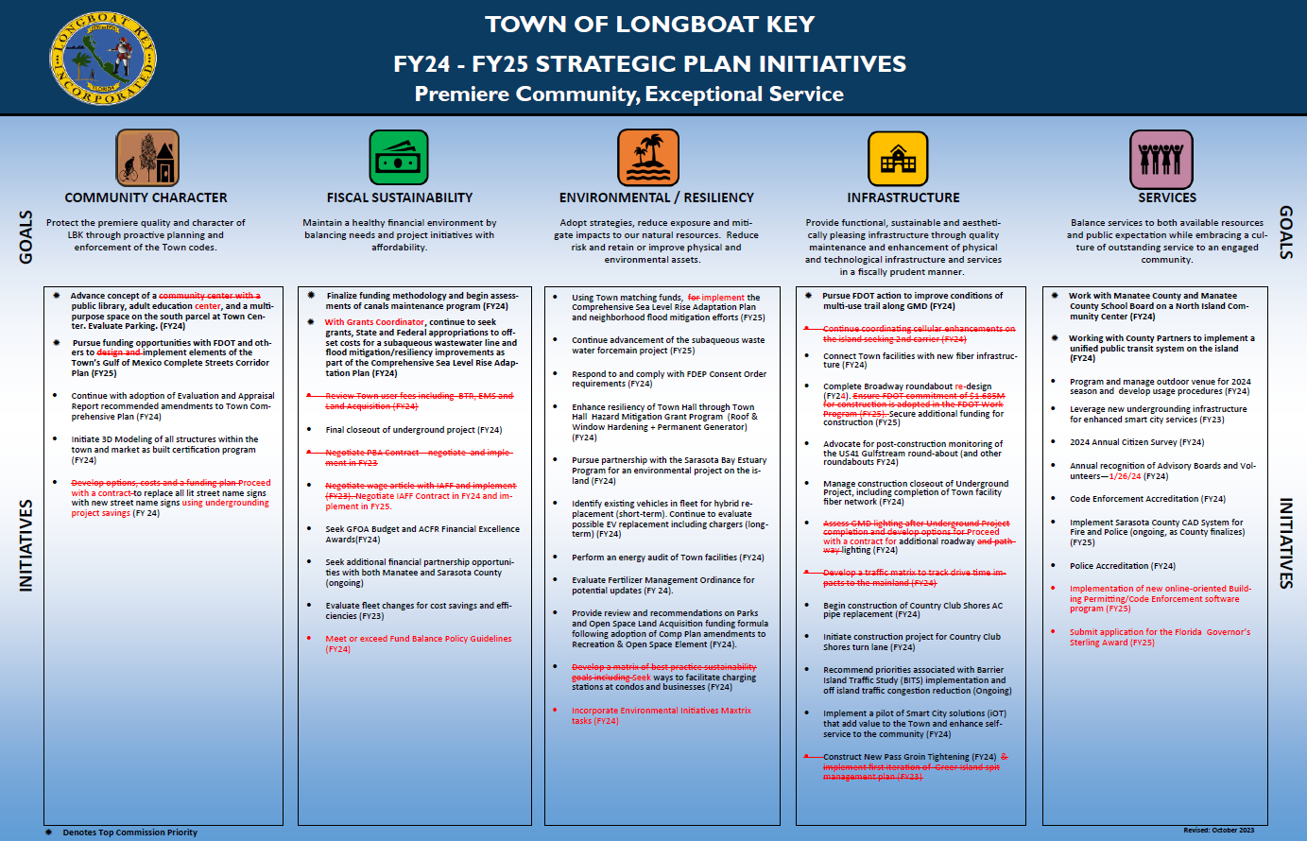
#2

Slide 12
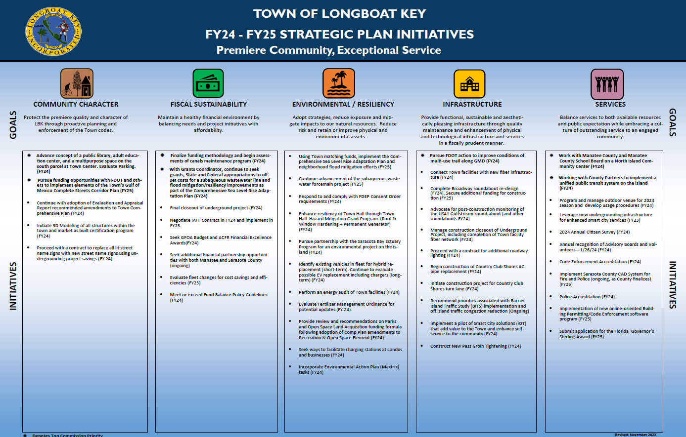
#2

Slide 13
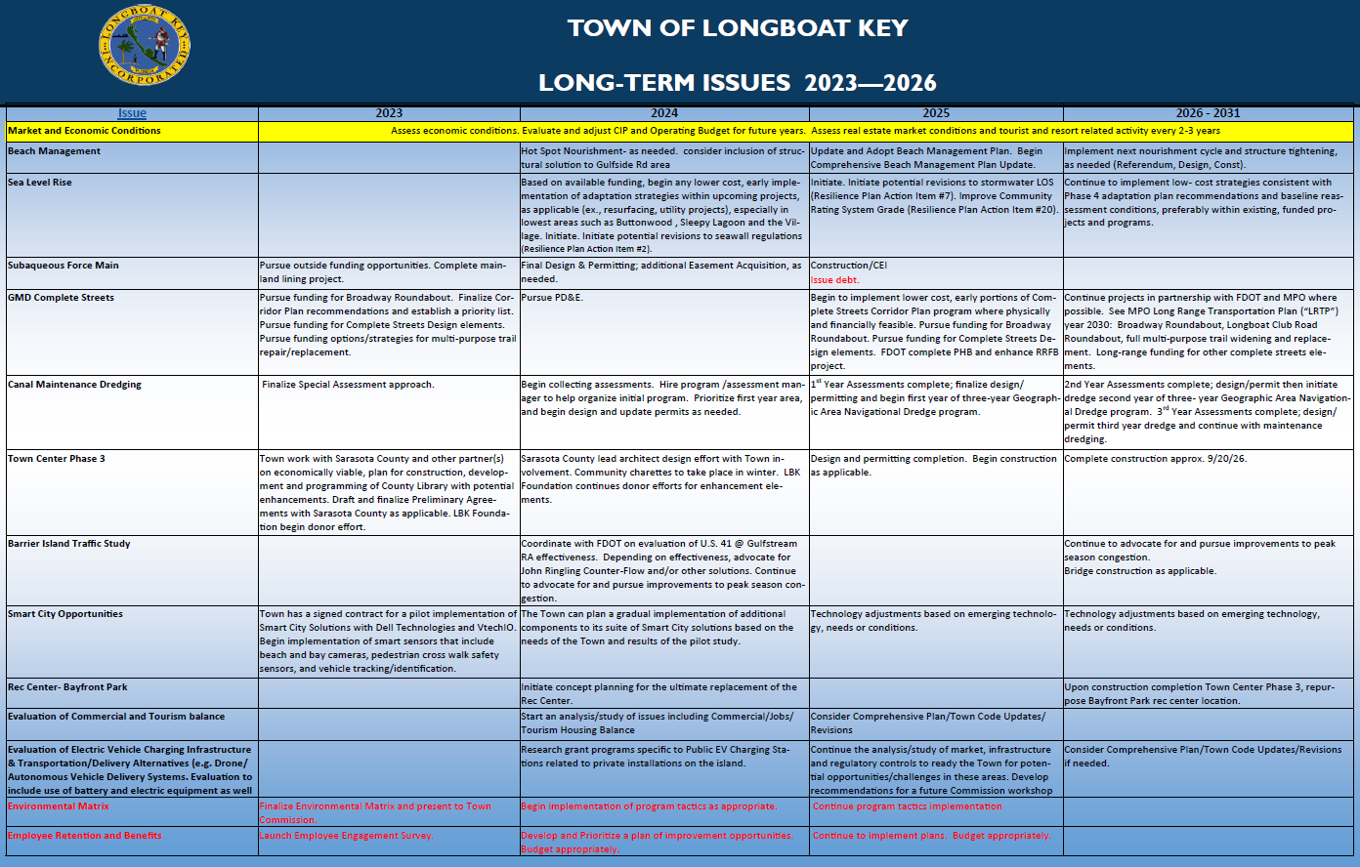
Long-Term Issues

Slide 14
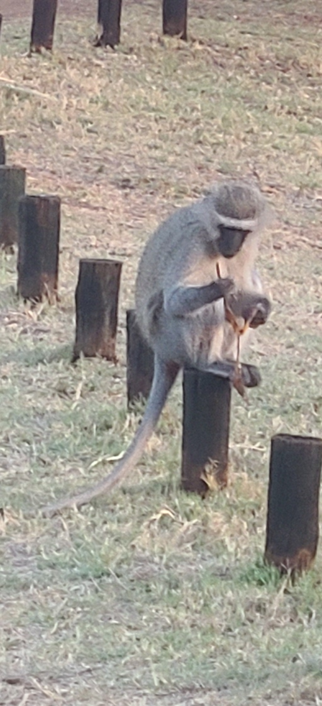
#6
General Updates

Slide 15
General Updates
Canal Dredge
Town Center
Phase 3 Dog Park
Rec Center Design
Complete Streets
  Broadway Roundabout
  Country Club Shores Turn Lane
GMD Repaving & Sidewalks
Subaqueous
Beach Evaluation
Transit
Local Bill – ’24 Legislative Session

Slide 16
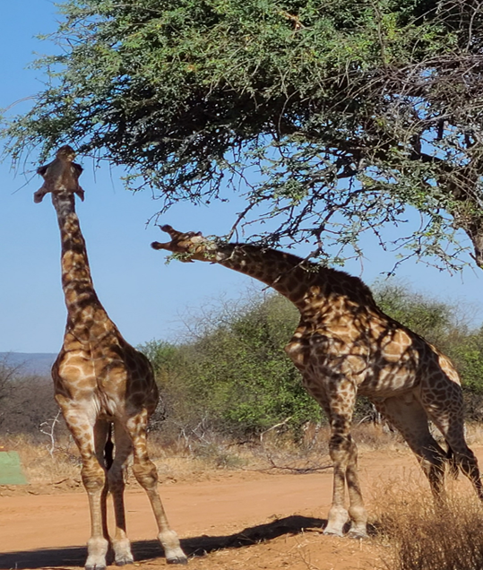
#7
Budget Highlights, Capital Plan Initiatives and Grants

Slide 17
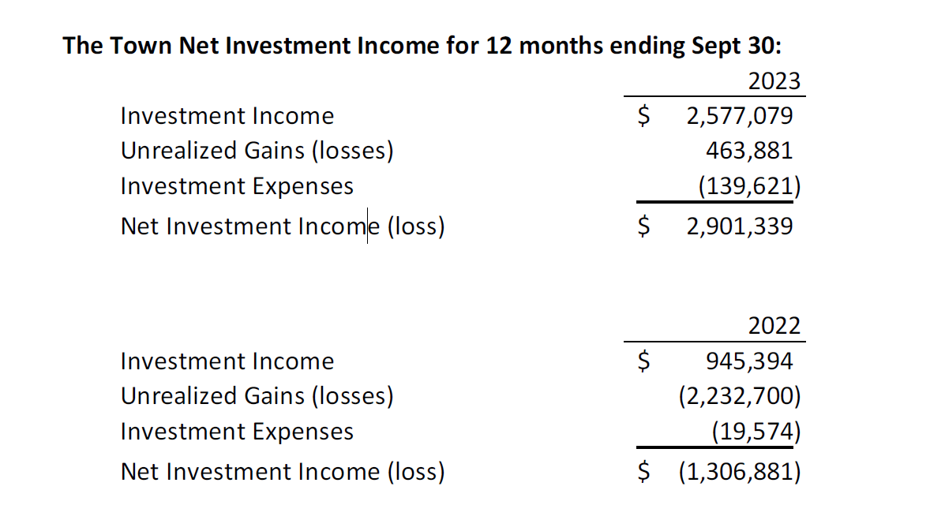
FY23 Preliminary Projection
FEMA Reimbursement for Ian
Investment Income – 10 rate hikes since March 2022
Sales Tax driven by inflation and economy
FPL Franchise up due to rate increases and increase in consumption
FY23 Revenue projected surplus $2.1 Million.
FY23 Expenditures surplus $600,000-$700,000.
Total $2.7 -$2.8 million addition to Fund Balance.

Slide 18
FY24 Budget Highlights
Revenues:
July 1 Certified Real Estate Values - 13.11% increase from FY23 - $8,353,979,772 Taxable Value
$1,580,016 in new Ad Valorem Revenue using a mill rate of 1.9600
$1,040,261 in new Non Ad Valorem Revenue
Sales taxes and Franchise fees expected to remain elevated due to economic activity and inflation
Investment income to remain stable with Feds expected to reduce rates once inflation is under control
Operating Expenditures:
Total Operating Expense Budget of $20,595,614
Wages and Benefits approximately 81.5% of Operating Budget
Fire (IAFF) and Police (PBA) Contracts Ratified
General Employees Merit increases have been applied
7 New Positions (2.3 FTE’s paid outside of General Fund)
Health Insurance, Pension and FRS Contribution increases

Slide 19
Capital Plan Initiatives
Initiatives include:
  Sea Level Rise
    Stormwater Management
    Drainage Improvements
    Road Improvements
  Traffic calming circles
  Broadway Roundabout
  Future Pathway lighting and Street lighting
  Building Permitting and Planning Software and implementation (Accela)
  Asbestos Pipe Replacement and Subaqueous Force Main Replacement
  Town Hall hardening – Roof, Windows and Generator
  Technology enhancements and smart city initiatives
  Station 91 Roof
  Boardwalk replacement
  Recreation Center Concept planning
  Canal Assessment Program

Slide 20
Grant Funding

Slide 21
Grants
Sea Level Rise/Flood Mitigation:
Sea Level Rise Study – Resilient Florida Program -Received $131,289 (FY22/FY23)
Norton Street Design – Awarded $350,000/$117,000 Match (FY24)
Resilient Florida Grant Program - Sleepy Lagoon - Applied for $3,360,000/$1,680,000 Match (FY24)
FDEM HMGP Villages - Applied $2,100,000/$700,000 Match
FDEM HMGP Sleepy Lagoon - Applied $1,016,137/$338,712 Match
FDEM HMGP Buttonwood - Applied $2,726,695/$908,899 Match
Subaqueous Force Main:
Statewide Surface Restoration and Wastewater Projects – Received $2,090,050 (FY23)
FY23 Federal Omnibus through EPA Community Grants -$3,000,000 Award (FY23)
Asbestos Cement Pipe Country Club Shores:
FDEP FY24 Legislative Appropriation – Awarded $1,541,985/Match $4,900,000 (FY24)
Broadway Roundabout:
Manatee County (1/2 Design up to $150,000) – Received $136,933 (FY23)
Cybersecurity:
Local Government Cybersecurity Grant – Received $18,664 (FY23)

Slide 22
Grants continued…
Town Center:
Karon Family Pavilion – Received $500,000 (FY23)
Longboat Key Foundation – Received $309,654 (FY23) -Pending $51,082 (FY24)
Beach:
Beach Management Funding Assistance Program – Received $244,346 (FY23)
Florida Coastal Management Program – Dunes Walkway - Applied for $30,000 (FY24)
Applications submitted FY24 and FY25 – Ranking #5 FY24
FEMA Storm Recovery:
Storm Ian –Cat A Debris Removal - Received $510,105
Storm Ian – Cat B In Process - $112,810 under review
Storm Idalia – Cat B In Process
Storm IRMA – HMGP Town Hall Hardening/Generator Project – Awarded $1,222,195/$455,258 match (FY24)
Public Safety:
Police Accreditation - Received $274,850 (FY22-FY24)
WCIND Police – Award $108,579 (FY23) Pending $108,579 (FY24)
Firehouse Subs Foundation – Received $39,295 Extrication Equipment (FY23)
FDLE JAG Grant – Police Projector $1,000 (FY24)
FDLE (Manatee County) – Rapid ID Scanners $11,492 (FY24)
FDLE Soft Body Armor – Applied $20,256 (FY24)

Slide 23
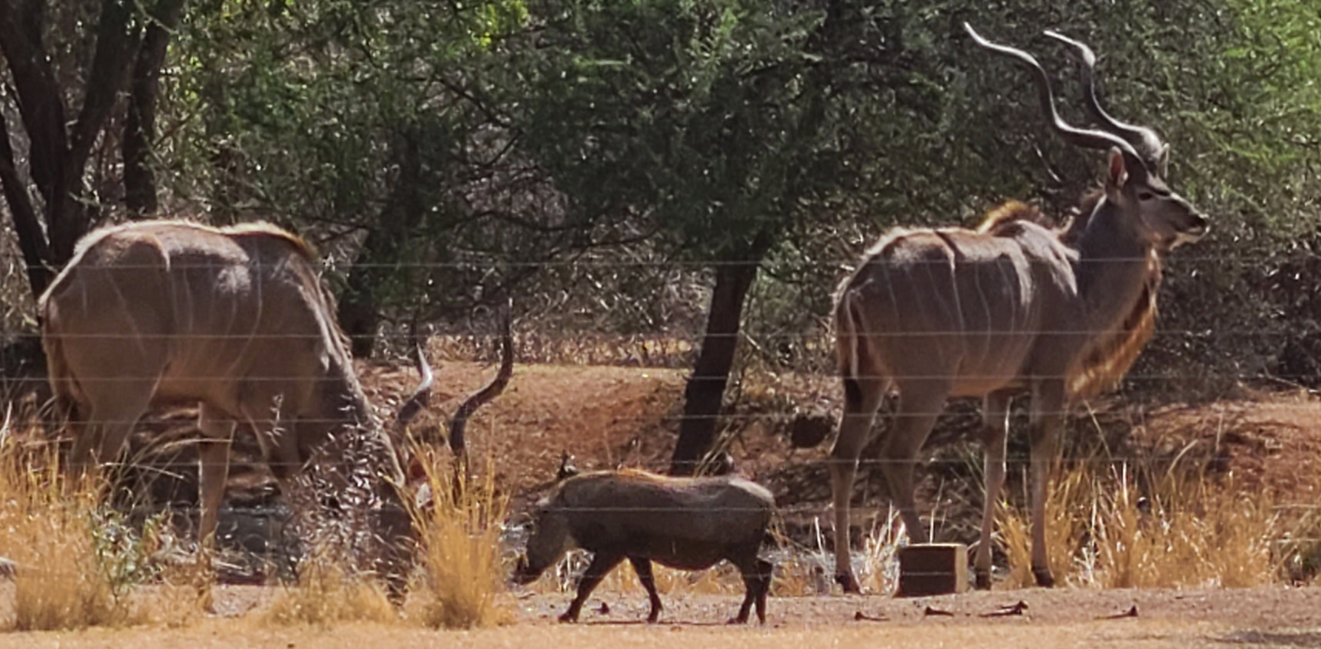
#8
Discussion and Direction

Slide 24
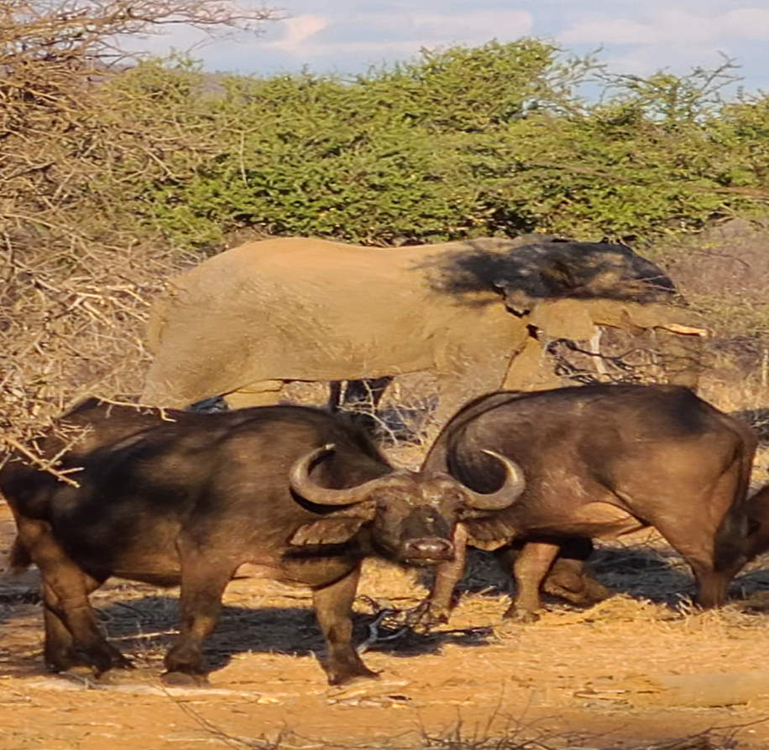
#9
Next Steps

Slide 25
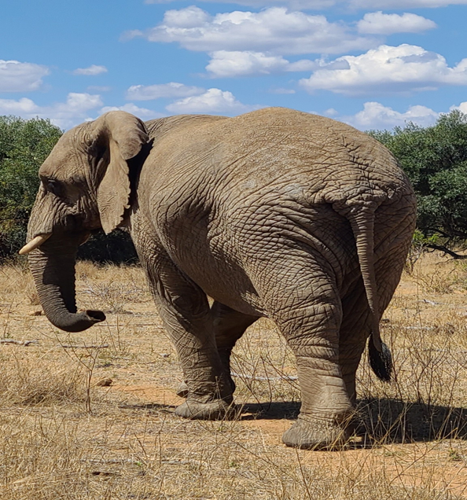
Thank You! – The End!

