Slide 1

Town of Longboat Key Presentation
March 11, 2025

Slide 2
Thank you for the invitation, Tess!
Agenda
Beaches & Canals
Transportation Projects
Town Center Green
Other Resiliency Initiatives
Post-Storm Recovery
Q&A
“Premier Community, Exceptional Service.”

Slide 3
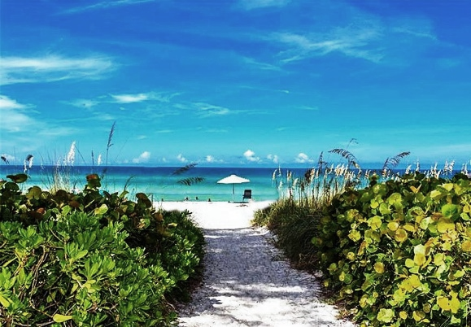
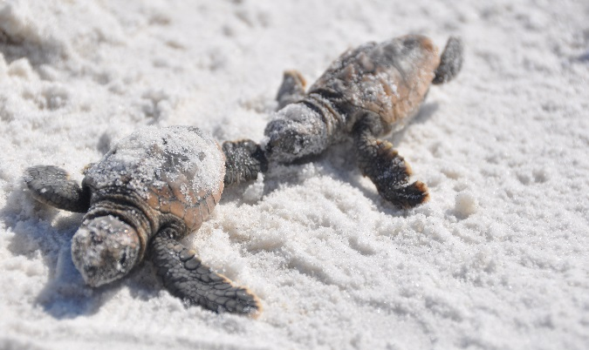
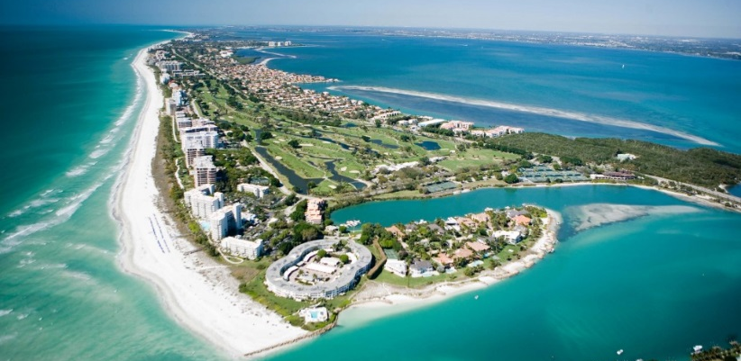
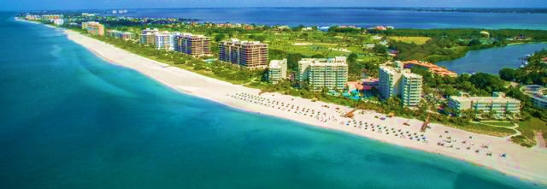
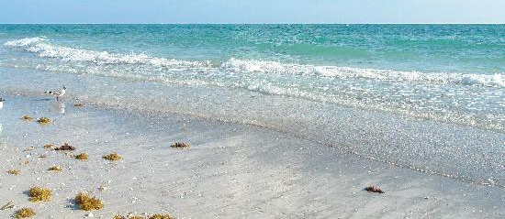
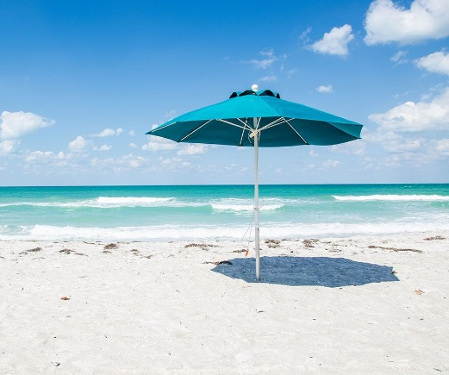
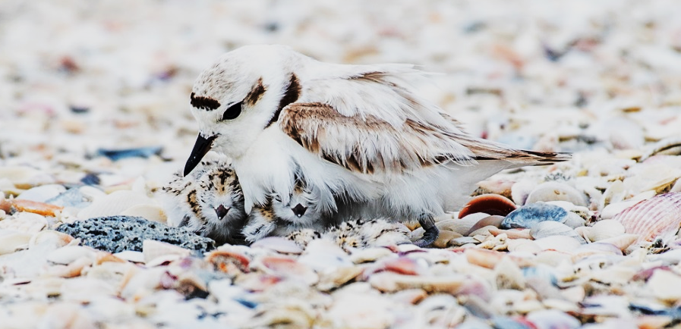
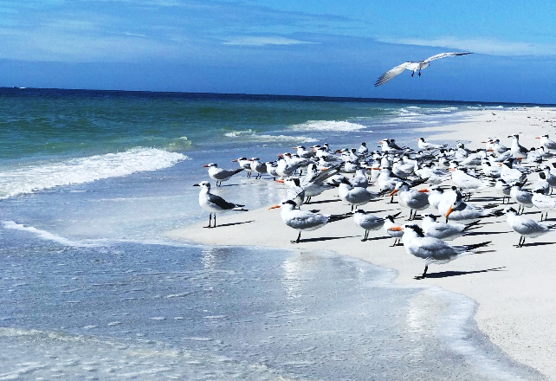
Quality of Life, Values on Longboat Key

Slide 4
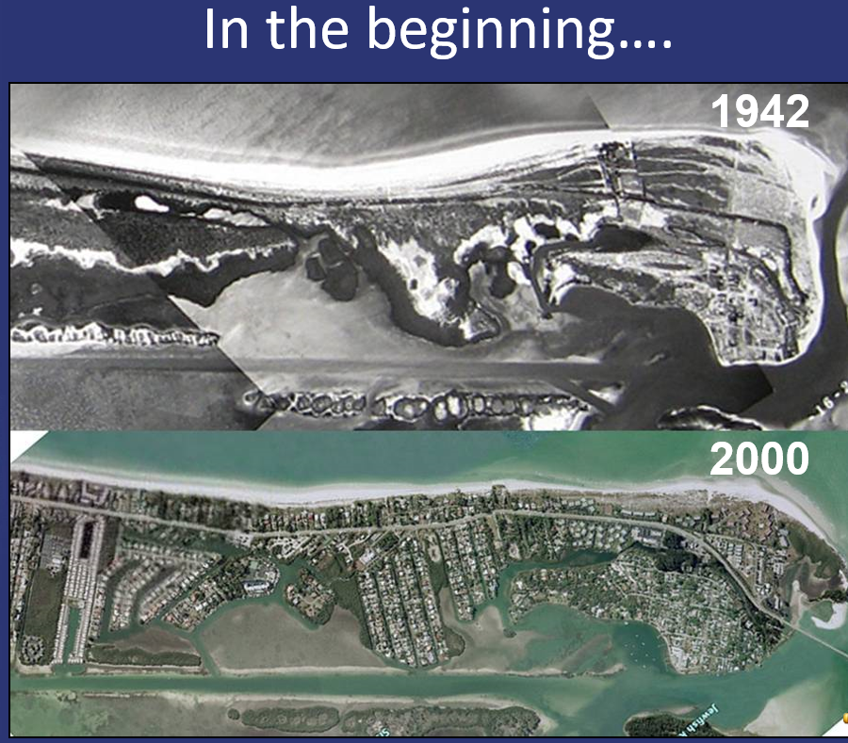
Beach History of Longboat Key

Slide 5
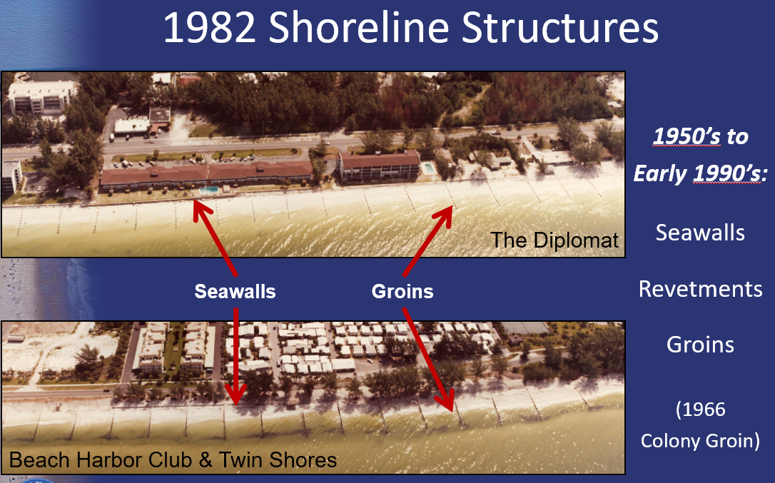
Beach History of Longboat Key

Slide 6
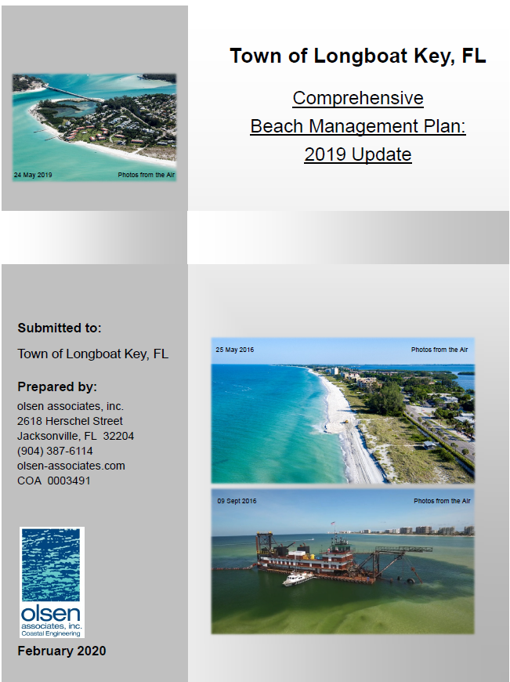
Beach History of Longboat Key
Town Adopted New Approach:
Comprehensive Beach Management Plan
  Establishment resulted in 1st Nourishment around 1993
  Recognizes Town is net erosional over time
  Mining operation with engineered beach within
  6 to 8-year nourishment cycles
  Addresses “Supply and Demand” for sand along 10-mile shoreline.
Includes Two Beach Districts:
  “District A” – All Properties from Gulf of Mexico Drive west; also including all commercial properties located on either side of Gulf of Mexico Drive.
  “District B” – All other property.
  Cost coverage at 80% / 20%, or 100% / 0%.

Slide 7
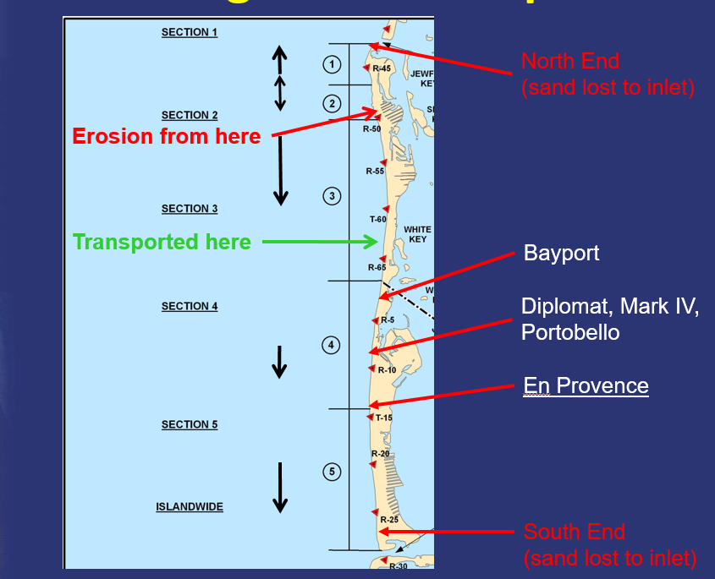
Sand Moves: Along Shore Transport

Slide 8
“Equilibration”
EXAMPLE PROJECT
olsen associates, inc.

Slide 9
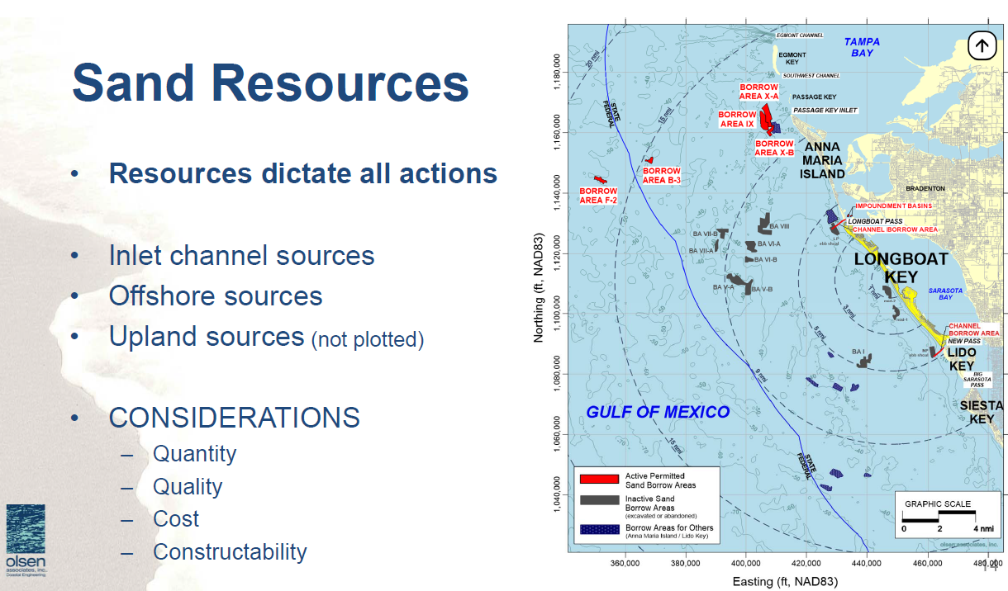
Sand Resources: Mining Operation

Slide 10
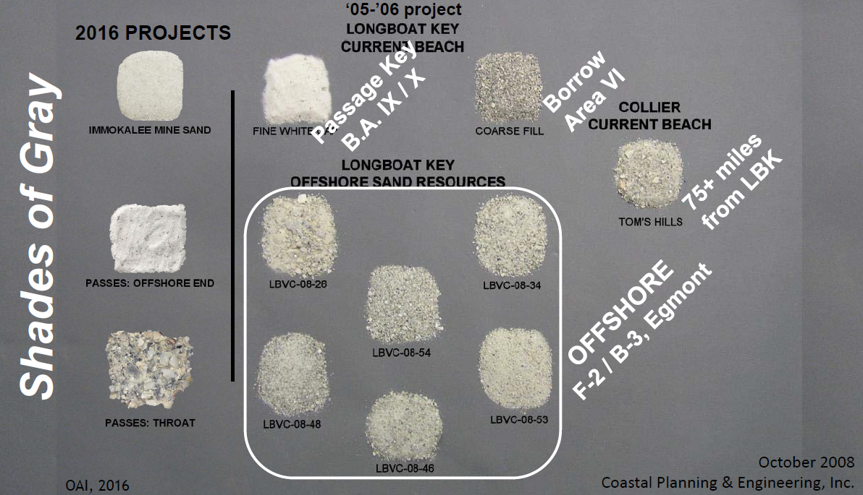
Sand Resources: Quality of Beach Sand

Slide 11
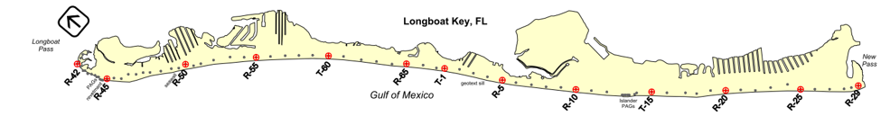
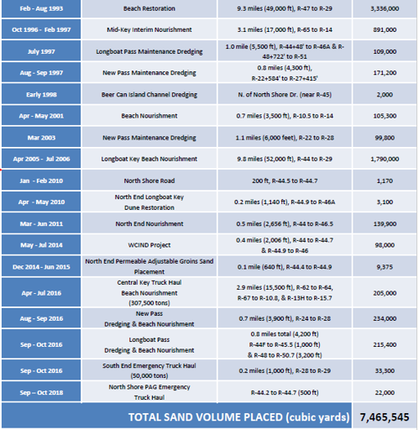
Beach Project History of Longboat Key
2021 Effort
Feb – Sept 2021 | North End Structures and Hotspot Nourishment | North, Central, and South 5+ Miles | 750,000
Mar – Apr 2021 | Gulfside Segment Longboat Pass | South Whitney to Gulfside | 76,000
Apr – Jul 2021 | South Segment and New Pass | Tie Segment 3 to New Pass | 180,000
Total from Past Effort = 7,465,645 CY Overall Total W/ Recent Work = |  |  | 8,471,545 Cubic Yards
2023 Greer Island = 25K CY to North End
2024 Gulfside RD = 80K CY from Longboat Pass

Slide 12
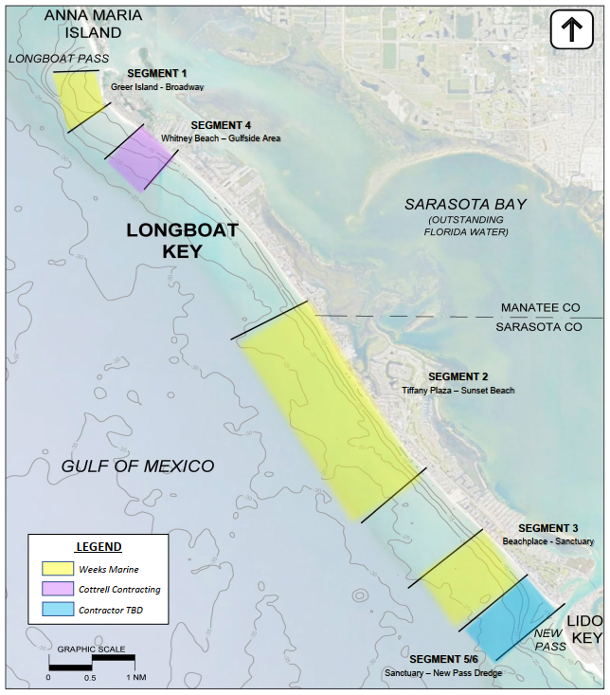
2021 Beach Projects: How and the Cost
N. End (Segment 1) Sand Source Changed to Passage Key
  Included 5-Rock/Stone Structures
  Added Segments 2 and 3
  One Big Project with Weeks Marine
Manatee County Started Longboat Pass
  Sole Source Contract with Cottrell to Complete Gulfside
Delay in Cottrell follow-on project
  Sole Source Contract with Cottrell to Complete New Pass
Weeks Contract = $31,017,220.00
$6,450,000.00 for N. End Structure Construction
$24,567,220.00 for sand placement = $32.75 per CY
Cottrell Contracts (2) = $5,045,994.00
Sand Placement = $19.71 per CY
$29.44 overall weighted average per CY

Slide 13
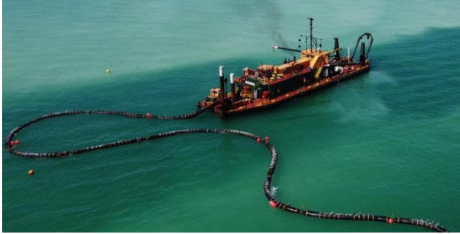
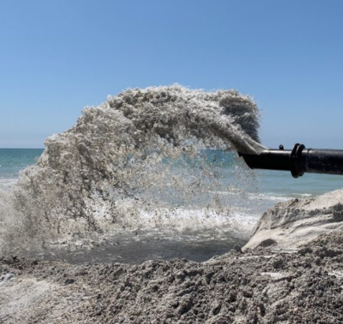
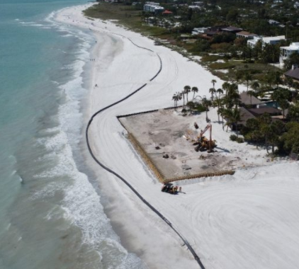
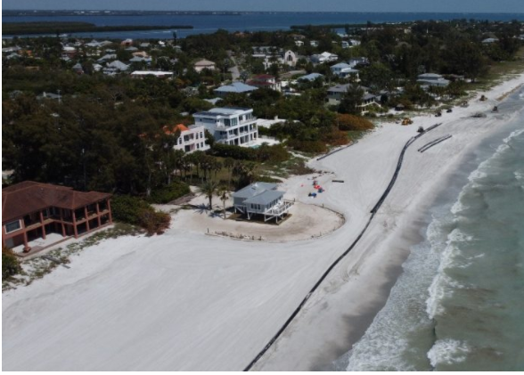
2021 Project: Gulfside Rd. area (Longboat Pass)

Slide 14
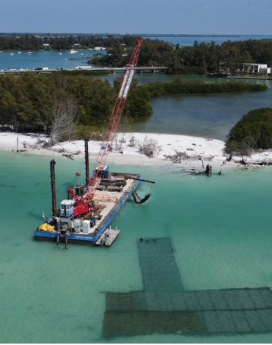
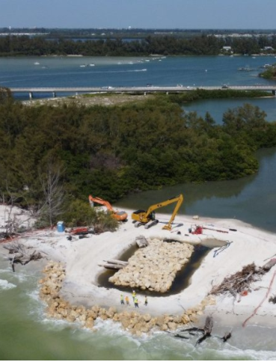
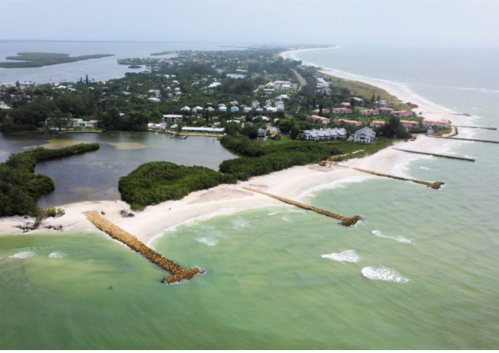
2021 Project: Five (5) North End Rock Structures

Slide 15
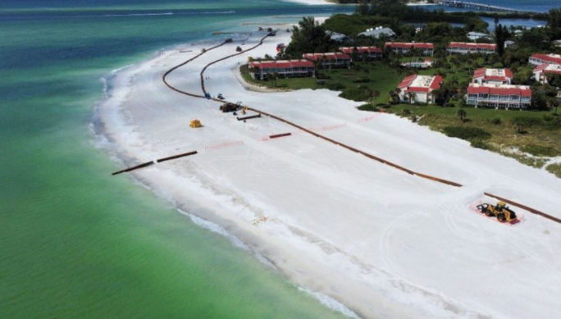
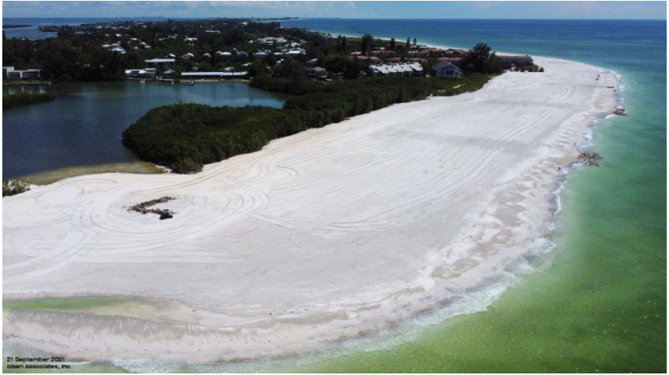
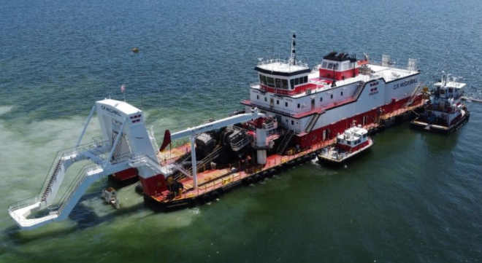
2021 Project: North End (Passage Key)

Slide 16
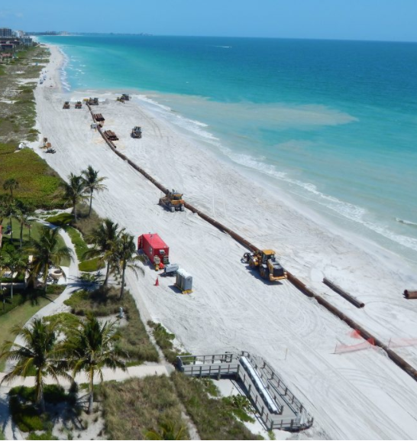
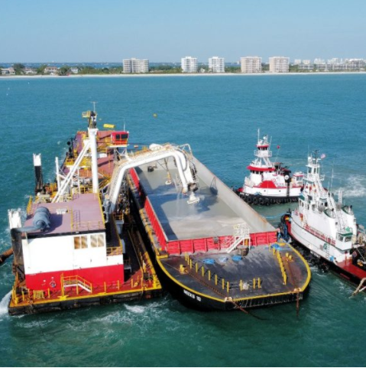
2021 Project: Mid Island (Passage Key)

Slide 17
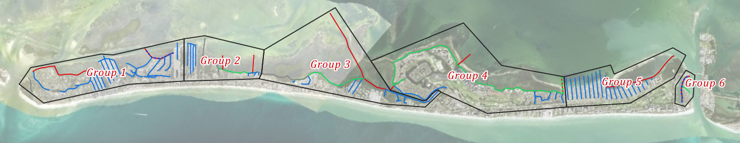
Canal Dredging of Longboat Key
Canals: Town $$$ Enigma
Recognizes boating accessibility as an island amenity. Question has been how to fund it.
1990s Discussion how to fund and implement a canal navigation maintenance program (dredge)
2003 was last major canal dredge project on Longboat Key (31 canals using General Fund dollars).
2016 – 2018 Town Commission re-engaged conversation and received poor advice that all canals requiring dredging could be done for about $1 million (14 canals)
2020 – 2025 actual current initial program estimate $9 million. Seagrass mitigation ~$3 million alone.

Slide 18
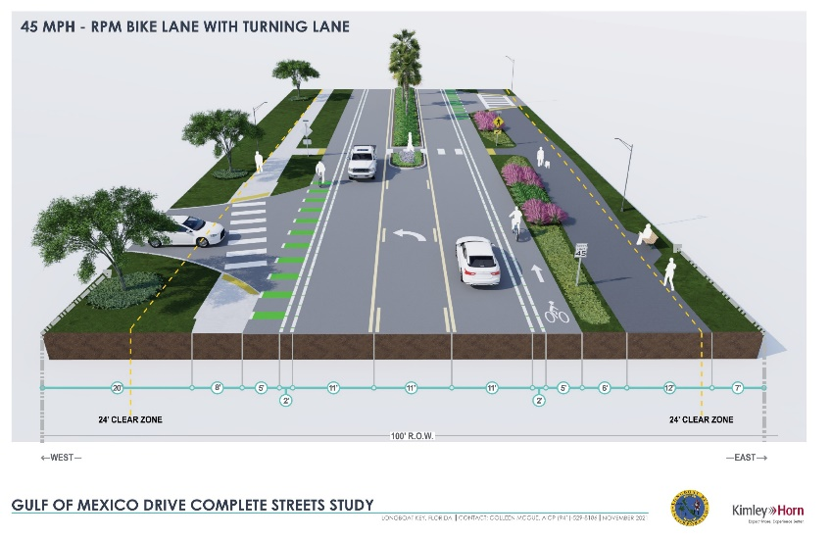
On-Island Transportation Projects
Country Club Shores Left-Turn Lane Project
12 mini southbound to eastbound left-turn lanes
10-foot wide left-turn lane, 6-foot wide bike lanes,
5-curbed landscape medians
Construction started February 2025 with
Superior Asphalt.
Construction funded by Florida Department of Transportation (“FDOT”) for $2.6 million.
Residents concerned by curbed medians for
exiting traffic

Slide 19
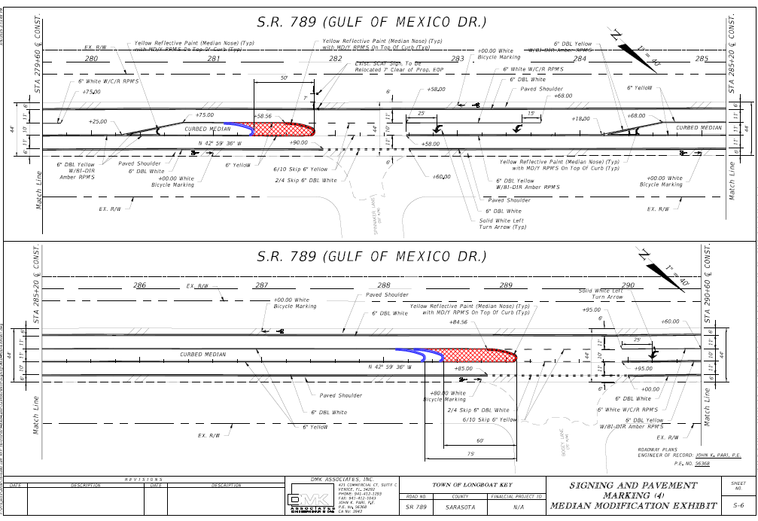
On-Island Transportation Projects

Slide 20
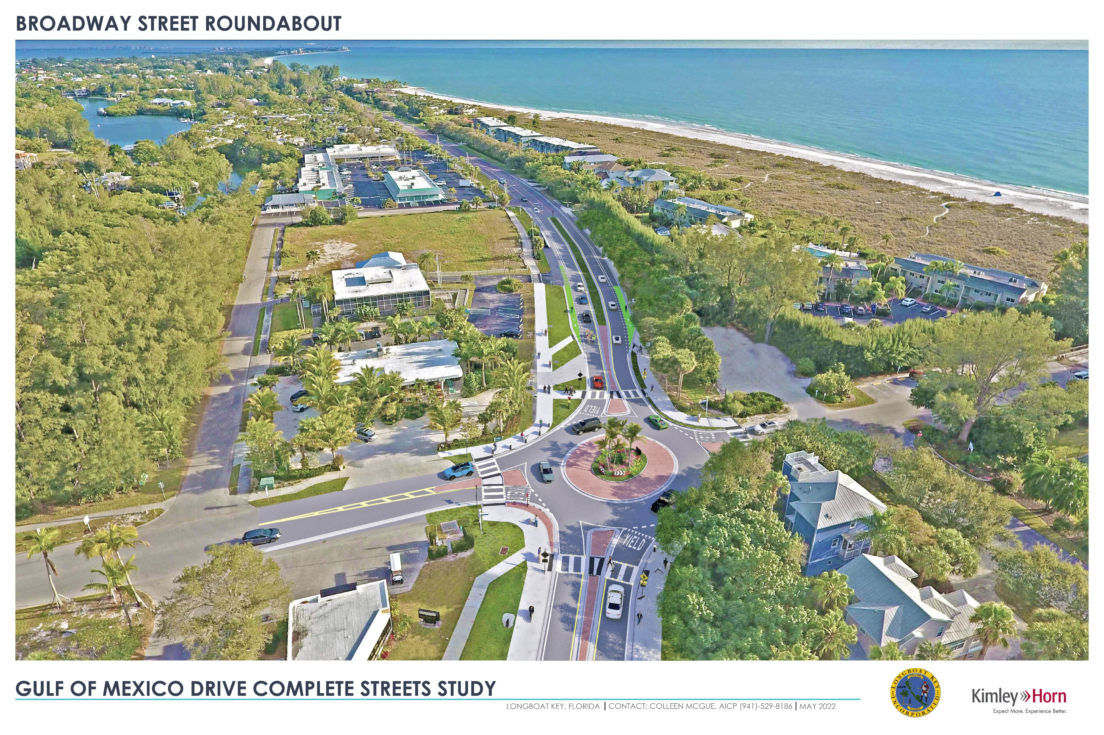
On-Island Transportation Projects
Broadway at Gulf of Mexico Dr. Roundabout
Started 2018 with “PD&E” and proceeded to design
April 2023: FDOT effectively “shut down”
the Town design and required Town to pivot
Re-engaged on a redesign that requires road reconstruction and elevation
Project construction went from $2.5 million to
about $6 million
FDOT has agreed to fund the majority of construction of the new project. Amendments in progress.
Start of construction planned for mid-2026.

Slide 21
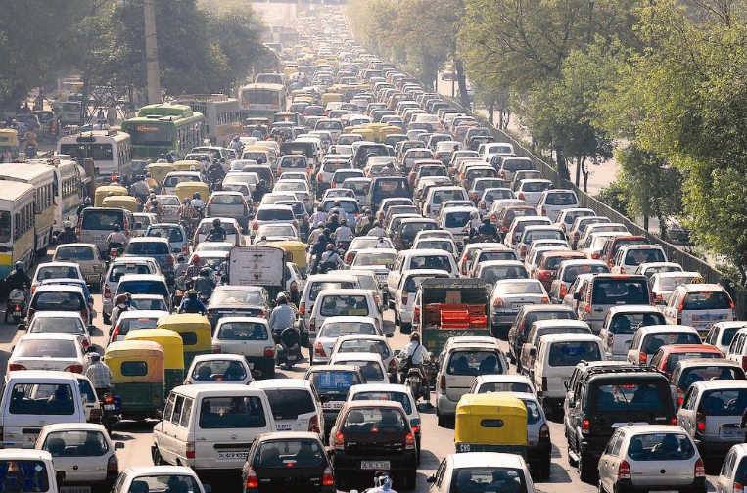
Off-Island Transportation
https://onthiielts.com.vn

Slide 22
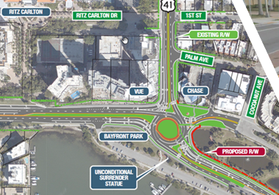
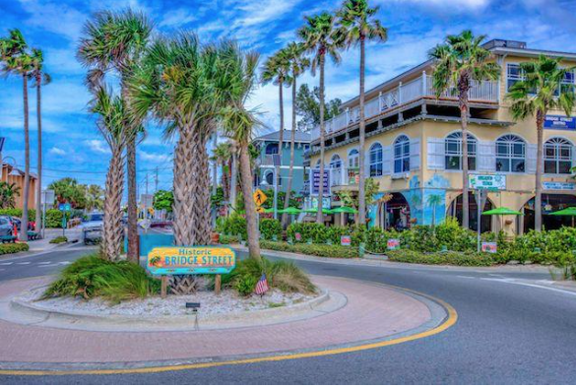
Mainland Access and Transportation Planning
  Transportation Planning and Coordination
  Florida Department of Transportation (“FDOT”)
  City of Sarasota, Bradenton Beach, Manatee and Sarasota Co.
  Sarasota-Manatee Metropolitan Planning Org. (“MPO”)
  “Peak Season Traffic Congestion!”
  Barrier Island Traffic Study (“BITS”) 2020
  Additional Flex Lane added to future bridge replacements (& Coon Key)
  Gulf Drive (SR 789) at Cortez Road (SR 684) intersection improvements
  Pedestrian Managers at St. Armand’s Circle (and Bridge Street)
  Water Taxis, multiple cities and county
  John Ringling Parkway Counter-Flow
  Pedestrian overpasses at U.S. 41
  “Beaches Full” Technology
https://annamariaislandcondorentals.com/experience-bridge-street-bradenton-beach-florida/

Slide 23
Mainland Access and Transportation Planning
  Transportation Planning and Coordination
  Florida Department of Transportation (“FDOT”)
  City of Sarasota, Bradenton Beach, Manatee and Sarasota Co.
  Sarasota-Manatee Metropolitan Planning Org. (“MPO”)
  “Peak Season Traffic Congestion!”
  Barrier Island Traffic Study (“BITS”) 2020
  Additional Flex Lane added to future bridge replacements (& Coon Key)
  Gulf Drive (SR 789) at Cortez Road (SR 684) intersection improvements
  Pedestrian Managers at St. Armand’s Circle (and Bridge Street)
  Water Taxis, multiple cities and county
  John Ringling Parkway Counter-Flow
  Pedestrian overpasses at U.S. 41
  “Beaches Full” Technology
https://annamariaislandcondorentals.com/experience-bridge-street-bradenton-beach-florida/

Slide 24
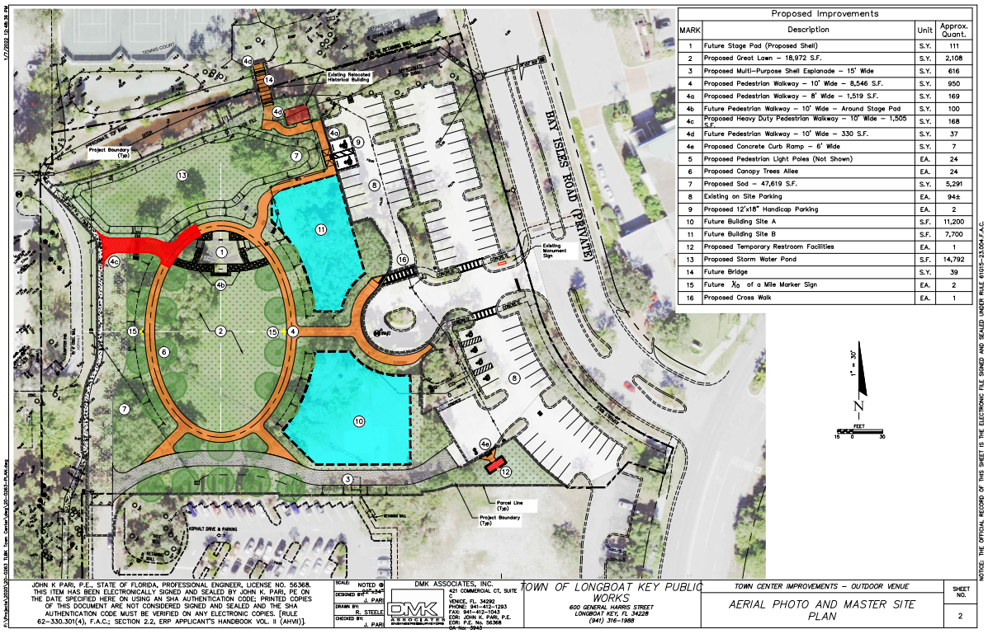
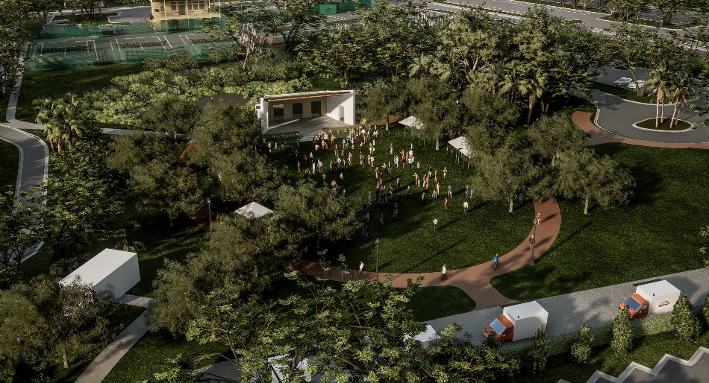
Town Center Green: 600 Bay Isles Road
Master Site Plan
2024 and 2017
Town bought: 4.81-acres
Land investment: $3.7M
2019 – 2023 began developing

Slide 25
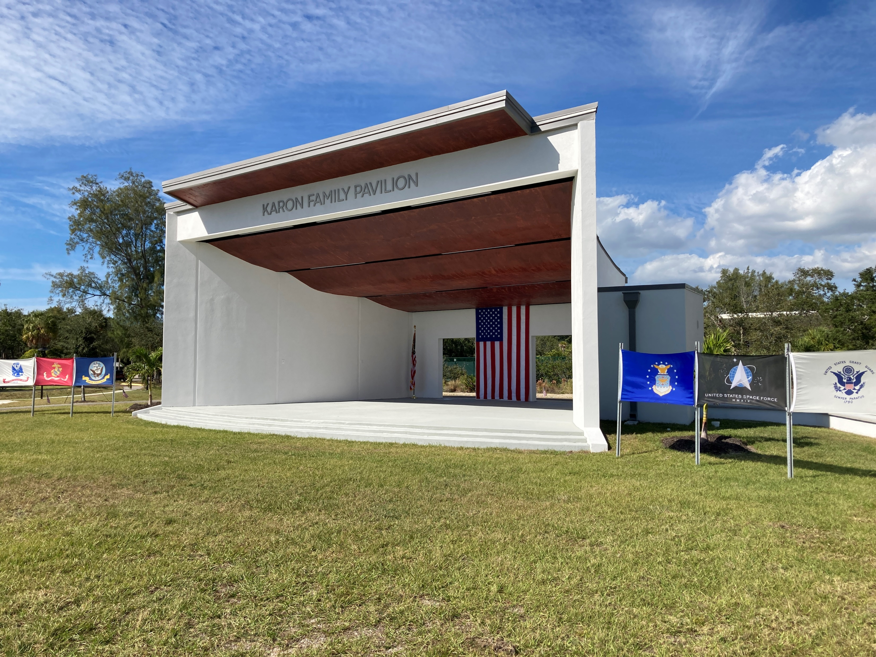
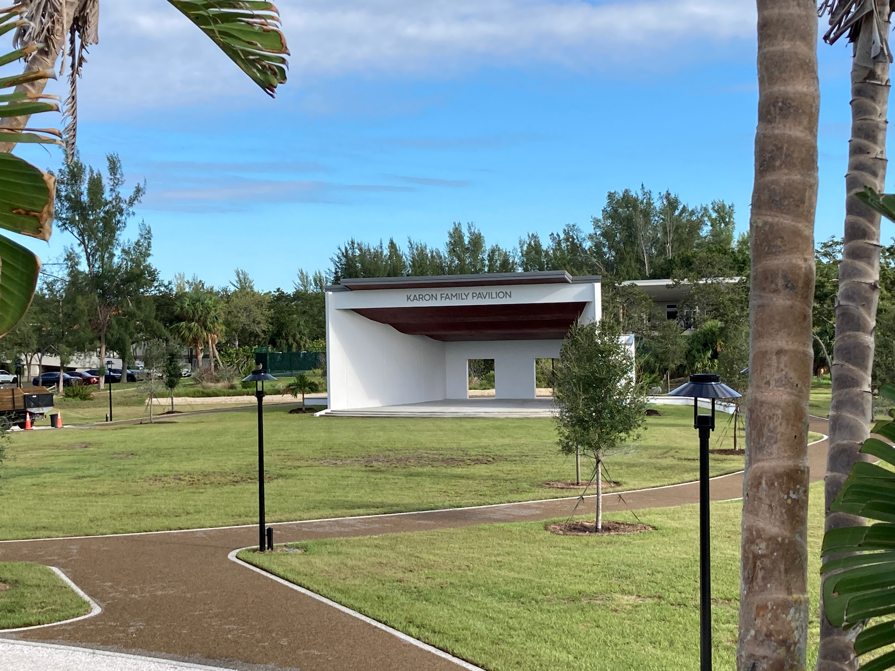
Town Center Green
Phase 2 Construction Complete!
Town plus private donor funding for Karon Family Pavilion
Total Construction Contract: $2,227,368.31
Veteran’s Day and Grand Opening Nov. 11, 2023

Slide 26

Town Center Green next phase:
Sarasota County Public Library/ Community Center
Subject Parcel

Slide 27
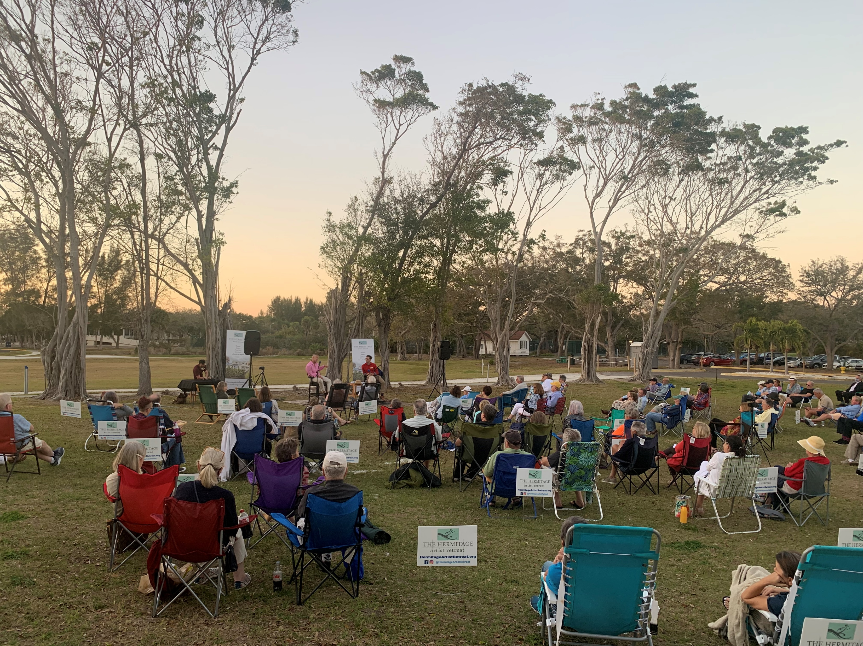
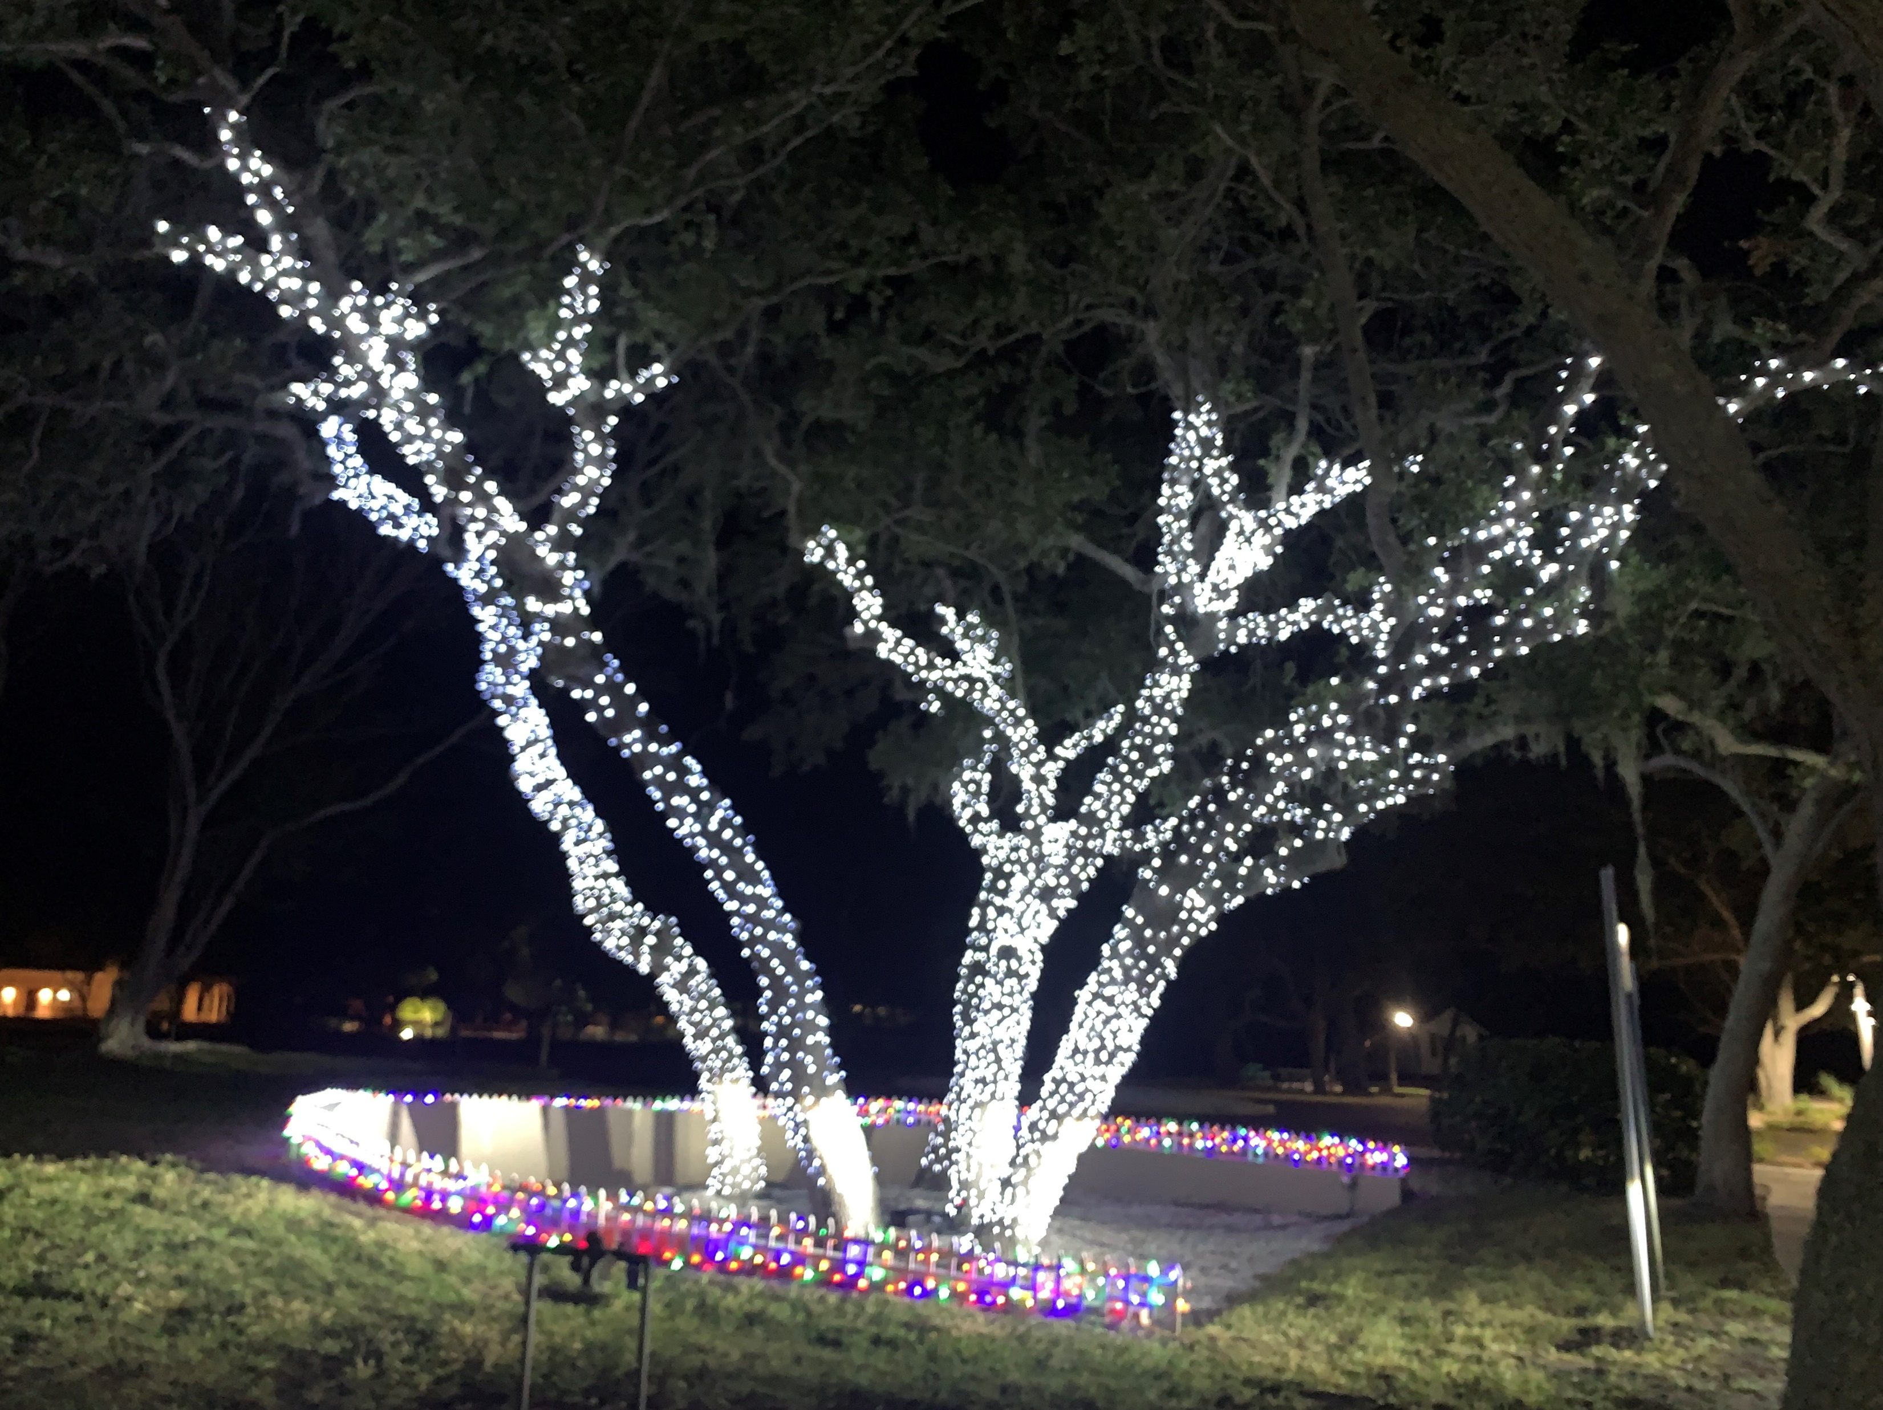
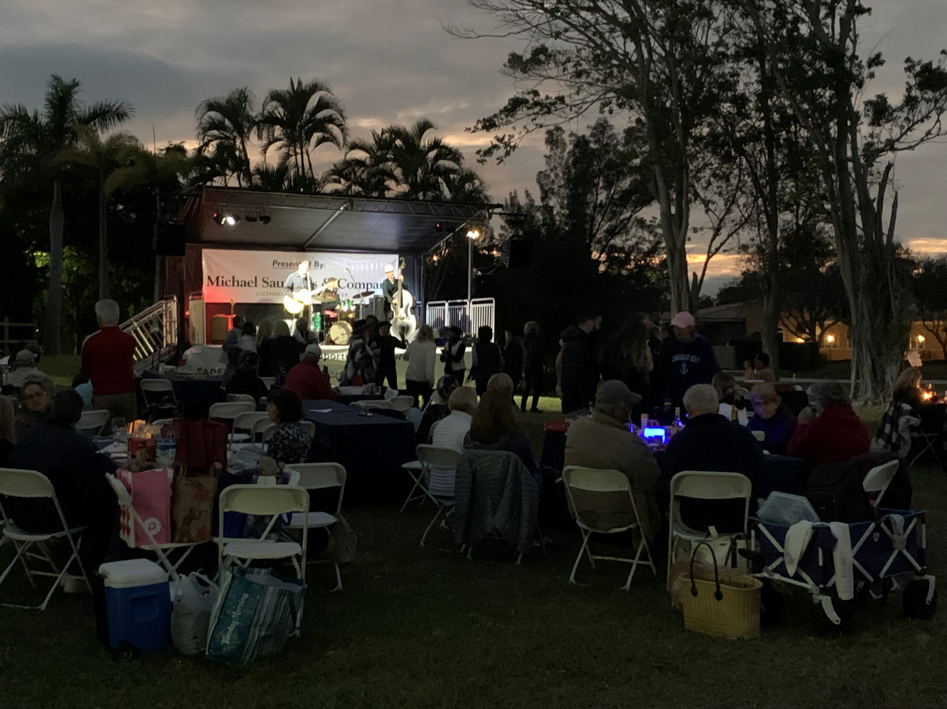
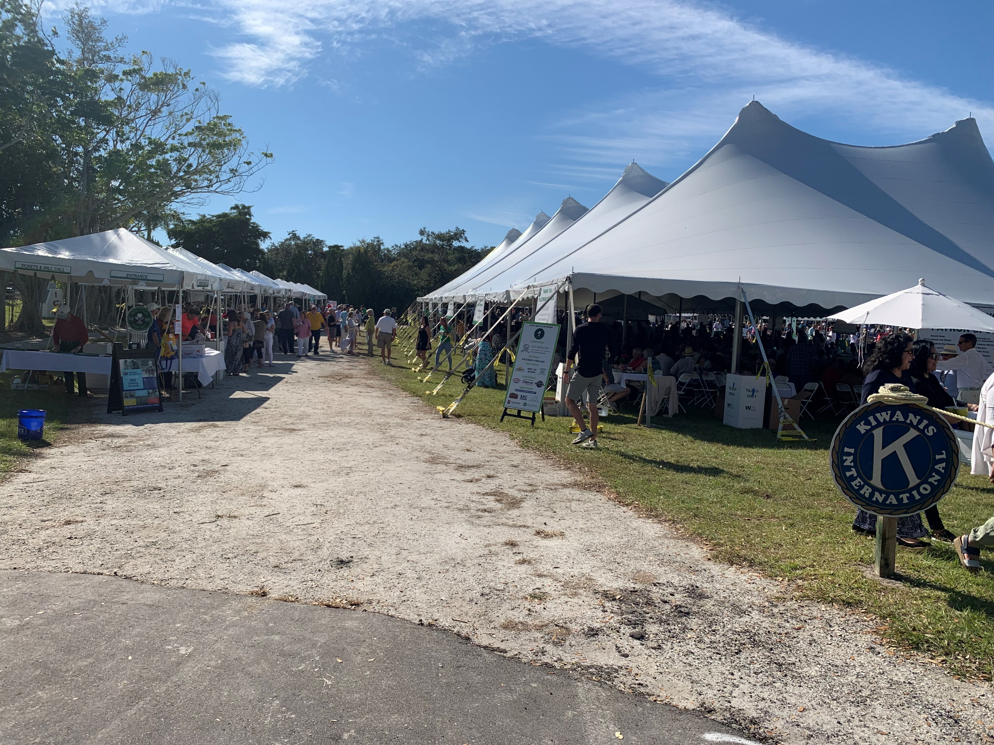

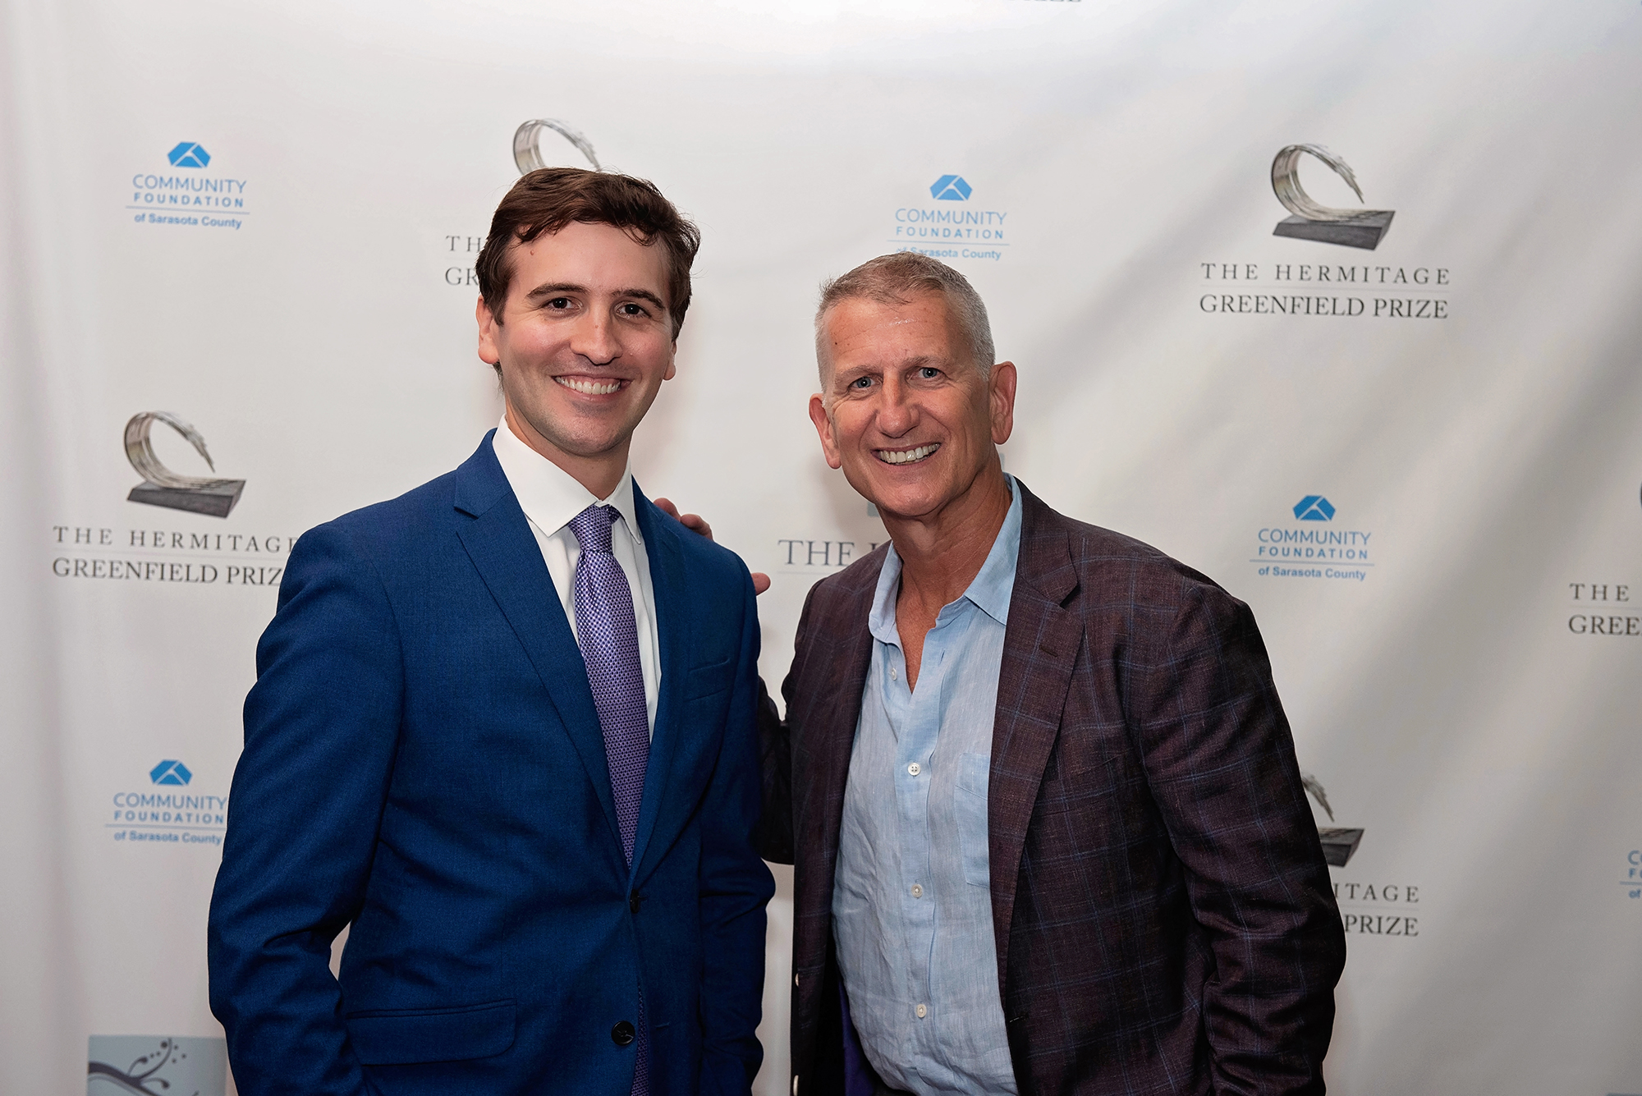
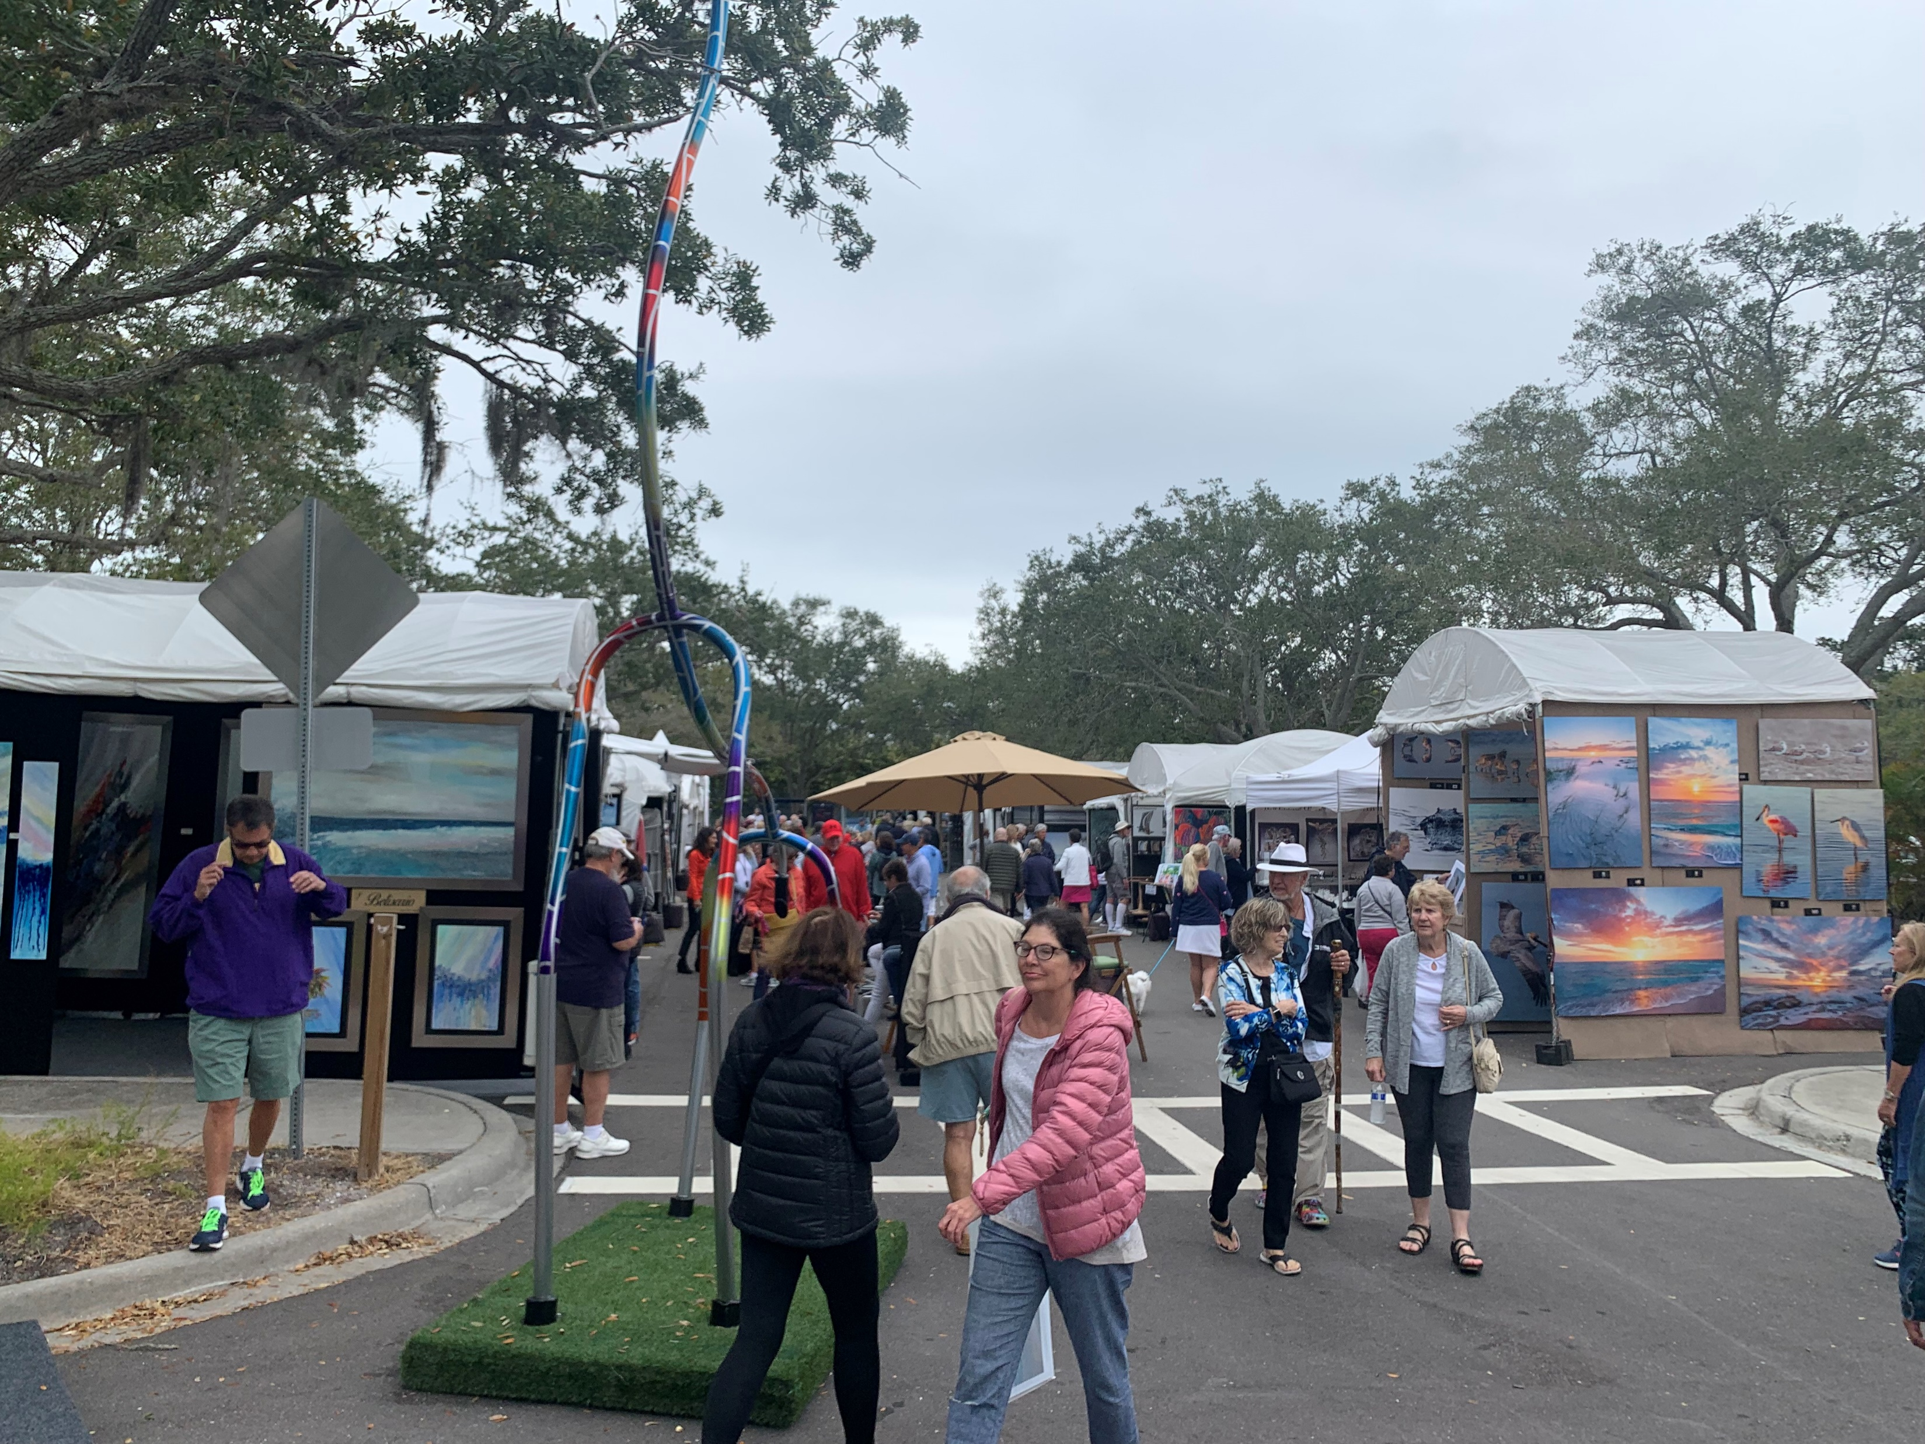
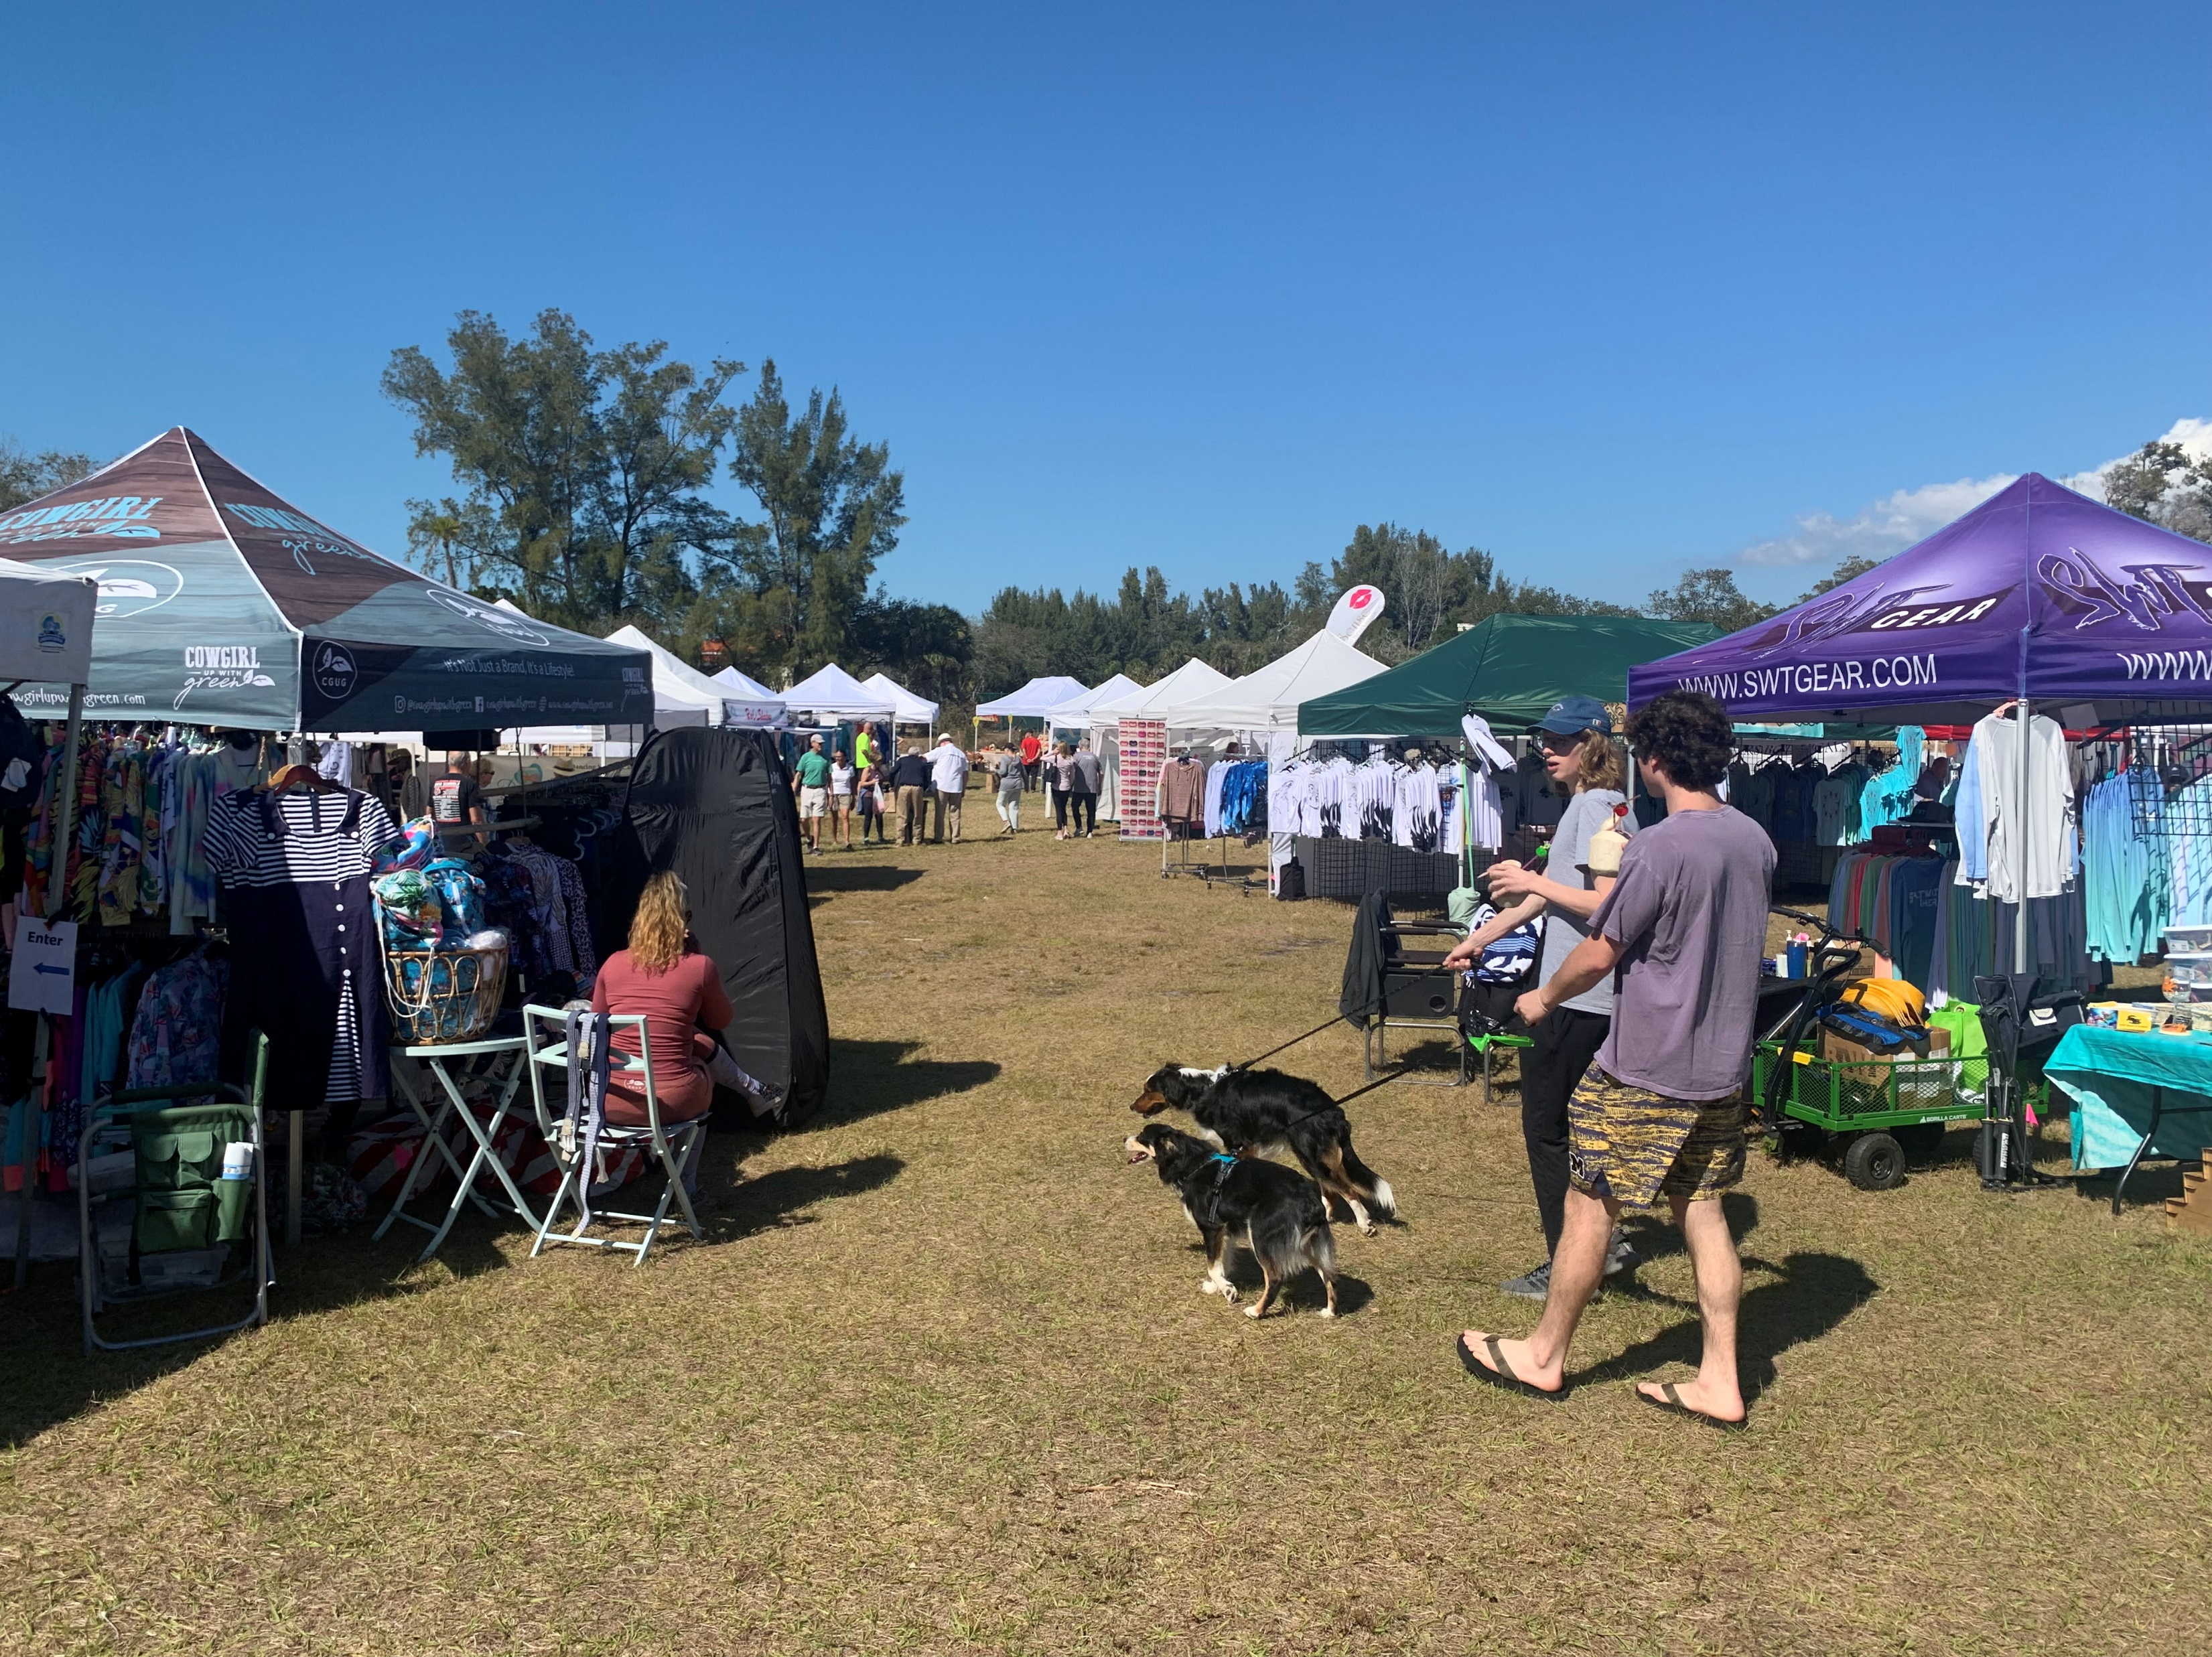
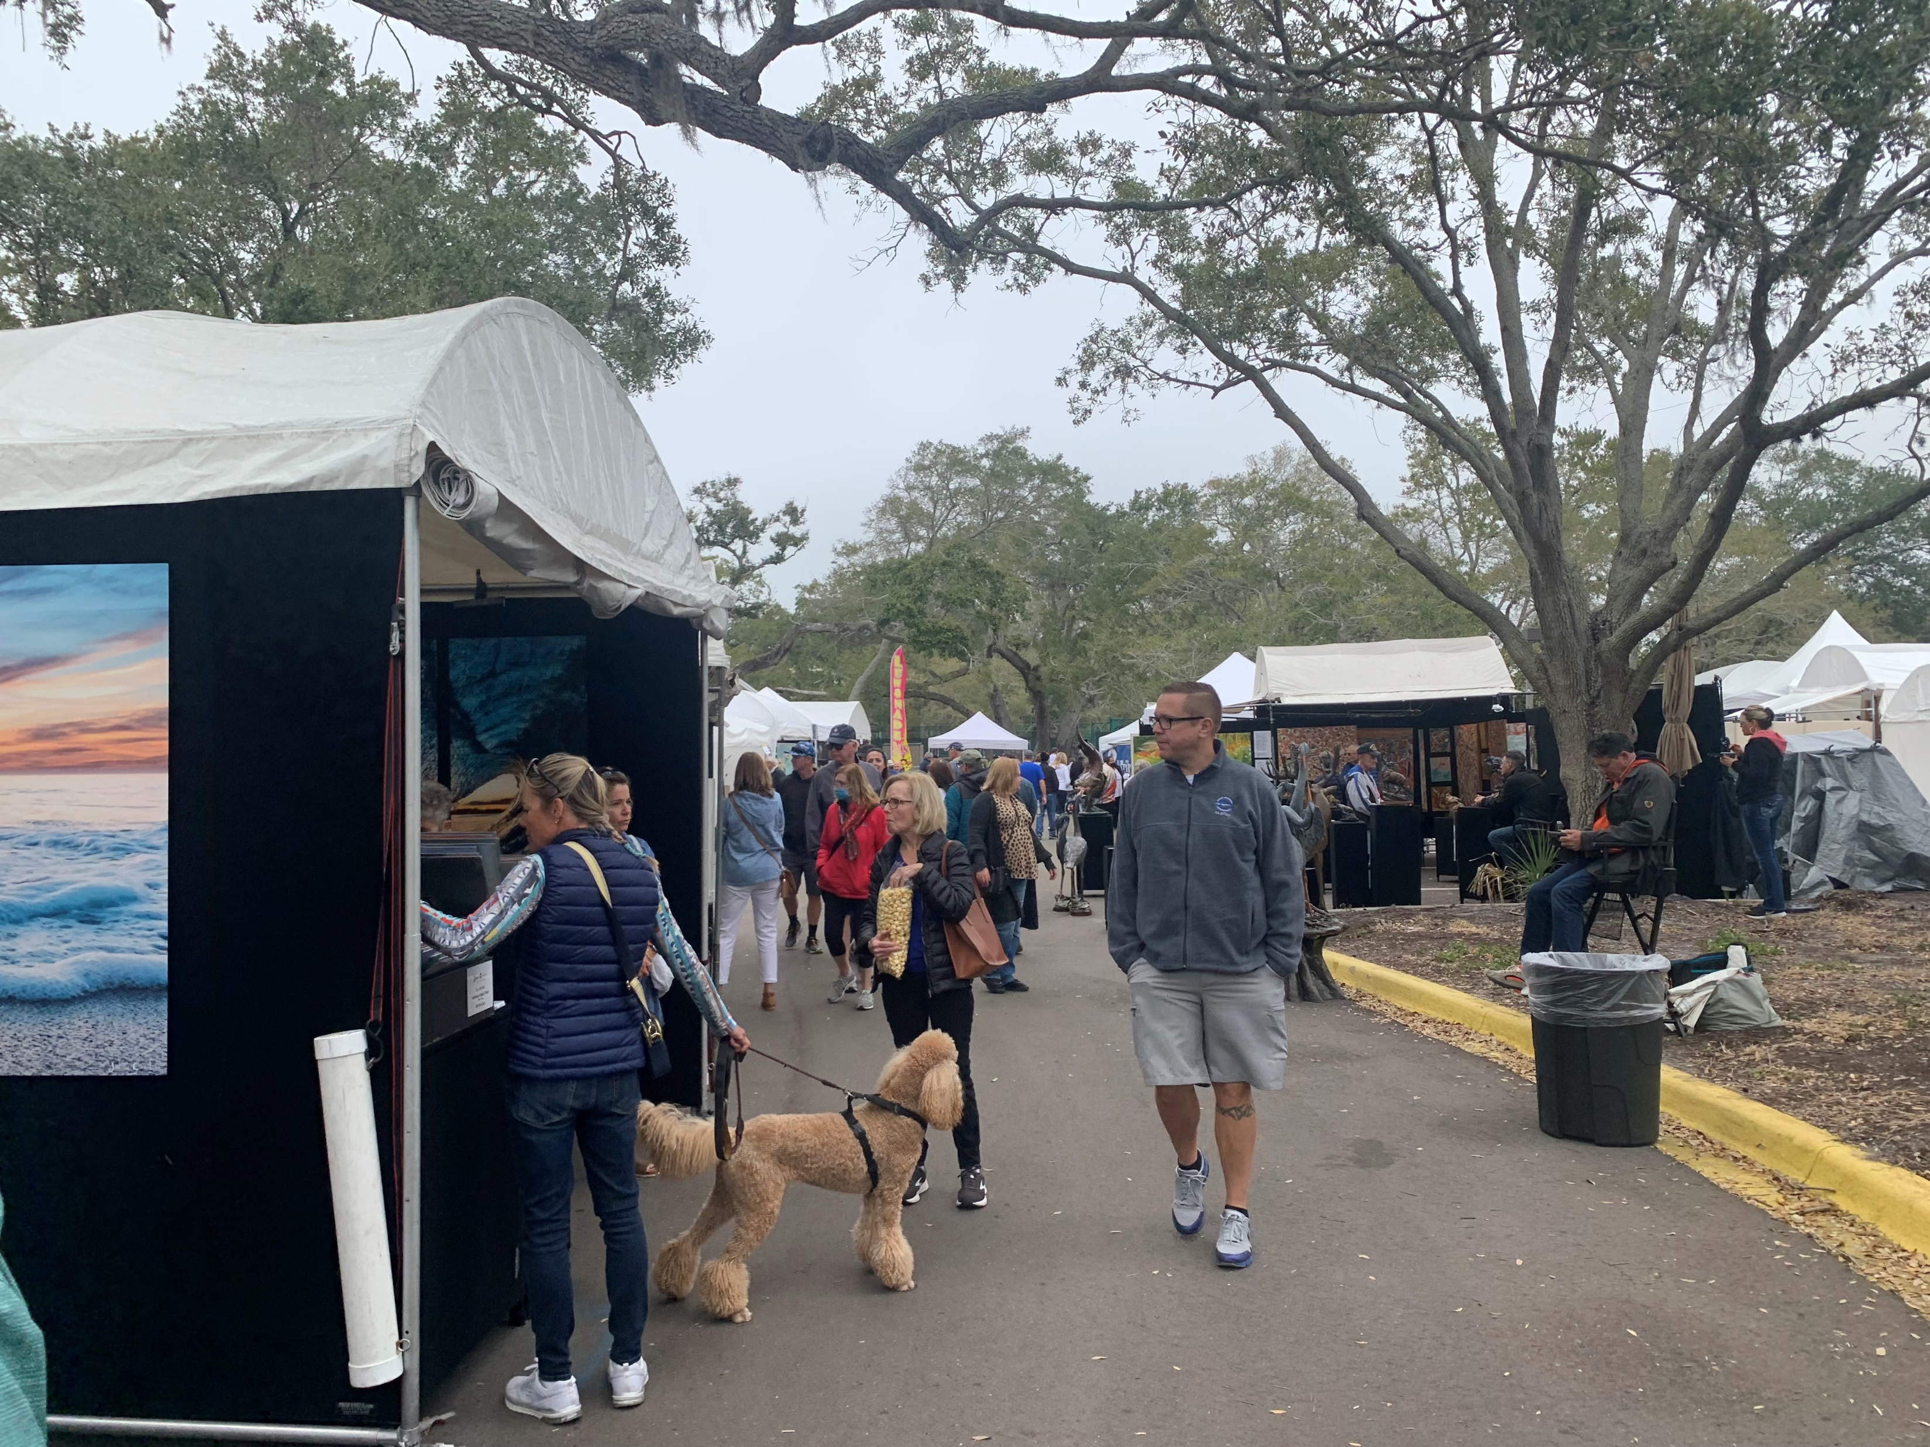


Example Successful Events

Slide 28
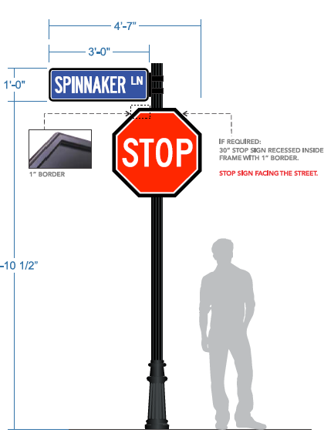
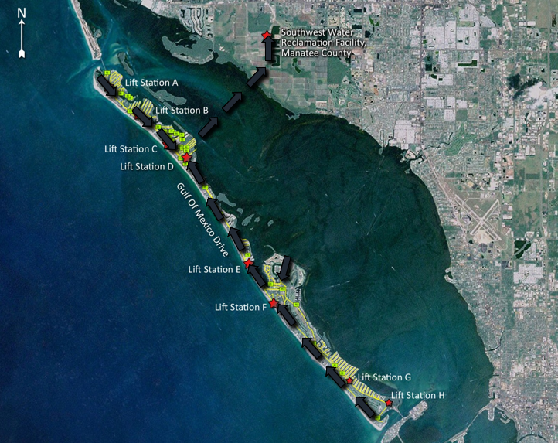
Major Resiliency Initiatives
Undergrounding Project
Electrical portion (“finally”) wrapping up. Poles down: June per FPL.
New backlit street name signs and more GMD lights to come.
Wastewater Subaqueous Force Main
New force main (“pressure”) pipe to reliably carry all Town wastewater under Sarasota Bay to Manatee County.
Up to $33 million. Planning since 2015.
Leak in June 2020 accelerated Town plans.
Roads and Drainage
Grant-funded road raising and other drainage improvements in Sleepy Lagoon, Buttonwood and Village neighborhoods.

Slide 29



Storm Recovery
Post-Storm 2024
August – October: Hurricanes Debby, Helene, and Milton
    Extraordinary Rainfall, Storm Surge 6’ to 8.5’, Wind Event
  Life Safety and Access: Urban Search & Rescue and First Push
  Power: FPL
  Town Water/Sewer systems
  All other infrastructure
  Debris Clean-up
Outlook for the Town is positive!
  Redevelopment will build in resiliency.
  Vacant (demo) lots that go for sale will build back
  to new, more resilient Florida Building Codes.
https://www.luxurylink.com/

Slide 30
Thank you!

