Slide 1
Manatee County and Town of Longboat Key
Joint Meeting
May 7, 2025

Slide 2
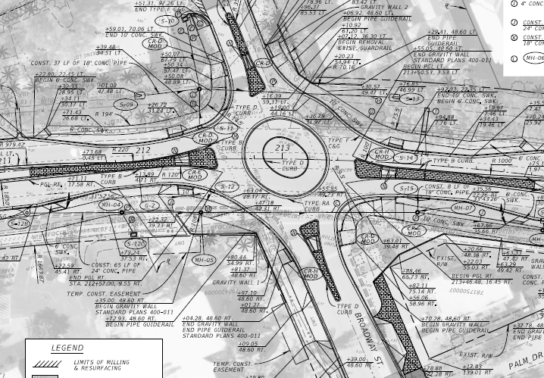
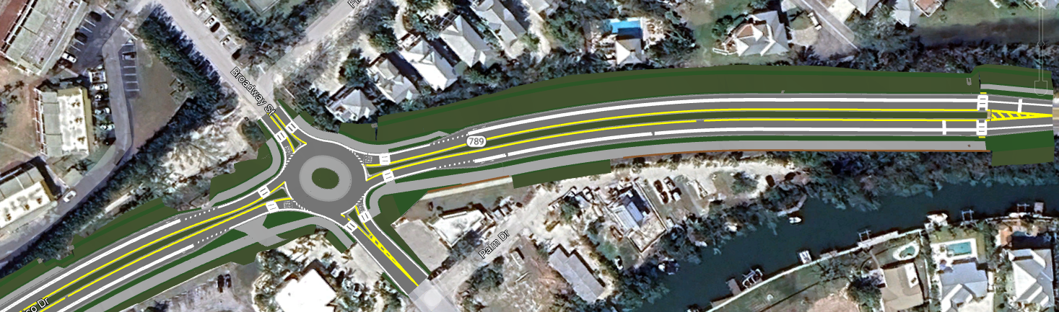
Infrastructure
Broadway St. at Gulf of Mexico Dr. Roundabout and Complete Street Improvement Project
Town working with FDOT:
FDOT agreed to fund over $5 million for roadway-related improvements and administer construction.
Amended design, permitting, coordination, and review underway with FDOT and Kimley-Horn & Associates.
Town covering new design cost.
Other Town costs:
  Landscaping
  Brick Pavers
  Utility Relocations
Letting Aug 2026.

Slide 3
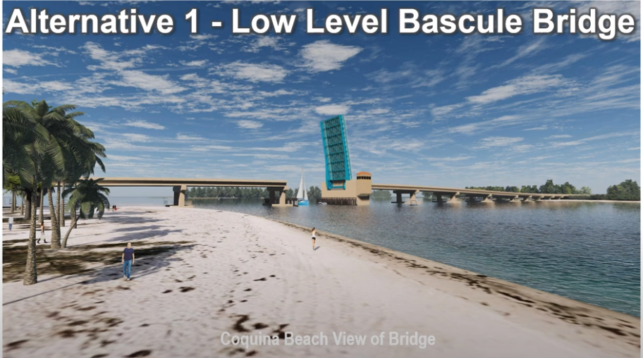
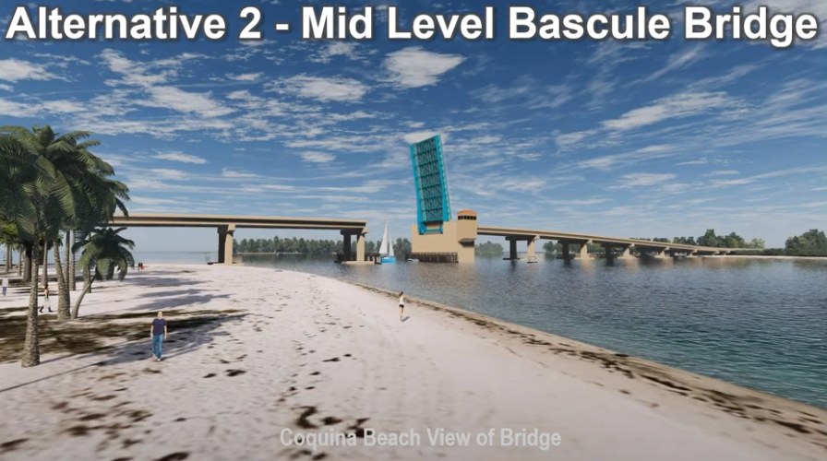
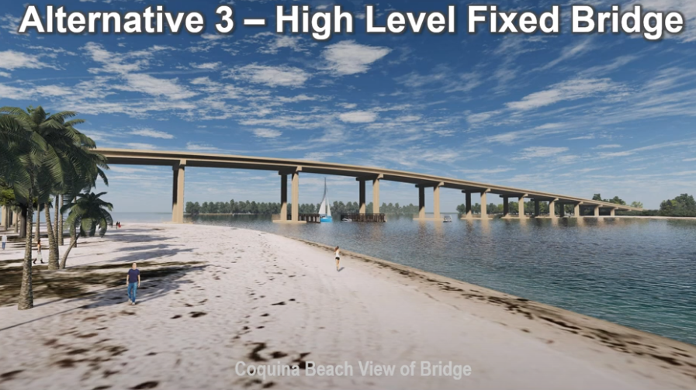
Infrastructure
Longboat Pass Bridge Options
Alternatives:
Low Level Bascule Bridge
Mid Level Bascule Bridge
High Level Fixed Bridge
Repair in-place (New)

Slide 4
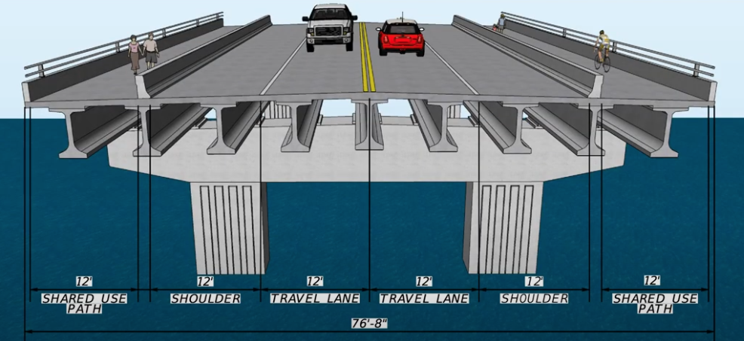
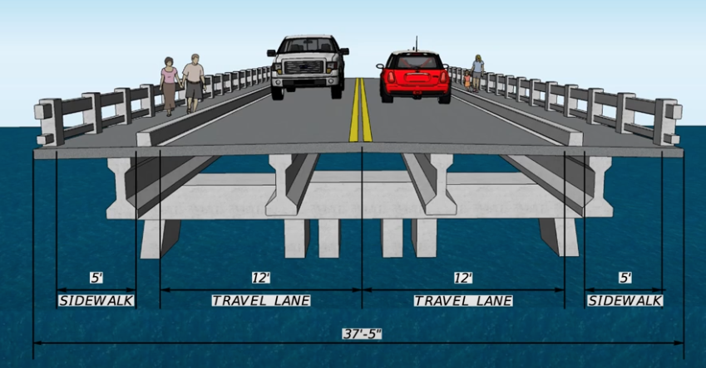
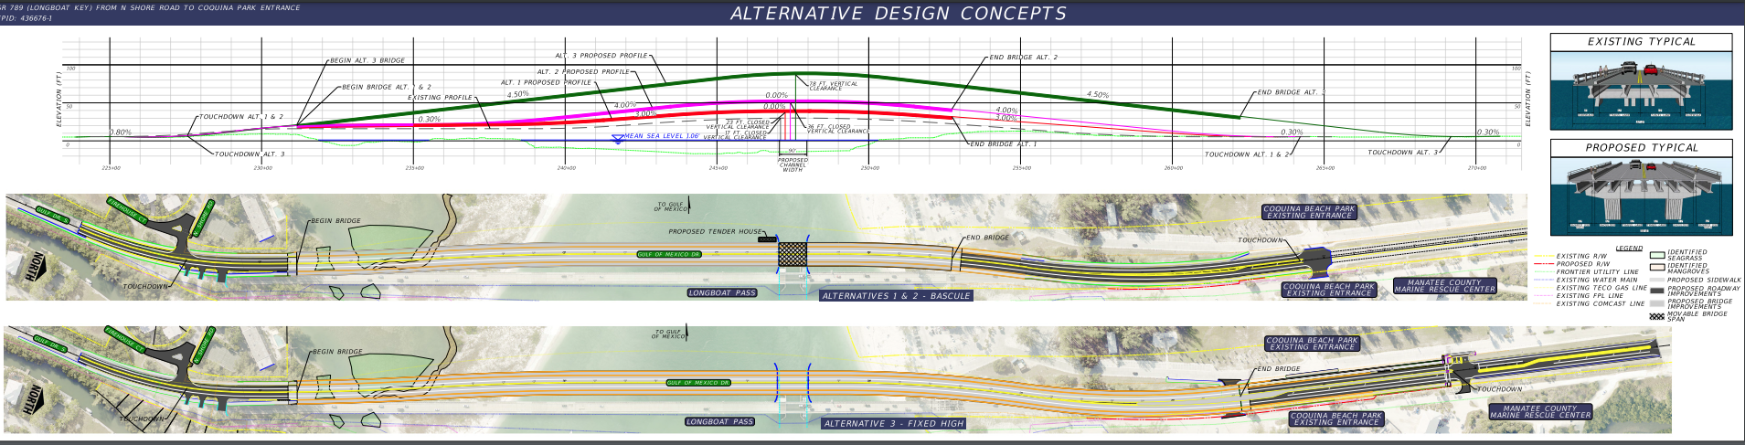
Infrastructure
Longboat Pass Bridge Options
Alternatives:
Low Level Bascule Bridge
Mid Level Bascule Bridge
High Level Fixed Bridge
Repair in-place (New)
At 78-feet of Vertical Clearance, Town believes the fixed span bridge is too large and out of scale with the character of the surrounding area.
At 23-feet and 36-feet respectively, the Town prefers the Low option as #1, then Mid as needed.

Slide 5
Infrastructure
Peak Season Traffic Congestion: #1 Town Issue
Gulf Drive (SR 789) corridor from Cortez Bridge to Longboat Key
  Major Positive Development:
    FDOT Funding Construction of Cortez Bridge Replacement (SR 684): Fixed Bridge
    Fixed span will eliminate long, congestion exacerbating draw bridge openings during peak season.
    Construction estimated at $115 million to start Spring/Summer 2026 and last 3-years.
  However:
    No improvement to Cortez Road (SR 684) at Gulf Drive (SR 789) intersection.

Slide 6
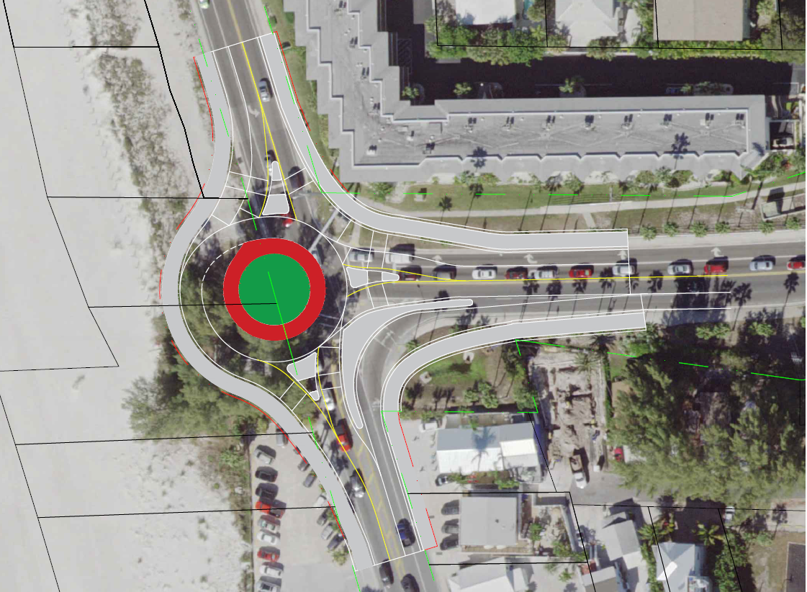
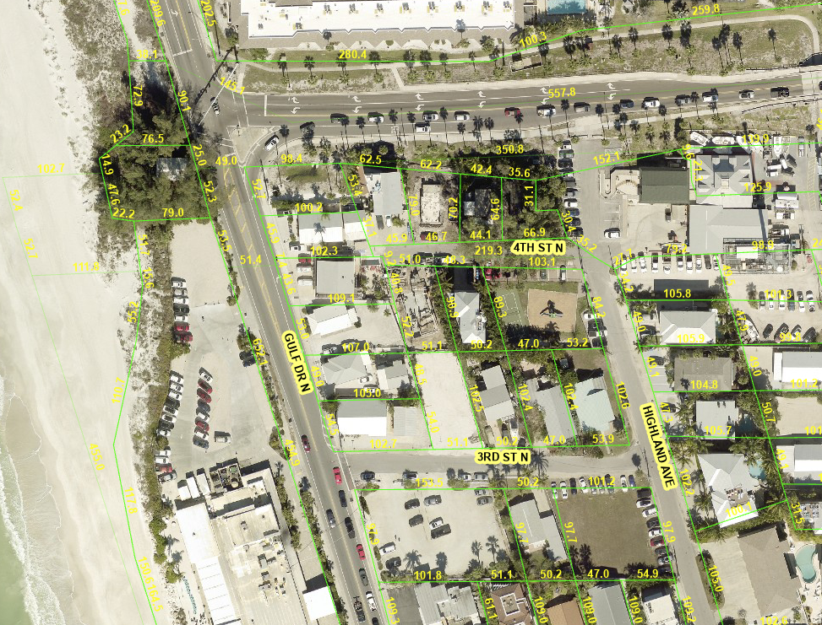
Infrastructure
Cortez Road (SR 684) at Gulf Drive (SR 789) Intersection:
Cortez Rd. SR 684
NB to EB right-turn lane queue extension?
Intersection control improvements?
  Roundabout (N/A)
  Other Lane Capacity increases
  A.M and P.M. Green Times with new Free Flow Bridge
Gulf Dr. SR 789

Slide 7
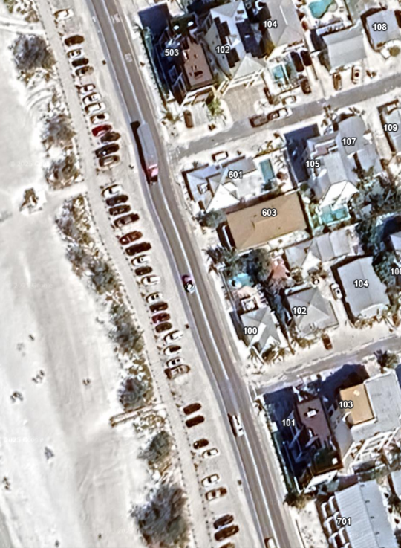
Infrastructure
Further South on Gulf Drive (SR 789)…
Cortez Beach:
Pull-in/Back-out parking free-for-all
Creates random friction throughout the Gulf Drive corridor
Current Status:
Post-Storm replacement of parking is ongoing.
Longer-Term Solution:
Single lane with angle parking using post-n-rope?
One-way in and one-way out along discrete segments down Gulf Drive.
Town understands long-term solution in progress.

Slide 8
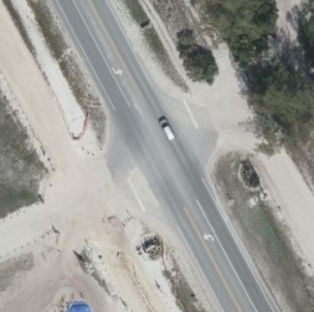
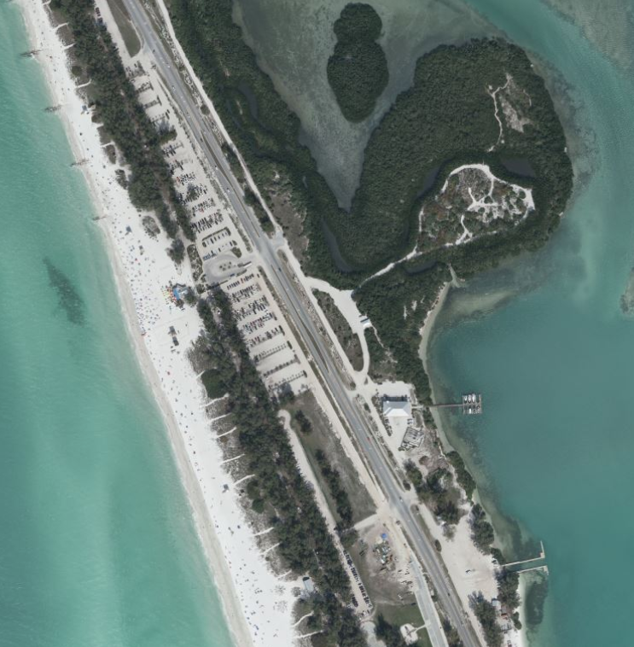
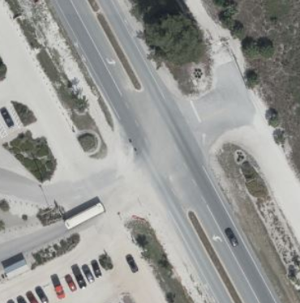
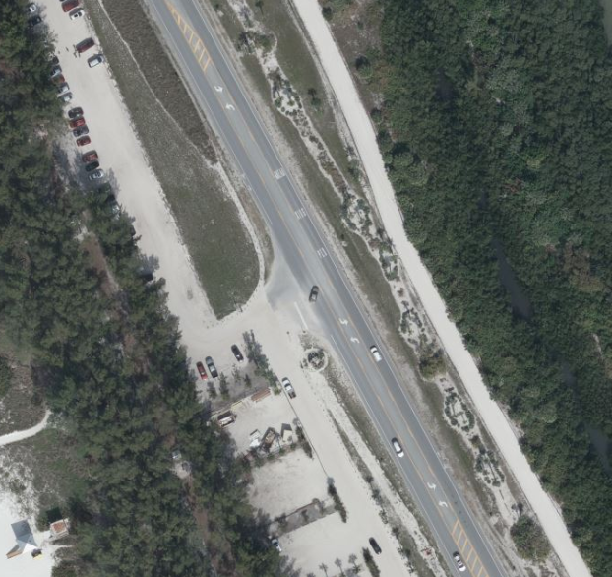
Infrastructure
Continuing South on Gulf Drive (SR 789)…
Coquina Beach Three (3) Access Points:
According to an article, 120 spaces were added to Coquina during recent expansion to reach over 1,000 parking spaces.
During peak season congestion, center lane staging and “nice” NB drivers at each beach access allow multiples of beach users out for every 1 car that moves forward northward.
  Drone Footage Video
Combine that with:
  Cortez Beach random parking friction.
  Low-Capacity Cortez Road at Gulf Drive intersection capabilities.
  Cortez Bridge drawbridge openings.
Data, analysis, solutions, implementation

Slide 9
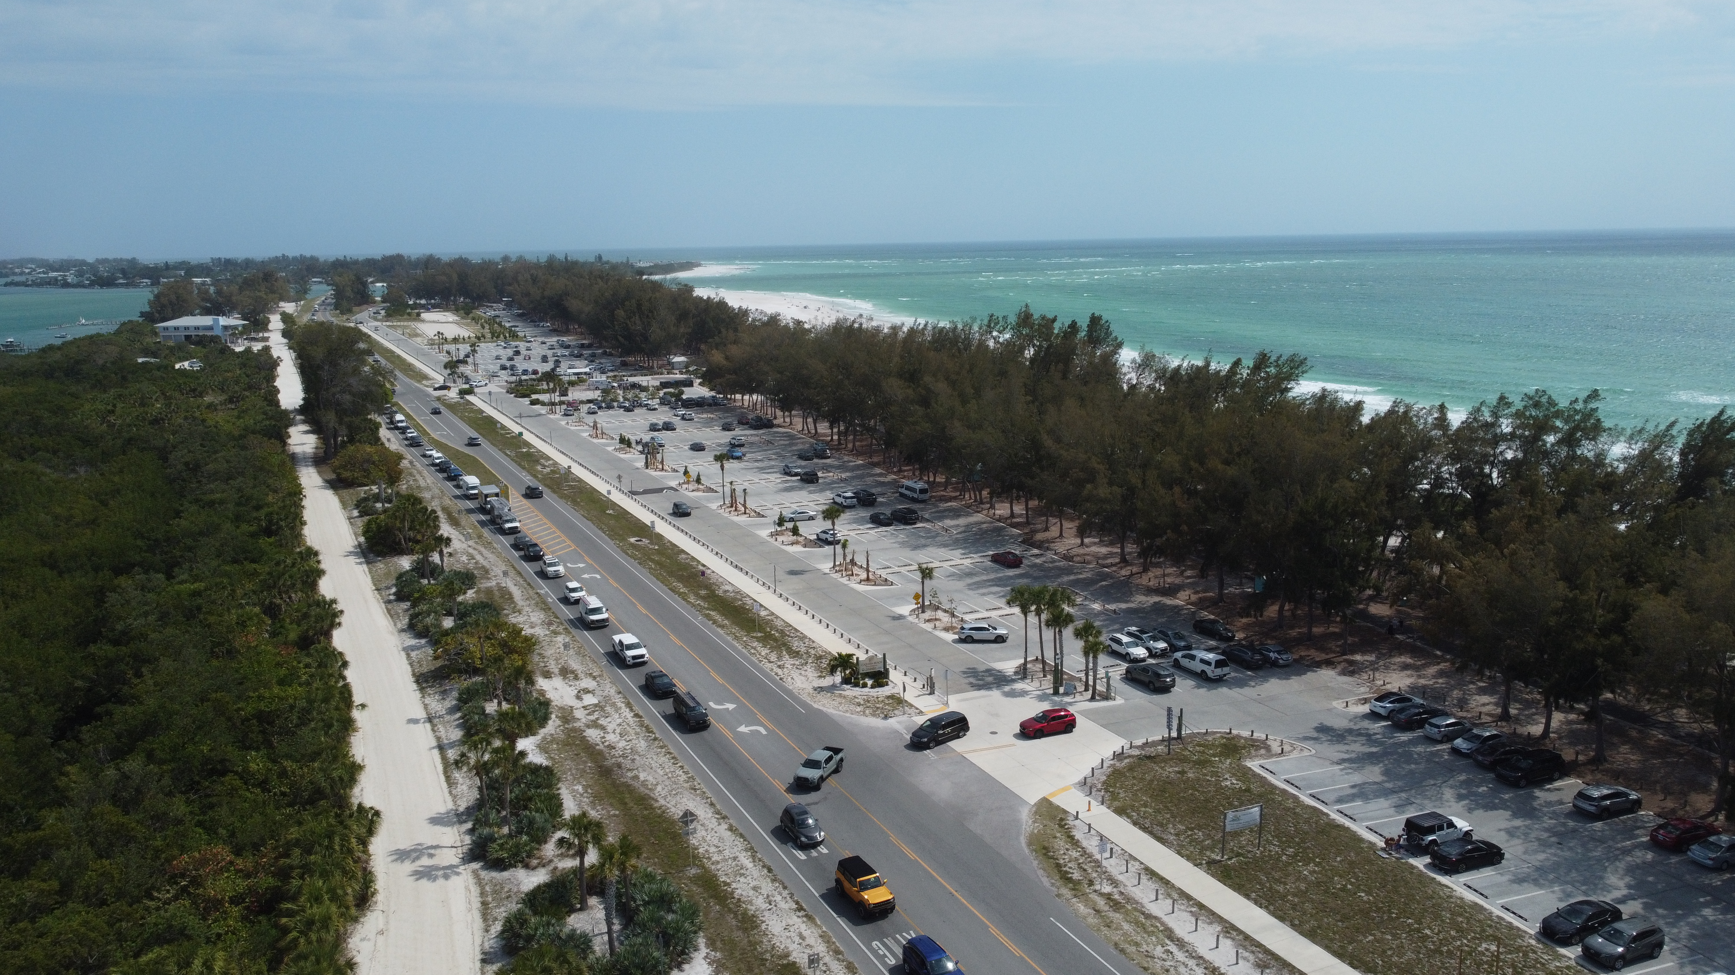
Infrastructure

Slide 10
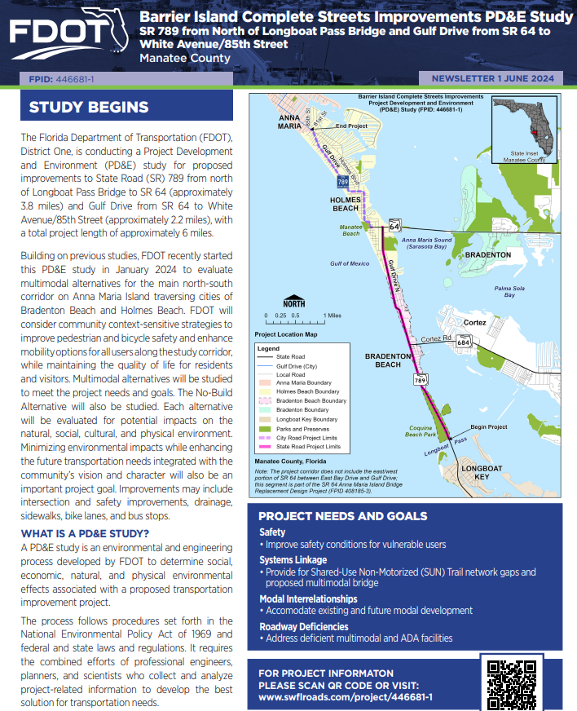
Infrastructure
Barrier Island Complete Street Improvements PD&E: $1.74 million.
Study is currently underway. Expected completion 2026.
Town working to get more involved and ensure congestion reducing solutions being considered:
  Meaningful improvements to the Gulf Drive (SR 789) and Cortez Road (SR 684) intersection.
  Channelizing pedestrians to discrete crossings.
  Channelizing vehicular beach parking where possible with Manatee County support.
  Improving Bridge Street circle vehicle movements and pedestrian controls.
  Options for Coquina access points.

Slide 11
Infrastructure
Continue the Cortez Bridge free-flow condition investment momentum...
Town:
Has two (2) points of access, with only north access through: Bradenton Beach community, Manatee County amenities, and FDOT facilities.
Does appreciate Manatee County working with FDOT on capacity enhancing improvement ideas on both sides of Cortez Bridge.
Also appreciates the continued closure of intermediate gates within Coquina Beach Parking lots.
Town with Manatee County, Bradenton Beach, and FDOT: would like to continue working together on congestion reducing/capacity adding solutions.
Notes of Interest - What we experience and hear:
  Congestion for hours at a time: cannot move northbound in the afternoon during peak season
  Residents, Business Owners, and Tourists have little to no interest in crossing the bridge during peak season to visit nor spend money on Bradenton Beach, Anna Maria Island, or mainland restaurants and shops.
  Service Workers and Contractors: near impossible commute in peak season. Hard to get vendors to work on an island in peak season.
  High unpredictability is a new metric MPO has discovered with this corridor.
  Gulf Drive (SR 789) corridor is a key improvement area for Barrier Island Traffic Study solutions.

Slide 12
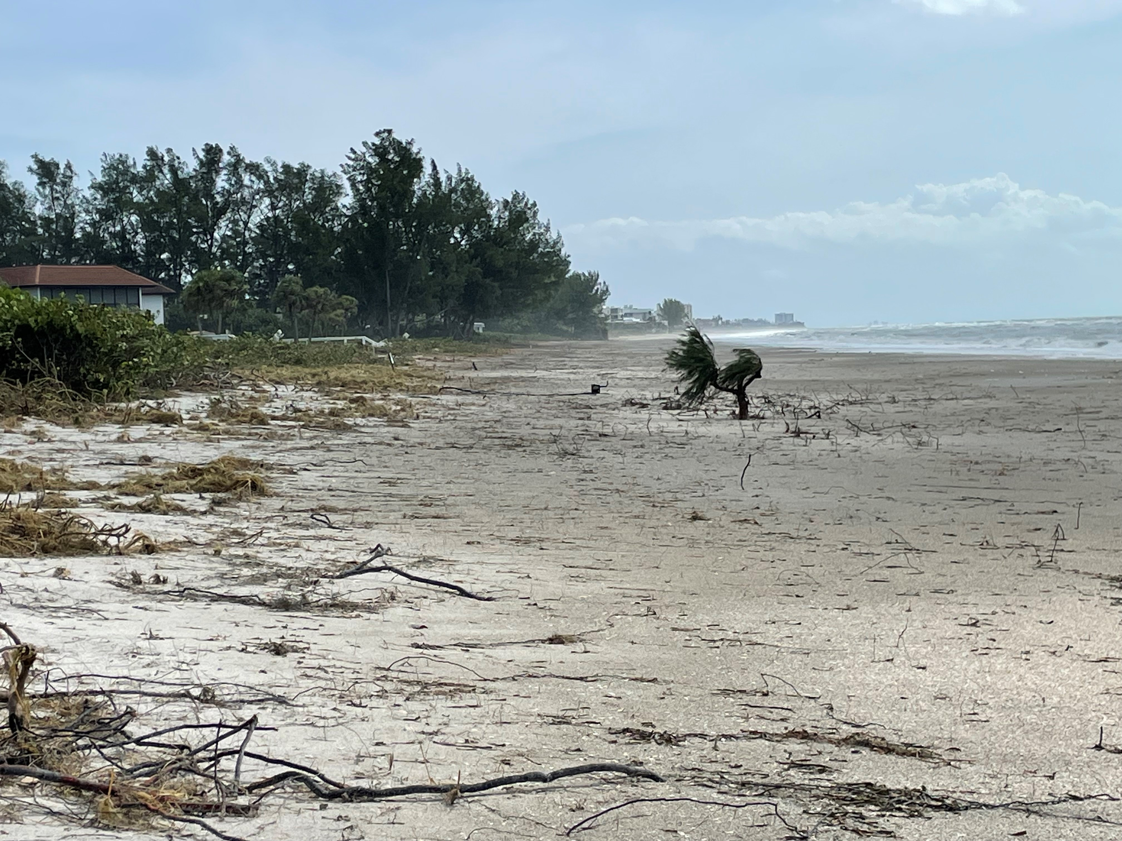
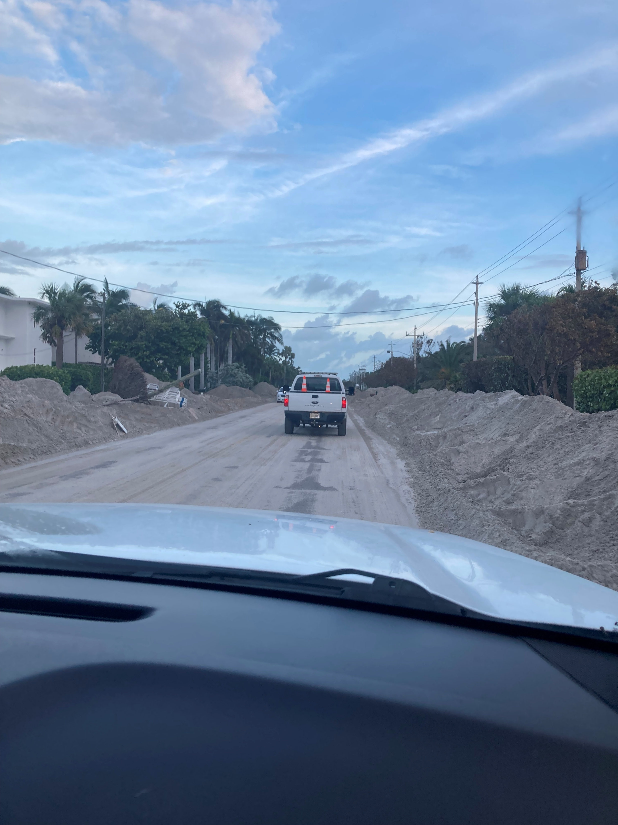
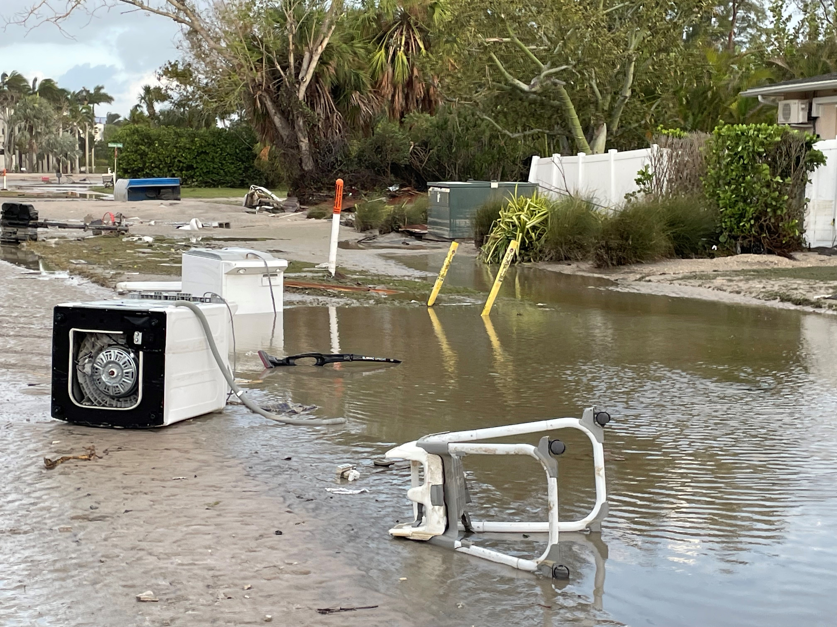
Beaches & Beach Nourishment
Hurricane Helene 2024

Slide 13
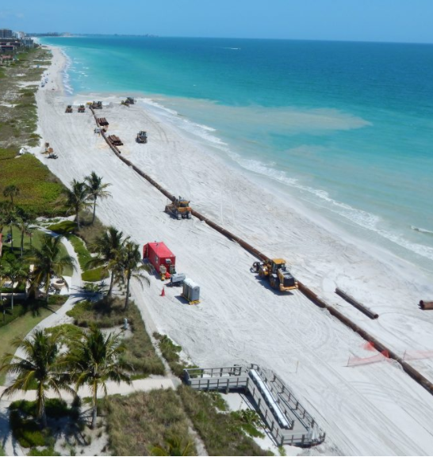
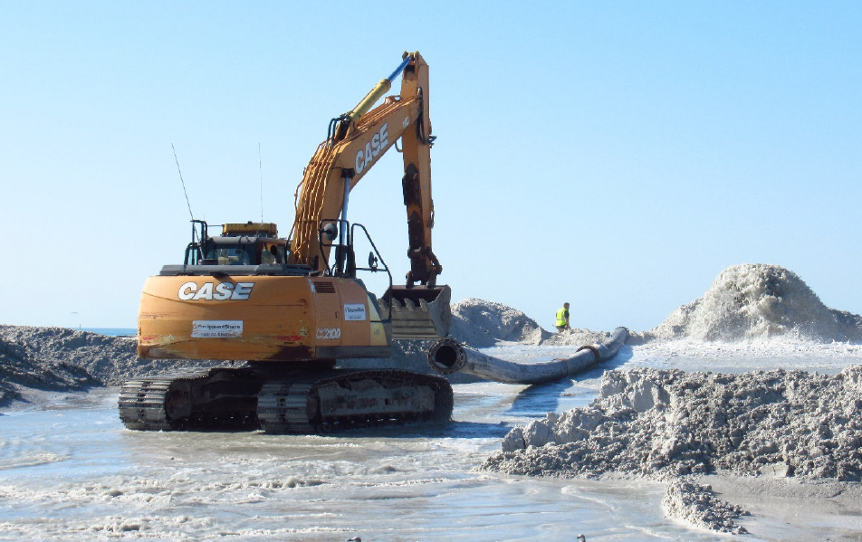
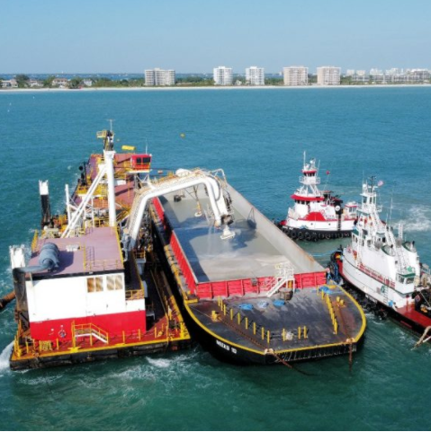
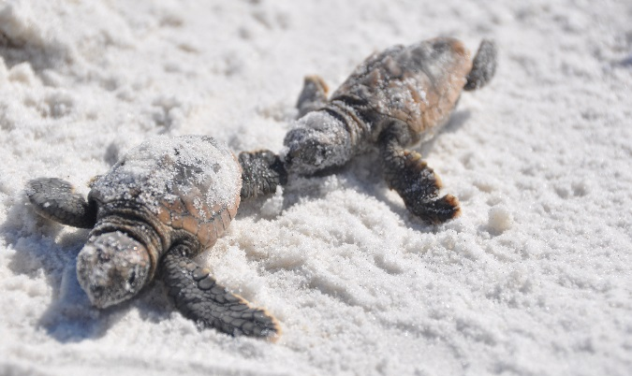
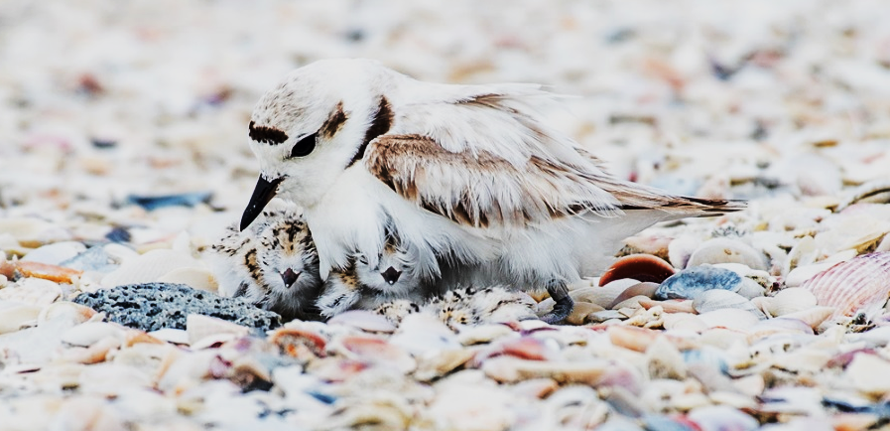
Beaches & Beach Nourishment
Tied for #1 Town Issue: Beaches and Storms
Estimated Town Beach loss due to storms:
  407,000 cubic yards
Town submitted Category “G” claim to FEMA and FDEM
  Awaiting responses.
Concurrent with FEMA reimbursement approval, Town plans to advance a more complete nourishment project.
  Begin planning, design, and permitting for 2027 – 2028.
Request Manatee County’s financial support for this next nourishment.

Slide 14
Beaches & Beach Nourishment
Resiliency, Restoration, and Quality of Life:
Advance Beach Profile and Dune Restoration 2027 - 2028
  (Beach Model + Referendum + FEMA + FDEP)
    Base Budgeting tool: $40/CY Construction & Design
      407,300 CY Helene and Milton: $16,292,000
      Cost Breakdown: FEMA: $12,219,000 (75%)
      FDEM: $ 2,036,500 (12.5%)
      FDEP: $ 570,220 (*28%)
      Town: $ 1,466,280 (9%)
      620,200 CY to 2021: $24,808,000
      Cost Breakdown: FEMA: $12,219,000
      FDEM: $ 2,036,500
      FDEP: $ 2,954,700 (*28%)
      Town $ 7,597,800
      800,000 CY Project: $32,000,000
      Cost Breakdown: FEMA: $12,219,000
      FDEM: $ 2,036,500
      FDEP: $ 4,968,460 (*28%)
      Town: $12,776,040
Base Project:
Storm Losses
Add 212,900 CY:
+$8,516,000
Up to $32 million
(Town + FEMA +
FDEP + Grant)
Add 179,800 CY:
+$7,192,000
+Gulfside Road Structural Solution Construction 2027 – 2028
$6 million (Town + 29% Grant)

Slide 15
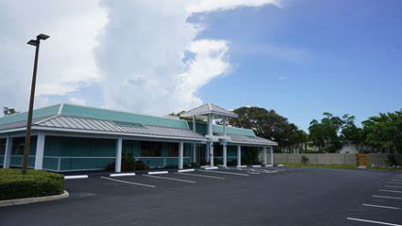
North End Community Space
Prior County Plan:
  Whitney Plaza 6,100-s.f. space
  Lease + Renovation:
    $135,080 1st year + $1.2 million
  Structure Flooding during Helene
Current status:
  Ongoing concerns by the County to invest in this structure.
  Preference to purchase.

Slide 16
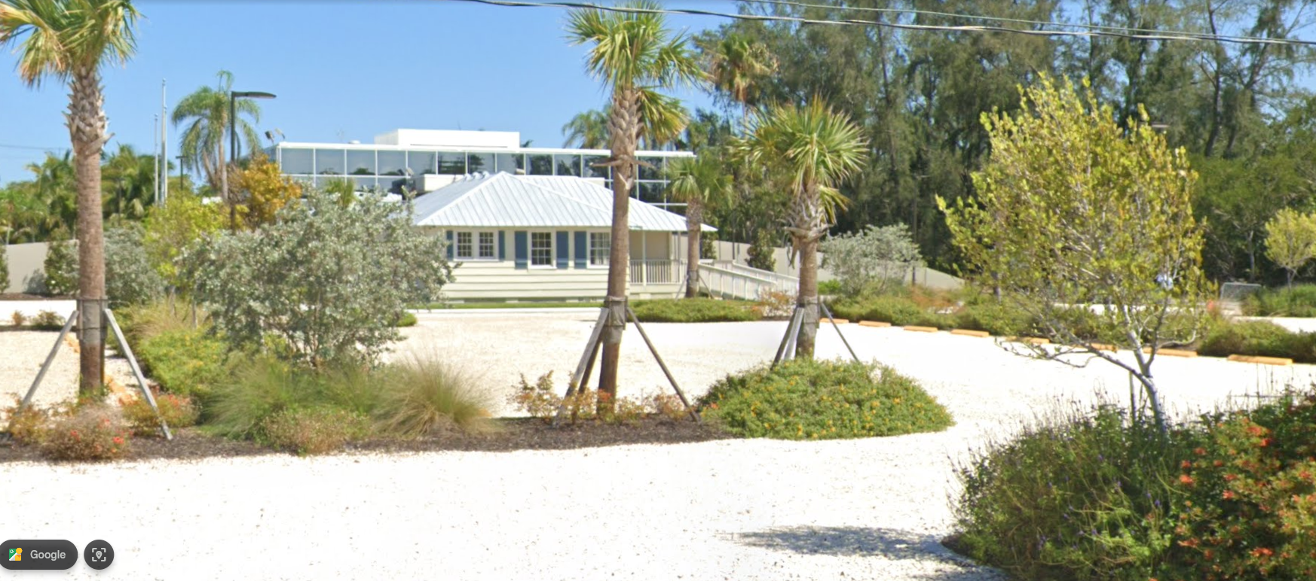
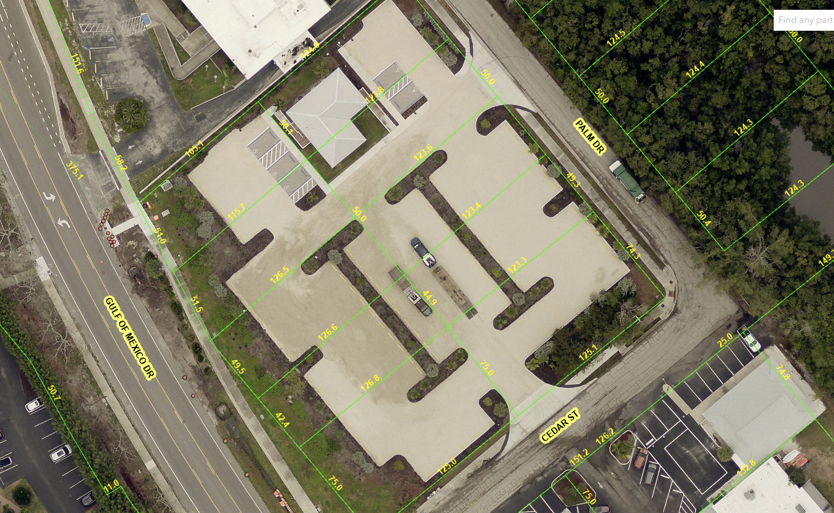
North End Community Space
Another Alternative?
  Chiles Group property.
  Historic Whitney Cottage
  1,300-s.f. multi-room space
  Two bathrooms
  Covered deck area
  88 graded aggregate parking spaces with runoff infiltration underneath
  Purchase only - No lease option.
    Primary considerations:
    Cost: FY 26 Budget(s). Reserves.

Slide 17
Infrastructure
Thank you!!

