Slide 1
Longboat Key Library and Community Hall Spaces
at Town Center Green
Joint Meeting with Sarasota County Board of County Commissioners
November 7, 2025

Slide 2
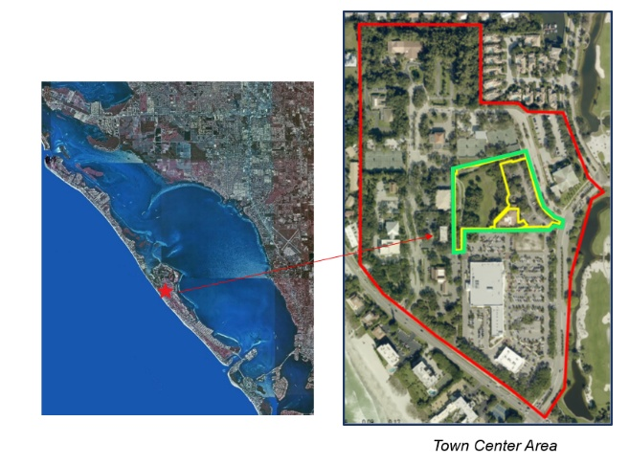
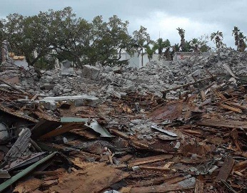
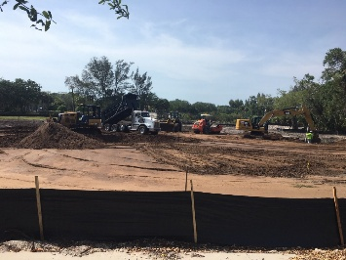
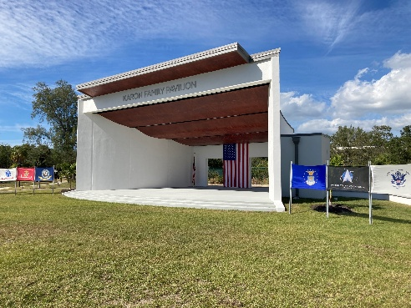
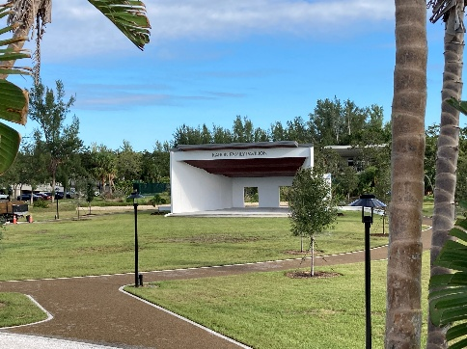
Background
Town has been actively developing a Town Center community gathering area since 2014…
Town land acquisition in 2014 and 2017 totaling 4.81-acres for $3.7 million
Phase 1: 2020 for $854,000
Demolition of abandoned restaurant
Raise site and initial grading
Sarasota County grant of $400,000
Phase 2: 2023 for $2.3 million
Elevate Site Further, Add Master Stormwater System, Event ‘Green’, Oval walkway, and
Donor-funded Outdoor Performance stage
Town Site & Park Enhancements: $1.5 million
Karon Family Pavilion $800,000

Slide 3

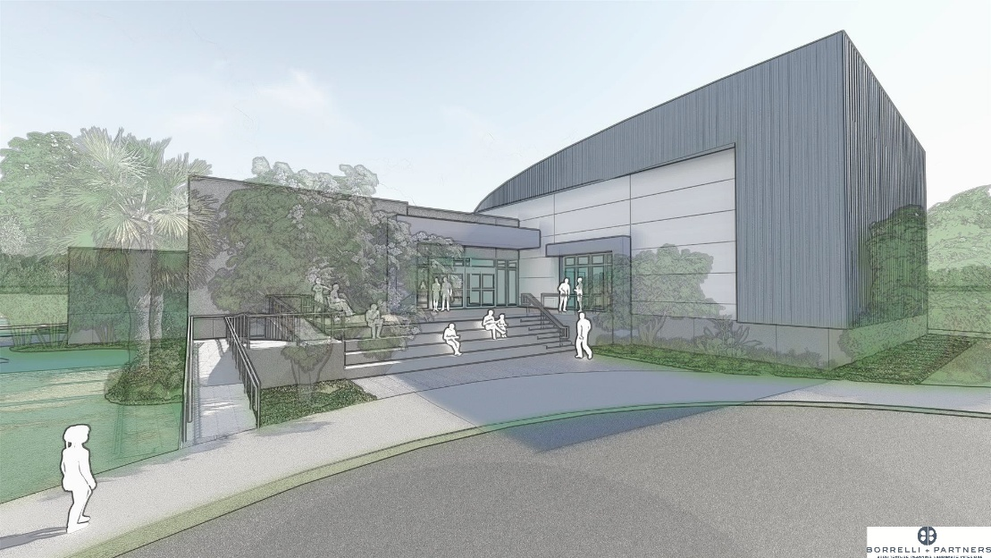
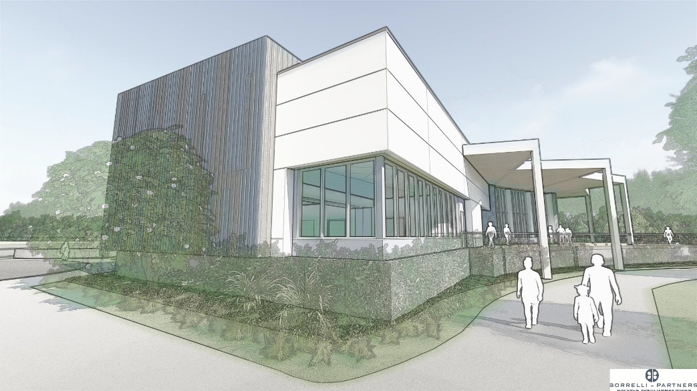


Partnership
Town and County have enjoyed a positive working partnership:
Sarasota County and Town agree on “Principles of Agreement.”
County commits $10 million towards new Longboat Key Library, plus operating.
Town desires to expand; Town marketed expansion areas as “Community Hall” spaces, indoor and outdoor, to Donors.
Generated Town Donor excitement.
Naming rights in various spaces for $500,000 and above.

Slide 4
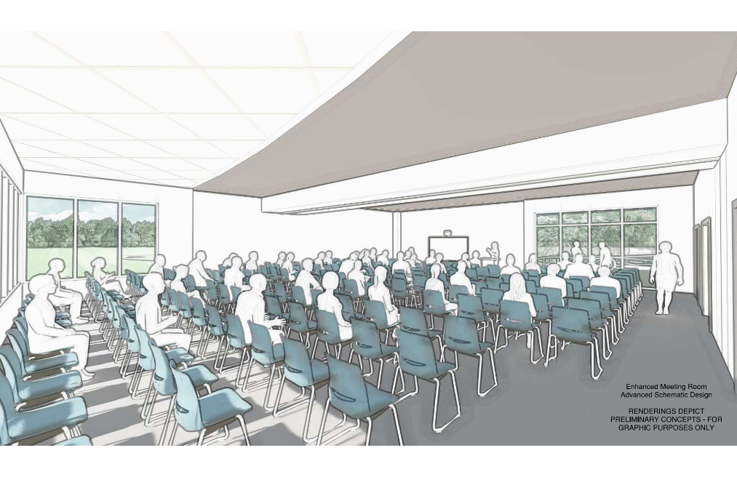
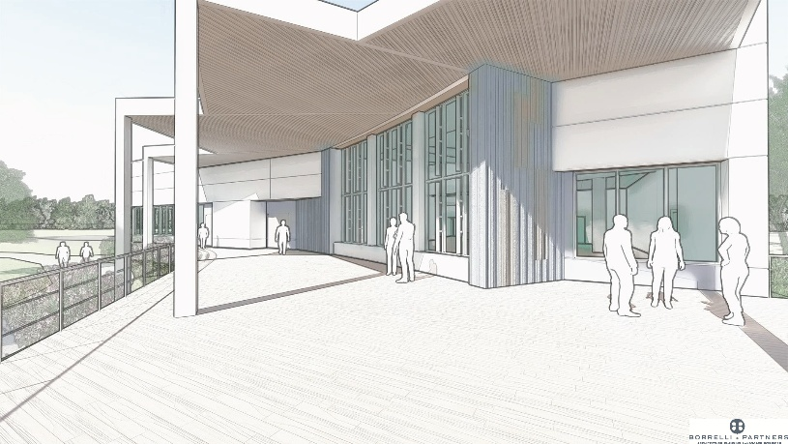
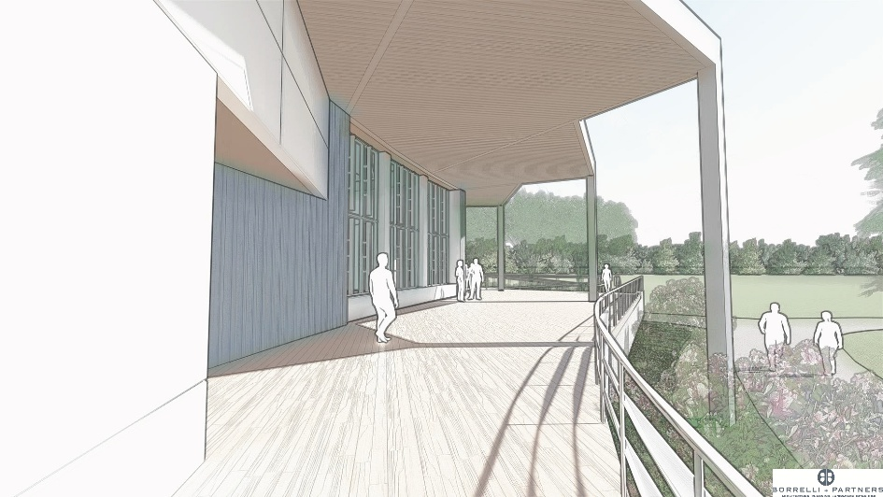
Town Donors = Library Supporters
Original Budget Estimate for Base Library Construction: $10 Million
Town Donors: $4 Million
Potentially may reach: $4.5 Million
Represents dollars generated for community space expansion worth 45% more than original base building budget.
Remarkable considering most donations pledged AFTER the 2024 storm season impacts and during recovery.

Slide 5
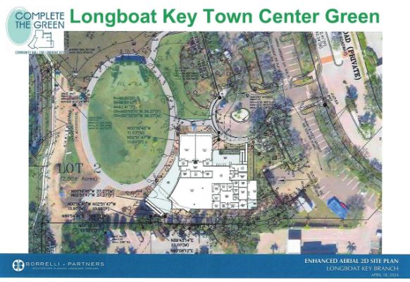
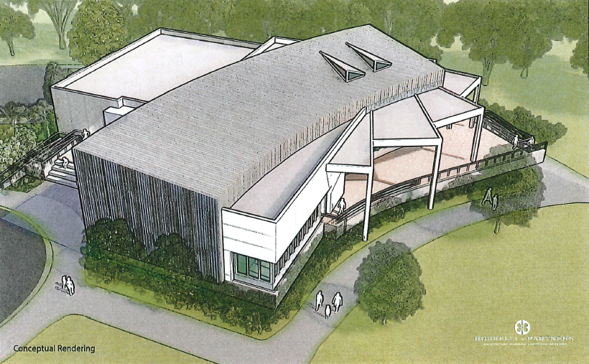
Partnership
Town and County Donor Recognition event planned for February 2026
Build excitement for groundbreaking planned around Fall 2026
Town is excited to be reaching the culmination of Town Center development, and we share our gratitude with
Sarasota County
THANK YOU!!

Slide 6
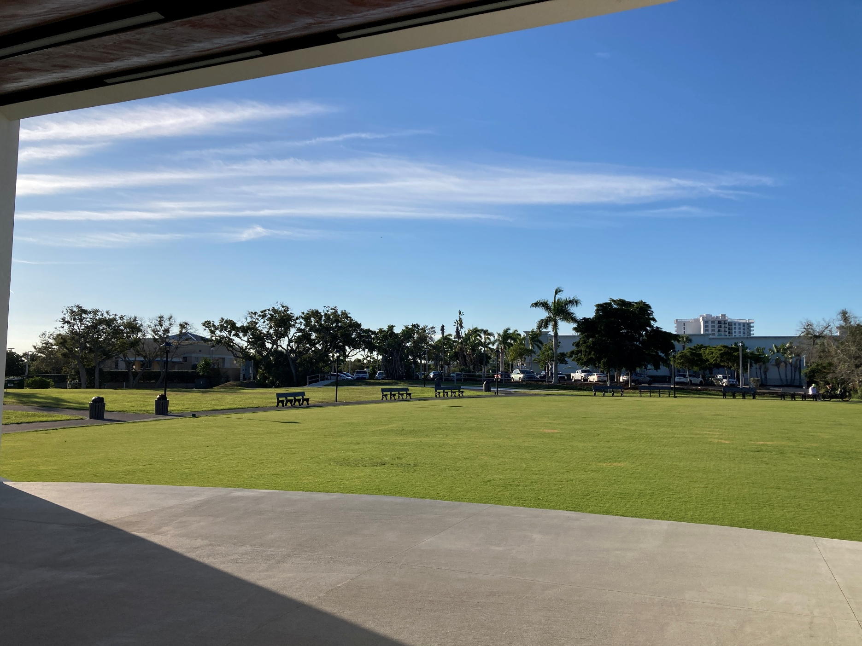
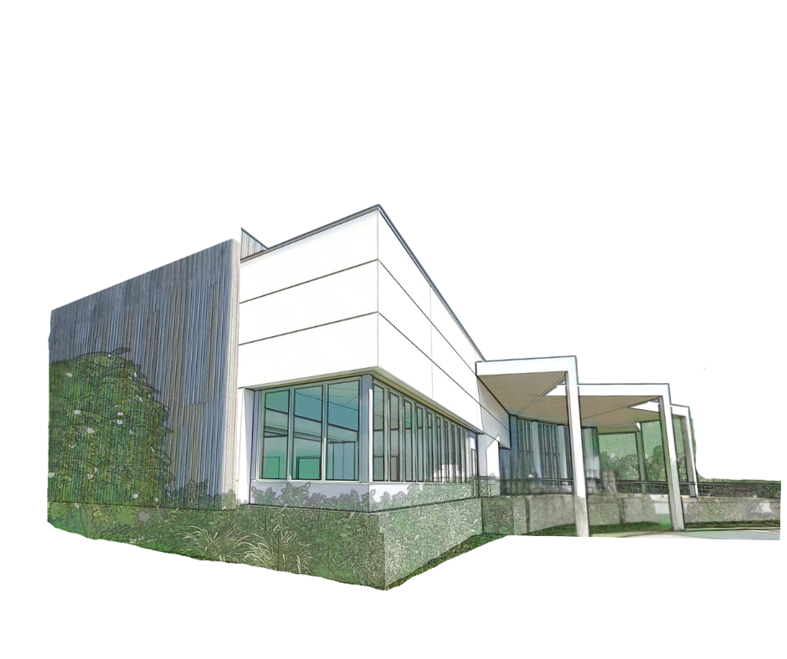
Partnership
THANK YOU!!

