Slide 1

LONGBOAT KEY LIBRARY – WORKSHOP #2
Longboat Key Library
Workshop 2
Town of Longboat Key Town Hall
Monday, March 18, 2024
1:30-4 p.m.

Slide 2
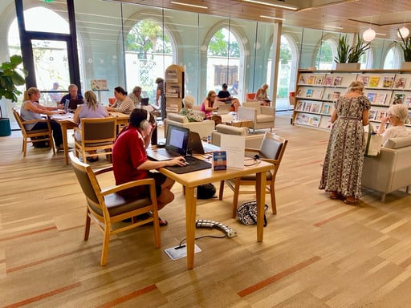
LONGBOAT KEY LIBRARY – WORKSHOP #2
TODAY’S AGENDA
  Purpose and Format
  Review Core Library Elements
  Conceptual Design
  Feedback and Comments

Slide 3
LONGBOAT KEY LIBRARY – WORKSHOP #2
Recap of
Library Core Elements
and Space Needs

Slide 4
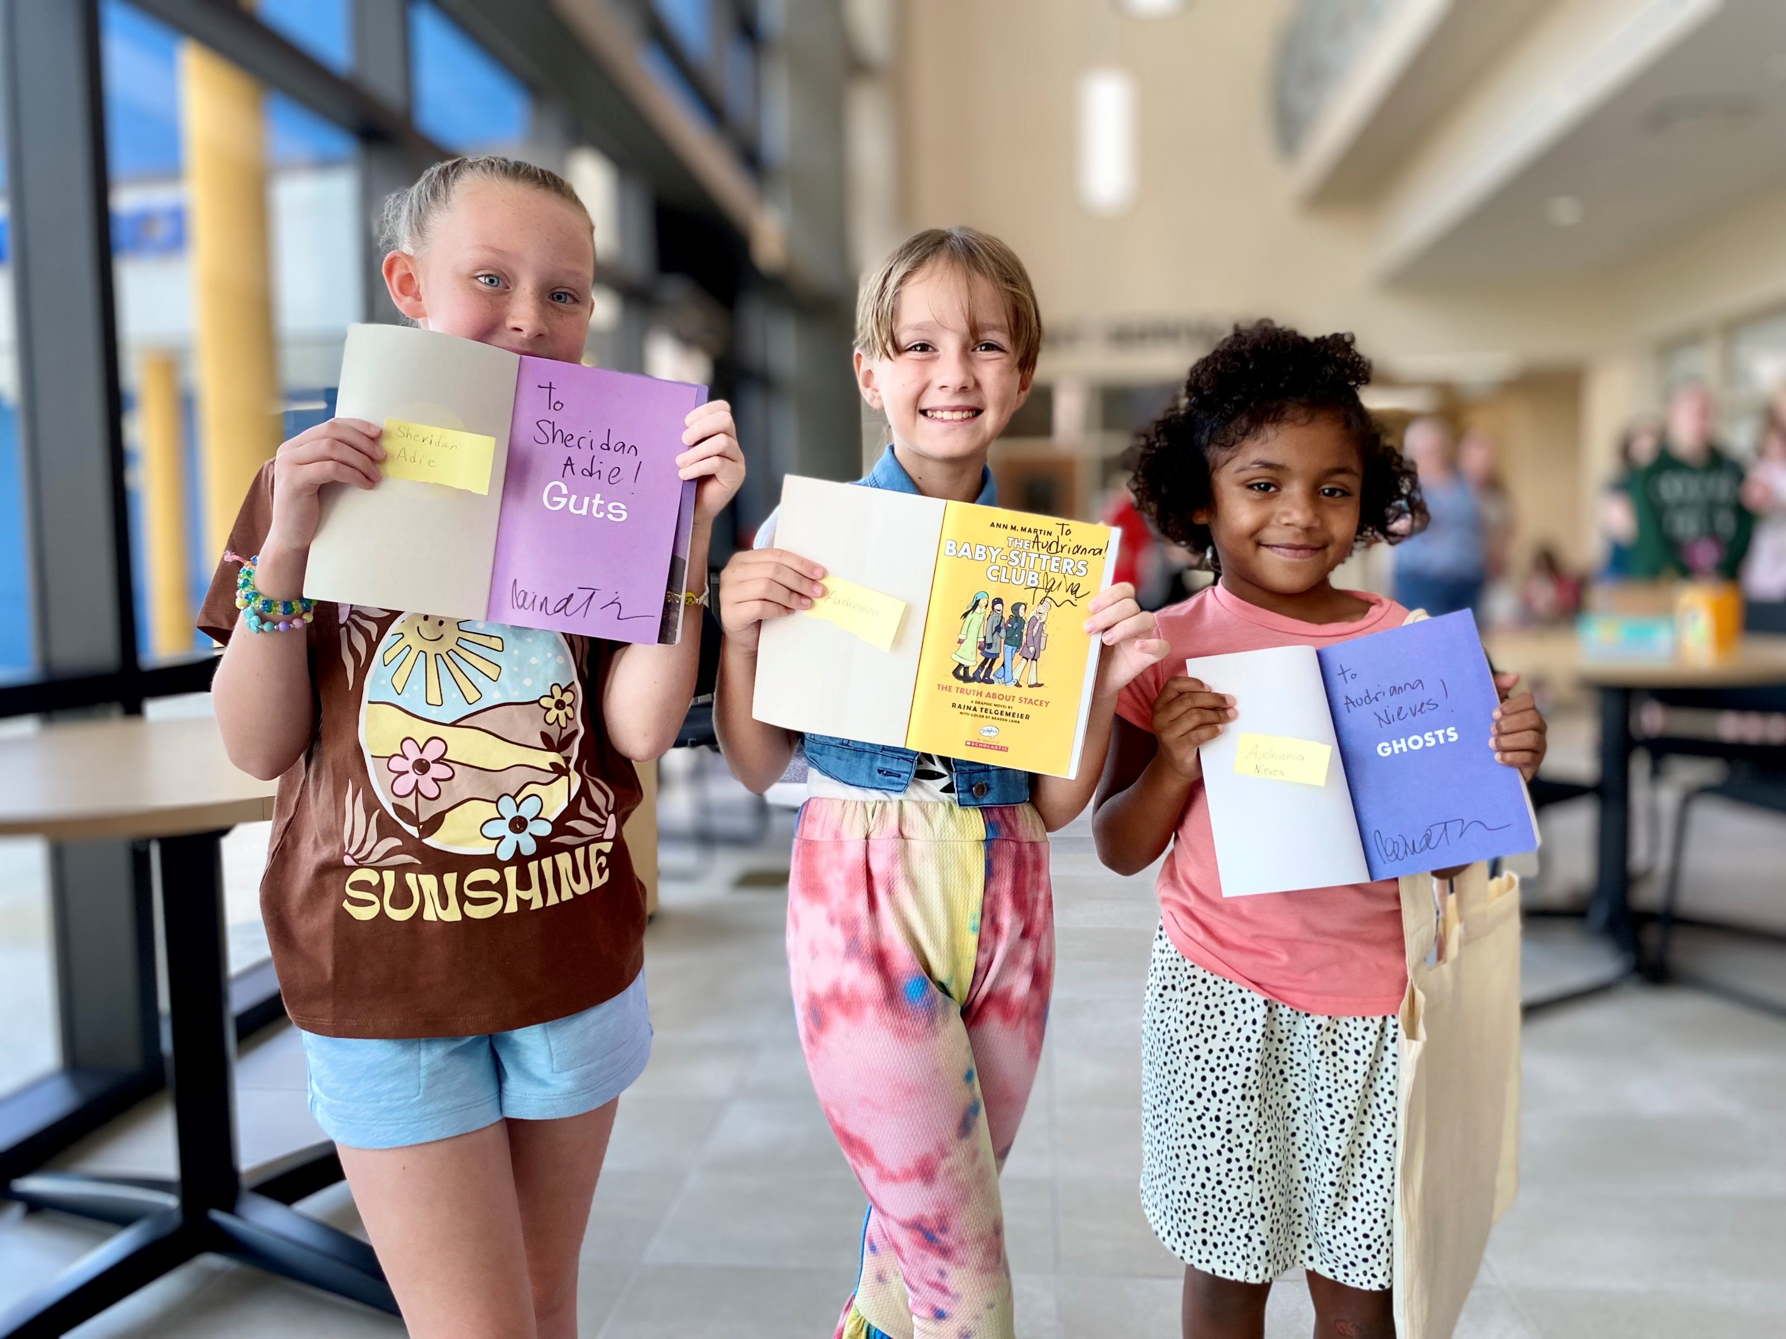
LONGBOAT KEY LIBRARY – WORKSHOP #2
Ensuring all residents can access and enjoy the quality of life that makes Sarasota County a great place to live, work, grow, play, and learn.
      Books and Materials
      Meeting Rooms and
      Gathering Spaces
      Technology
      Programs and Events

Slide 5
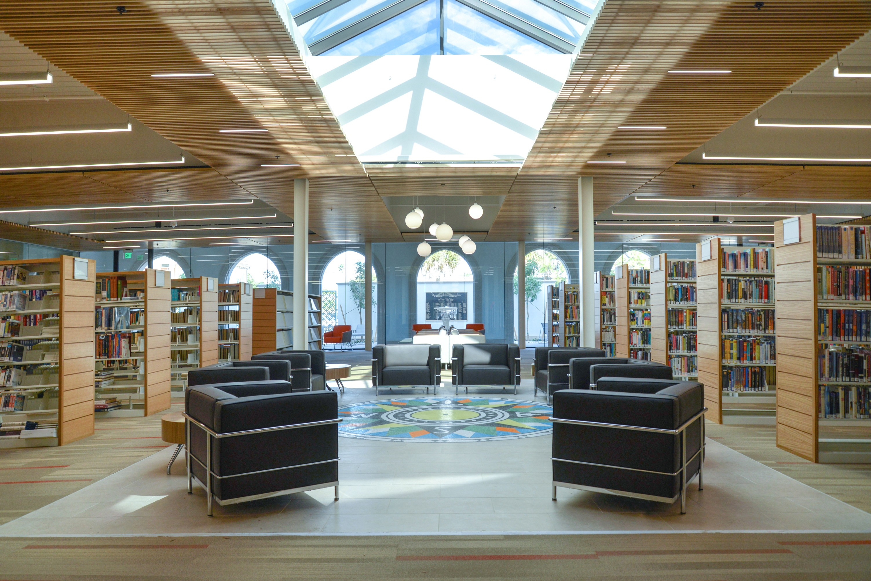
Core Elements: Collection Space
LONGBOAT KEY LIBRARY – WORKSHOP #2
Comfortable, inviting seating
Lots of places to sit and relax
Good lighting and windows
Quiet reading areas
Visually pleasing environment

Slide 6
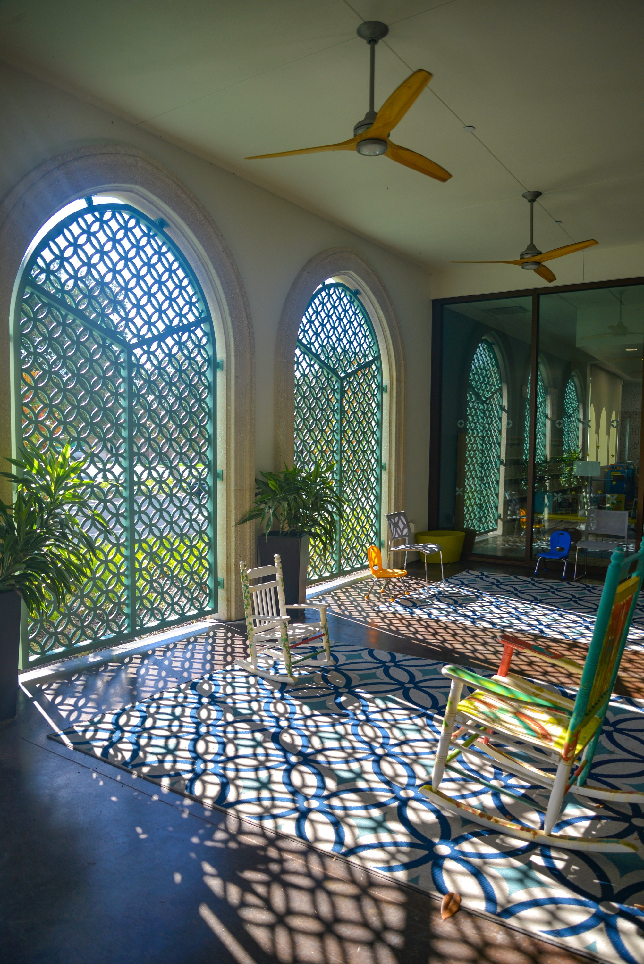
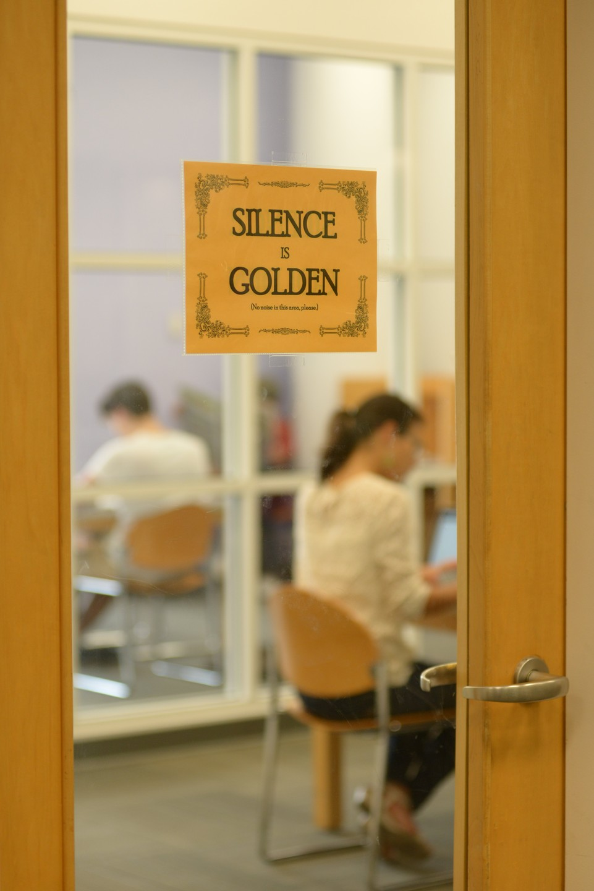
Core Elements: Meeting and Conference Rooms
LONGBOAT KEY LIBRARY – WORKSHOP #2
Small comfortable area to work for a few hours
Gathering spaces and private spaces
Vestibule that is accessible when the library is closed
Outdoor spaces for programs
Outdoor seating and tables
Quiet private areas

Slide 7
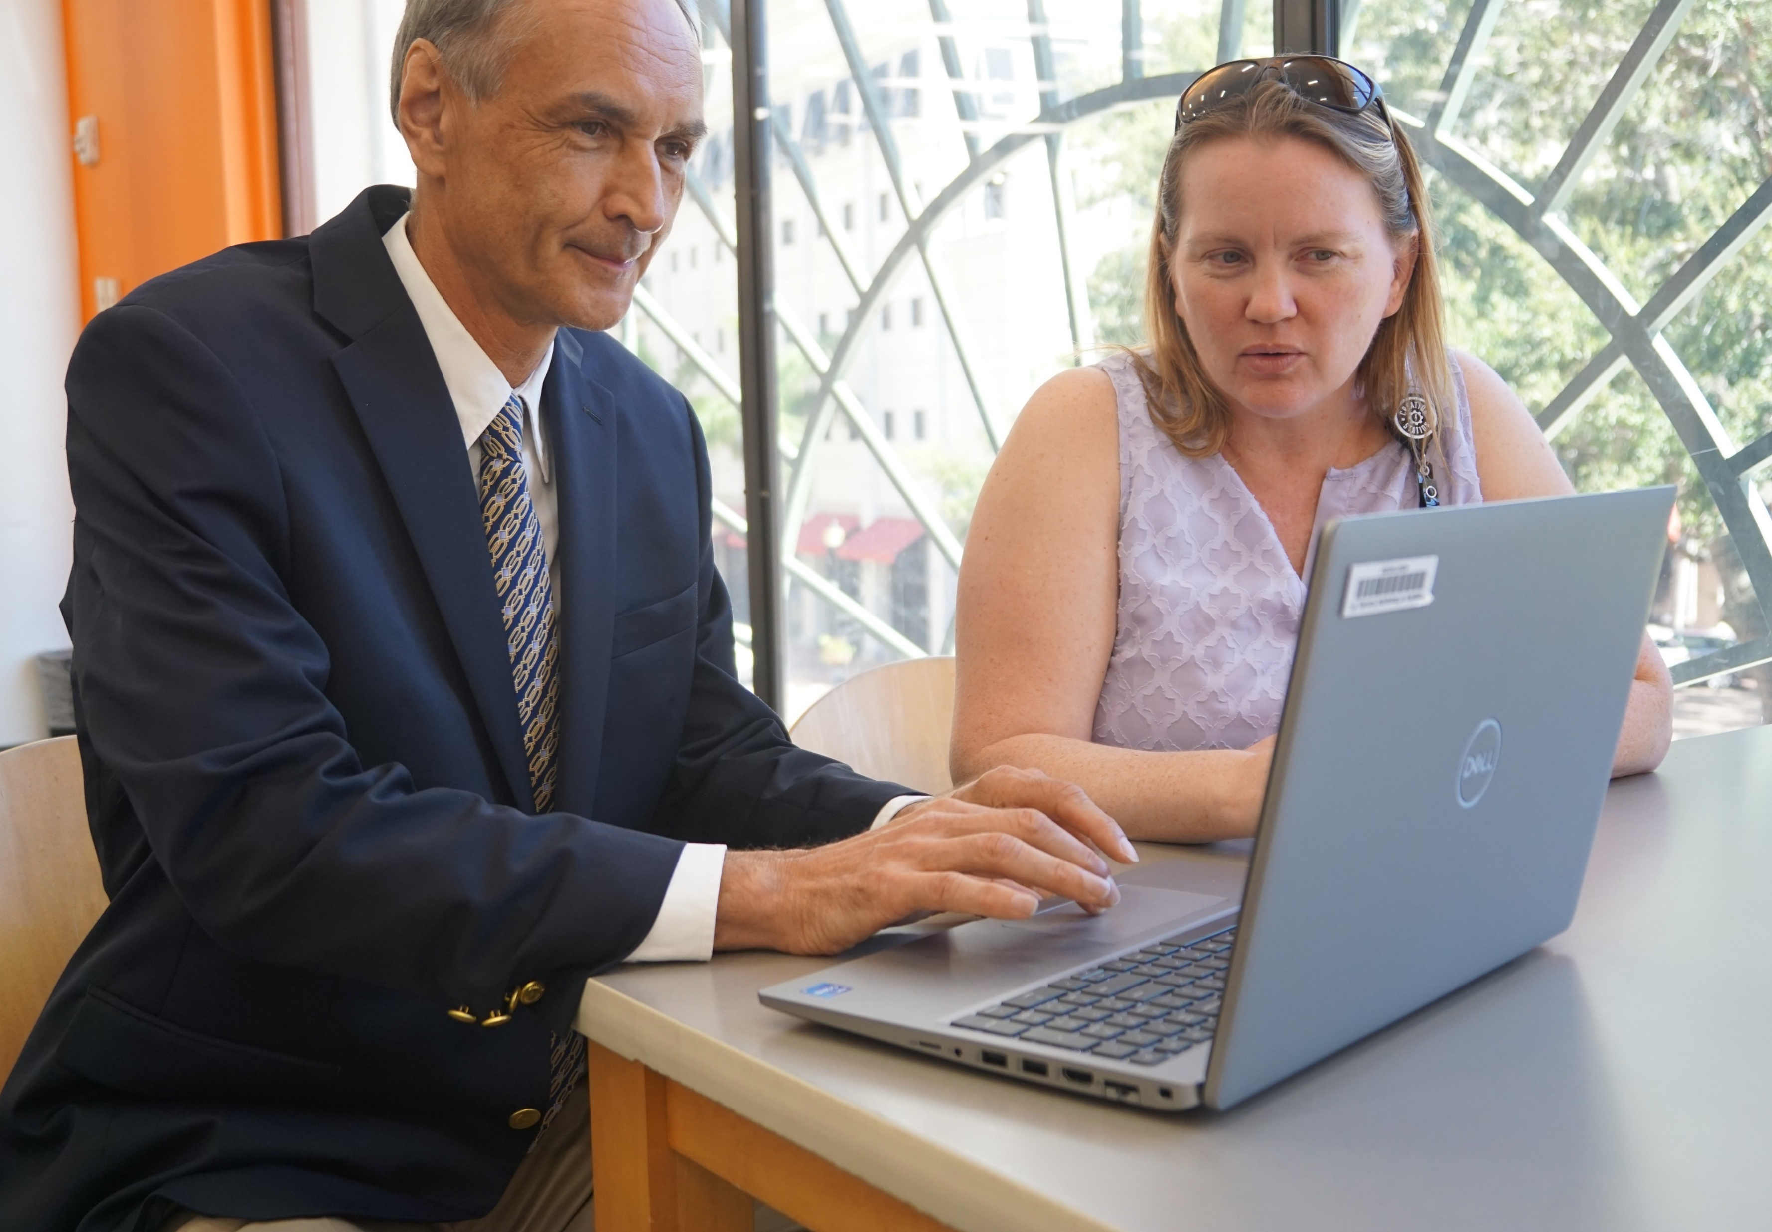
Core Elements: Public Technology
LONGBOAT KEY LIBRARY – WORKSHOP #2
Public computing and equipment
Makerspace with sewing, digitization, woodworking, etc.
Wi-Fi connectivity, both indoors and outdoors
Technology training and assistance
Technology and art materials for public use that are too expensive for an individual to purchase, e.g. 3-D printers, etc.

Slide 8
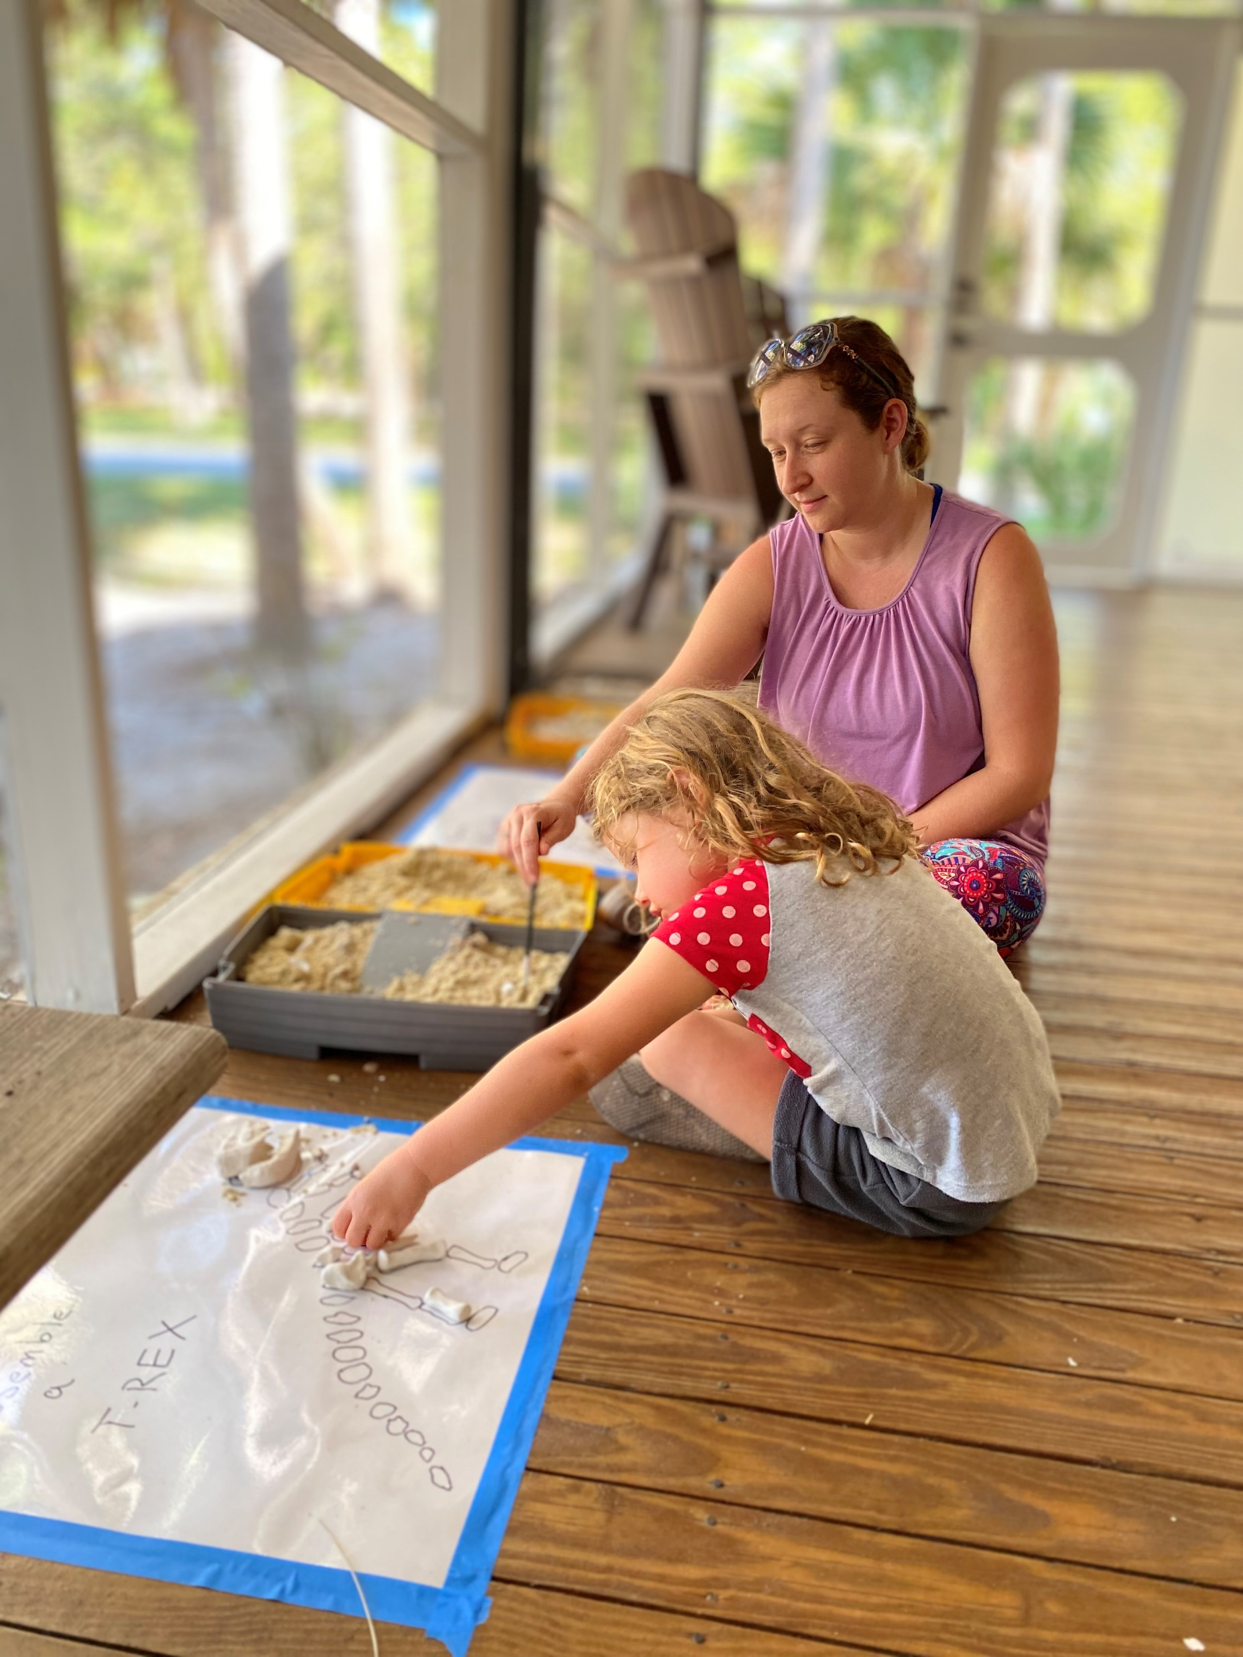

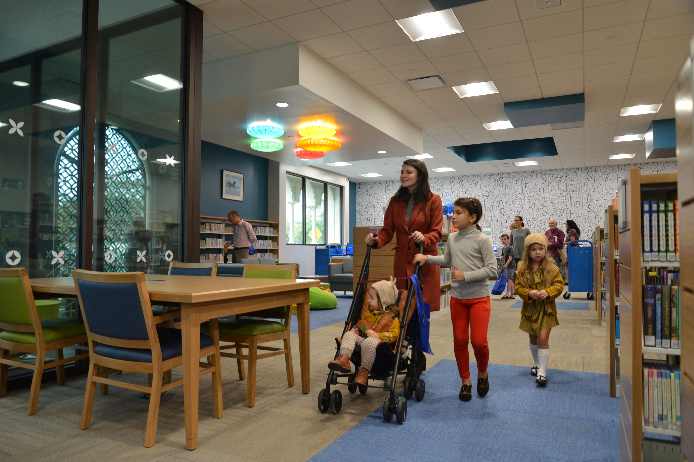
Core Elements: Youth Area
LONGBOAT KEY LIBRARY – WORKSHOP #2
Spaces for families to meet other families
Open area where kids of all ages can explore and learn
A children’s section, we need services for our children

Slide 9
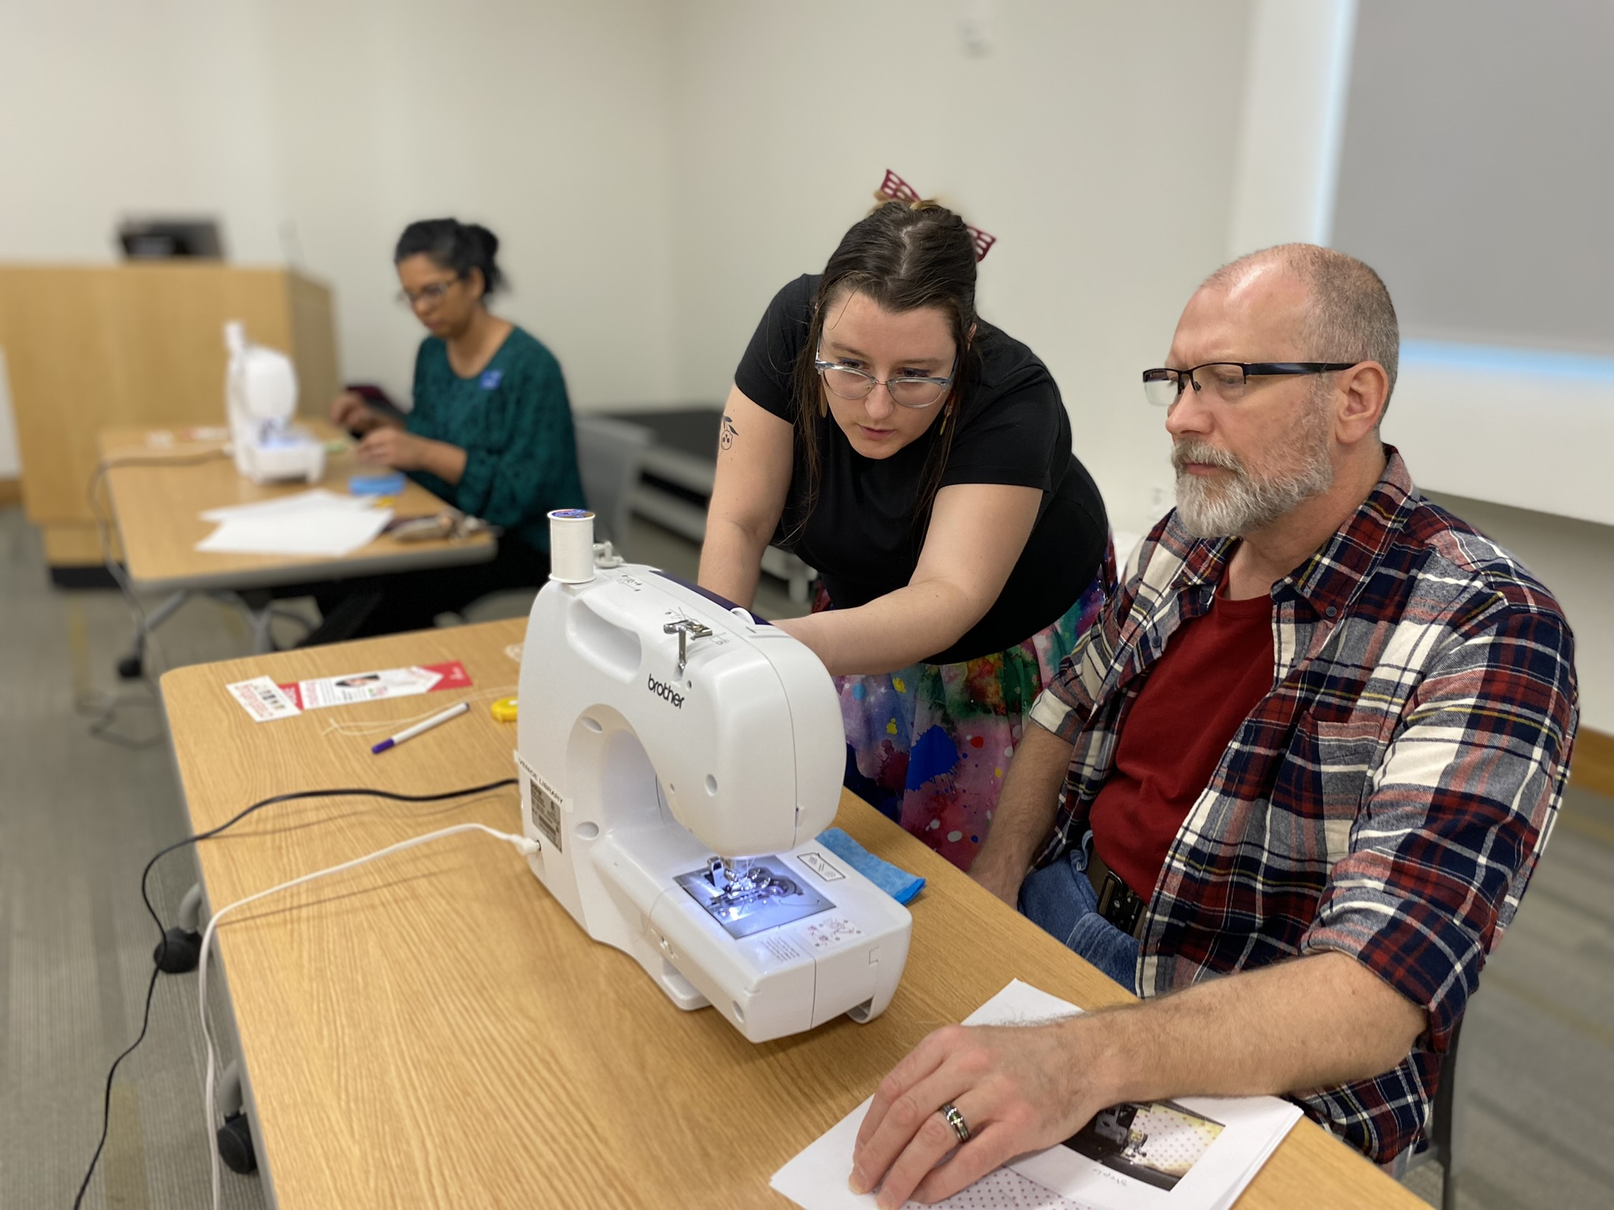
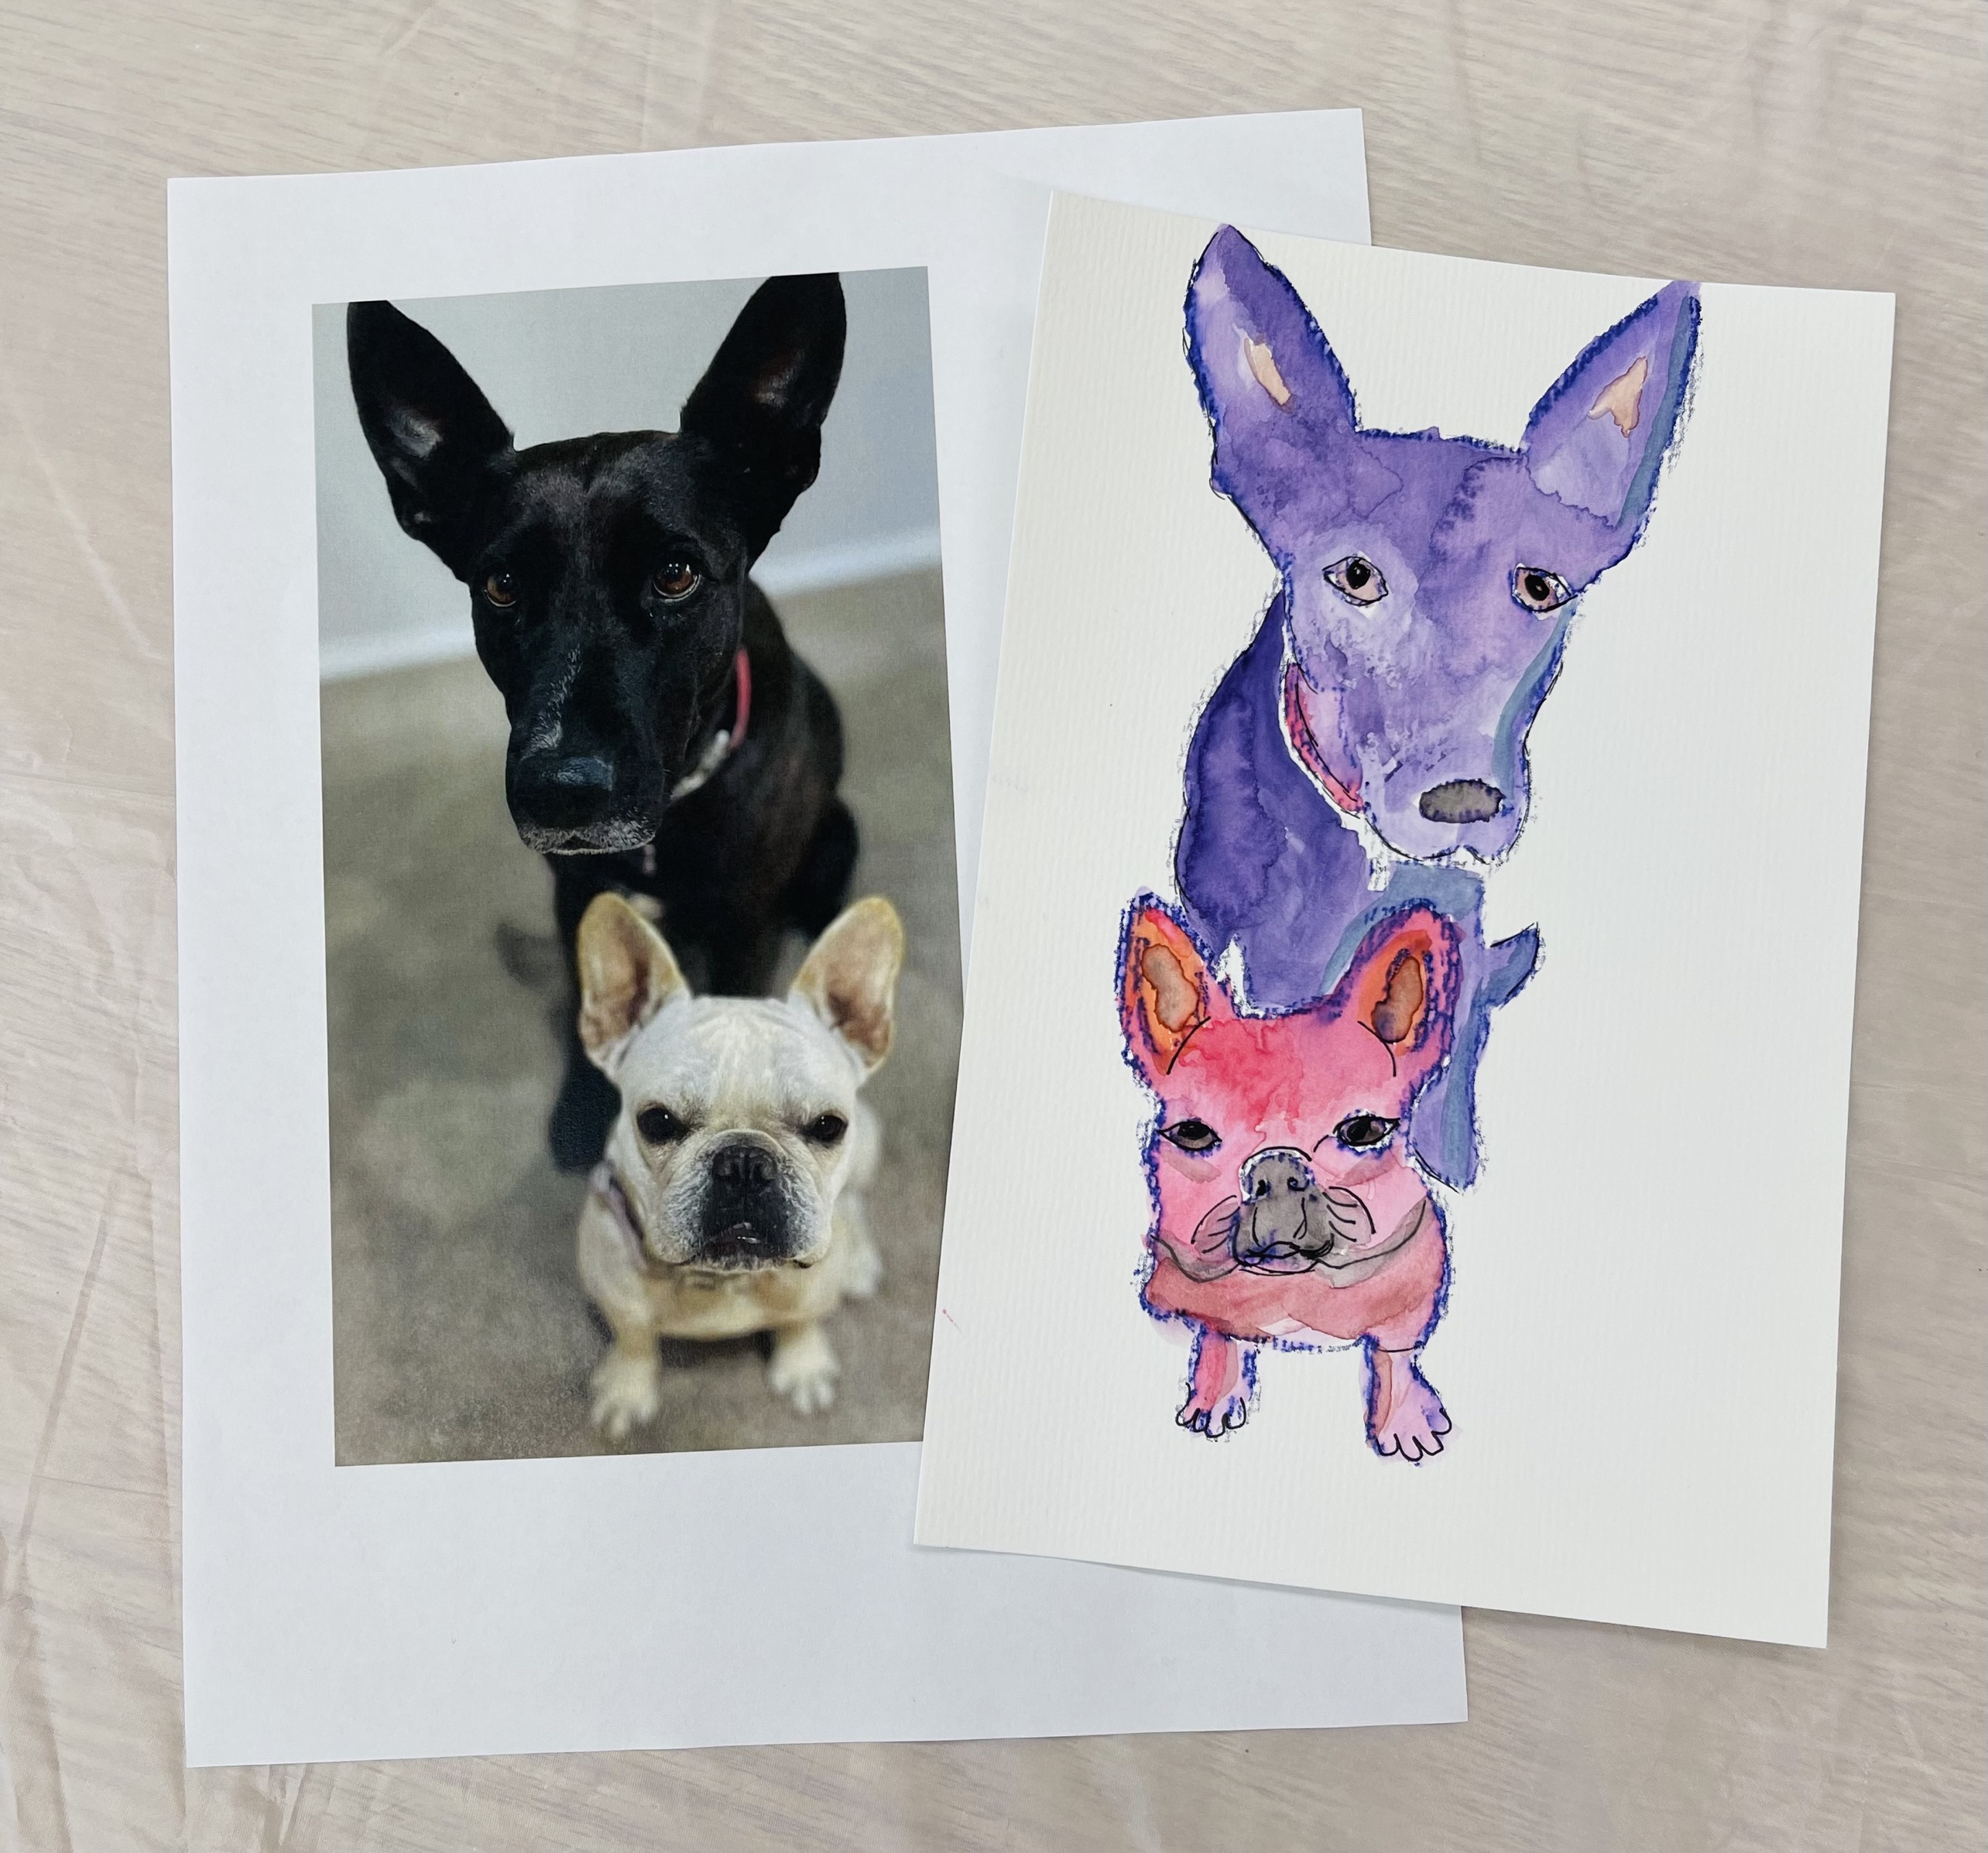
Core Elements: Programs and Events
LONGBOAT KEY LIBRARY – WORKSHOP #2
Art classes
Author events
Book clubs
Crafts
History topics
Musical performances
Reading programs
Spanish language instruction
Speakers on current events and local interests
Travel
Writing workshops

Slide 10
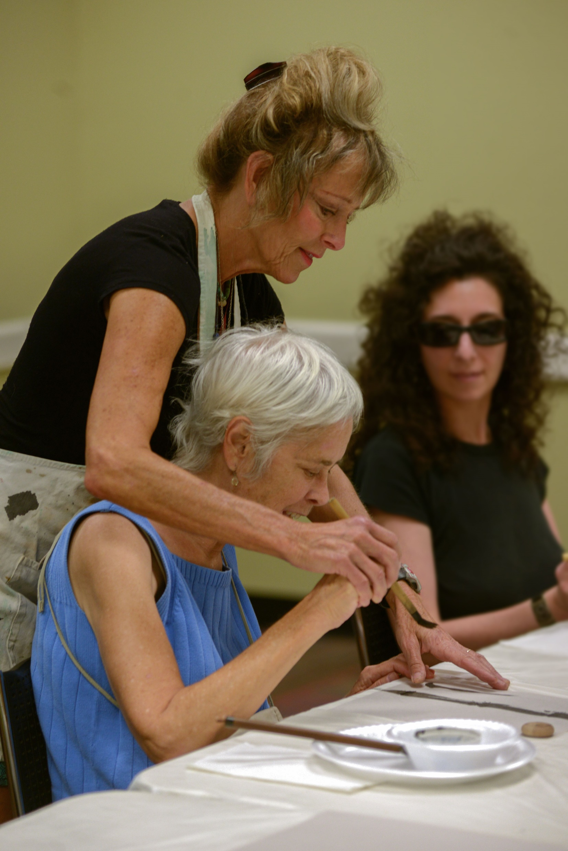
Libraries and Historical Resources Strategic Plan
LONGBOAT KEY LIBRARY – WORKSHOP #2
Seven unique focus areas
Emphasis on programming
Driving force for program development
Bringing consistent offerings to every library

Slide 11
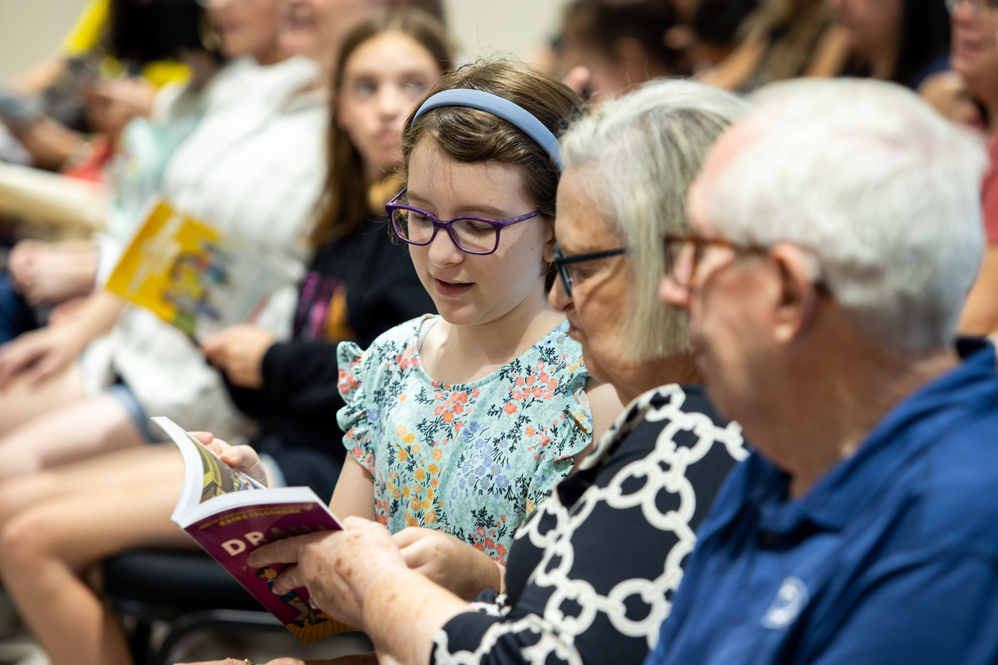
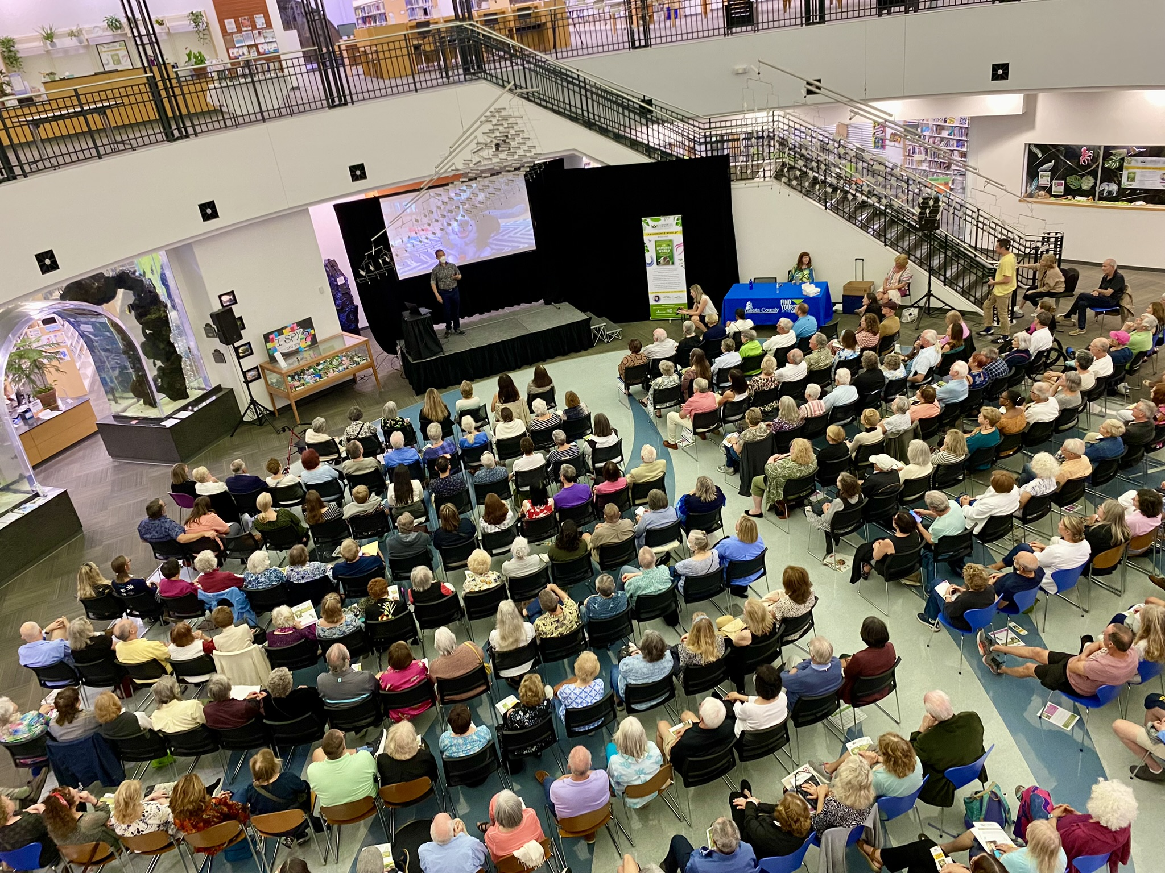
Library as Community Convener
LONGBOAT KEY LIBRARY – WORKSHOP #2
“I love that my library is a community hub. Libraries often serve as community gathering places, hosting events, workshops, book clubs, and other activities that bring people together. This sense of community and connection can foster a love for the library as a social space.”

Slide 12
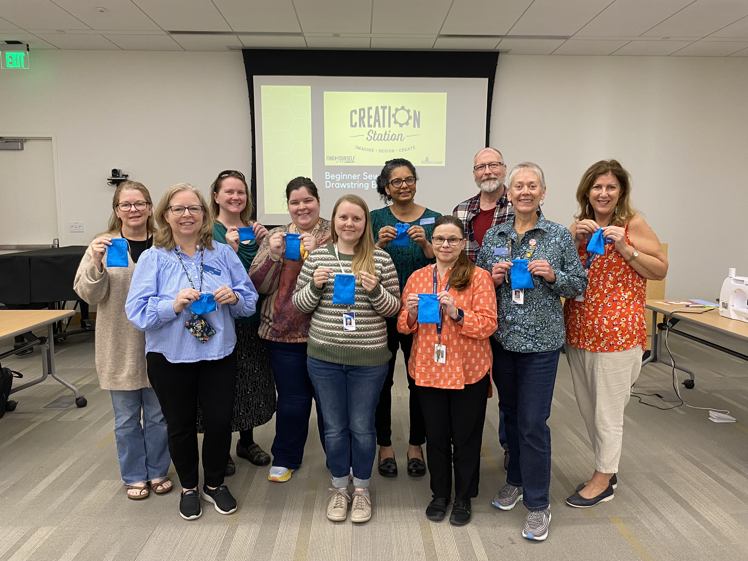
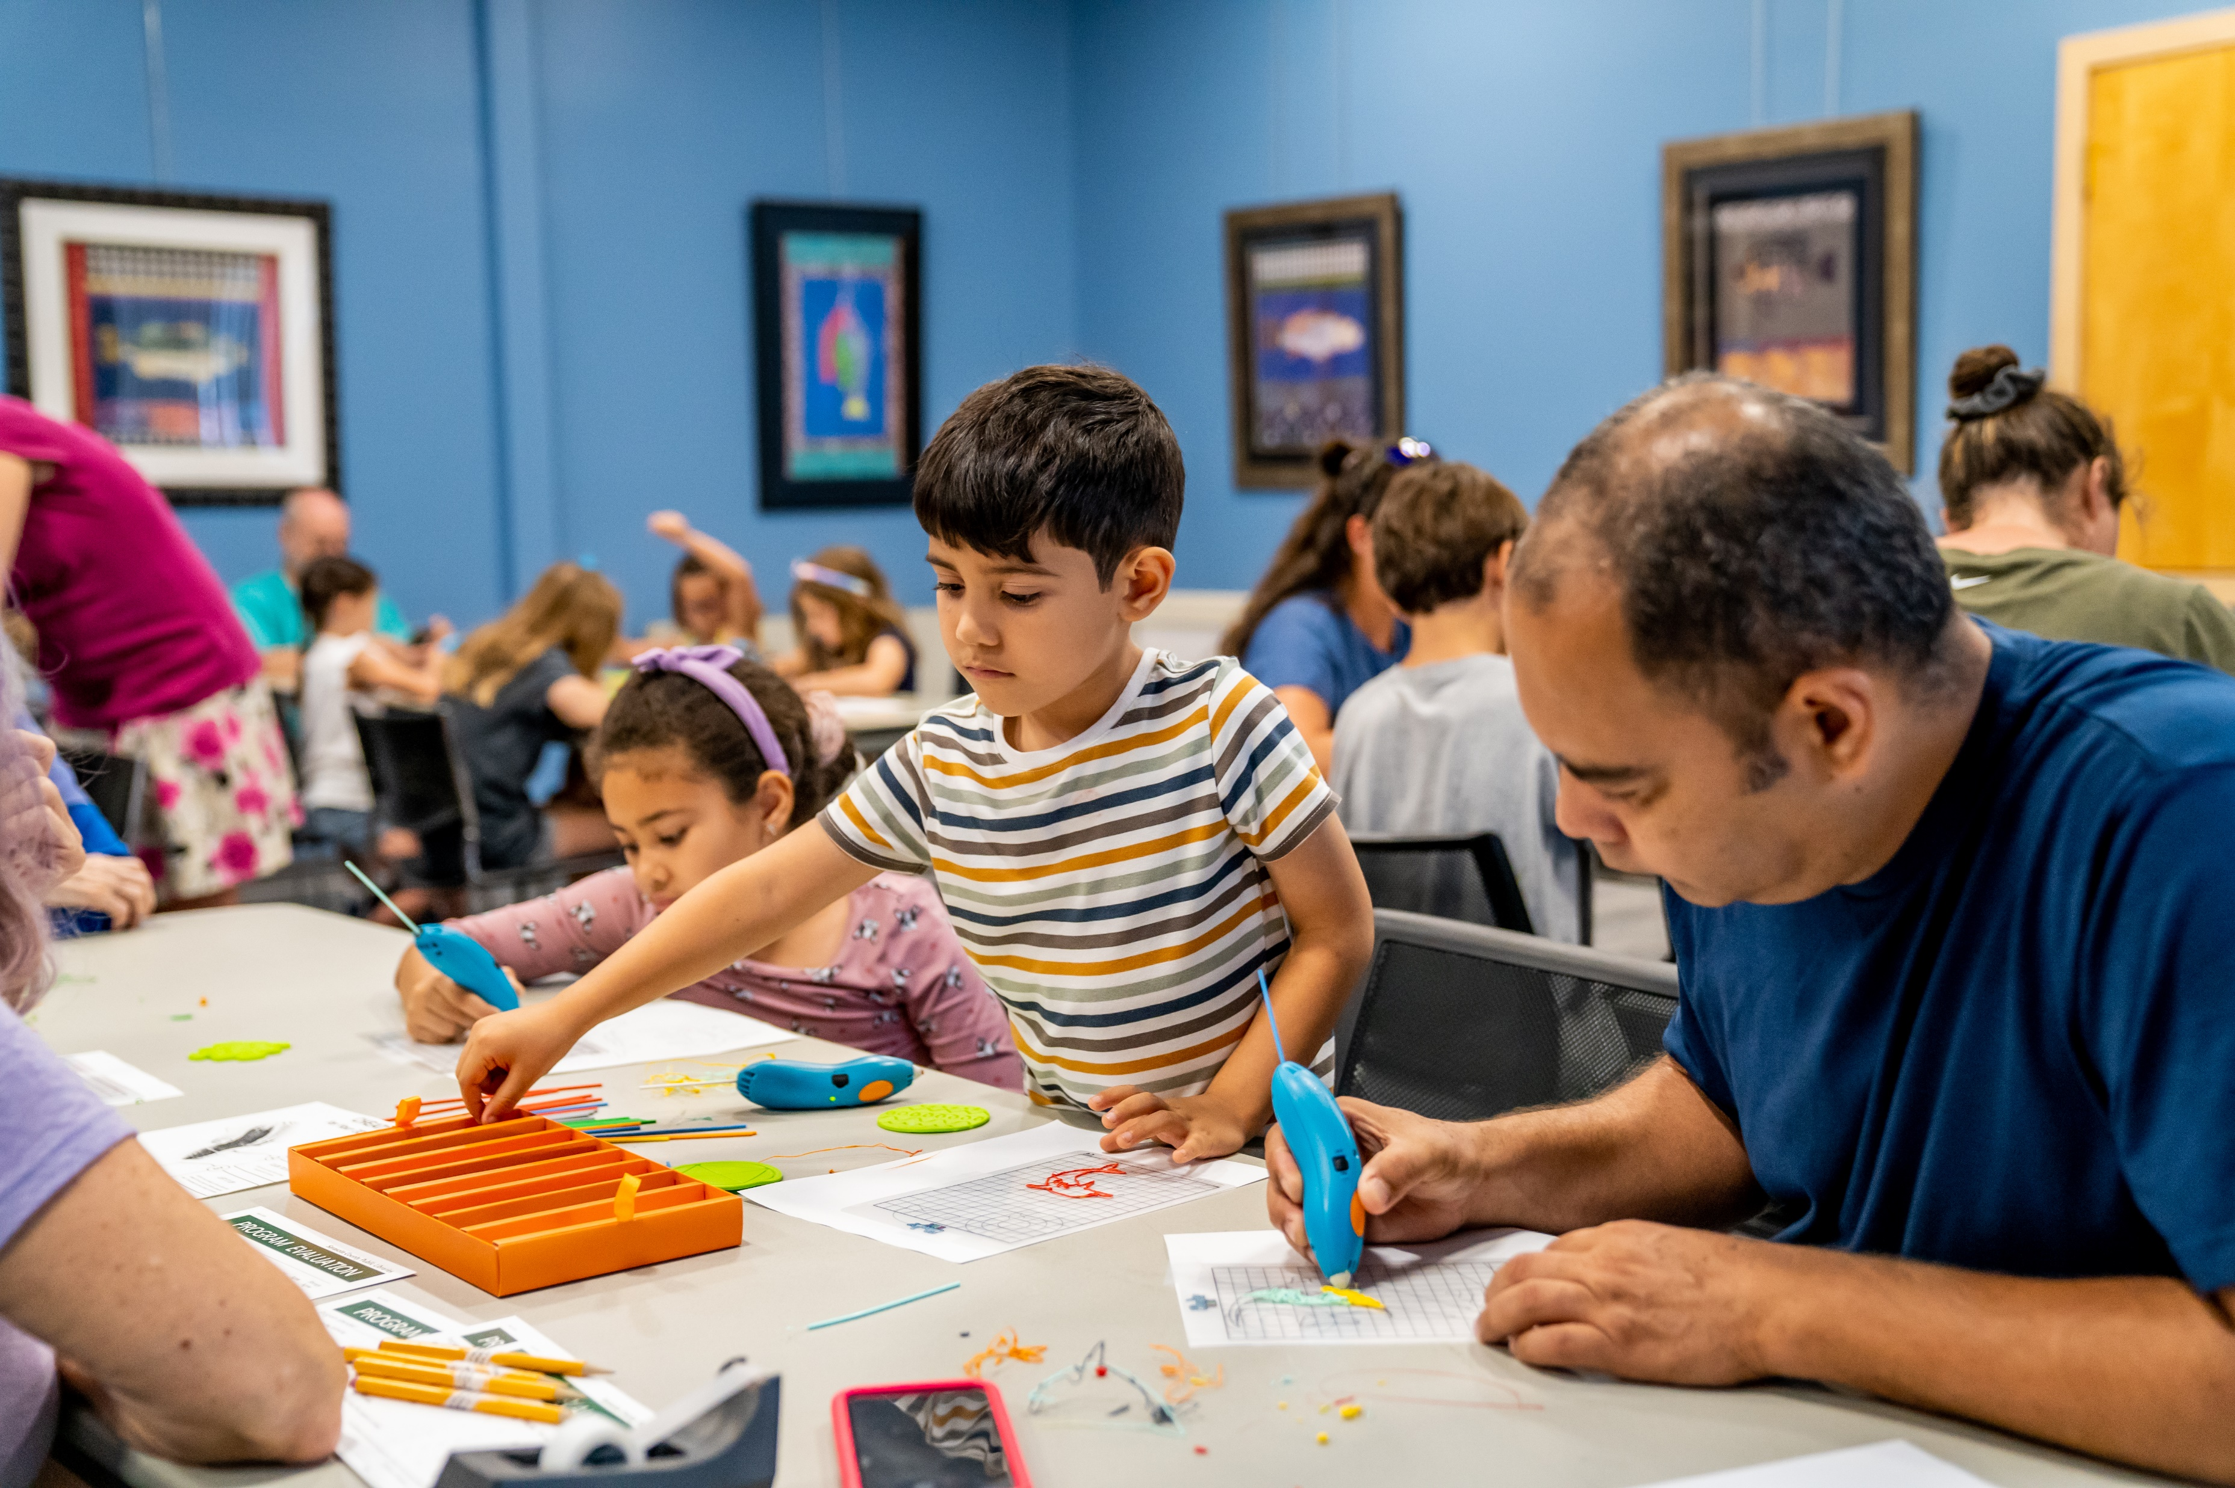
Lifelong Learning
“It is the hub of the community! I really appreciate all of the free programs which give me an opportunity to try something new, i.e. origami, jewelry design, art projects and soap making. I also enjoy going to the lectures, particularly those that are history-related. I visit at least twice a week to attend a program or check out books and CDs.”
LONGBOAT KEY LIBRARY – WORKSHOP #2

Slide 13
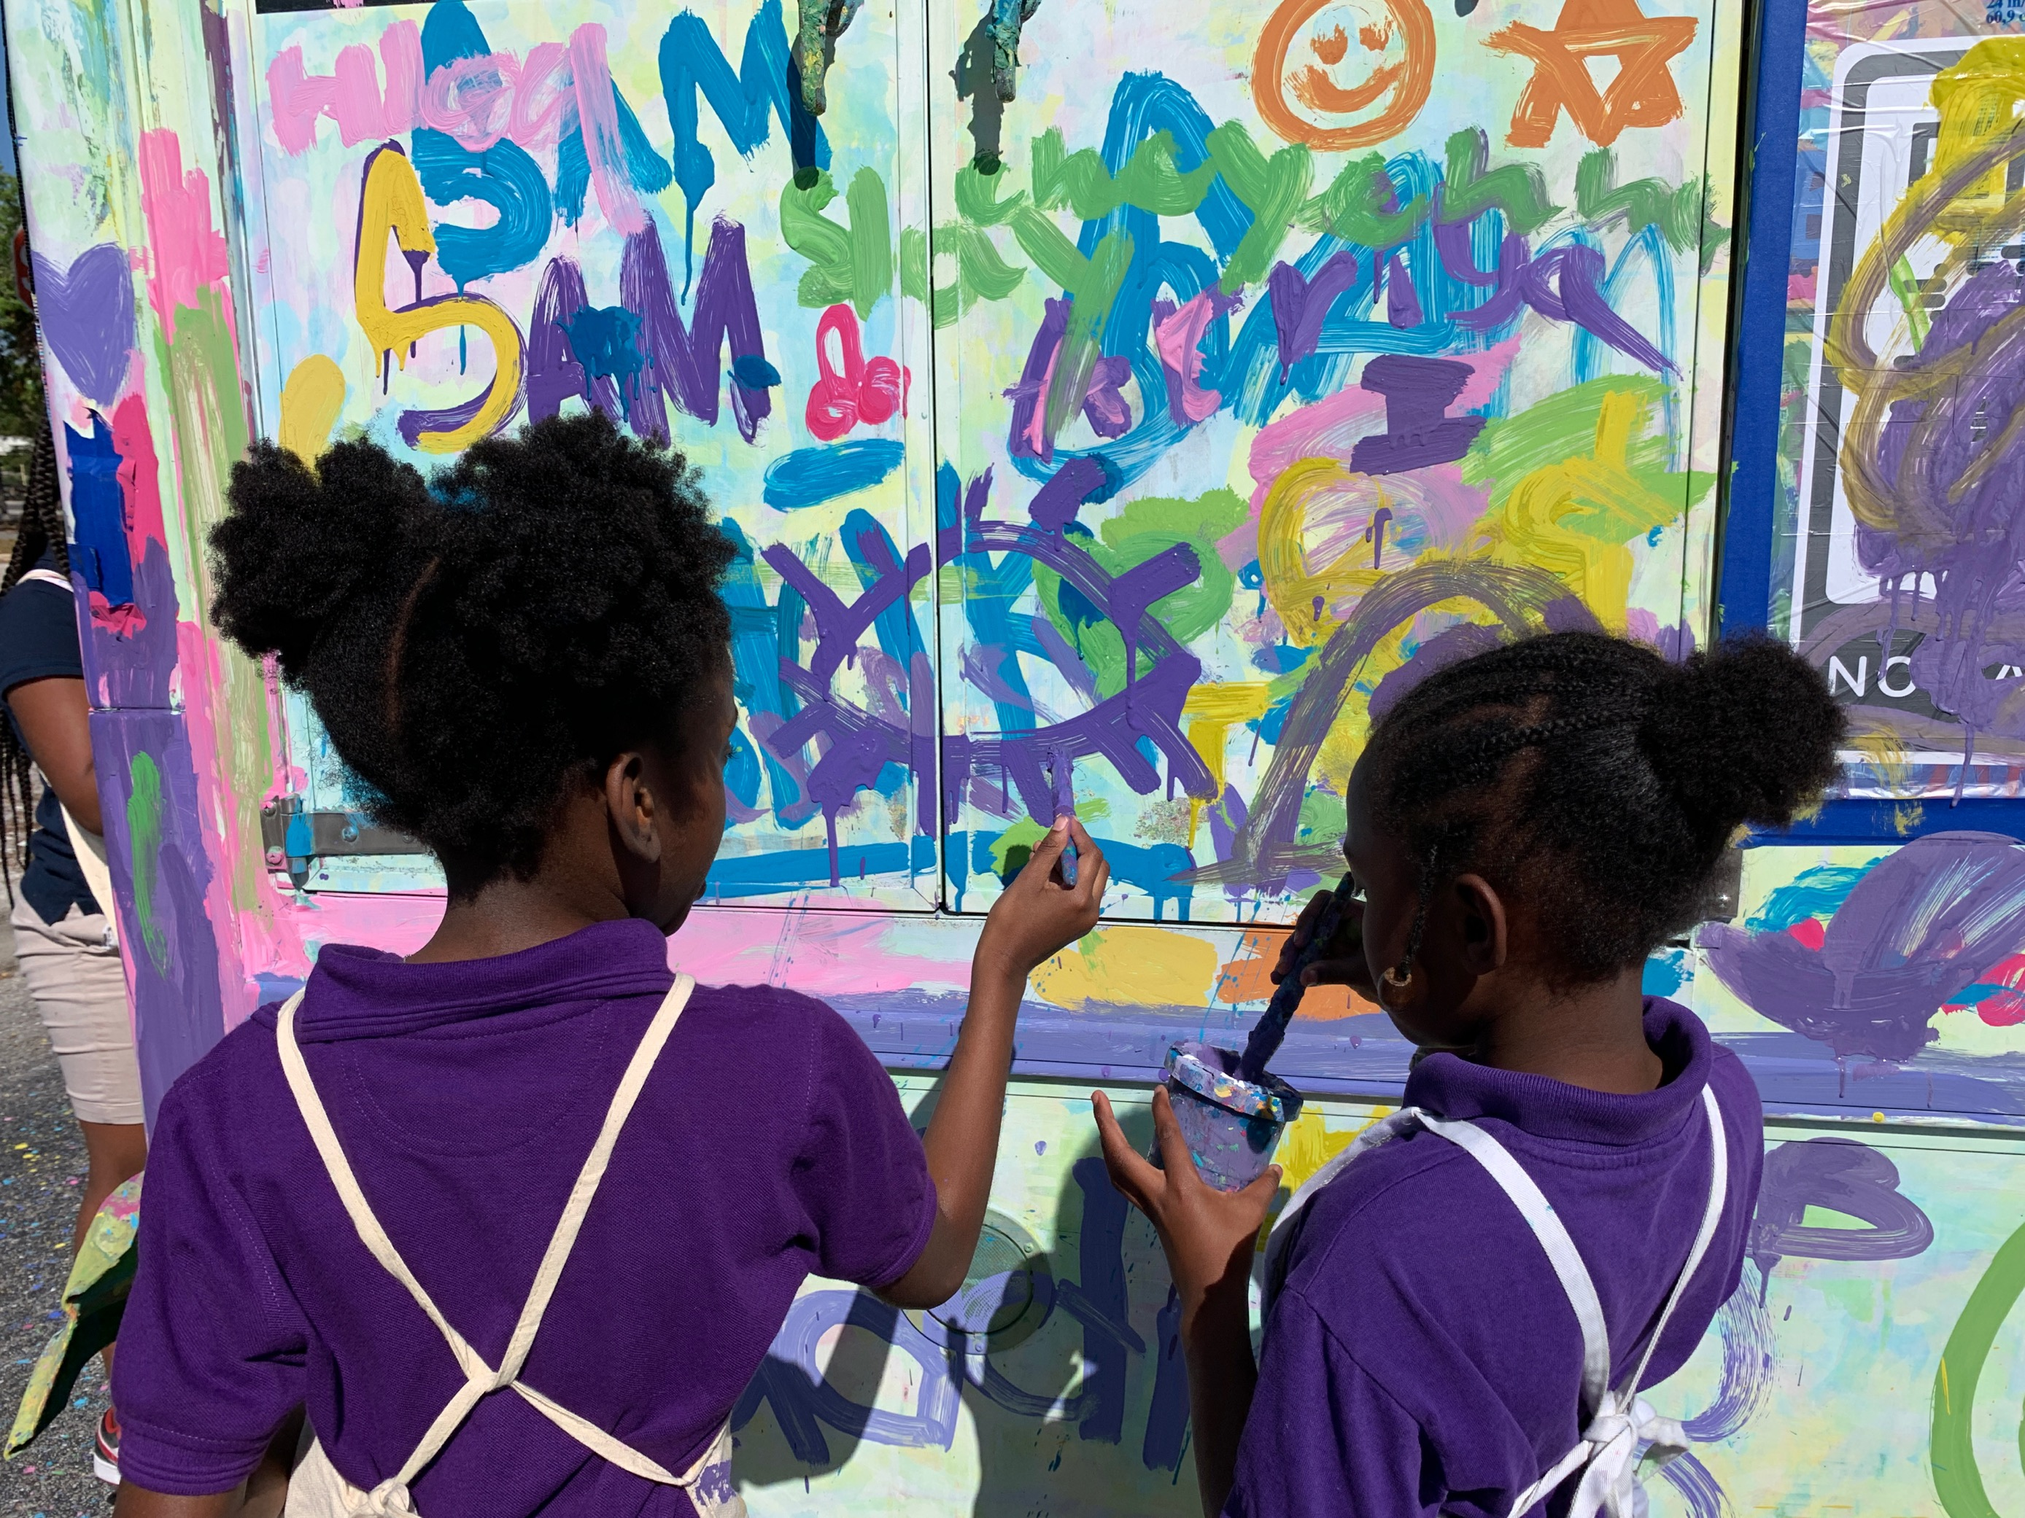
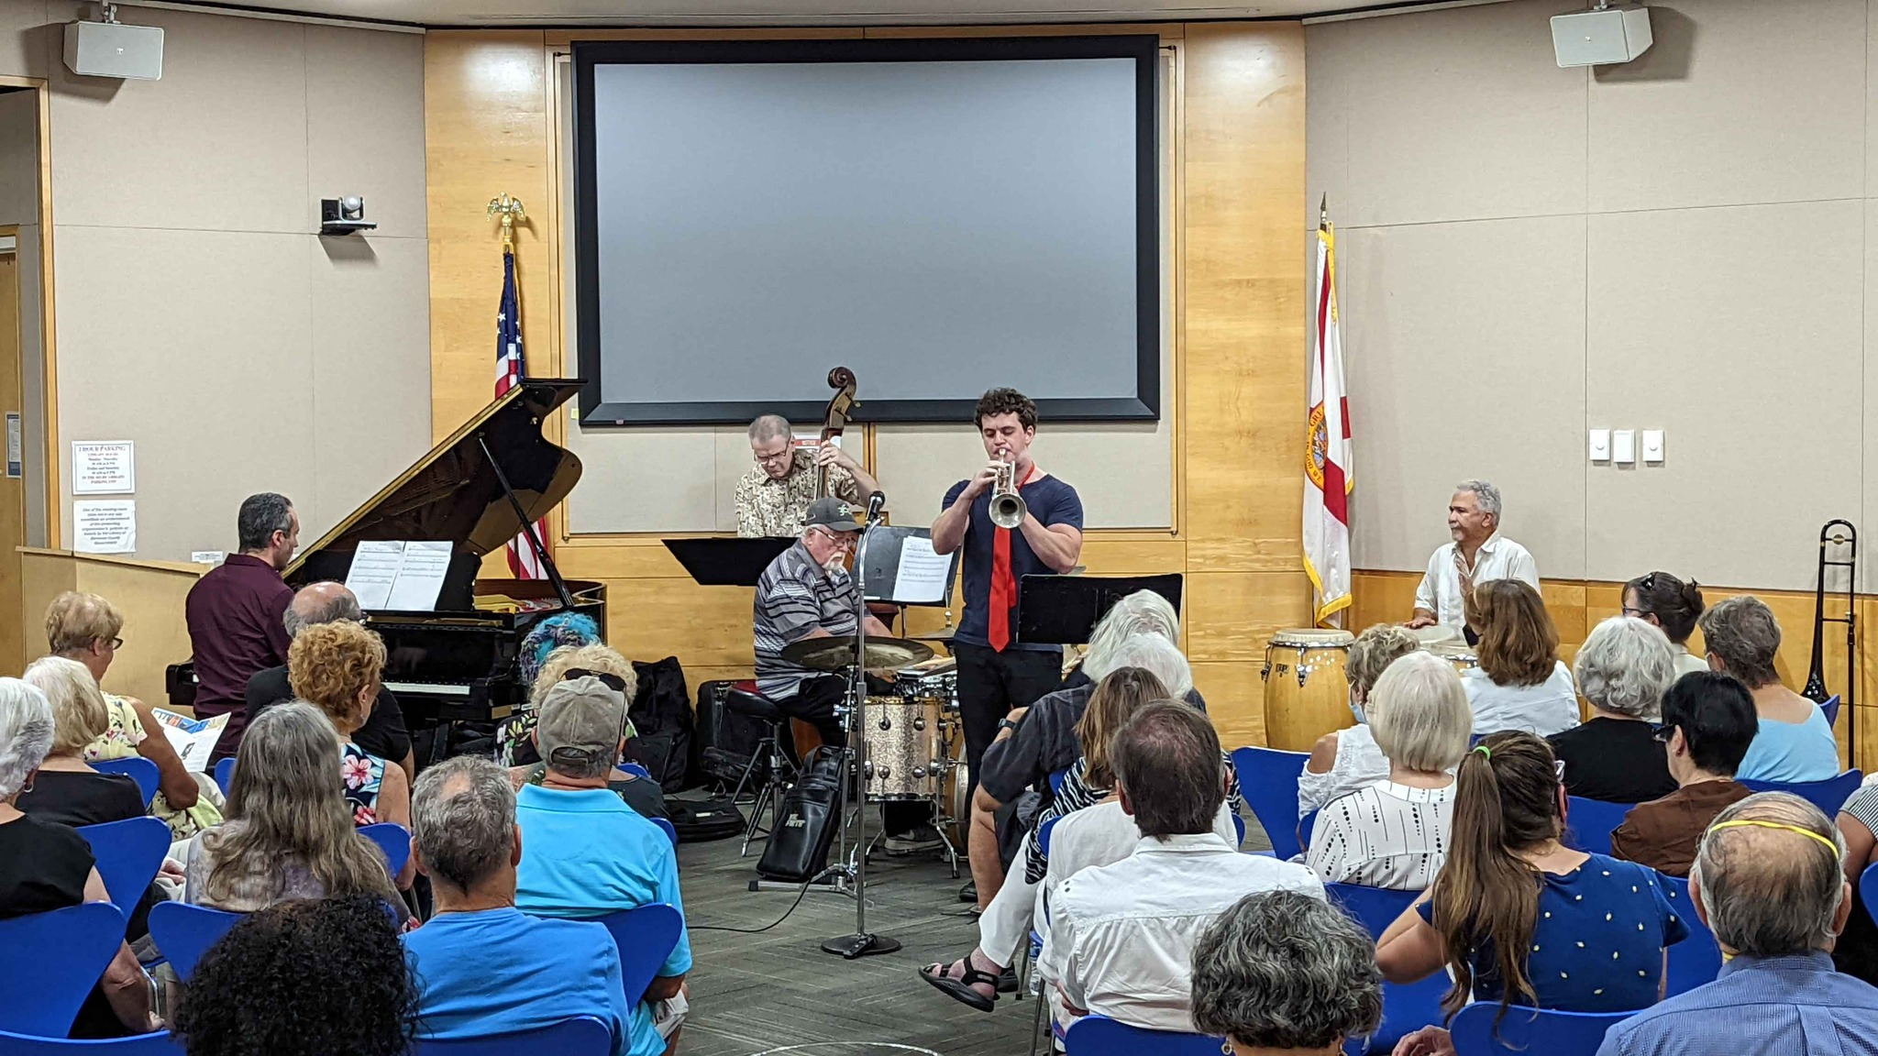
Vibrant Cultural Life
LONGBOAT KEY LIBRARY – WORKSHOP #2
“I can't tell you when I've been to an event with such a broad demographic. It was refreshing and exciting, and a perfect symbol of the fact that the library system is here for everyone in our community. A huge success in my book (pun intended).”

Slide 14
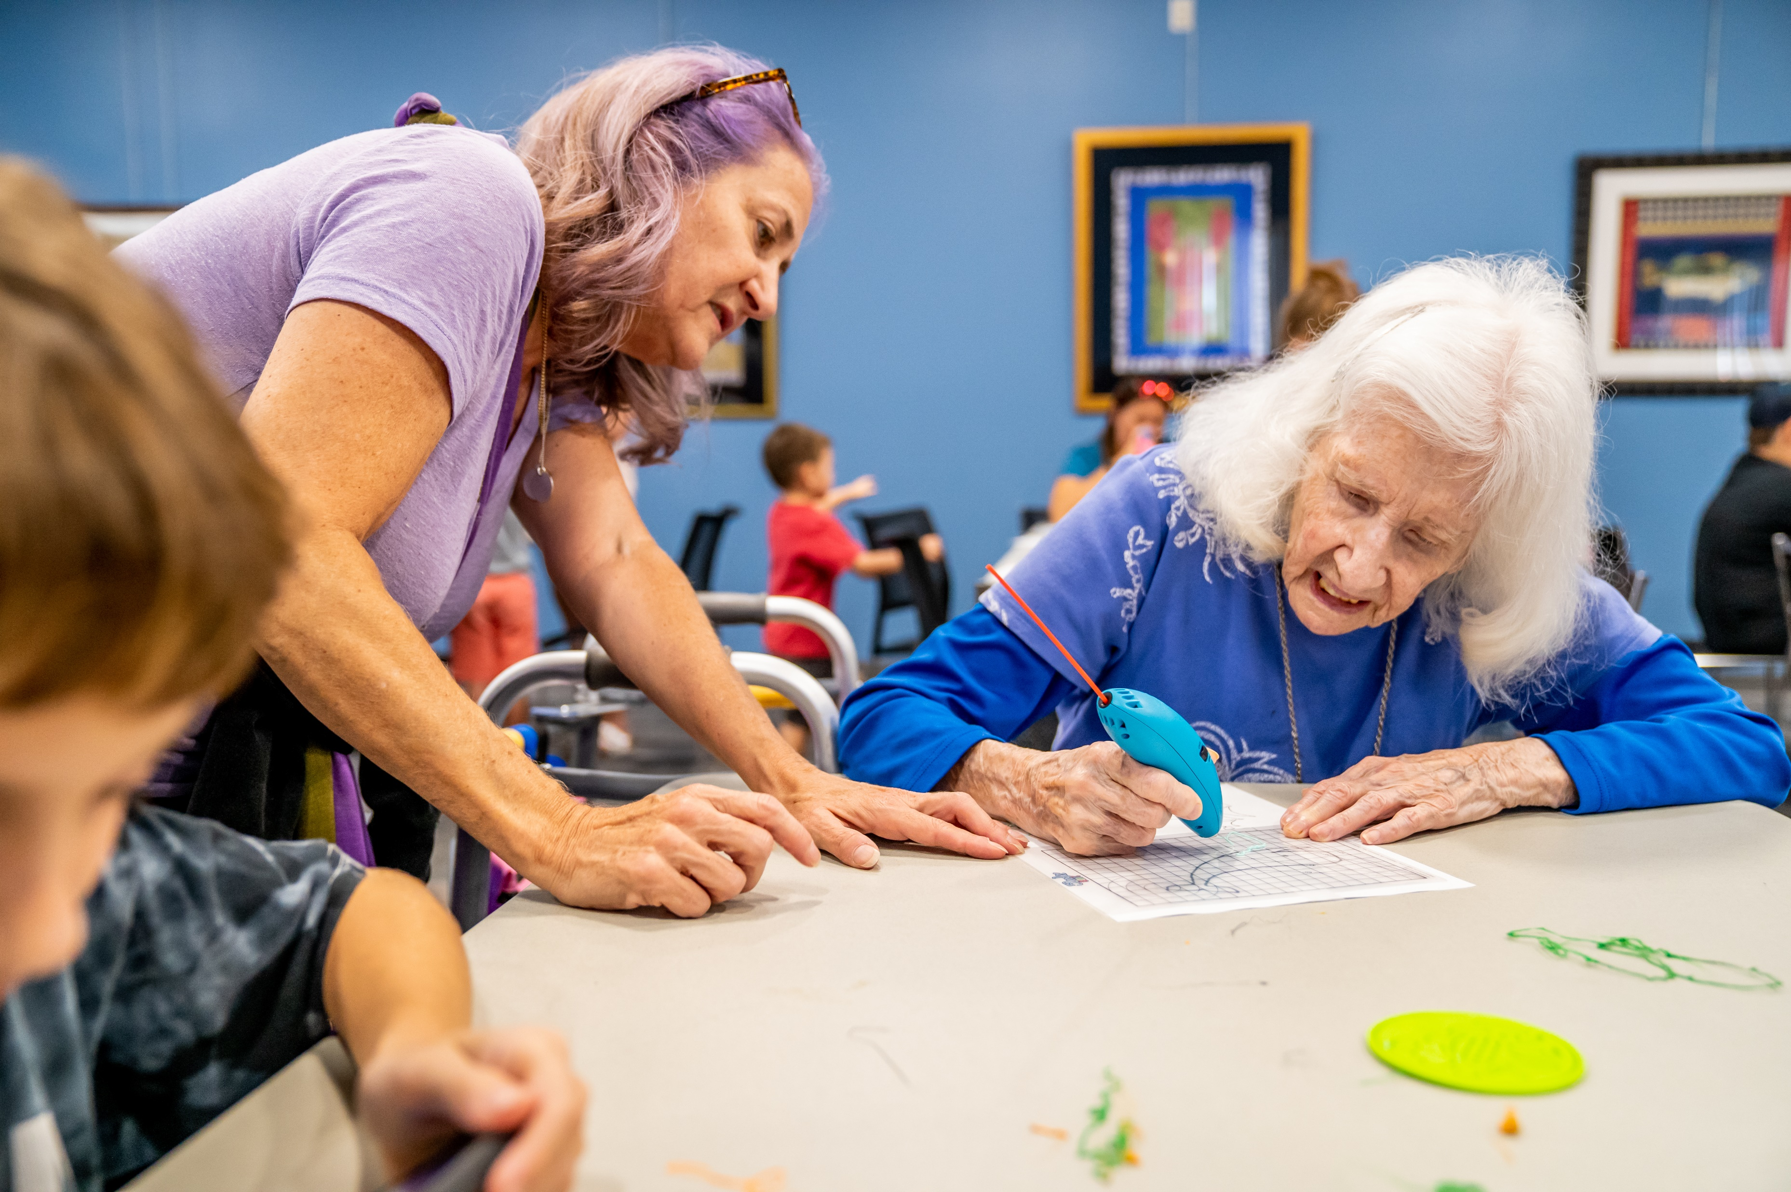
Active Older Adults
LONGBOAT KEY LIBRARY – WORKSHOP #2
“For those who live alone, it can be the only time they have social interaction and feel connected. Our library is a vital contributor to the well being of its residents.”

Slide 15
Healthy Living
  “The library is a haven that supports mental health and interaction in the community.”
LONGBOAT KEY LIBRARY – WORKSHOP #2

Slide 16
Workshop 1: Suggested Enhancements
LONGBOAT KEY LIBRARY – WORKSHOP #2
Upsized meeting room
Activated outdoor spaces
Deck/terrace open or covered

Slide 17
17

Slide 18
18

Slide 19
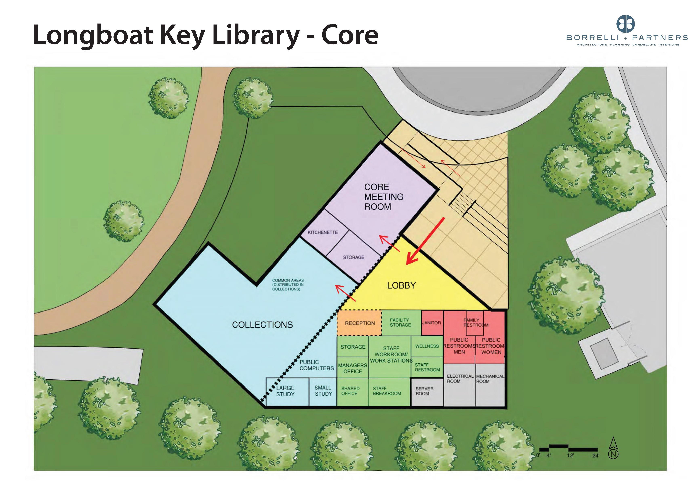
19

Slide 20
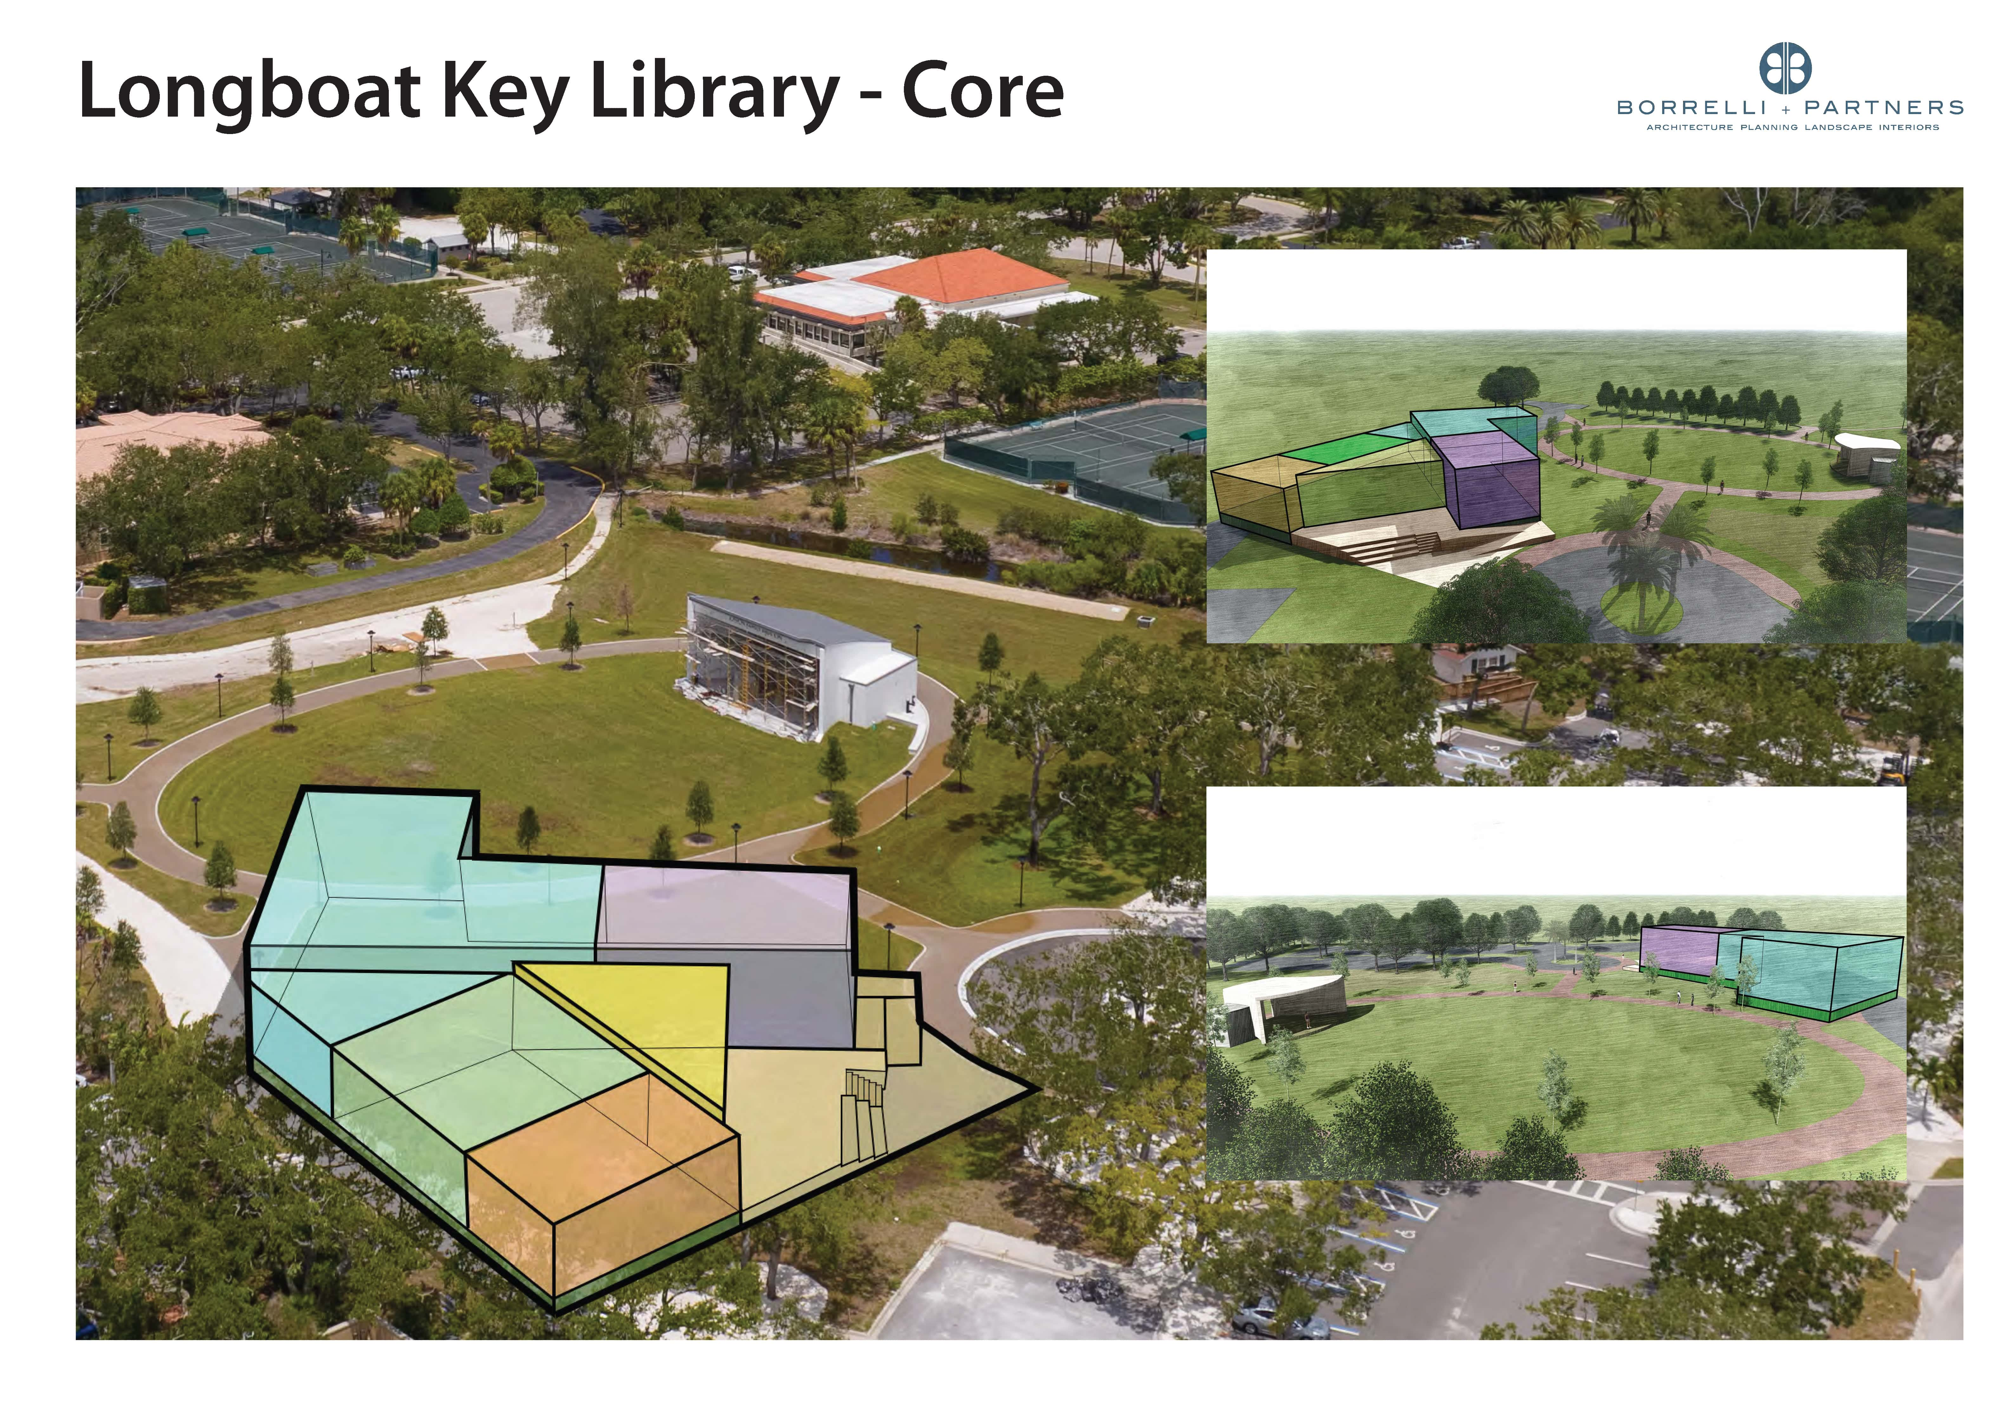
20

Slide 21
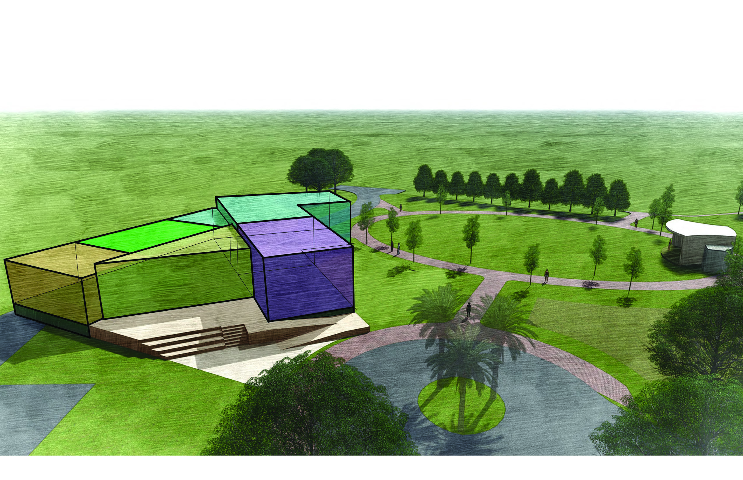
21

Slide 22
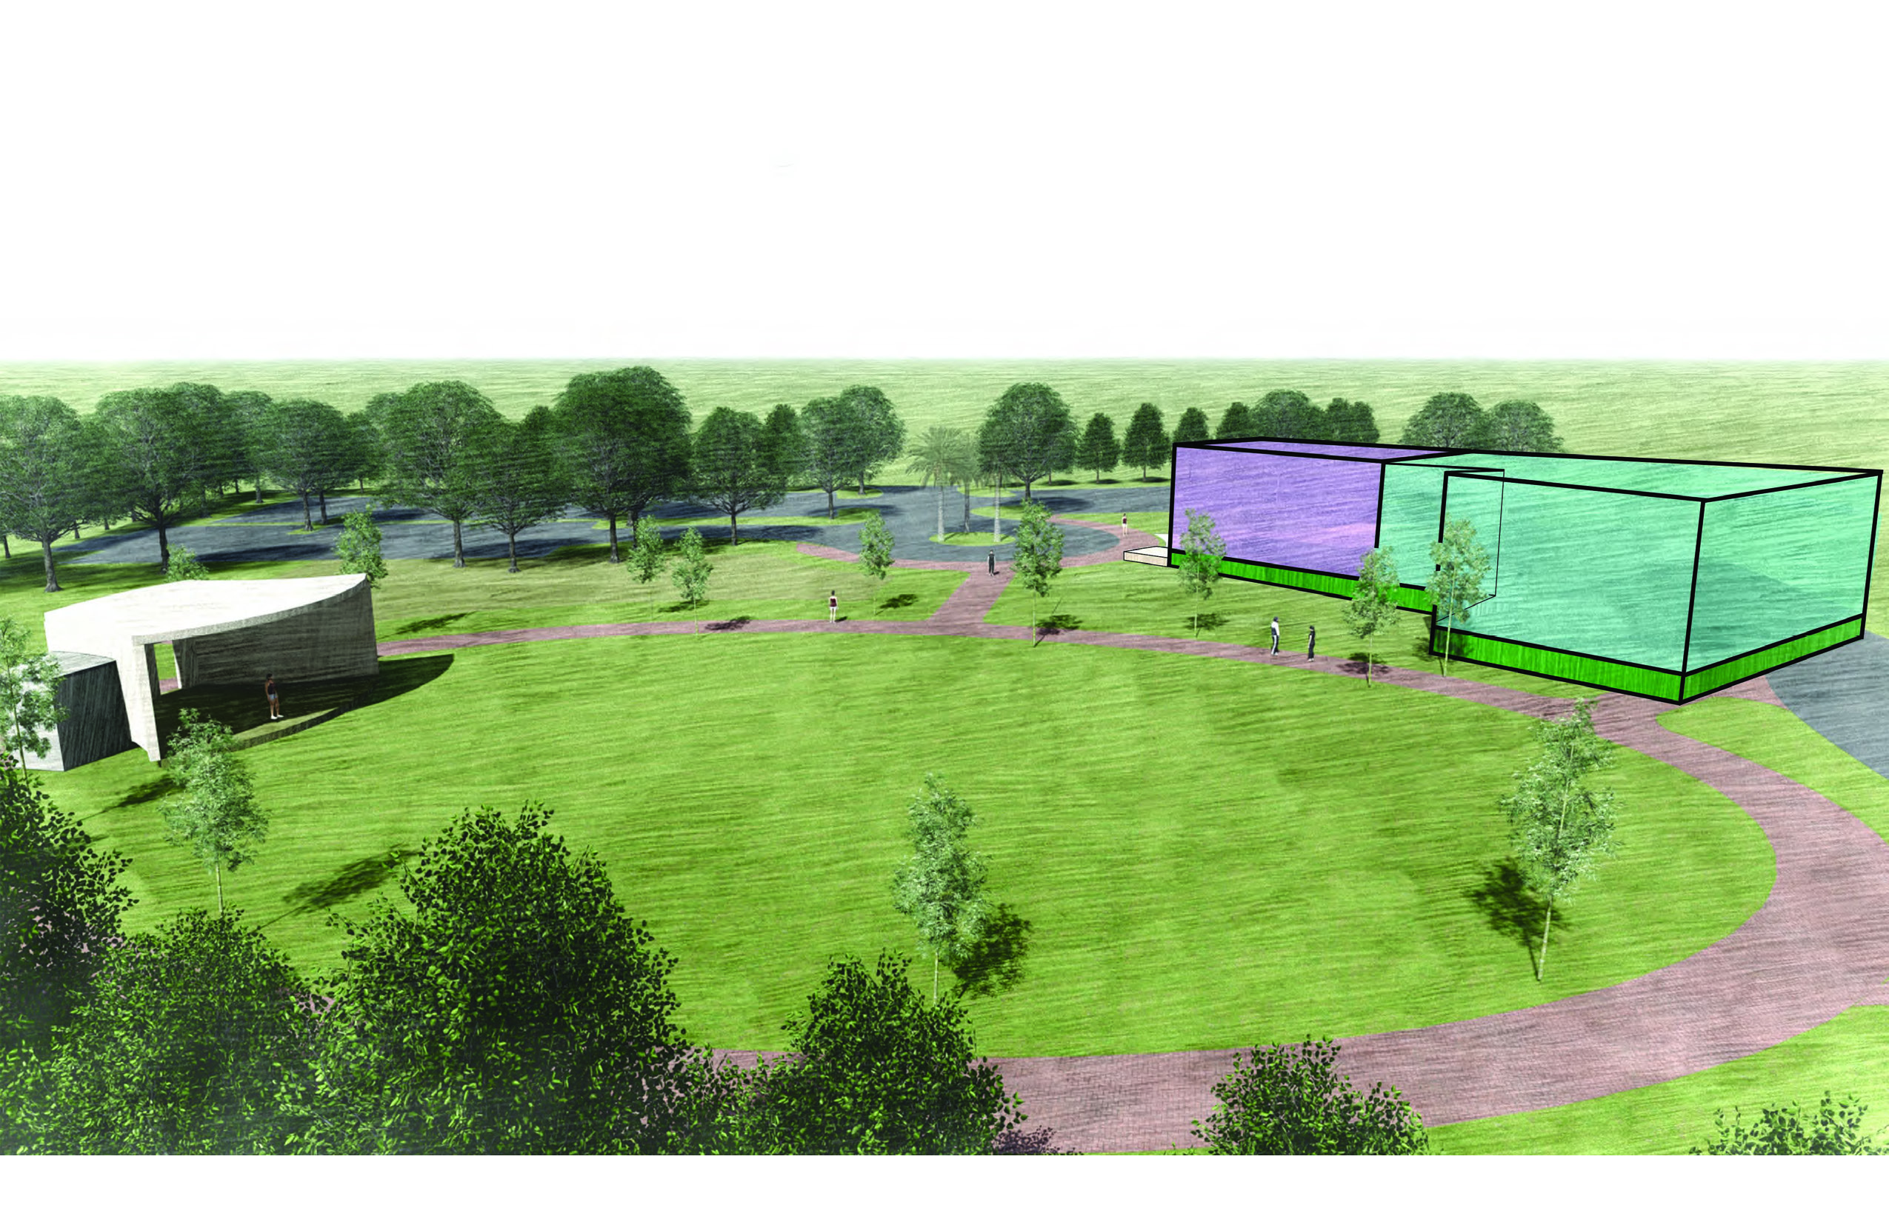
22

Slide 23
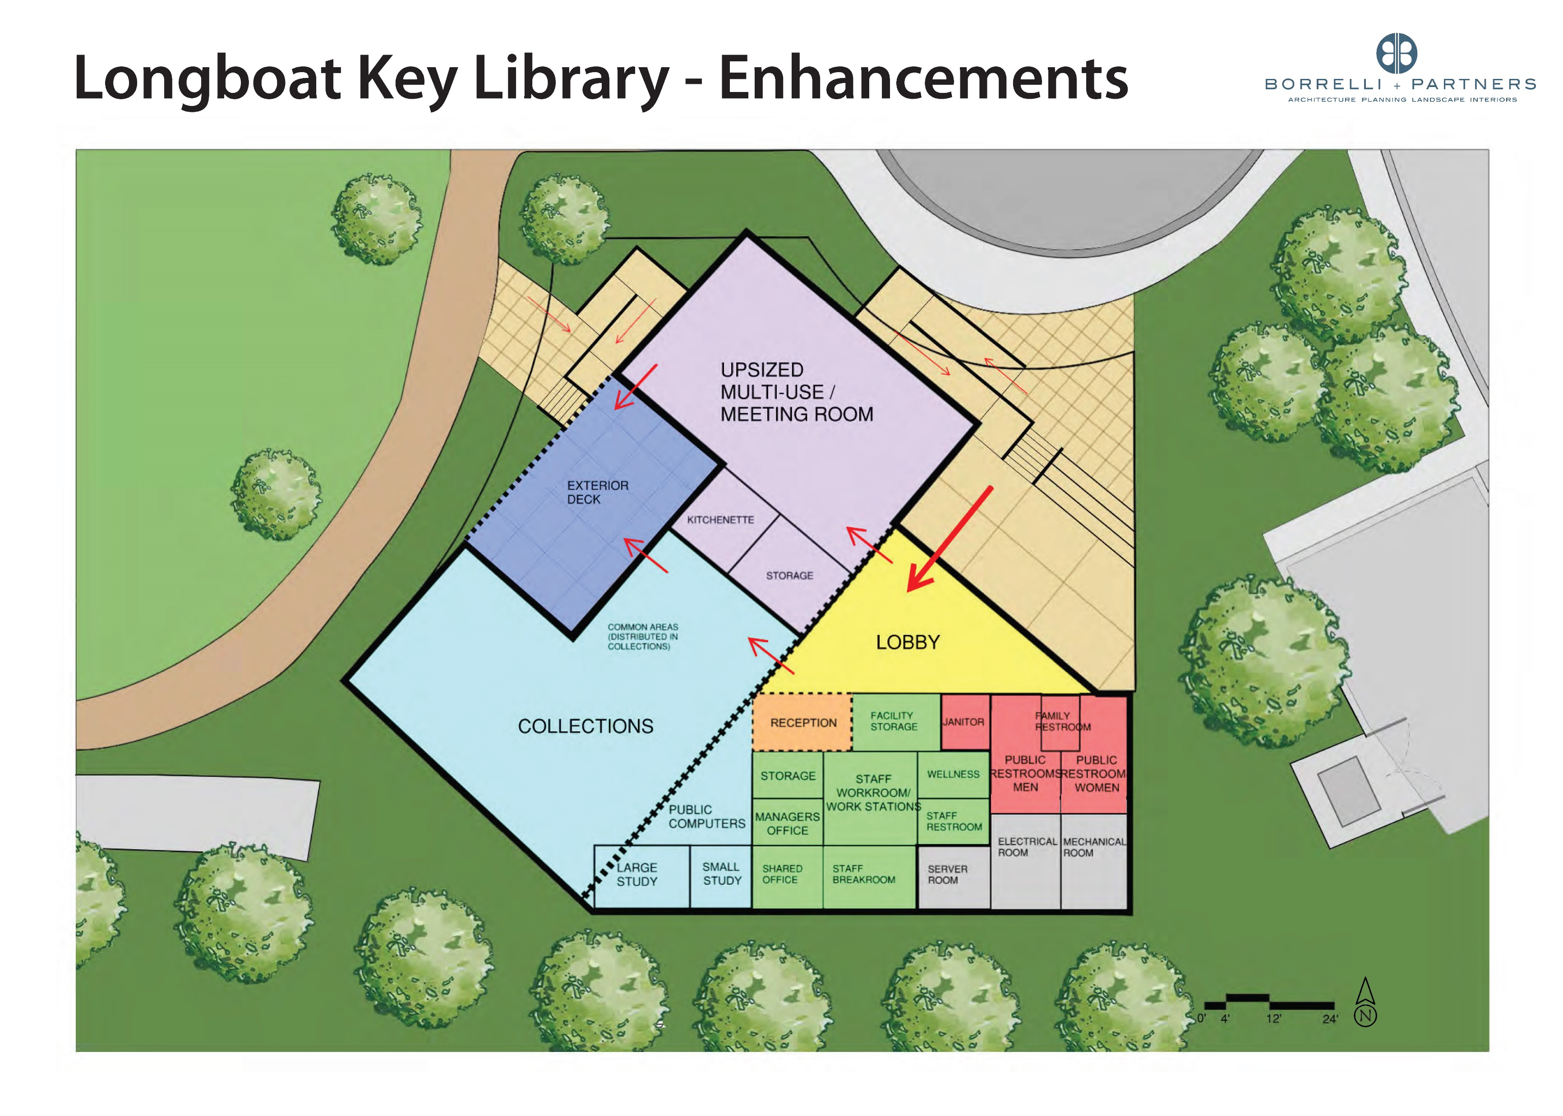
23

Slide 24
24

Slide 25
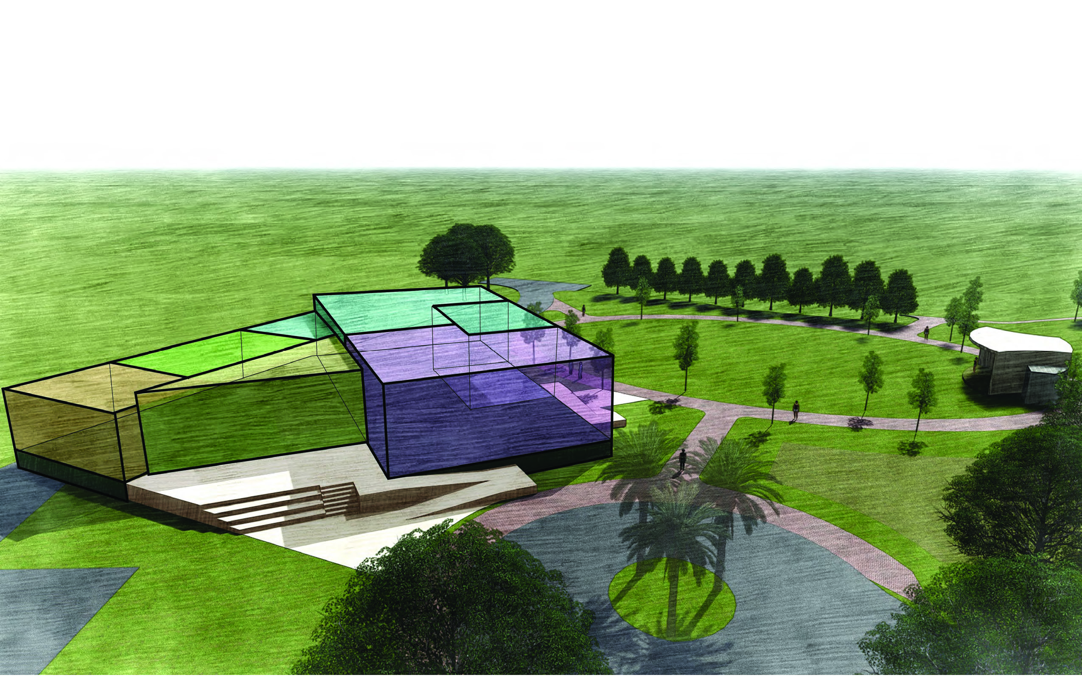
25

Slide 26
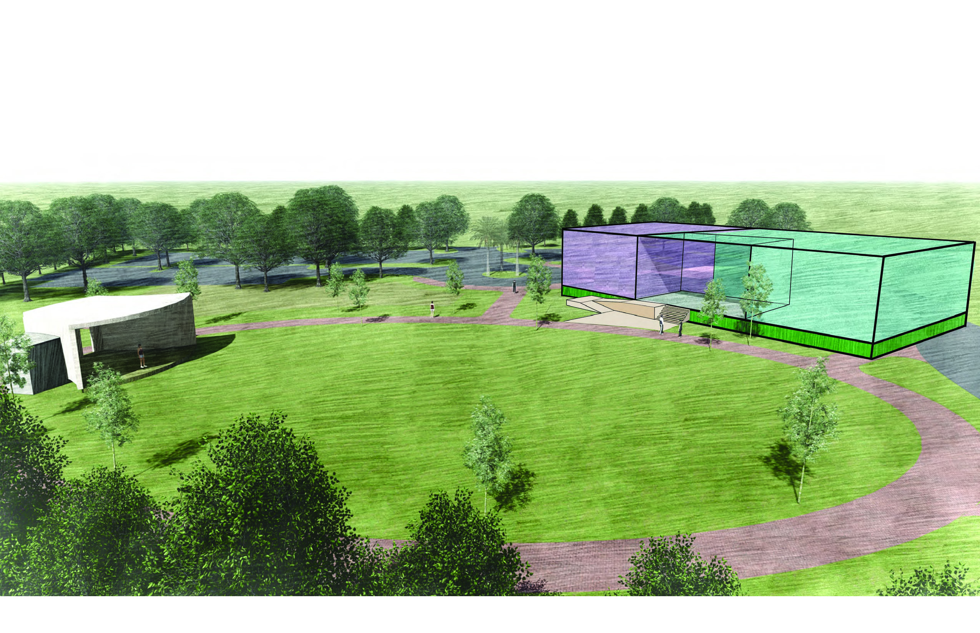
26

Slide 27
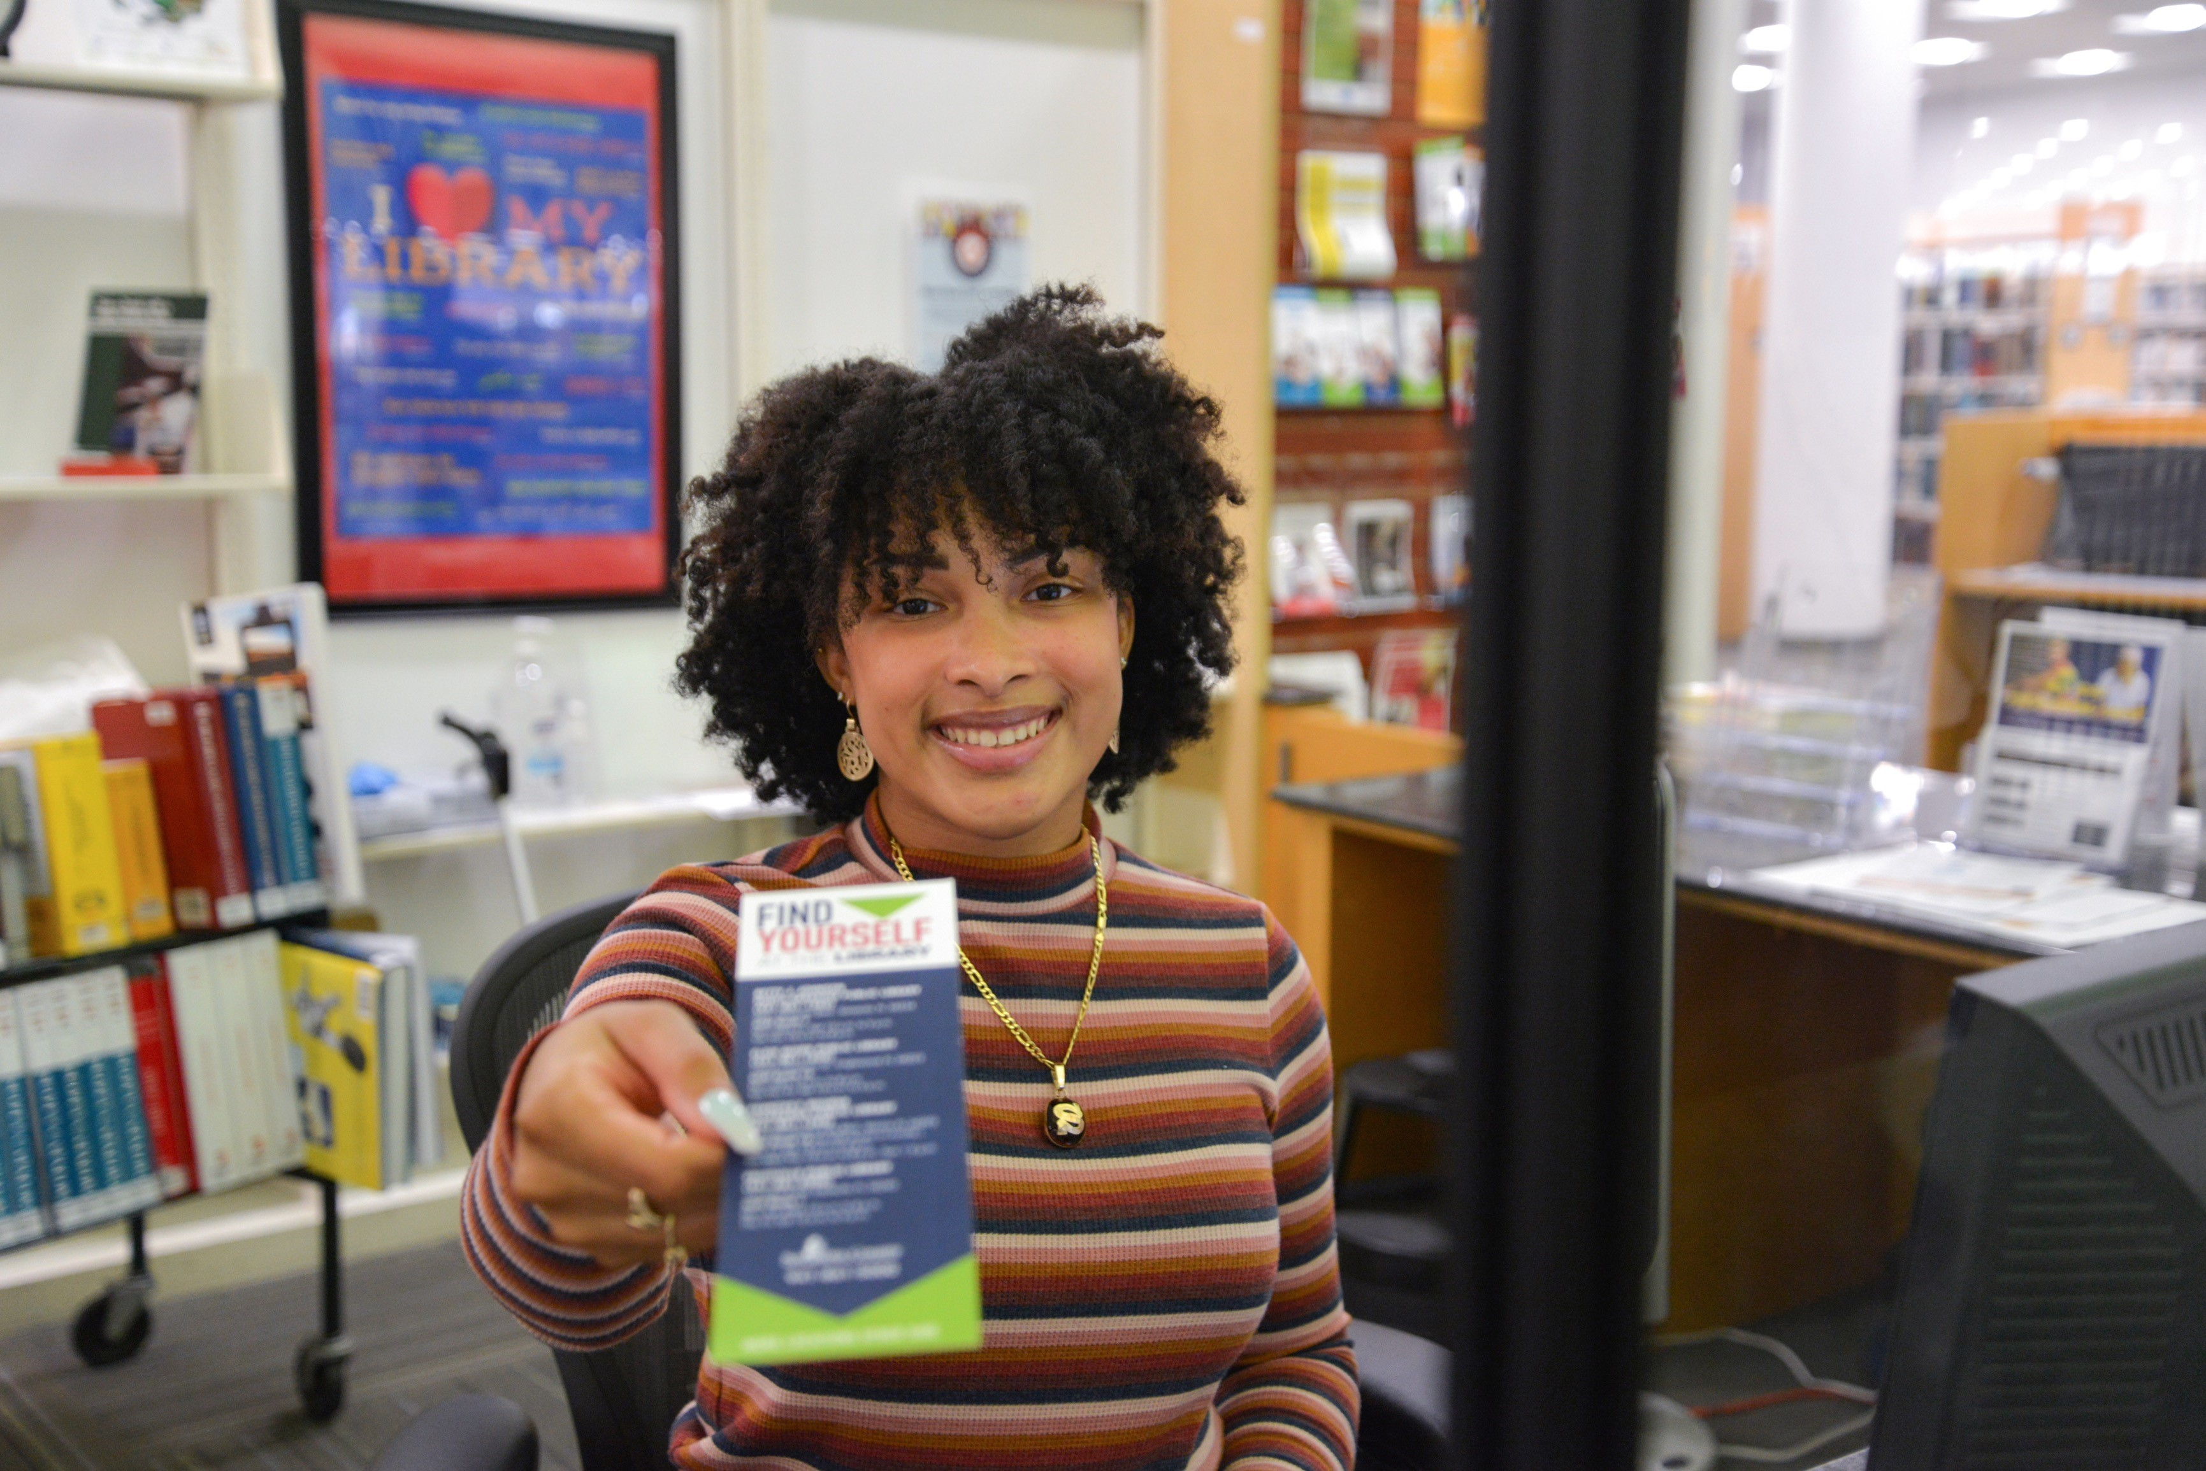
LONGBOAT KEY LIBRARY – WORKSHOP #2
Feedback/Comments

Slide 28
LONGBOAT KEY LIBRARY – WORKSHOP #2
Next Steps After Today:
  Design Options (April)
      Core Library Elements
      Potential Enhancement(s)
  Fundraising Effort (May to August)
  Estimated completion of construction is end of 2026

