Slide 1
Sarasota County
Library Design
April 1, 2024
Notes:
Good afternoon, for the record I’m Carolyn Brown, Support Services Director here to discuss the design of the Sarasota County Library on Longboat Key.

Slide 2
Recap of Public Workshop Held 3/18/24
Approximately 50 residents and interested parties attended
Town Manager began the meeting with an update on the Whitney Plaza Community Center

Slide 3
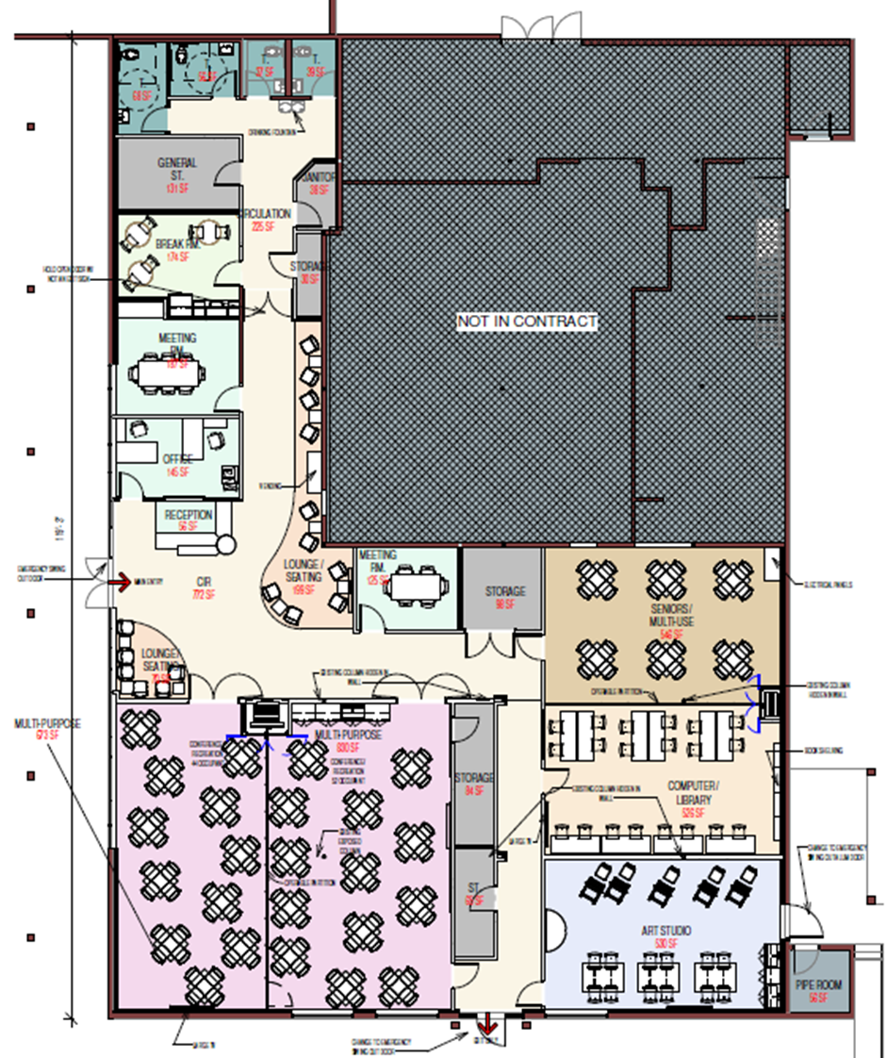
Whitney Plaza Community Center

Slide 4
Recap of Public Workshop Held 3/18/24
Sarasota County staff presented an overview of services which will be provided at new County Library for Longboat Key, as well as elements of their overall Sarasota County Library Strategic Plan which includes a heavy focus on diverse and varied programming. Also discussed was the feedback received at the first public input meeting and the key points and suggested enhancements which included:
  Upsized meeting room
  Activated outdoor spaces
  Deck/terrace open or covered
Architect Borrelli & Partners presented information on what the core and enhanced library project would include and approximate sizes of these spaces.

Slide 5
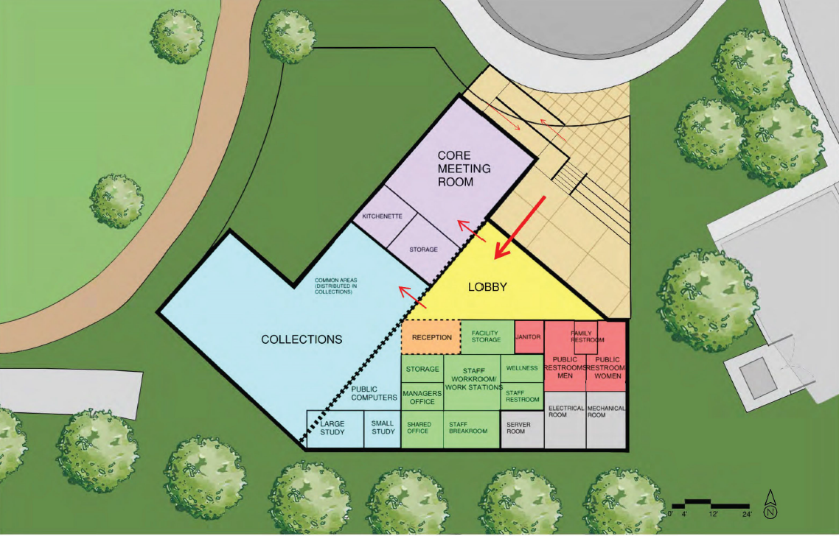
Core

Slide 6
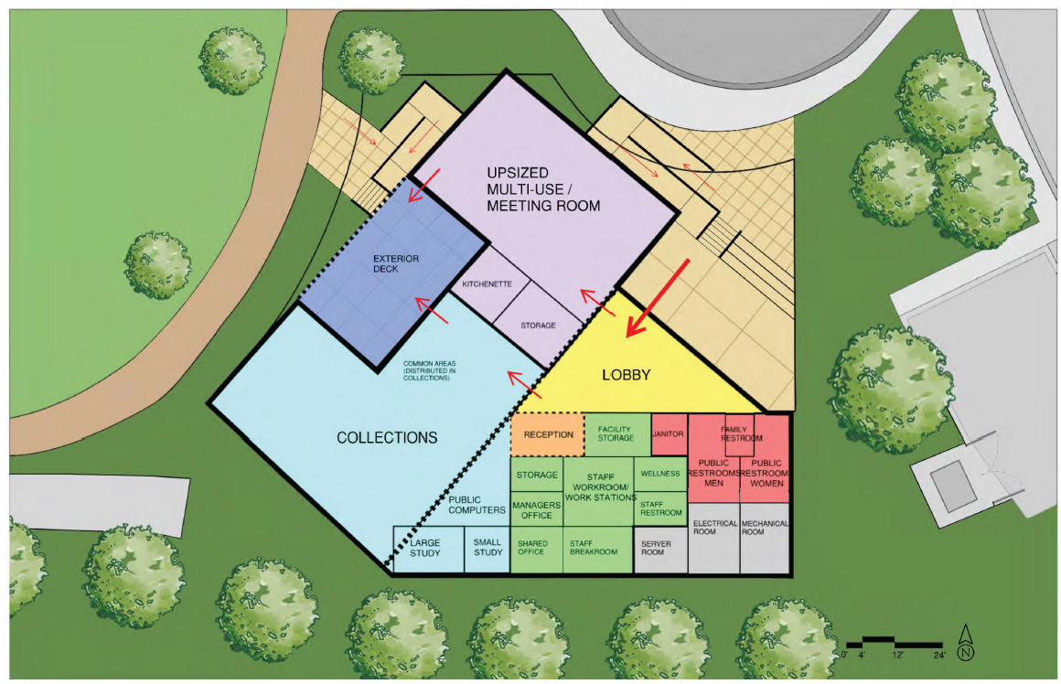
Enhancements

Slide 7
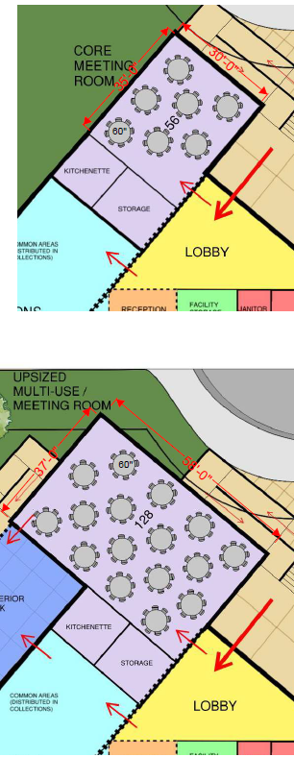
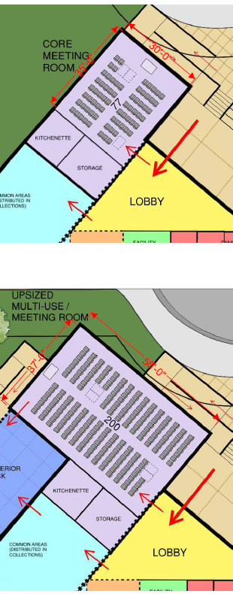
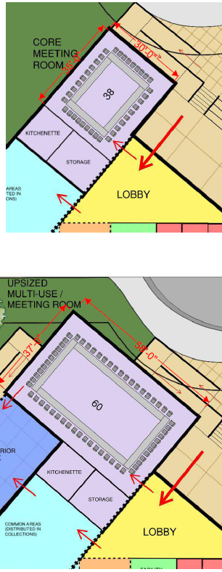
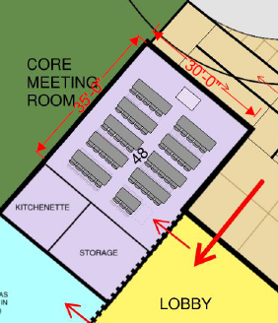
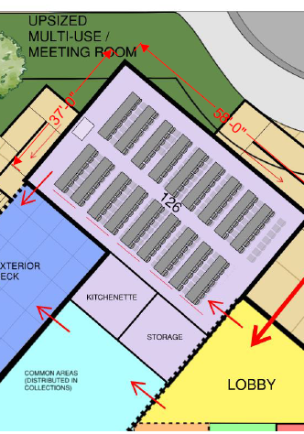
Round Tables
Theater Seating
Square Meeting
Classroom

Slide 8
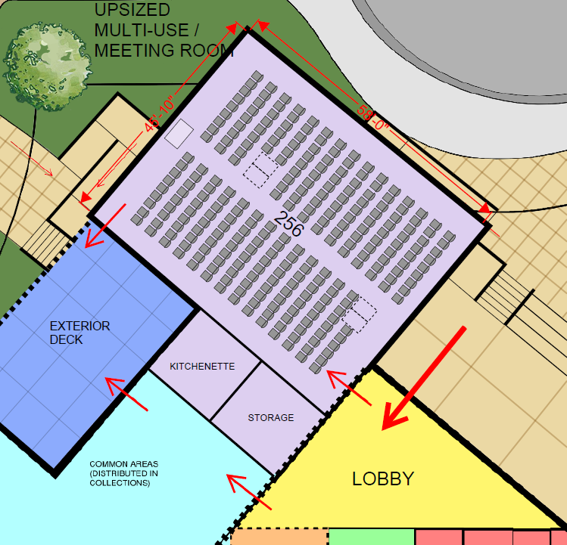
Theater Seating – Upsized 45’10” x 58’ Community Room**
**Further work by the architect is needed to study the impact of a space larger than 200 people including - if it will fit on the site, the need for increased lobby size, entrances / exits, bathrooms, HVAC, parking, and overall operational impacts and costs.
Notes:
The architects are still studying the impact of a room larger than 200 people on the building as a whole and what it would mean for things like increased lobby size, entrances/exits, bathrooms, HVAC, MEP, parking, etc. There are potentially additional operational impacts that Libraries will have to consider as well. Depending on these impacts we may decide not to go above a certain size.

Slide 9
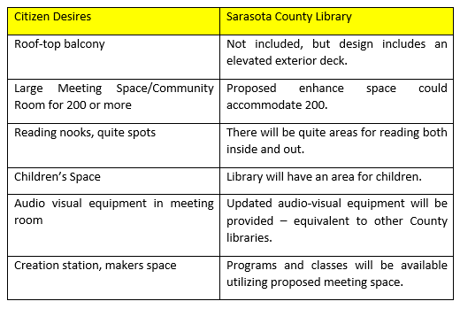
Comparison Chart

Slide 10
Next Steps
Borelli will explore the potential to enlarge the enhanced community room further.
Mid to late April, concepts will be finalized
These can serve as graphics for marketing materials
Cost estimates will be determined
County will create a construction project for funding consideration by the Board of County Commissioners
The Sarasota County Library Foundation will serve as the fundraising arm for project enhancements
Fundraising timeline is from May 2024 – August 2024
It is anticipated that the library will be ready by end of 2026

Slide 11
Discussion

