Slide 1
Longboat Key
Historical Society
Cottage
November 9, 2020

Slide 2
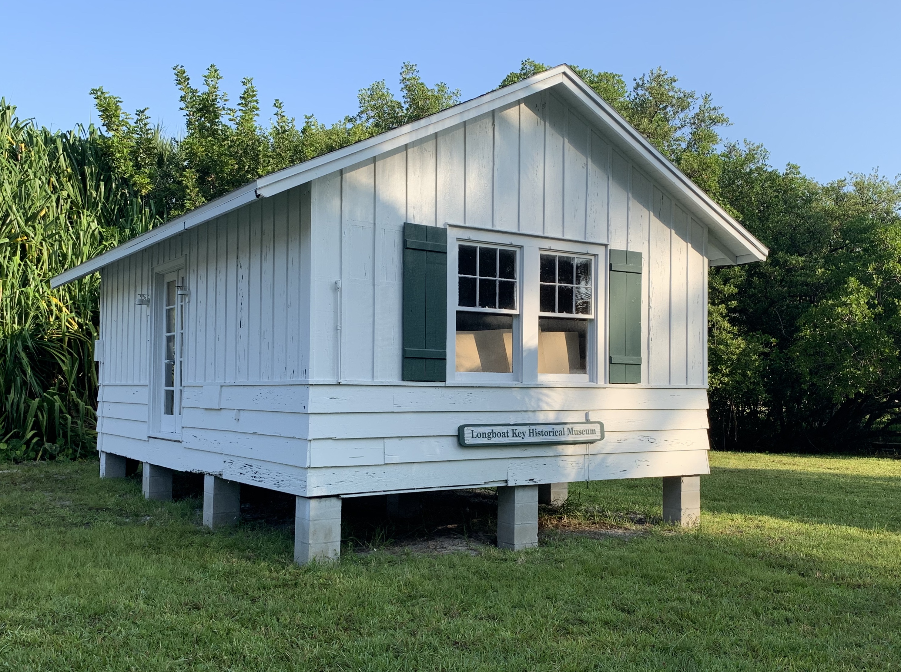
Longboat Key
Historical Society Cottage
Request to locate within the Town Center Property
Site Considerations- final location
Revised Lease Language
Next Steps

Slide 3
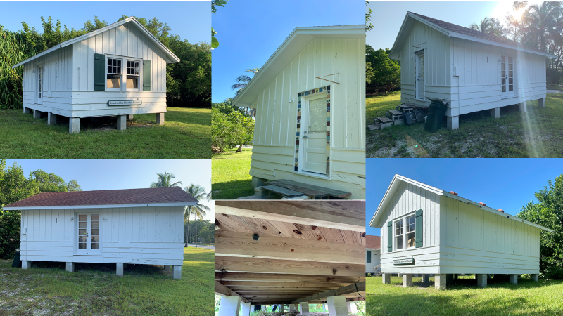

Slide 4
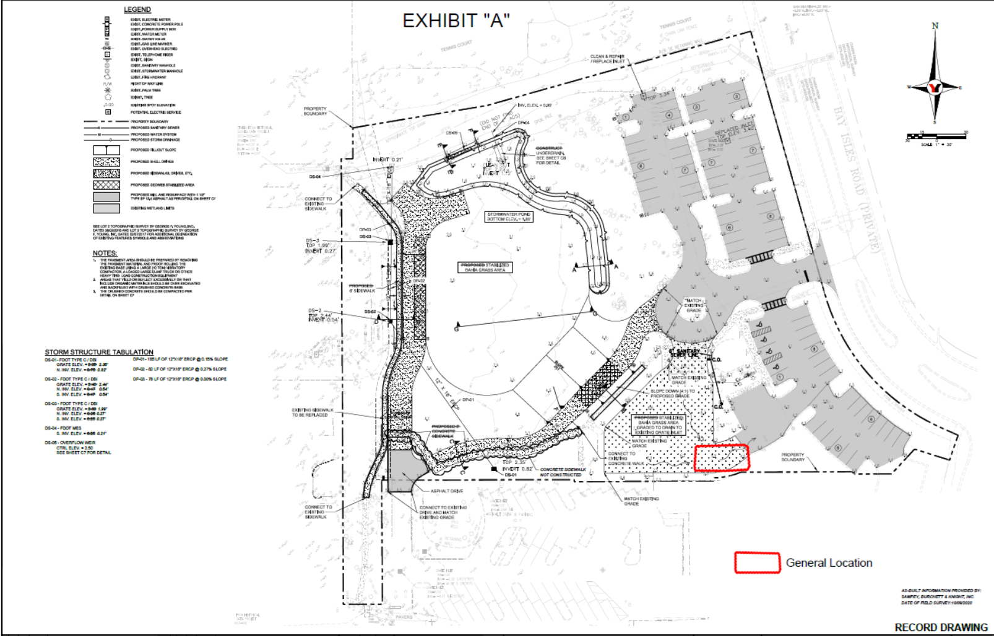
Original Proposed Location
Site 1

Slide 5
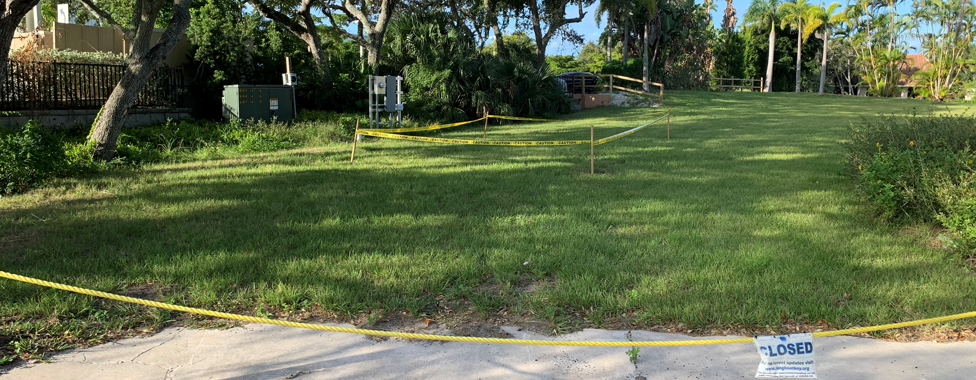
Original Proposed Location
Site 1

Slide 6
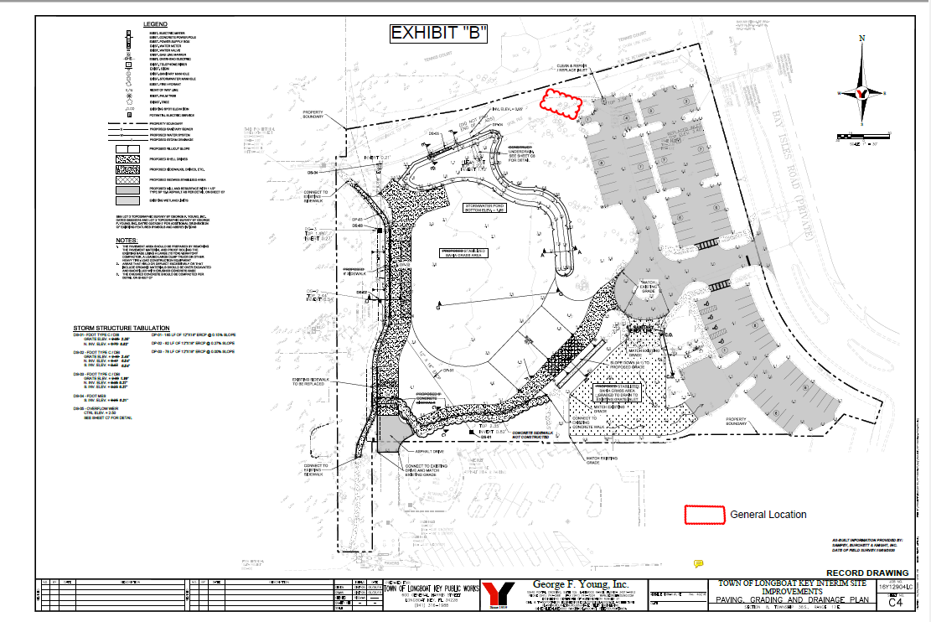
New Proposed Location
Site 2

Slide 7
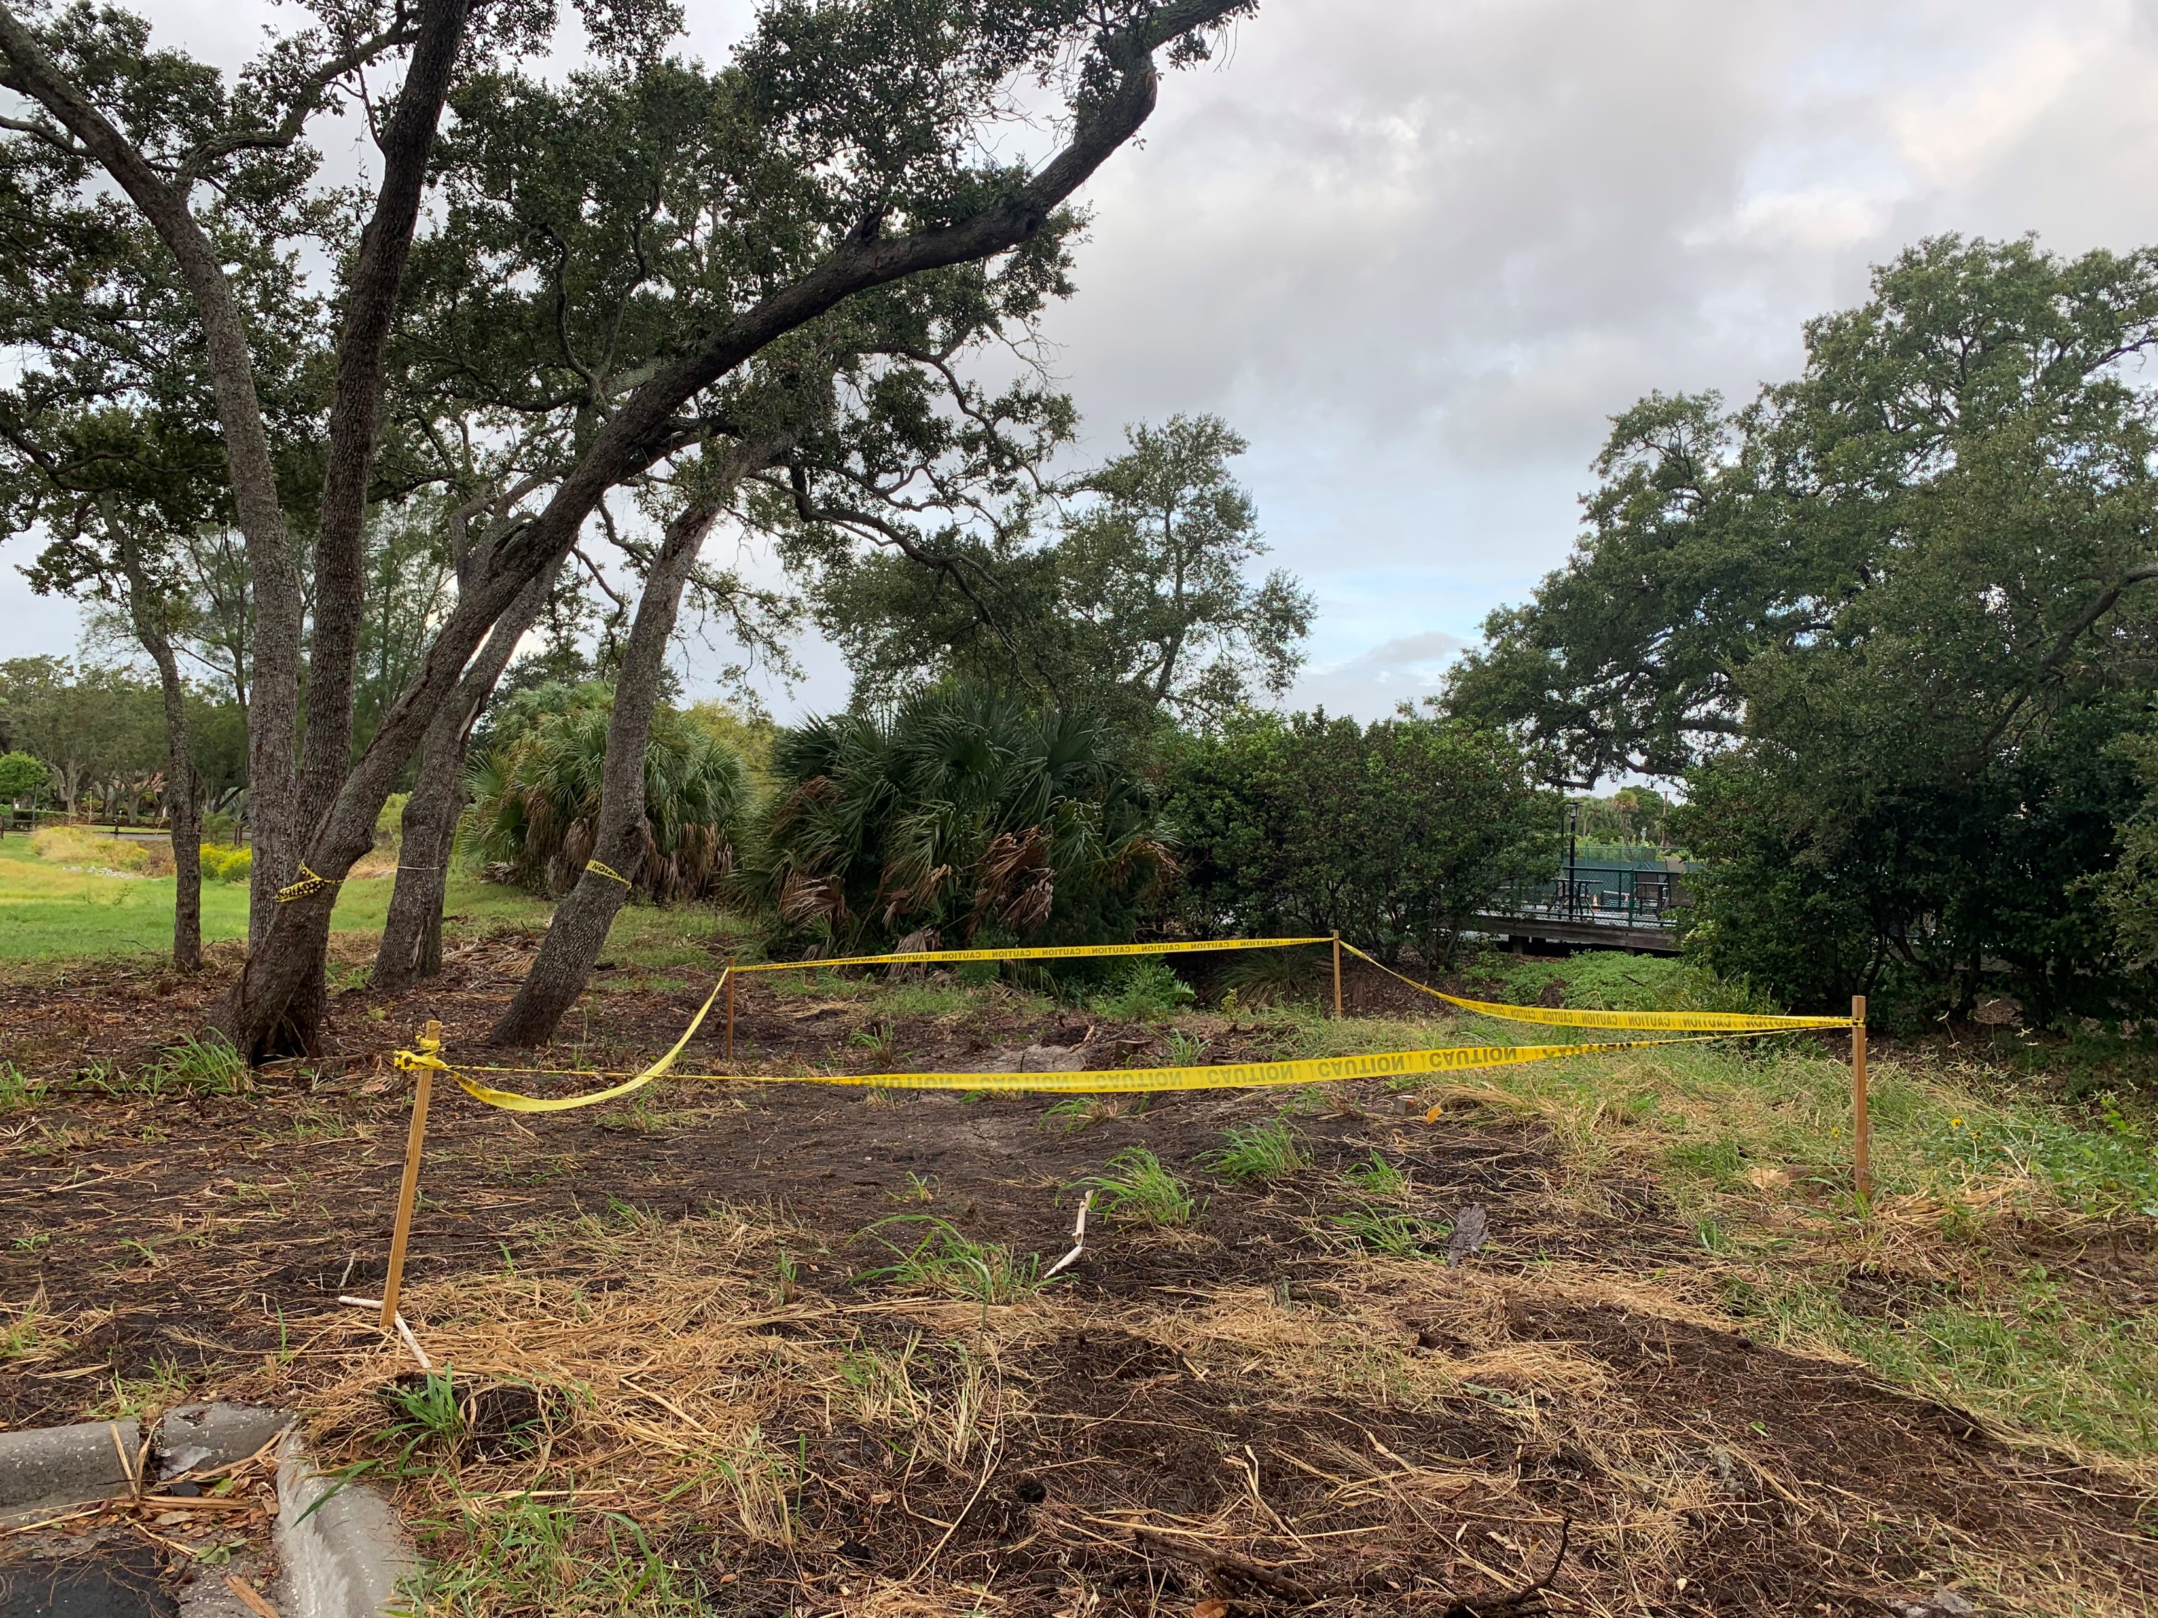
Proposed Location
Site 2

Slide 8
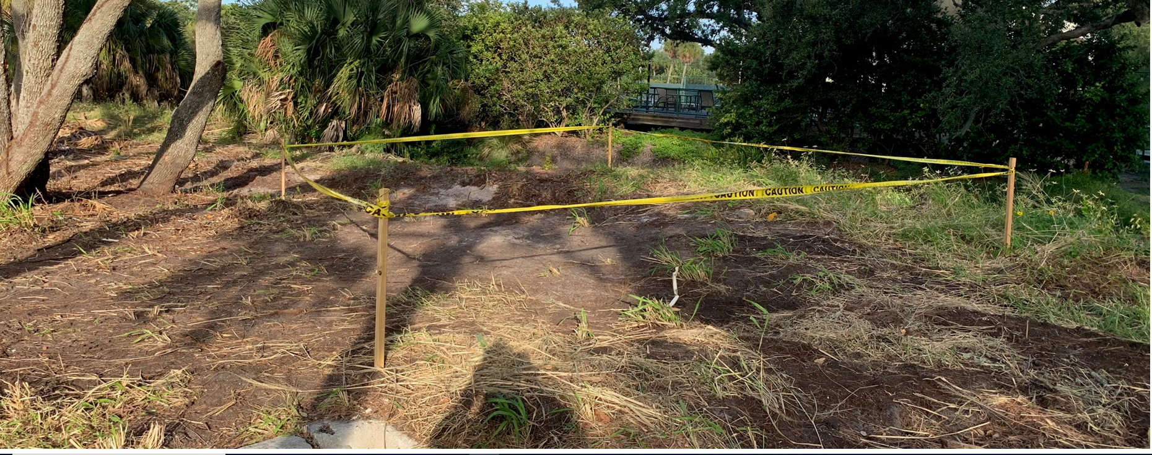
Proposed Location
Site 2

Slide 9
Additional Lease Language
Language was inserted stating that the lessee is responsible for any governmental tax or assessment liability.
Language was added to clarify the Town’s ability to enforce the requirement to maintain the property.
Language was added to clarify the connection to utilities.

Slide 10
LBKHS Correspondence
LBKHS provided documentation regarding their financial capacity to perform
Confirmed they will execute the Lease Agreement

Slide 11
Next Steps
Finalize Location
Finalize Lease Language
Authorize Execution of Lease Agreement
LBKHS Apply for necessary permits to move structure
  Temporary use permit
  Move permit
  Construction permit to place on foundation
  Move permit and move structure
Town process a modification to the Bay Isles PUD
  To incorporate the approved concept plan for the Town Center including the location of the LBKHS Historic Cottage

Slide 12
Questions

Slide 13
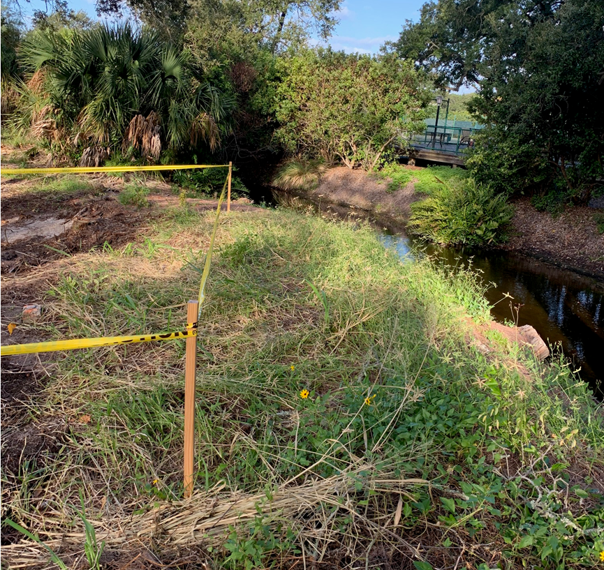
Proposed Location
Site 2

Slide 14
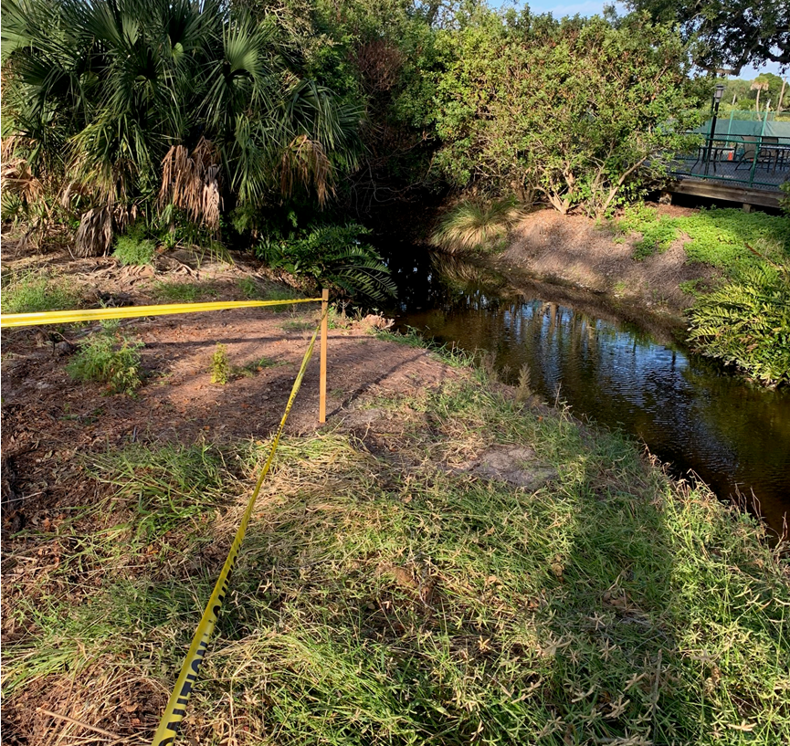
New Proposed Location
Site 2

