Slide 1
Longboat Key
Historical Society
Cottage

Slide 2
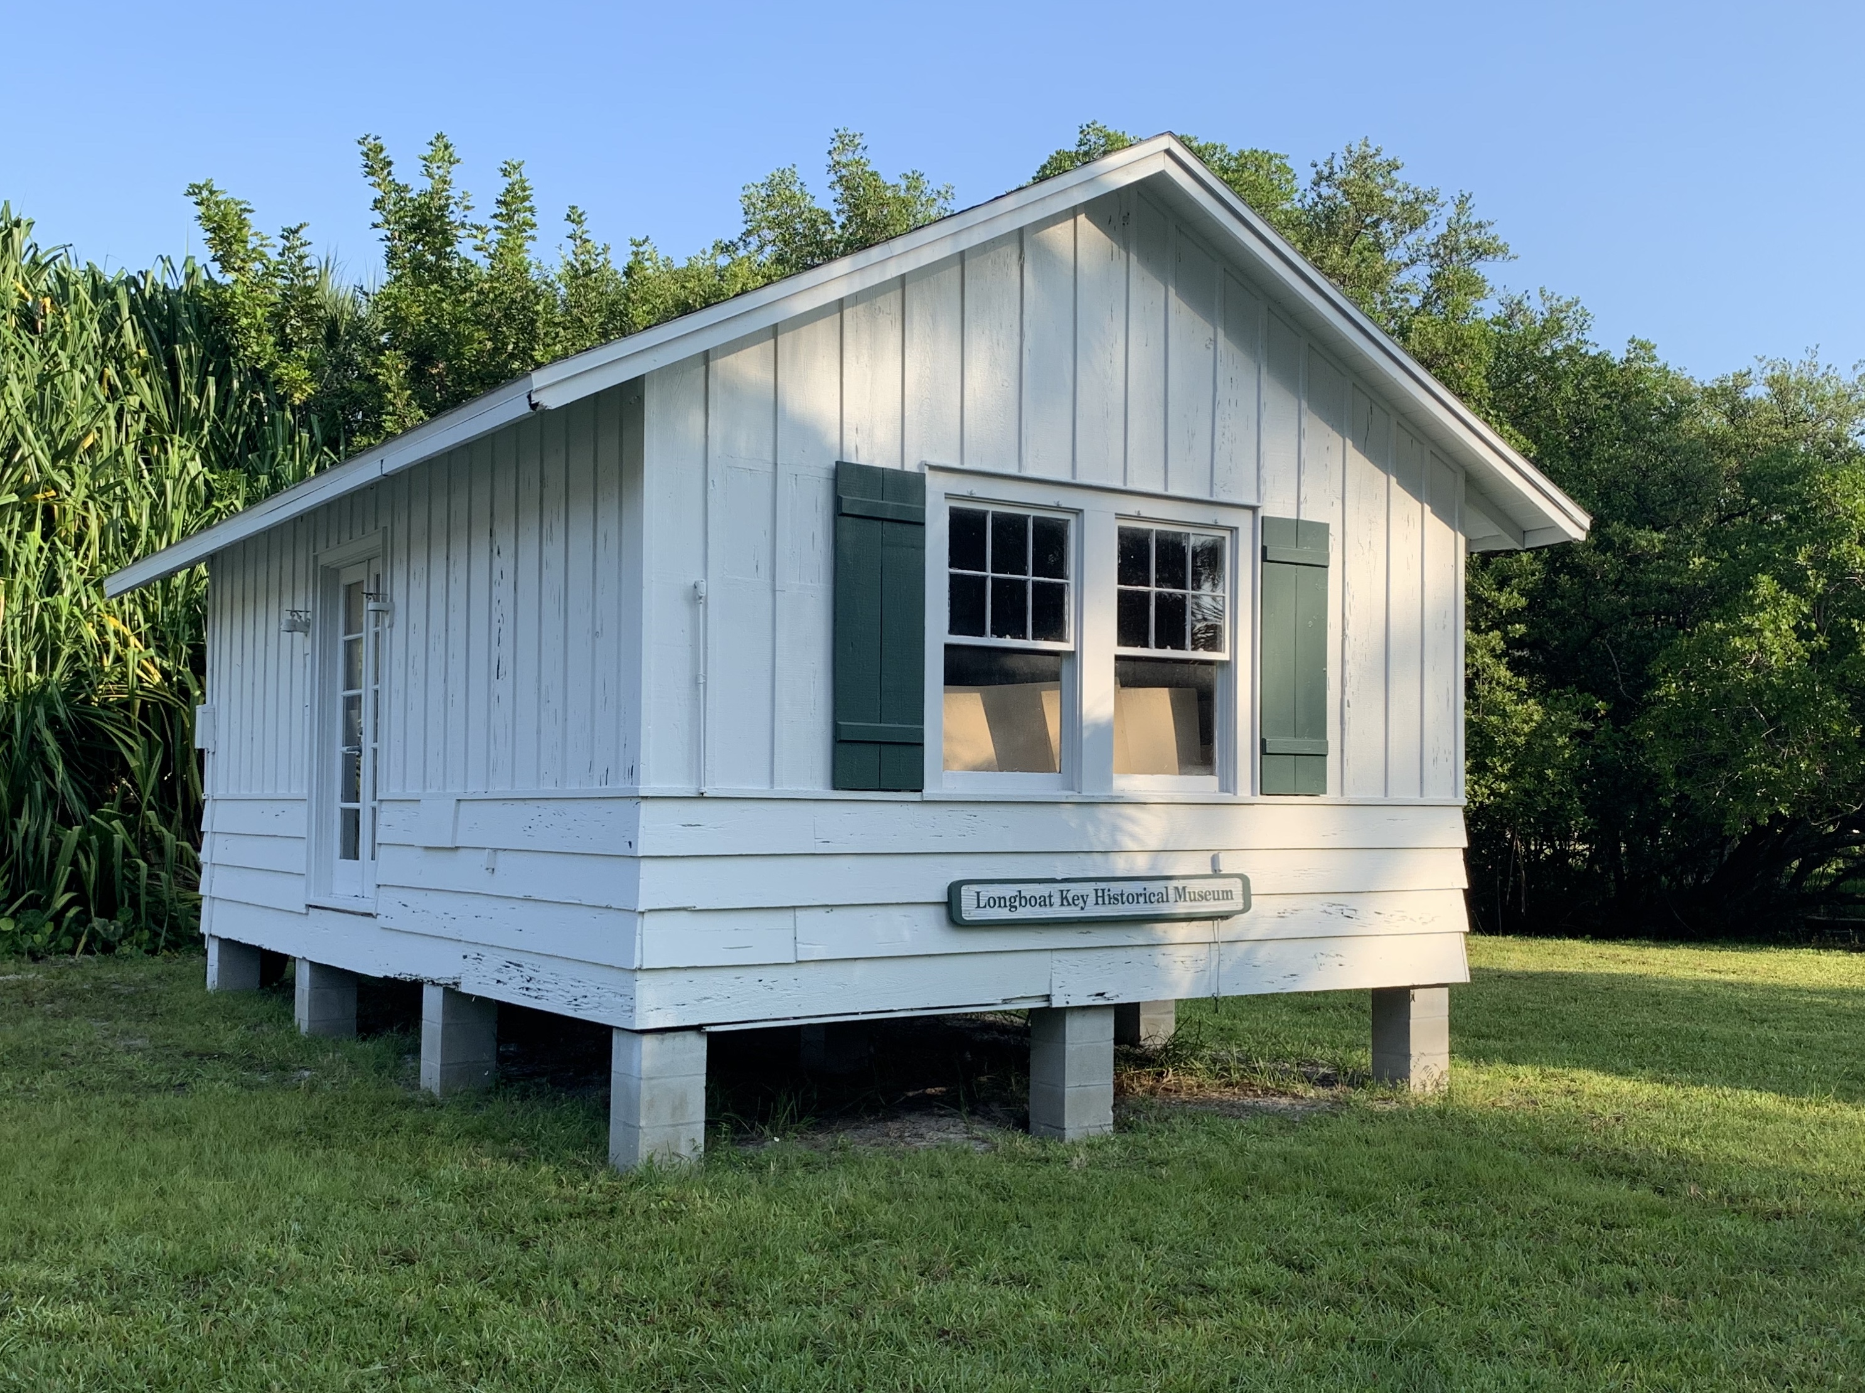
Longboat Key
Historical Society Cottage
Request to locate within the Town Center Property
Proposed Lease
Recommended Location
Next Steps

Slide 3
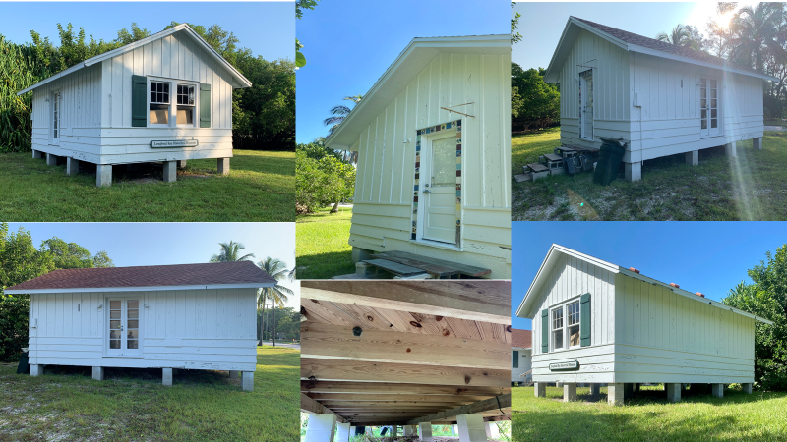

Slide 4
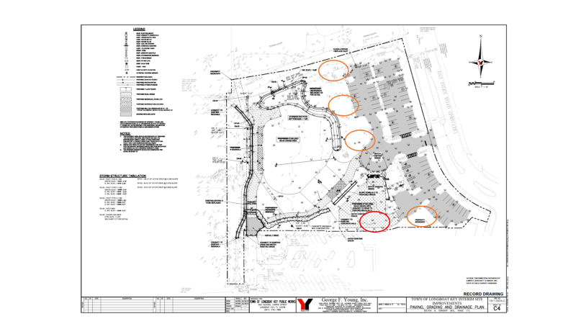

Slide 5
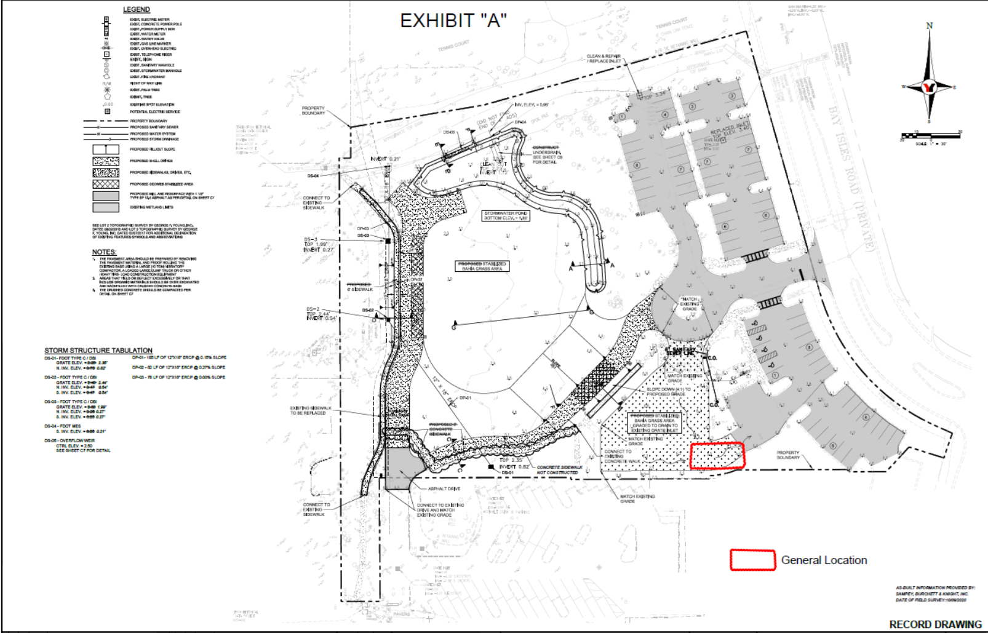

Slide 6
Site Review
Staff (Public Works, PZB, and Support Services)
Hoyt Architects
  Good site visibility
  Proximity to parking
  Good access to services
  Phases 1-9 of the Town Center plan should be able proceed without undo interruption
  It will be an interesting entry feature for the Town Center Park
“I would also like to add that we find this small vernacular building to be a good example of the simple, but well designed cottage structures that were part of Longboat Key’s history.”
The Historical Society
  “The Longboat Key Historical Society (LBKHS) is very excited to be part of the new town center. After our initial visit of the town center is the LBKHS collective decision to have the historic cottage placed at the site we visited on Friday afternoon. For clarification it would be the site that has the back of the cottage facing the Chase bank building and very close to the already existing power supply on the site…”

Slide 7
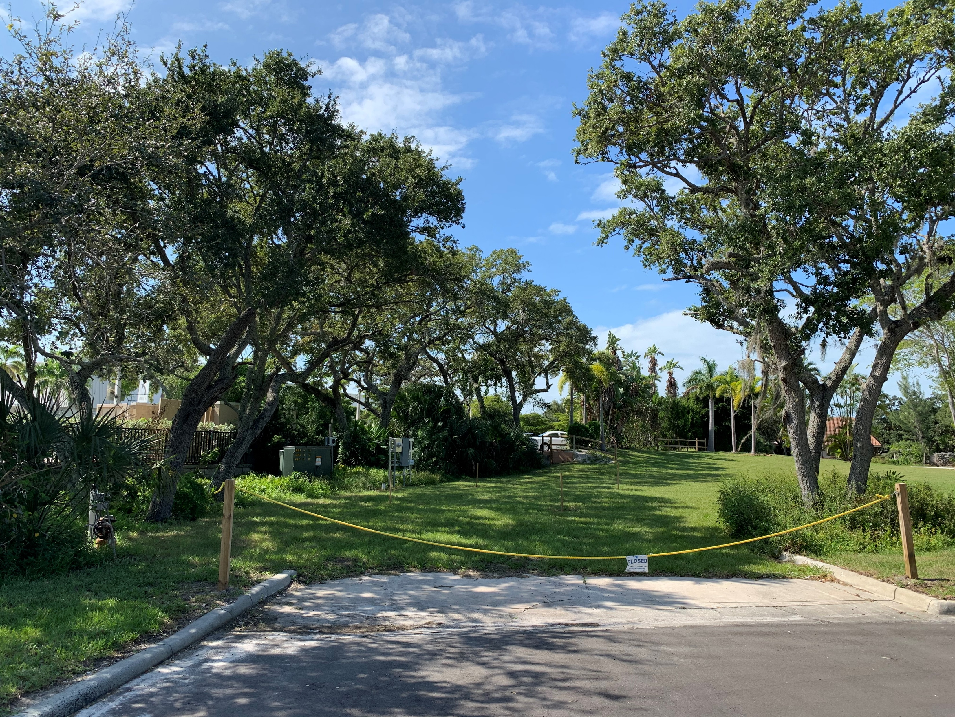
Easiest for Contractor to set up
In close proximity to electric utilities
Visible barrier to unsightly electrical panel on property
Handicap parking already exists on this side of property
Site is level and allows space for handicap assessible ramp
Designated parking for the cottage is readily available

Slide 8
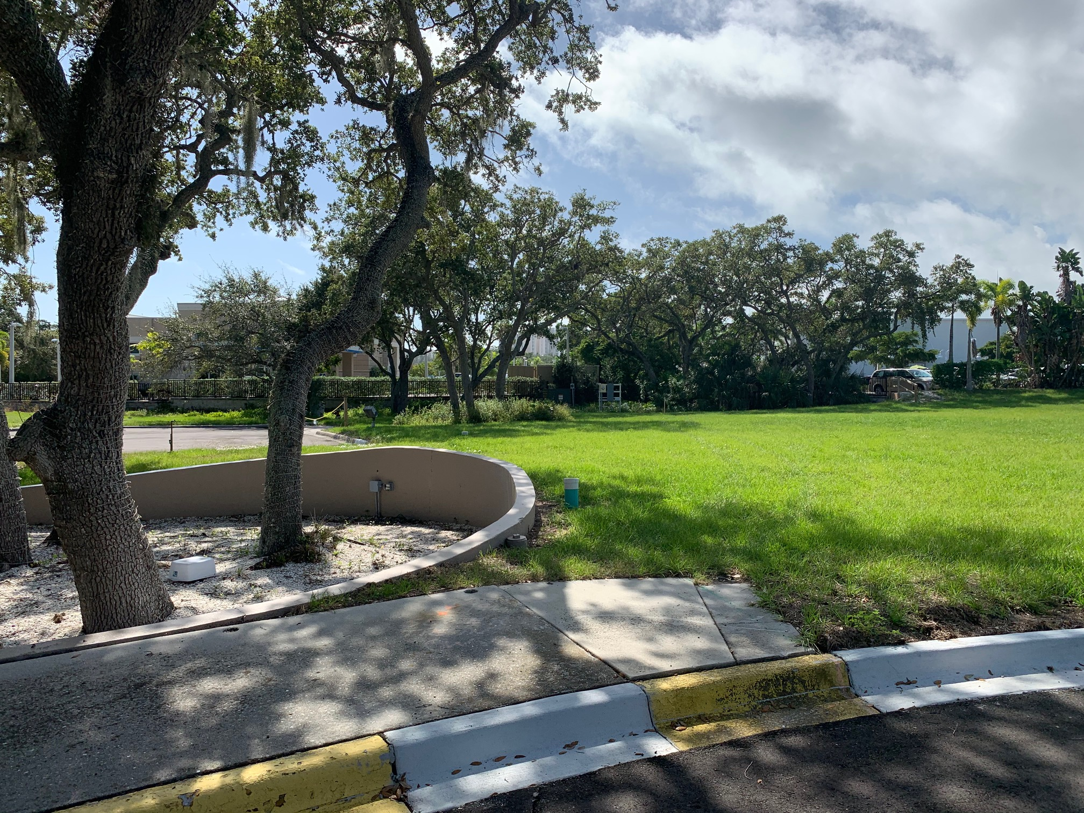

Slide 9
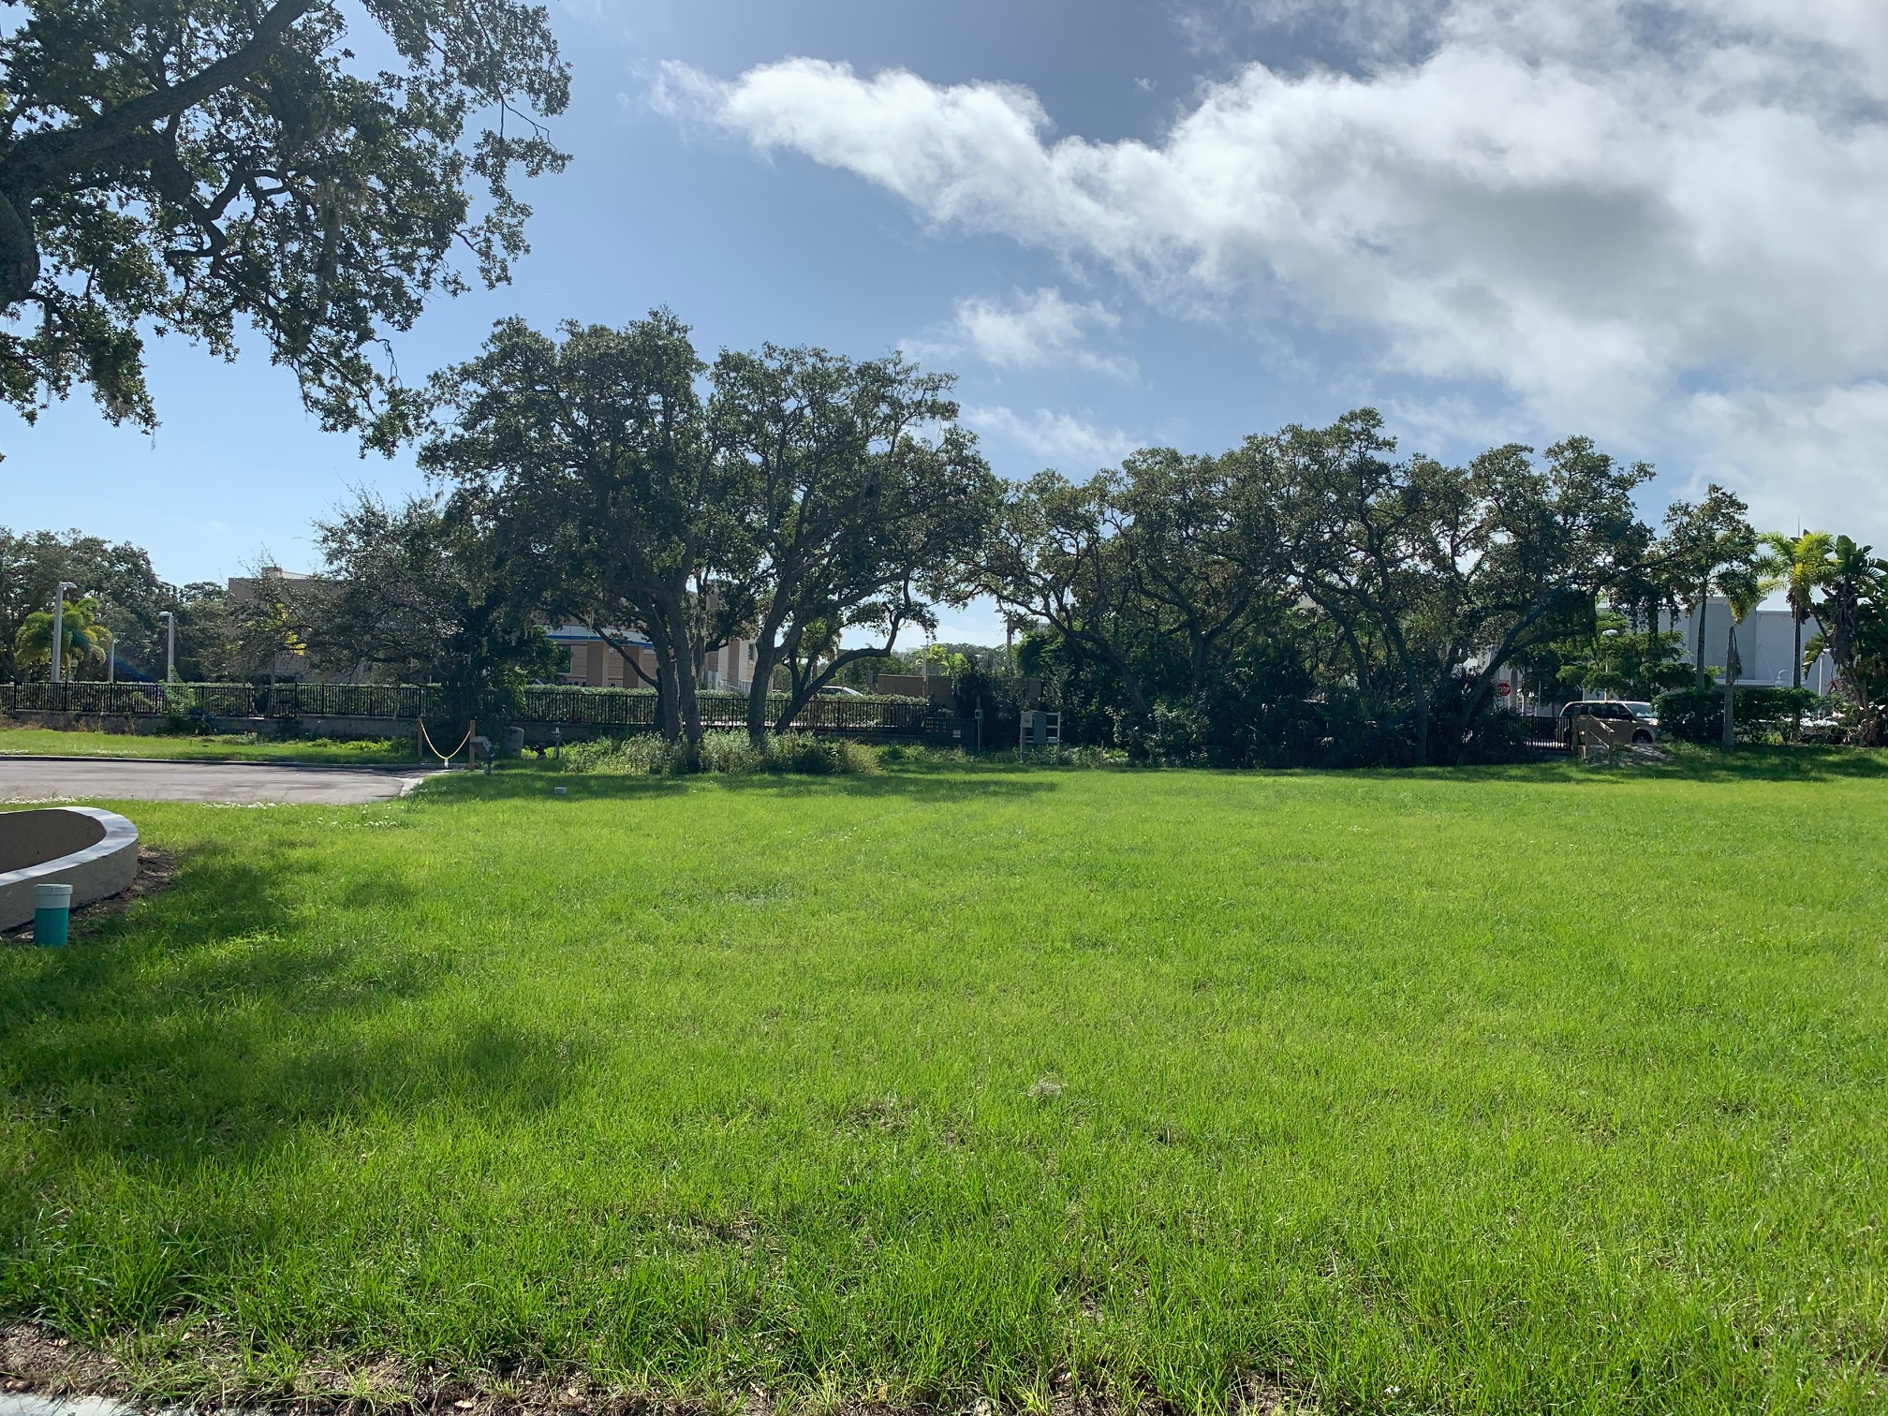

Slide 10
Terms of Lease
Town Attorney prepared the proposed lease including the following terms:
  Approximately 20’ x 50’ site (1,000 square feet)
  5 year lease with option to renew for 1 additional 5-year period. Following the renewal term there is an option to renew lease for additional one-year periods
  $10.00 per year rent
  Lessee shall comply with all applicable federal, state and local laws, regulations, ordinances, regulations or rules
  Lessee shall fully pay for all water, gas, heat, light, power, telephone service, internet service and other public utilities and all other costs and expenses in connection with use, operation and maintenance of the Premises and cottage
  Lessee, at its sole cost and expense provide for initial relocation of cottage to the Premises and acknowledges the possibility that the cottage may need to be relocated to another location on Lessor’s property
  Lessee shall procure and maintain special risk property coverage and liability coverage

Slide 11
Additional Language
Suggested new section for inclusion:
TAX & ASSESSMENT LIABILITY
Lessee shall be fully responsible for the timely payment of any property taxes or assessments, if any, associated with the Lessee’s use and occupation of the property.

Slide 12
Next Steps
Review financial capacity of LBKHS to perform
Finalize Lease Agreement
Confirm location (Exhibit A)
LBKHS Execute Agreement
Town Executive Agreement
LBKHS Apply for necessary permits to move structure
  Temporary use permit
  Move permit
  Construction permit to place on foundation
  Move permit and move structure
Town process a modification to the Bay Isles PUD
  To incorporate the approved concept plan for the Town Center including the location of the LBKHS Historic Cottage

Slide 13
Questions

