Slide 1
Bay Isles Association, Inc.:
Bay Isles Parkway and
Bay Isles Pedestrian Underpass (Tunnel)
Transfer of Ownership / Maintenance / Liability
Town Commission Regular Workshop Meeting
May 19, 2025

Slide 2
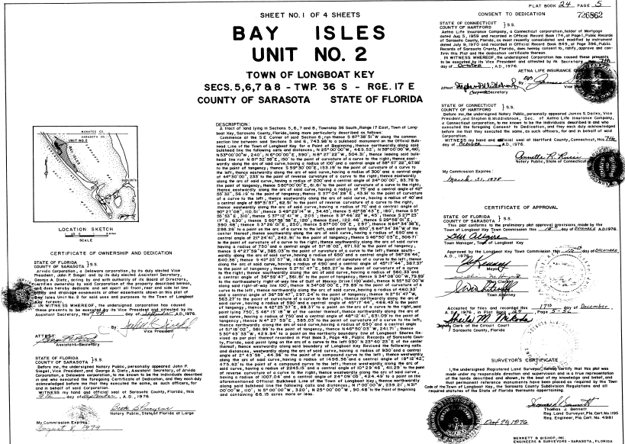
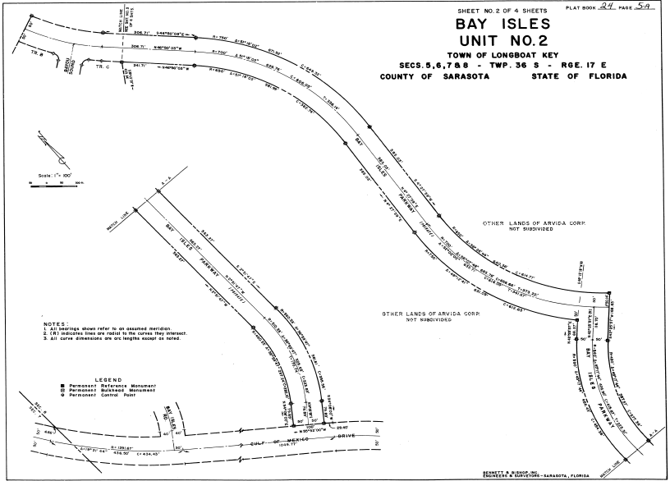
Bay Isles Association, Inc.: Bay Isles Parkway
‘Bay Isles Parkway’
Established as a private road by Plat in 1976
  Bay Isles, Unit No. 2
  Plat Book 24, Page 5
Ownership and Dedication:
  Bay Isles Association, Inc. (“BIA”) acknowledges ownership and maintenance.

Slide 3
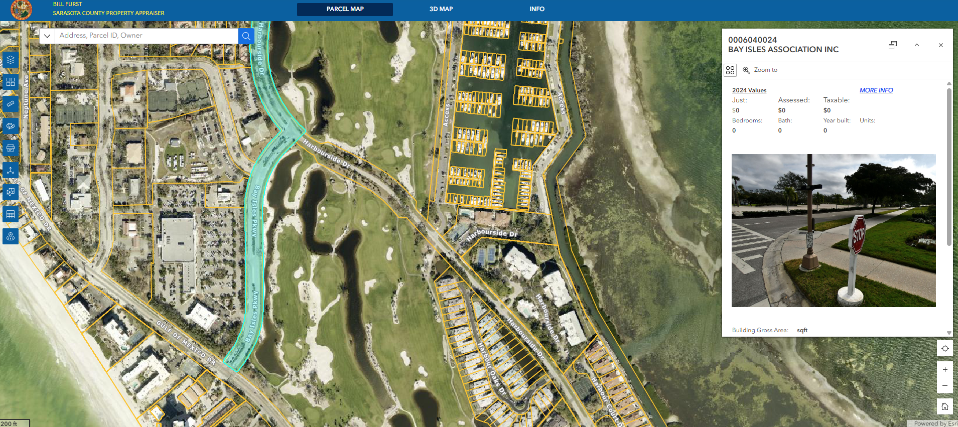
Bay Isles Association, Inc.: Bay Isles Parkway

Slide 4
Bay Isles Association, Inc.: Bay Isles Parkway
BIA Proposes Divestiture of Bay Isles Parkway to the Town of Longboat Key
Proposal dated April 2025
Why?
Liability Exposure: Commercial Insurer Risk Mitigation.
Traffic Enforcement Limitations: No enforcement capability.
Notes:
At this time, no known claims or litigation are related to the roadway.
BIA proposes to continue maintaining sidewalks and medians in coordination with Shoppes of Bay Isles and The Resort at Longboat Key Club.
BIA current estimate of annual maintenance costs (avg. over 5 years): $15,008
  Largest maintenance expense estimate of $13,200 for Landscaping/Electric/General
  Other items include painting curbs, roadway restriping, and sign repairs
  No major resurfacing capital costs included.

Slide 5
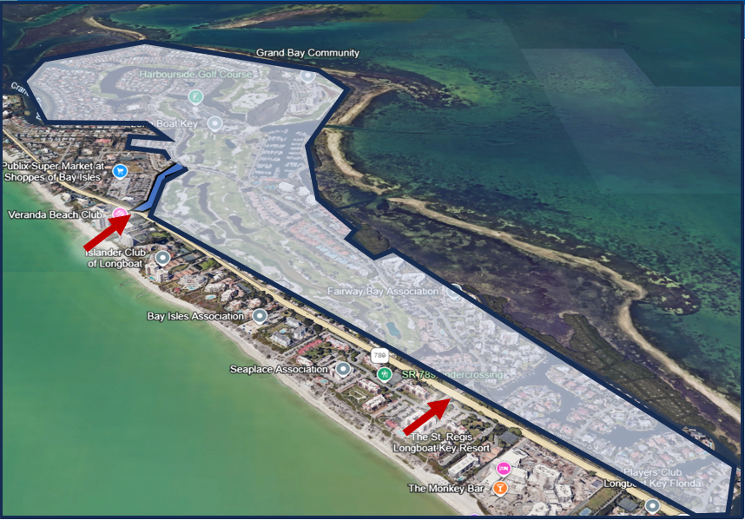
Bay Isles Association, Inc.: Bay Isles Parkway
In February 2024, Town requested:
Engineering overview of roadway infrastructure conditions. Received
Financial disclosure of costs for BIA to own and maintain. Received
Any pending claims or litigation related to the roadway. Received
Continuation of existing agreements and potential new agreements for Town’s assumption of cost and liability.
In Discussion/Negotiation
Record drawings. N/A

Slide 6

Bay Isles Association, Inc.: Bay Isles Parkway
Condition Assessment: BIA engaged Stantec
Bay Isles Parkway – Roadway Evaluation Technical Memo dated March 31, 2025
Overall Roadway Condition:
Roadway milling and resurfacing needed in 2 to 5 years (2027 – 2030). Depends on the continued deterioration rate.
Fifteen (15) locations identified with risk of base failure. More involved and costly repair.
About 90% of curbing in satisfactory condition. Assume about 10% curb replacement.
Minor locations identified for individual sidewalk repair (at/near GMD intersection).
Minor locations for tactile surface replacement/installation (at/near GMD intersection).
One stormwater outfall needs to be cleared, with rip-rap installed.
Streetlights (4) are functional. Need to be painted, and one foundation cover needs to be replaced. The Town may consider BIA upgrading lighting if an agreement is reached.

Slide 7
Bay Isles Association, Inc.: Bay Isles Parkway
Condition Assessment: BIA engaged Stantec
Bay Isles Parkway – Roadway Evaluation Technical Memo dated March 31, 2025
Specifications and Recommendations:
Mill 3 inches of roadway and resurface Bay Isles Parkway from Gulf of Mexico Drive to the Bay Isles Gatehouse.
Repair about 1,500 square yards of base in reported areas.
Match existing pavement striping and marking.
Remove and replace about 10% curbing.
Remove and replace ribbon curbing and all brick pavers (…or replace with base and asphalt).
Remove and replace damaged sidewalks.
Replace tactile surface detectable warning mats at ramp several locations.
Remove about 100 CY of silt at one outfall and add about 110 tons of concrete rip-rap.
(…Consider upgrading light poles but currently functional. If keeping, conduct minor aesthetic improvements).
Stantec engineer’s opinion of cost (2025): $699,850

Slide 8
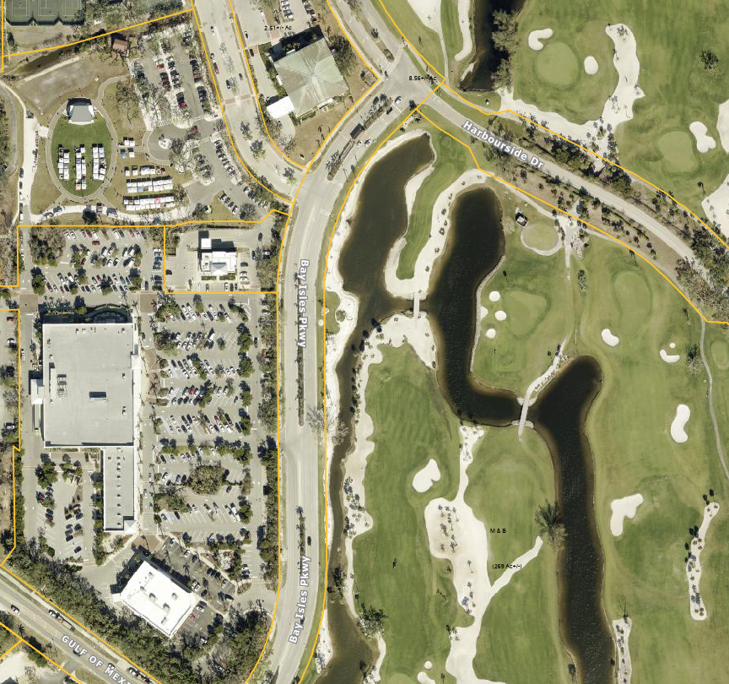
Bay Isles Association, Inc.: Bay Isles Parkway
In April 2025, BIA provided:
Transportation Counts:
Bay Isles Parkway driveways and intersections by Stantec using “TRENDS” (blue)
Count Data
March 11, 2025 – March 13, 2025 (Tues. – Thurs.)
12:00 am to 11:45 pm.
Both directions total traffic (averages below)
Publix North Driveway: 5,406
Publix South Driveway: 2,399
Bay Isles Road: 1,181 (8%)
Bay Isles Gatehouse: 5,631 (39%)
Bay Isles Rd.
Bay Isles Gatehouse
Publix N.
(53%)
Publix S.

Slide 9
Bay Isles Association, Inc.: Bay Isles Parkway
For the Town to consider an Agreement for Dedication, recommended Terms below:
BIA and Town define limits. Includes conducting a roadway boundary, topo, and elevation survey with Title Search and review of Declarations, Covenants, and Restrictions. (BIA)
Full mill, base repair, and resurfacing project to Town standard per Stantec recommendations
(Work estimated to be done 2027 – 2030)
  Stantec opinion of cost $699,850 in 2025 dollars (BIA)
  Stantec conducts pre-construction work.
All median landscaping, ground cover, irrigation systems, street lighting (4), and supporting electrical systems. All to the same level as they are now. (BIA)
Ownership and maintenance of the “Bay Isles” entry sign at the GMD intersection (BIA)
Resort at Longboat Key Club (“Club”) executes an agreement with the Town to continue to accept all runoff coming from the roadway drainage system, including all existing interconnections.
  Continue to drain through the Club system. The Club maintains the downstream system.
  (Club, BIA help coordinate)

Slide 10
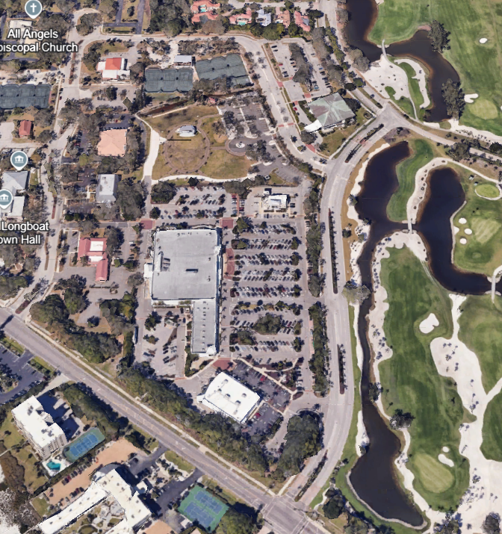
Bay Isles Association, Inc.: Bay Isles Parkway
Recommended Terms (continued):
Recall Transportation Driveway split: 39%...........
Possible term to acknowledge traffic split:
  BIA upgrade all Bay Isles Road medians to be consistent with Bay Isles Parkway to a Town-approved palette and then maintain at the same standard on an ongoing basis.
  Conduct median improvements over time. For example, over a 2 to 5-year period, or until such time as Bay Isles Parkway resurfacing and repair is completed.
Remedy: Also, what happens if BIA abandons its responsibility to maintain all medians?

Slide 11
Bay Isles Association, Inc.: Bay Isles Parkway
Town would own and maintain roadway elements as “Public”:
Subgrade, Base, Asphalt, pavement striping, and marking
Concrete curbing
Stormwater drainage inlets, lids, pipes, and outfalls ends
Traffic signs
Grounds, outside of medians and the Club’s historical maintenance area
Conduct law enforcement along the Parkway
Assume liability to sovereign immunity limits along the roadway.
BIA continued and potentially new maintenance:
BIA continues to maintain all landscaping, irrigation, lighting, and elements within medians.
BIA continues to maintain the sidewalk along the west side and also the entry sign.
BIA dress and maintains all Bay Isles Road medians.
Other Notes:
Town fiber conduit and water/wastewater utilities are already under Town maintenance.
Town/BIA notify all other utilities regarding transfer of ownership at the proper time.

Slide 12
Bay Isles Association, Inc.: Bay Isles Parkway
Initial Next Steps:
Town Attorney’s Office: Draft a Transfer of Ownership Agreement with terms discussed. Negotiate terms with BIA.
Once terms are mutually agreed to, bring back the agreement for Town Commission consideration.
BIA conducts Boundary, Topographic, and Elevation Survey with a Title Search
  Title search to include a review of all covenants and restrictions of record related to Bay Isles Parkway.
Note: Due to the condition and amount of alligator cracking base failure, the milling, repair, and resurfacing should be done within the next 3 years. Terms should reflect that as a target date for the repair. Until then, BIA should be hiring a contractor to cut and patch base sections when warranted as the current maintenance entity.

Slide 13
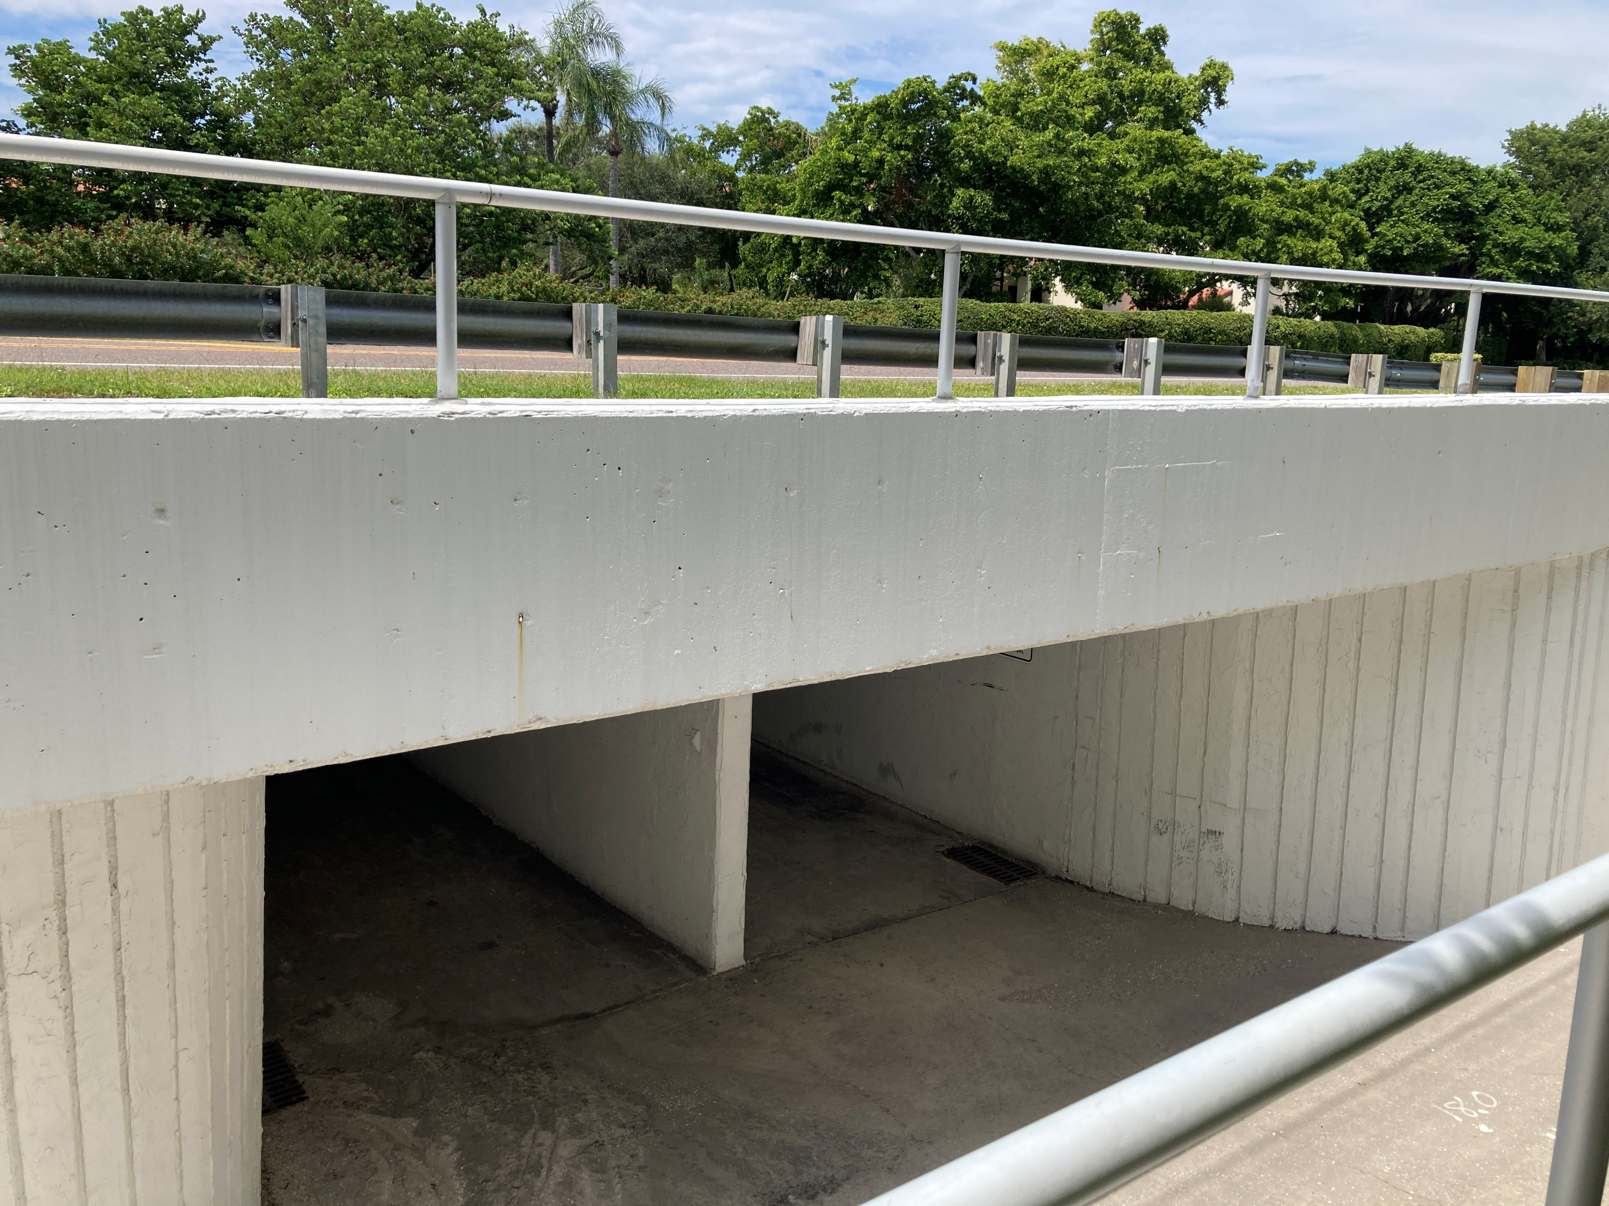
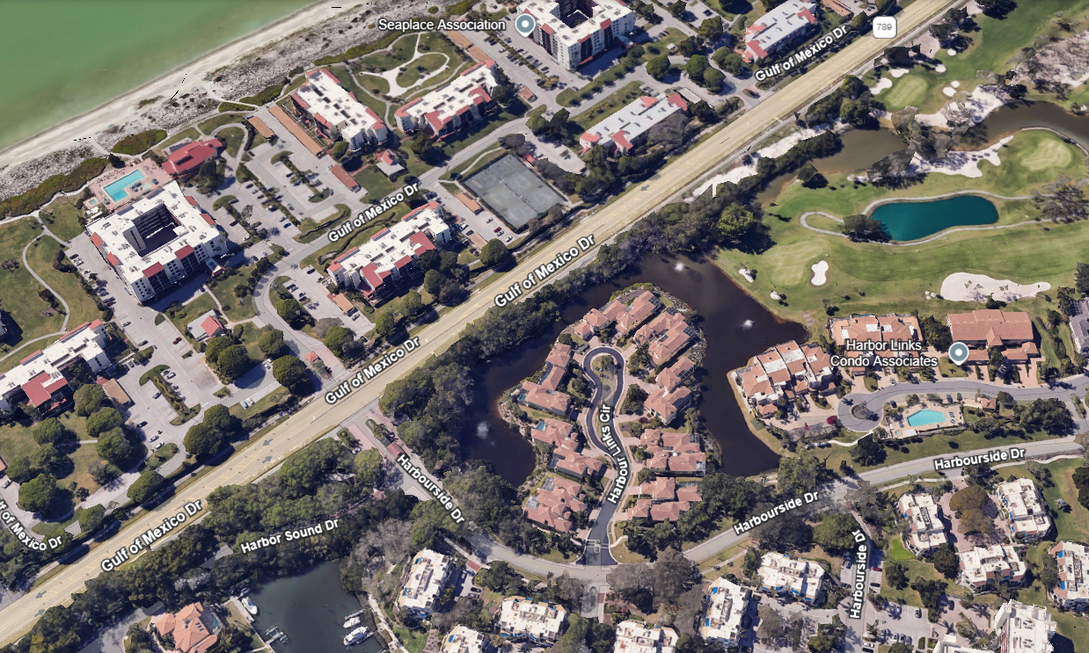
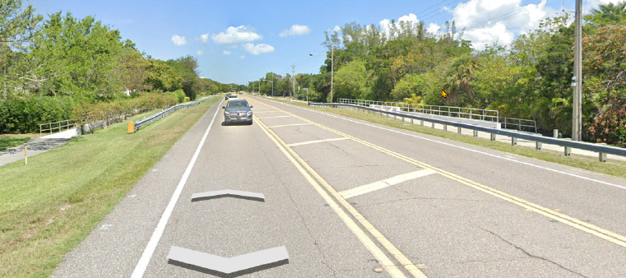
Bay Isles Association, Inc.: Pedestrian Tunnel
Getting Acquainted: Location and Views
Bay Isles
Pedestrian Tunnel

Slide 14
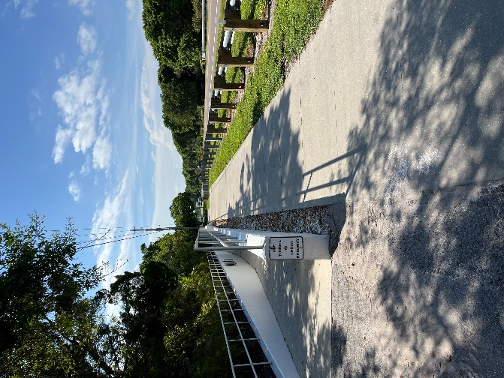
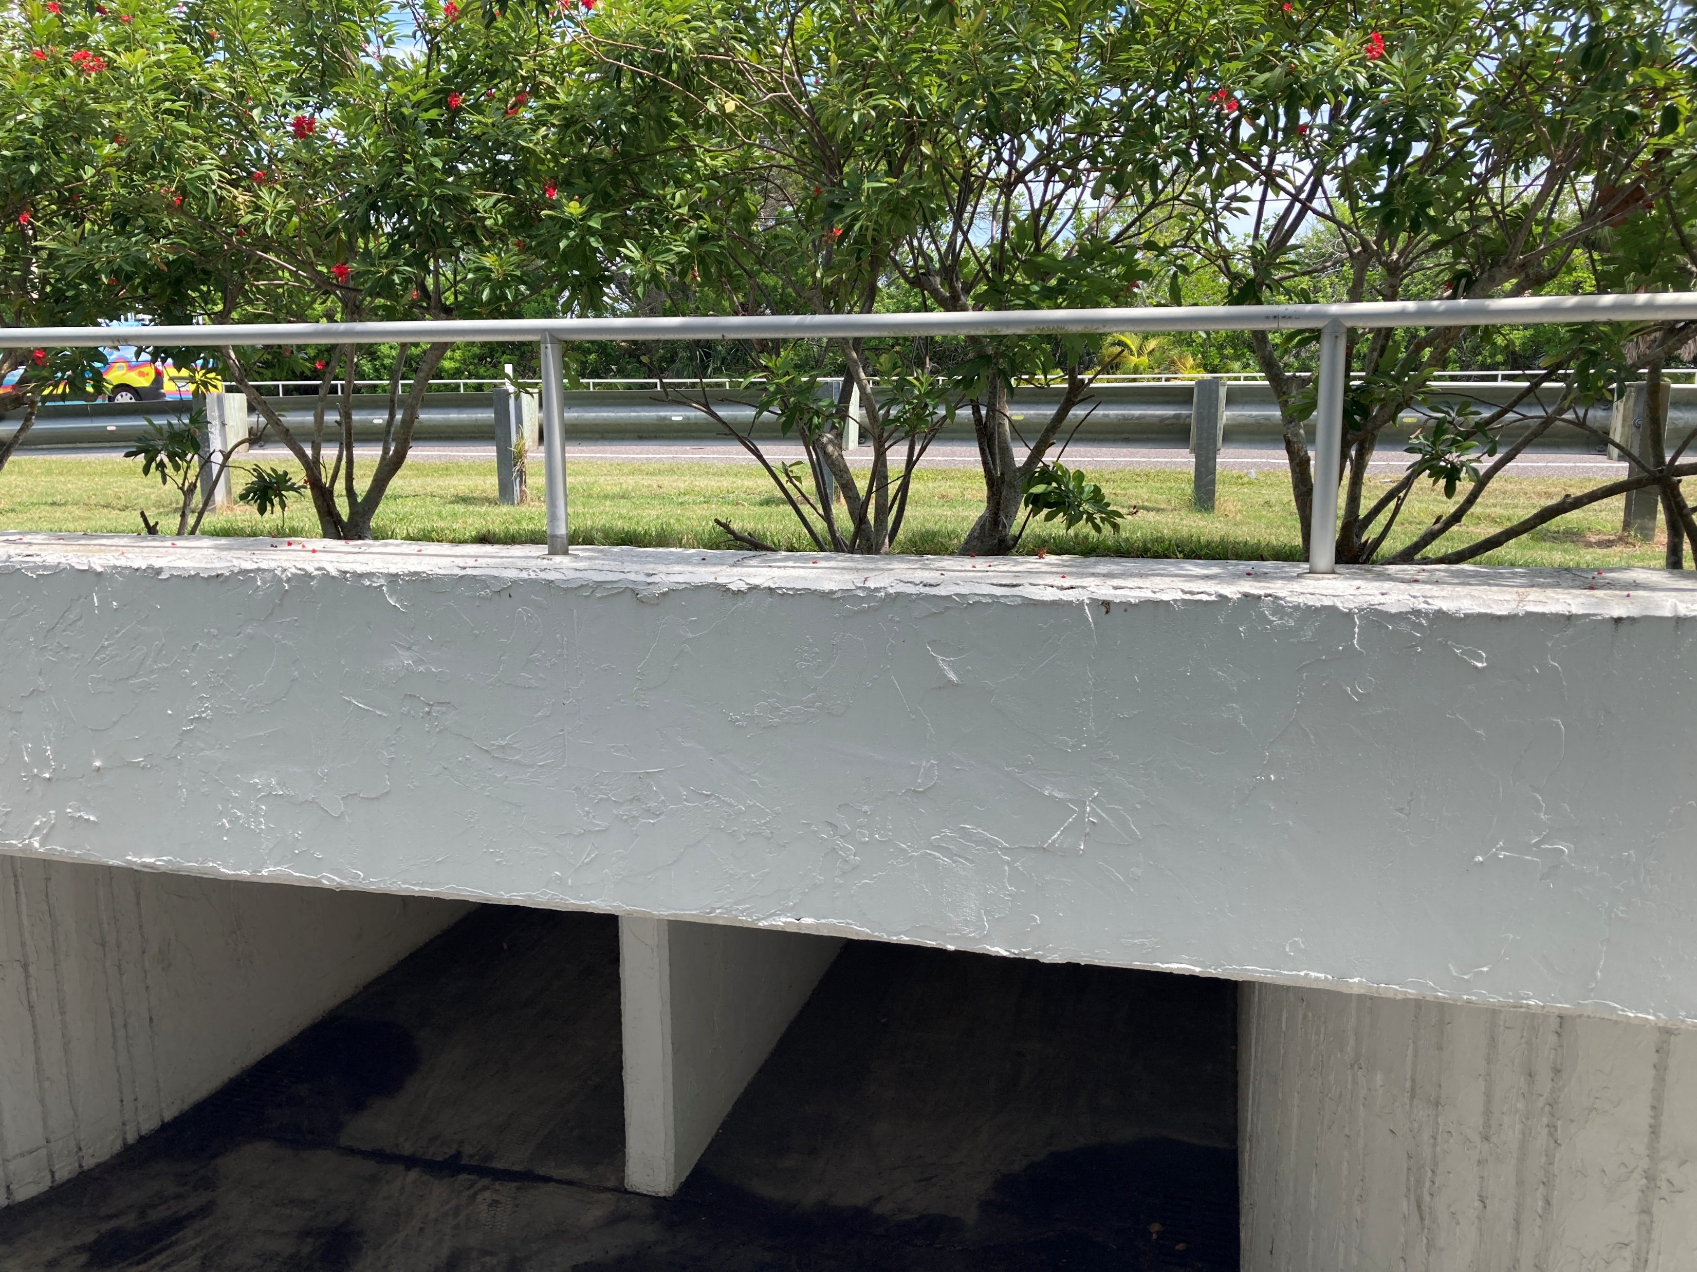
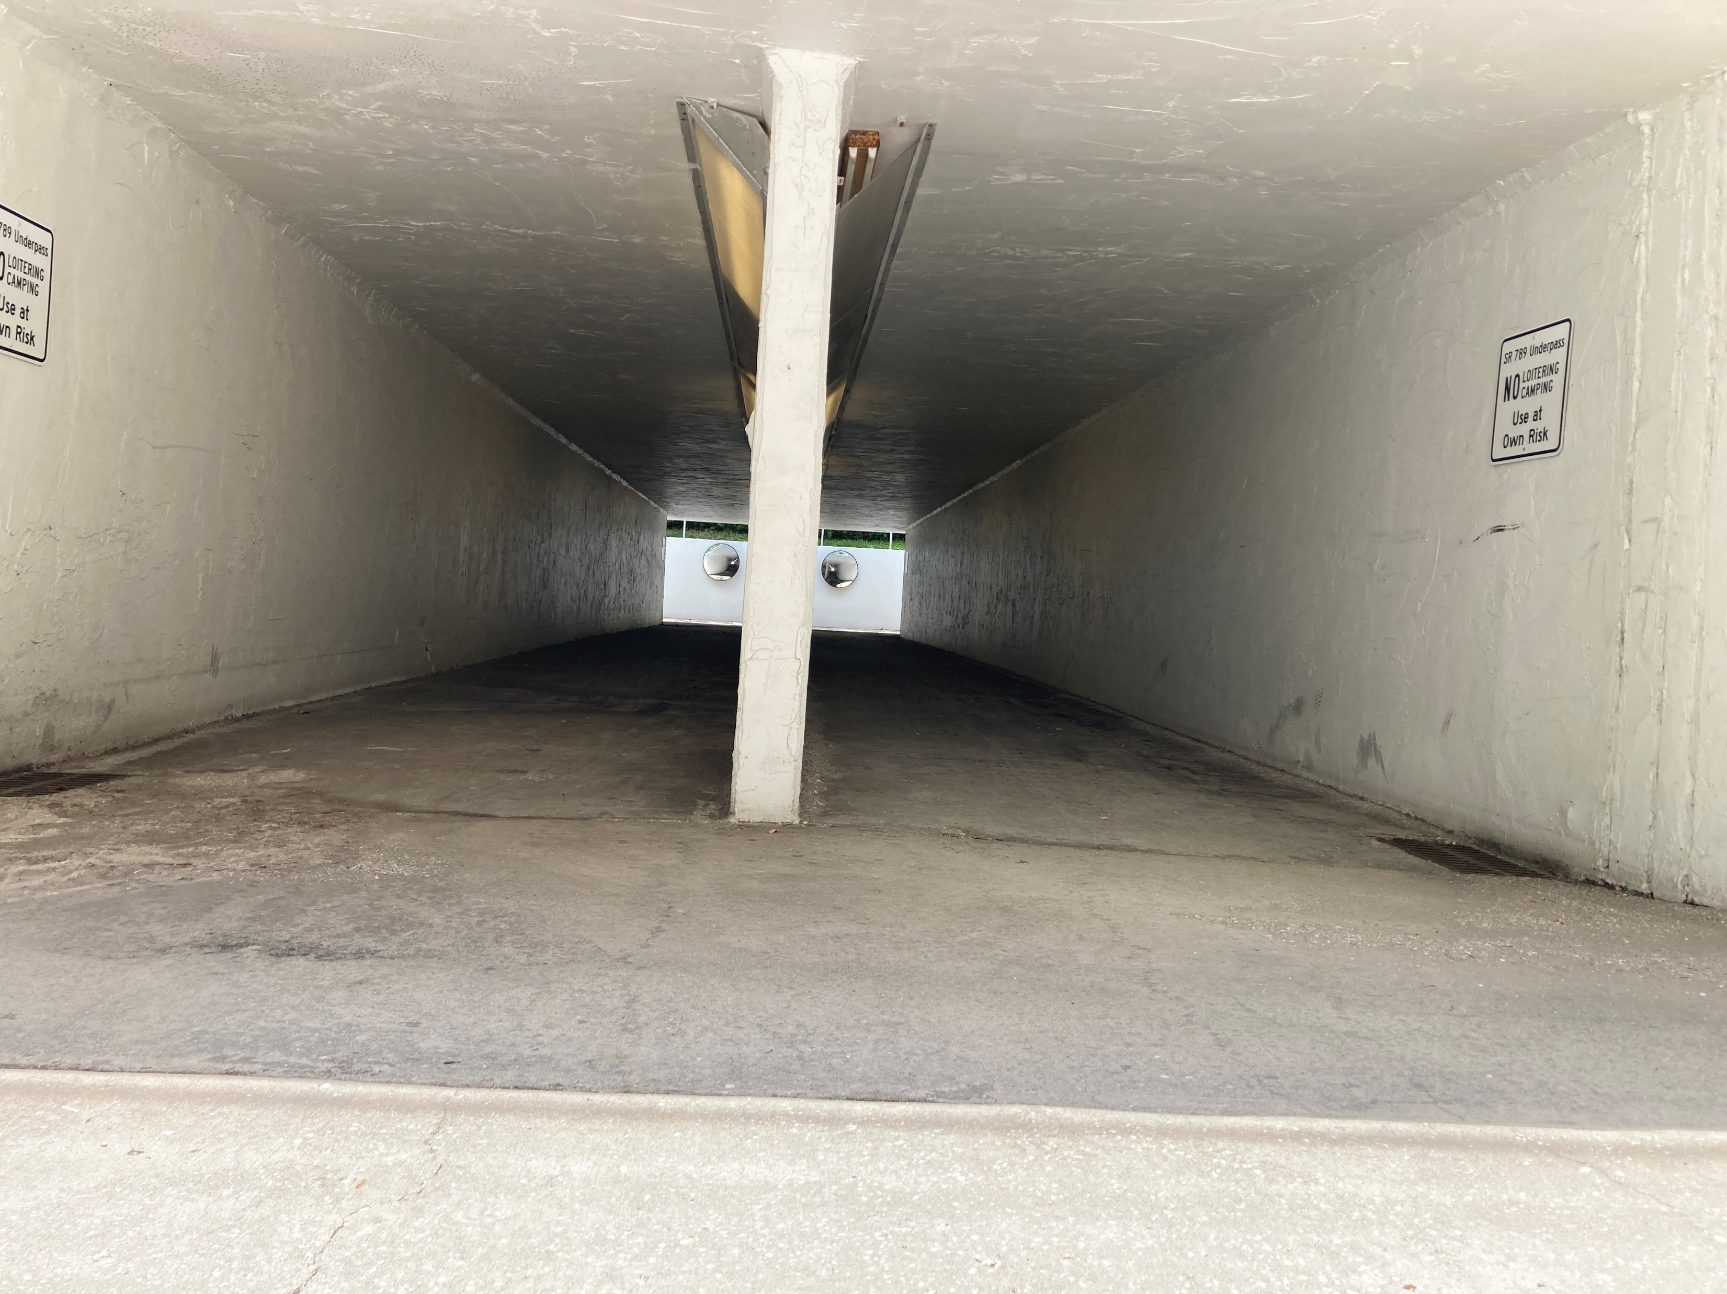
Bay Isles Association, Inc.: Pedestrian Tunnel
Background:
  Built by Arvida, Inc. in late 1970s
    John Burgstiner Equipment Company
    (dba John Burgstiner, Inc.)
  Provides a safe, convenient bicycle/pedestrian crossing connection under GMD between Bay Isles, Seaplace, and the surrounding area.
  This segment of GMD has no nearby marked surface crossings. Current FDOT criteria would limit that ability.
  BIA is contemplating abandoning the asset. Why? Due to liability exposure and maintenance costs over time.
  BIA has approached both the Town and FDOT about taking over ownership and maintenance.
  At this time, no known claims nor litigation related to the tunnel.

Slide 15
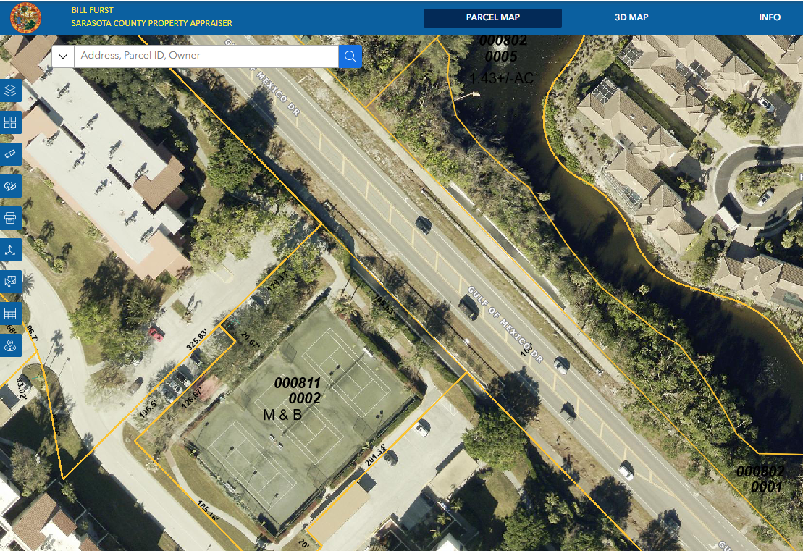
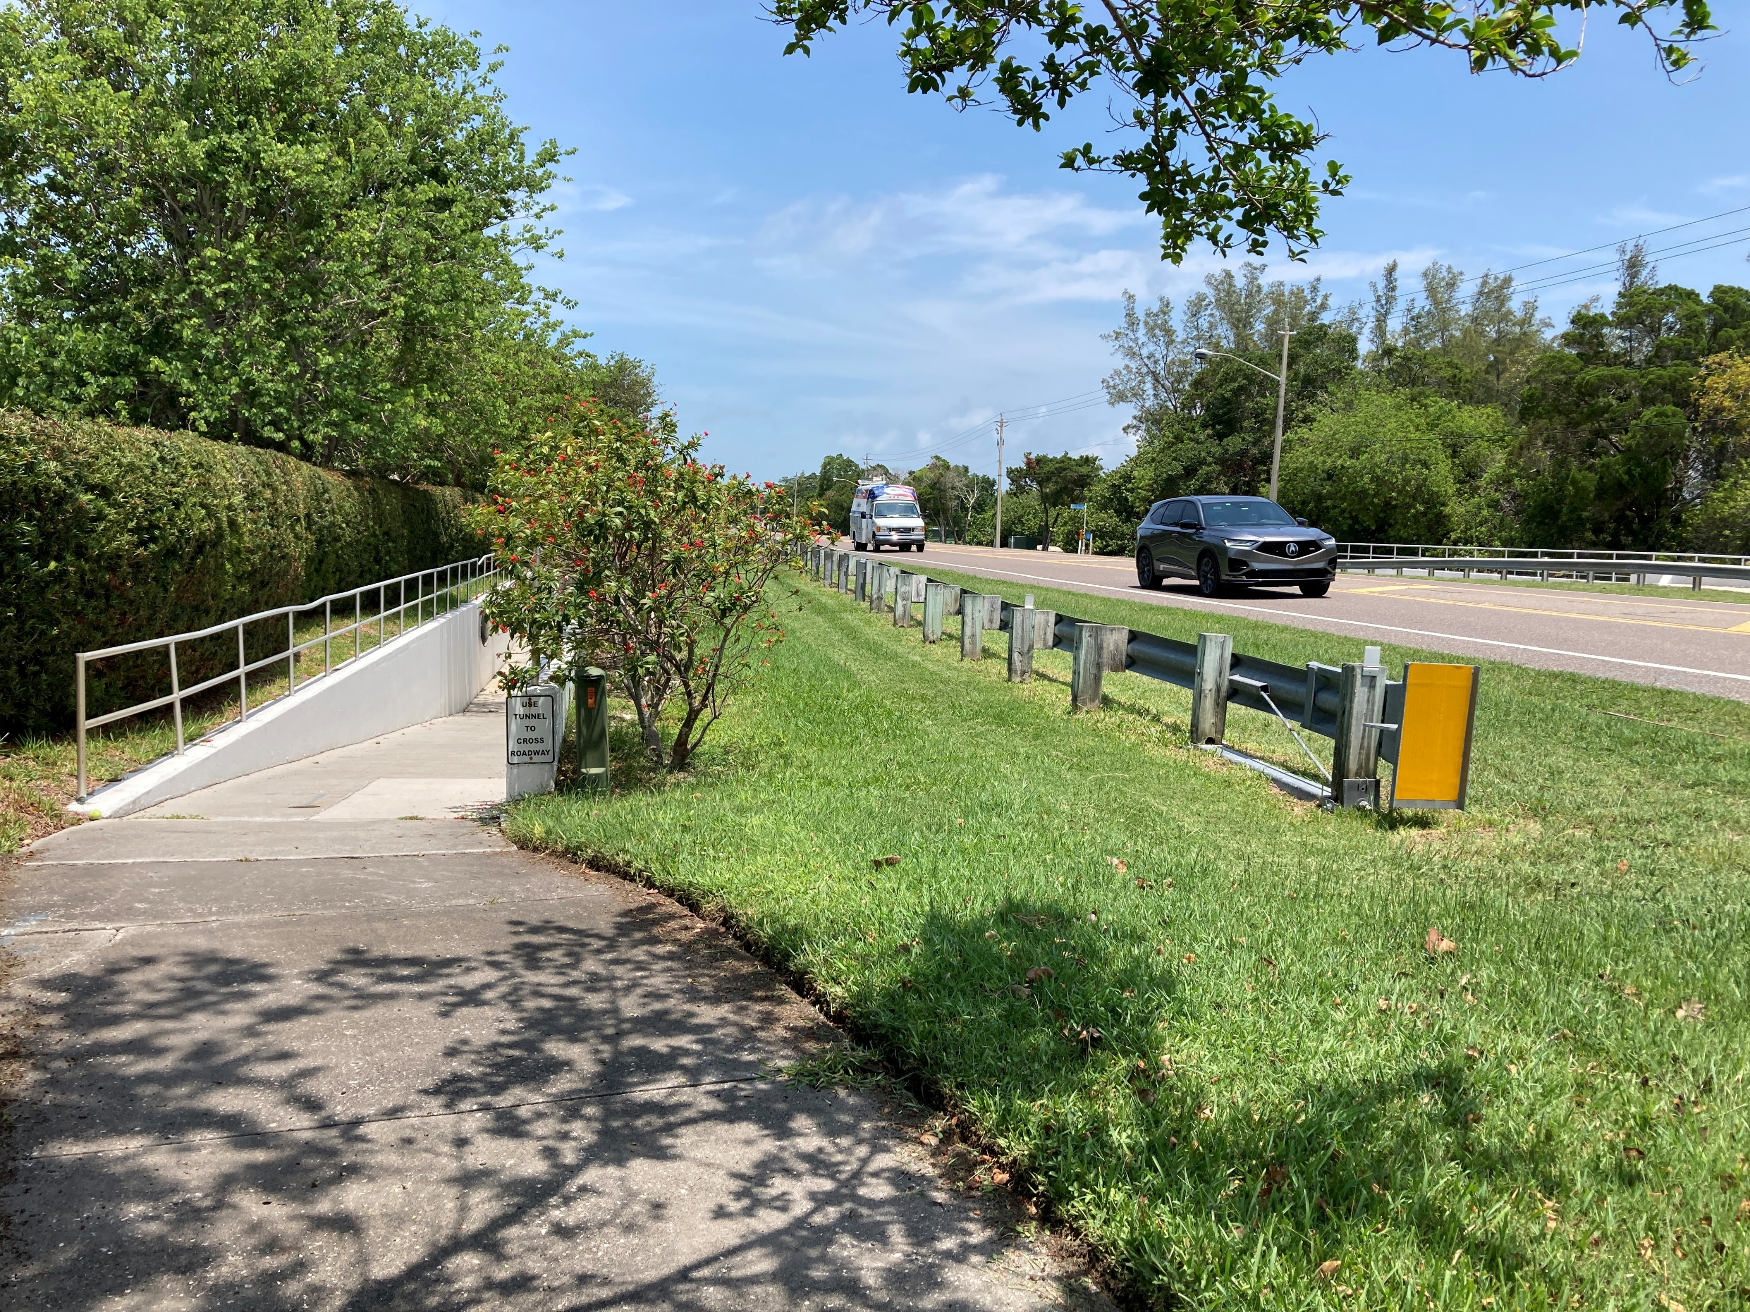
Bay Isles Association, Inc.: Pedestrian Tunnel
Background (continued):
  Outstanding ownership question(s):
    Except for the eastern ramp located on BIA property, BIA claims they do not hold any ownership interest in the tunnel within the state right-of-way, only maintenance responsibility.
    West ramp apparently on Seaplace properties.
    At a meeting on April 28, 2025, FDOT reiterated to the Town that FDOT does not own nor has an interest in owning, nor maintaining the tunnel under state R/W.
    The Town does not currently own any of it.

Slide 16
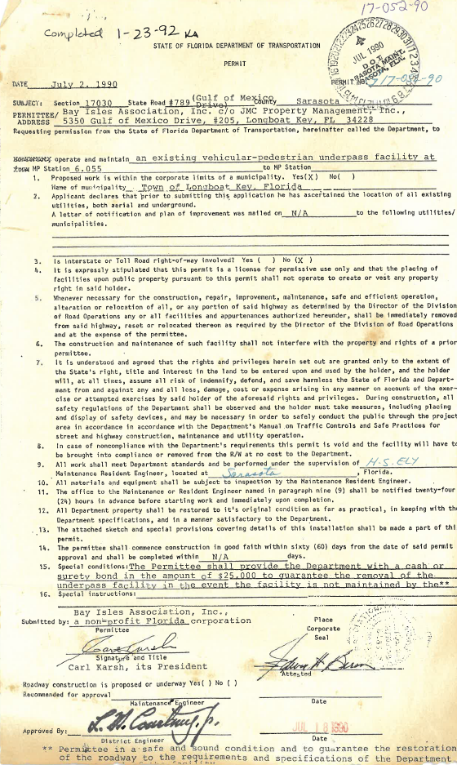
Bay Isles Association, Inc.: Pedestrian Tunnel
Background (continued):
  FDOT Permit from July 2, 1990, documenting Bay Isles Association, Inc. as the permittee and maintenance entity for the tunnel.
  Included a requirement of posting a $25,000 surety bond to FDOT to guarantee removal of the tunnel in the event BIA ceases to maintain.
  BIA does acknowledge maintenance responsibility and desires to divest itself of these responsibilities.

Slide 17
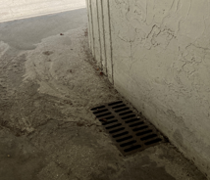
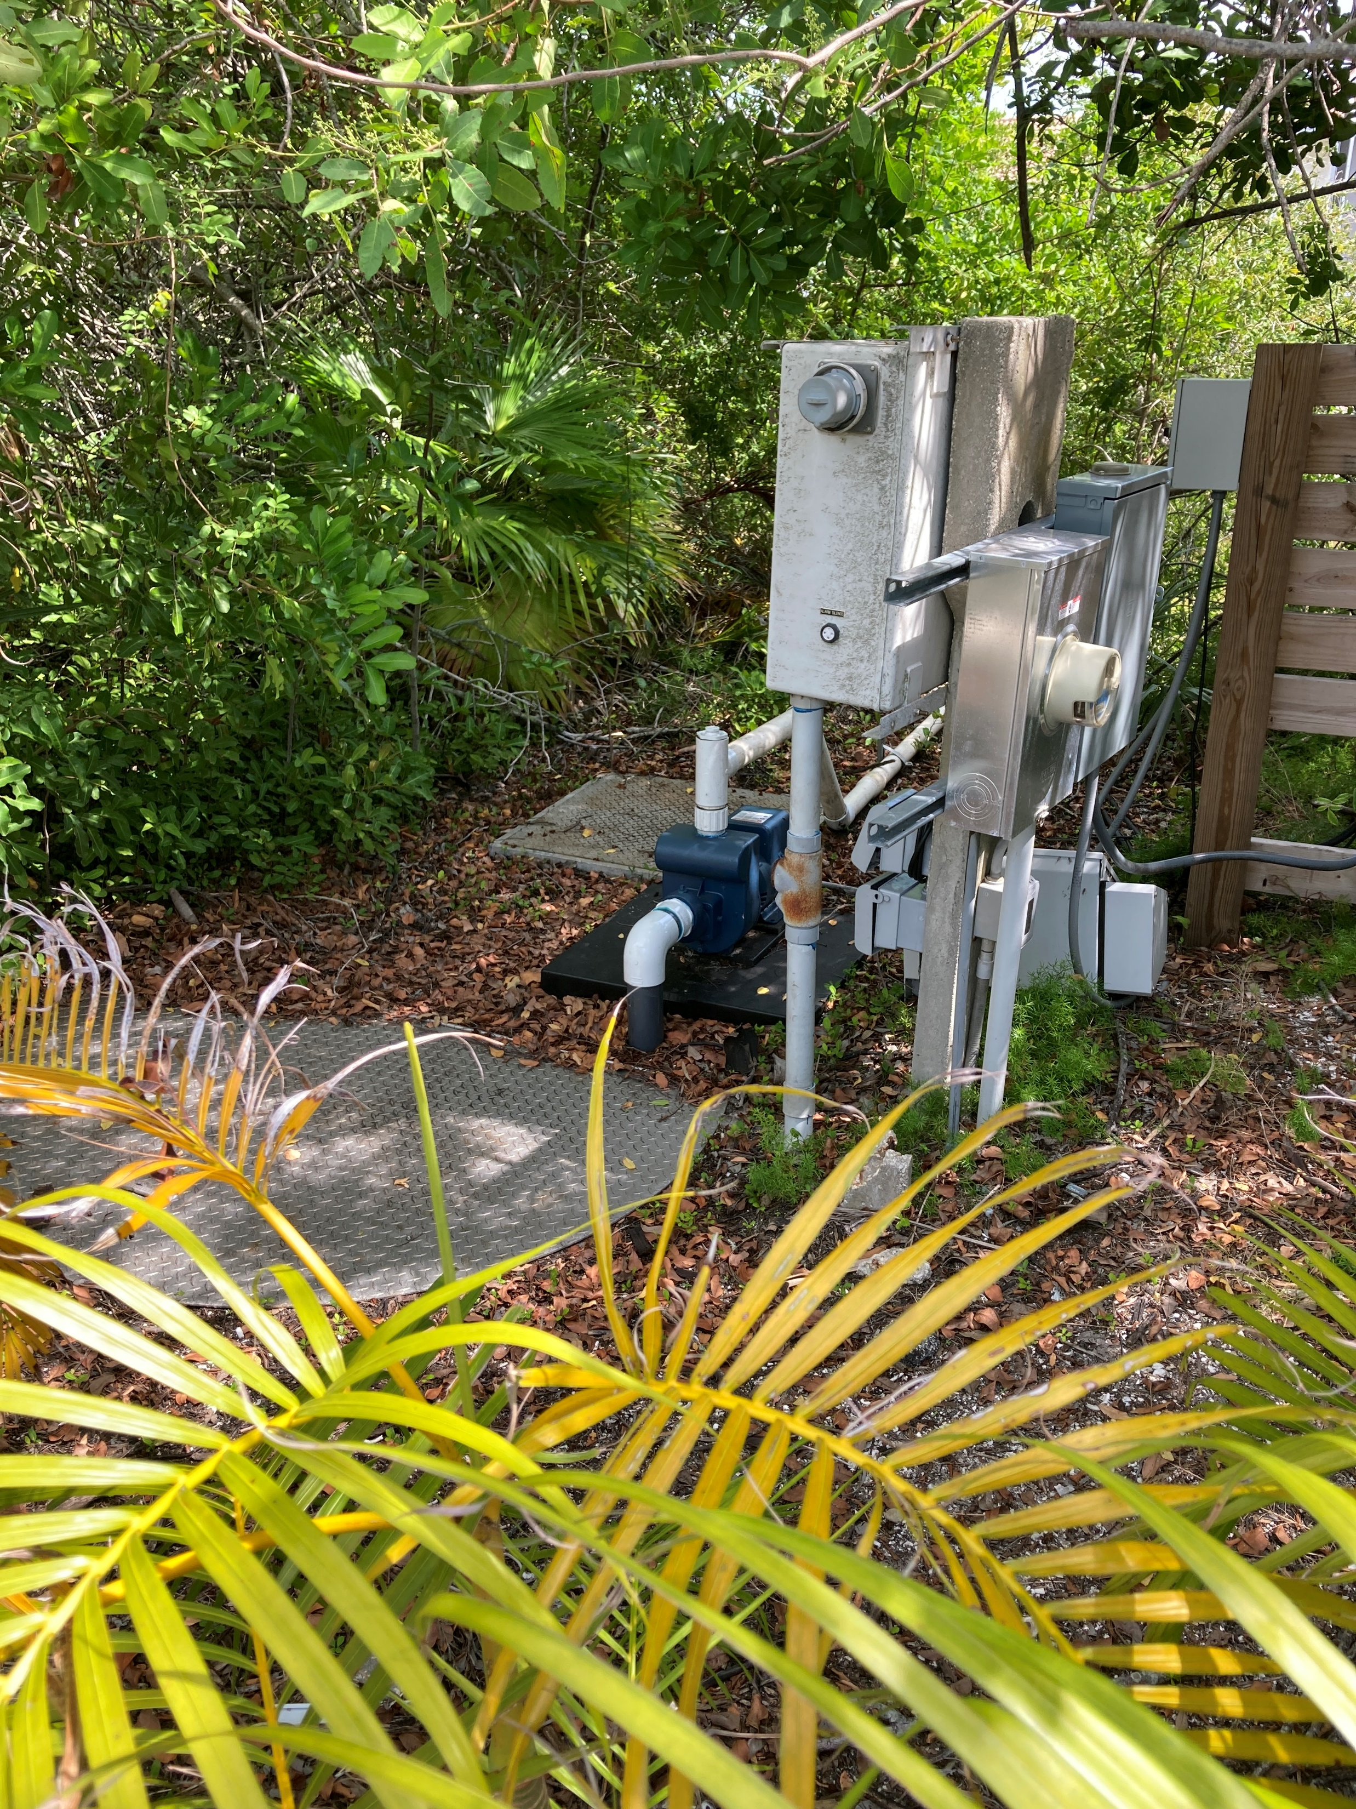
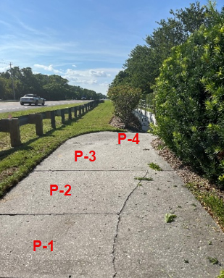
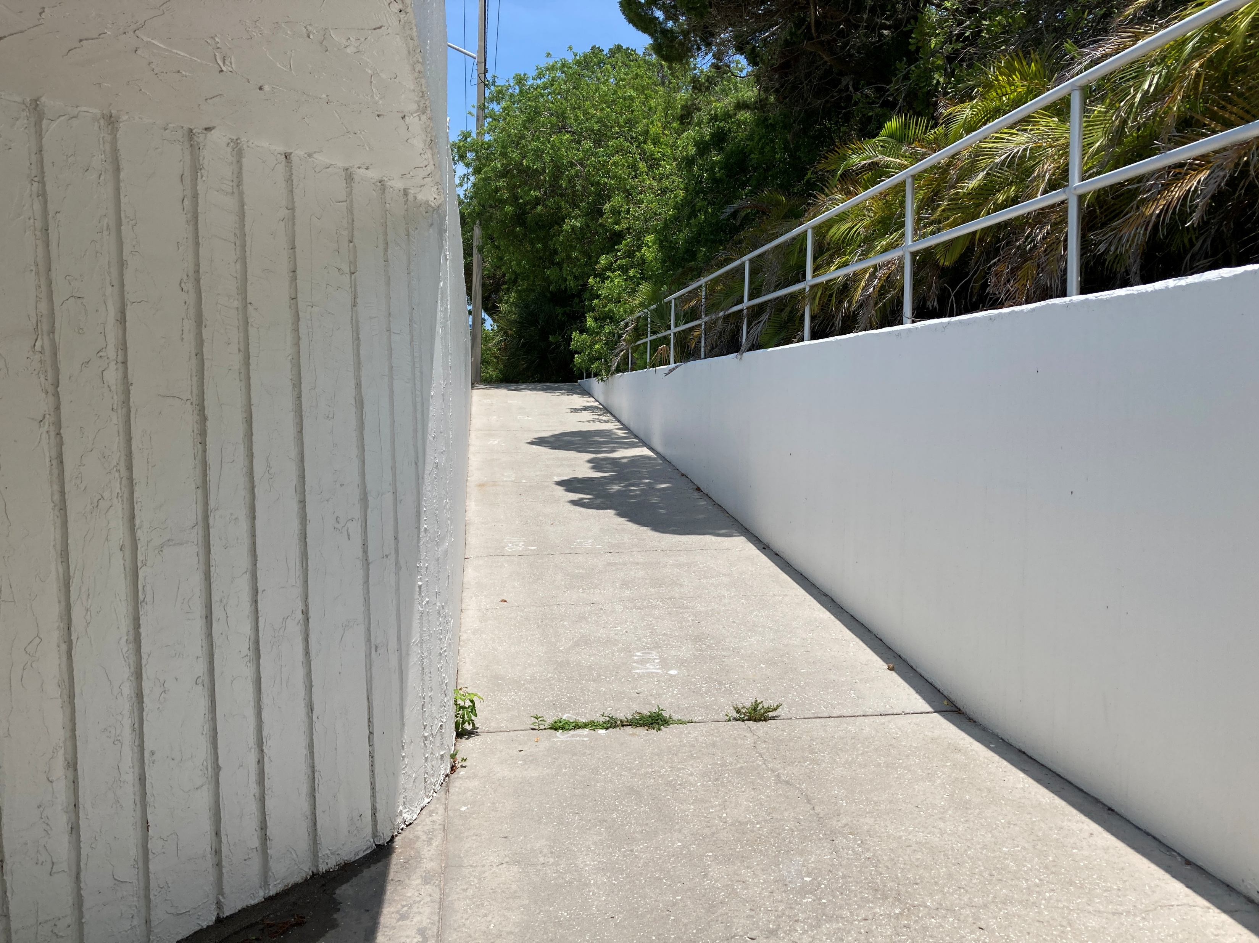
Bay Isles Association, Inc.: Pedestrian Tunnel
Stantec (hired by BIA), FDOT, and Town have independently reviewed and analyzed the structure. Observations:
Appears to be structurally sound.
Due to the low elevation of the tunnel, tunnel drainage requires functioning pumps, which appear to have been repaired recently. May need additional work.
Runoff discharges through the private Bay Isles system(s).
All ramps are on private properties (BIA and Seaplace).
The ramps down to the base of the tunnel do not meet ADA standards for accessible ramps (up to 19% slope according to FDOT - standard is 8.3%).

Slide 18
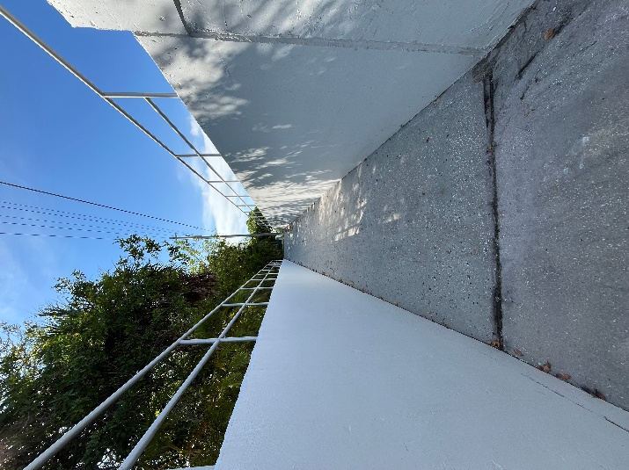
Bay Isles Association, Inc. Pedestrian Tunnel
Ongoing Discussions:
BIA is looking to cease maintenance of the tunnel.
Although FDOT acknowledges the importance of this asset as a safe crossing, FDOT affirms that they do not own it nor have an interest in partnering on ownership and maintenance.
FDOT recently built a sidewalk on the west side of GMD to bypass
the non-ADA ramp for walkers along GMD.
Consideration includes the Town potentially taking over entirely.
Due to physical land ownership and cost constraints, ramps may not need to be upgraded: “reasonable accommodation” for existing structures.
  Additional land on either side to extend the ramps a longer distance is all privately owned.
  A recent “ballpark” estimate from our local construction manager to demolish and reconstruct one end wall and ramp on both sides = $640,000 total.
  Demolition and reconstruction could compromise the remaining structure.

Slide 19
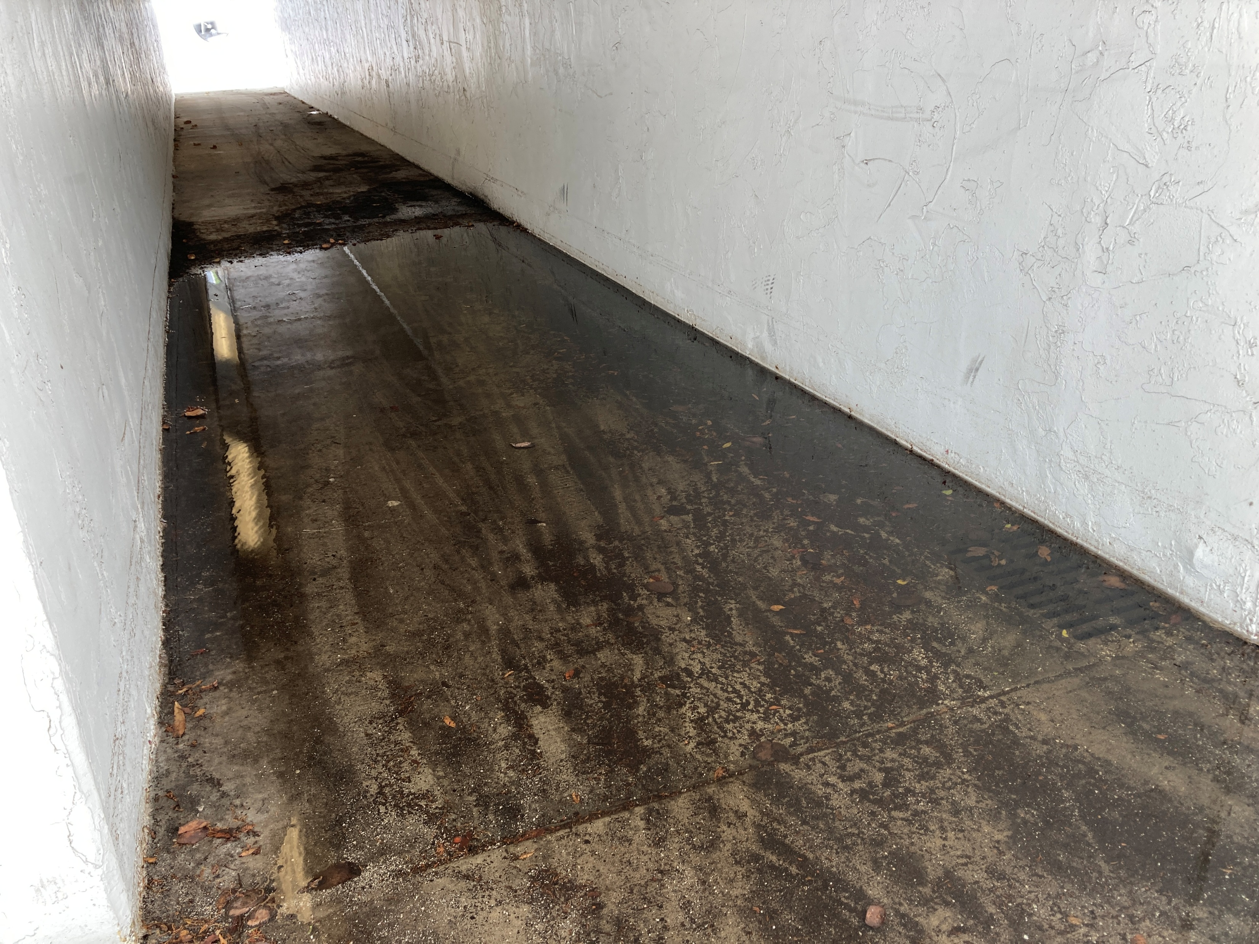
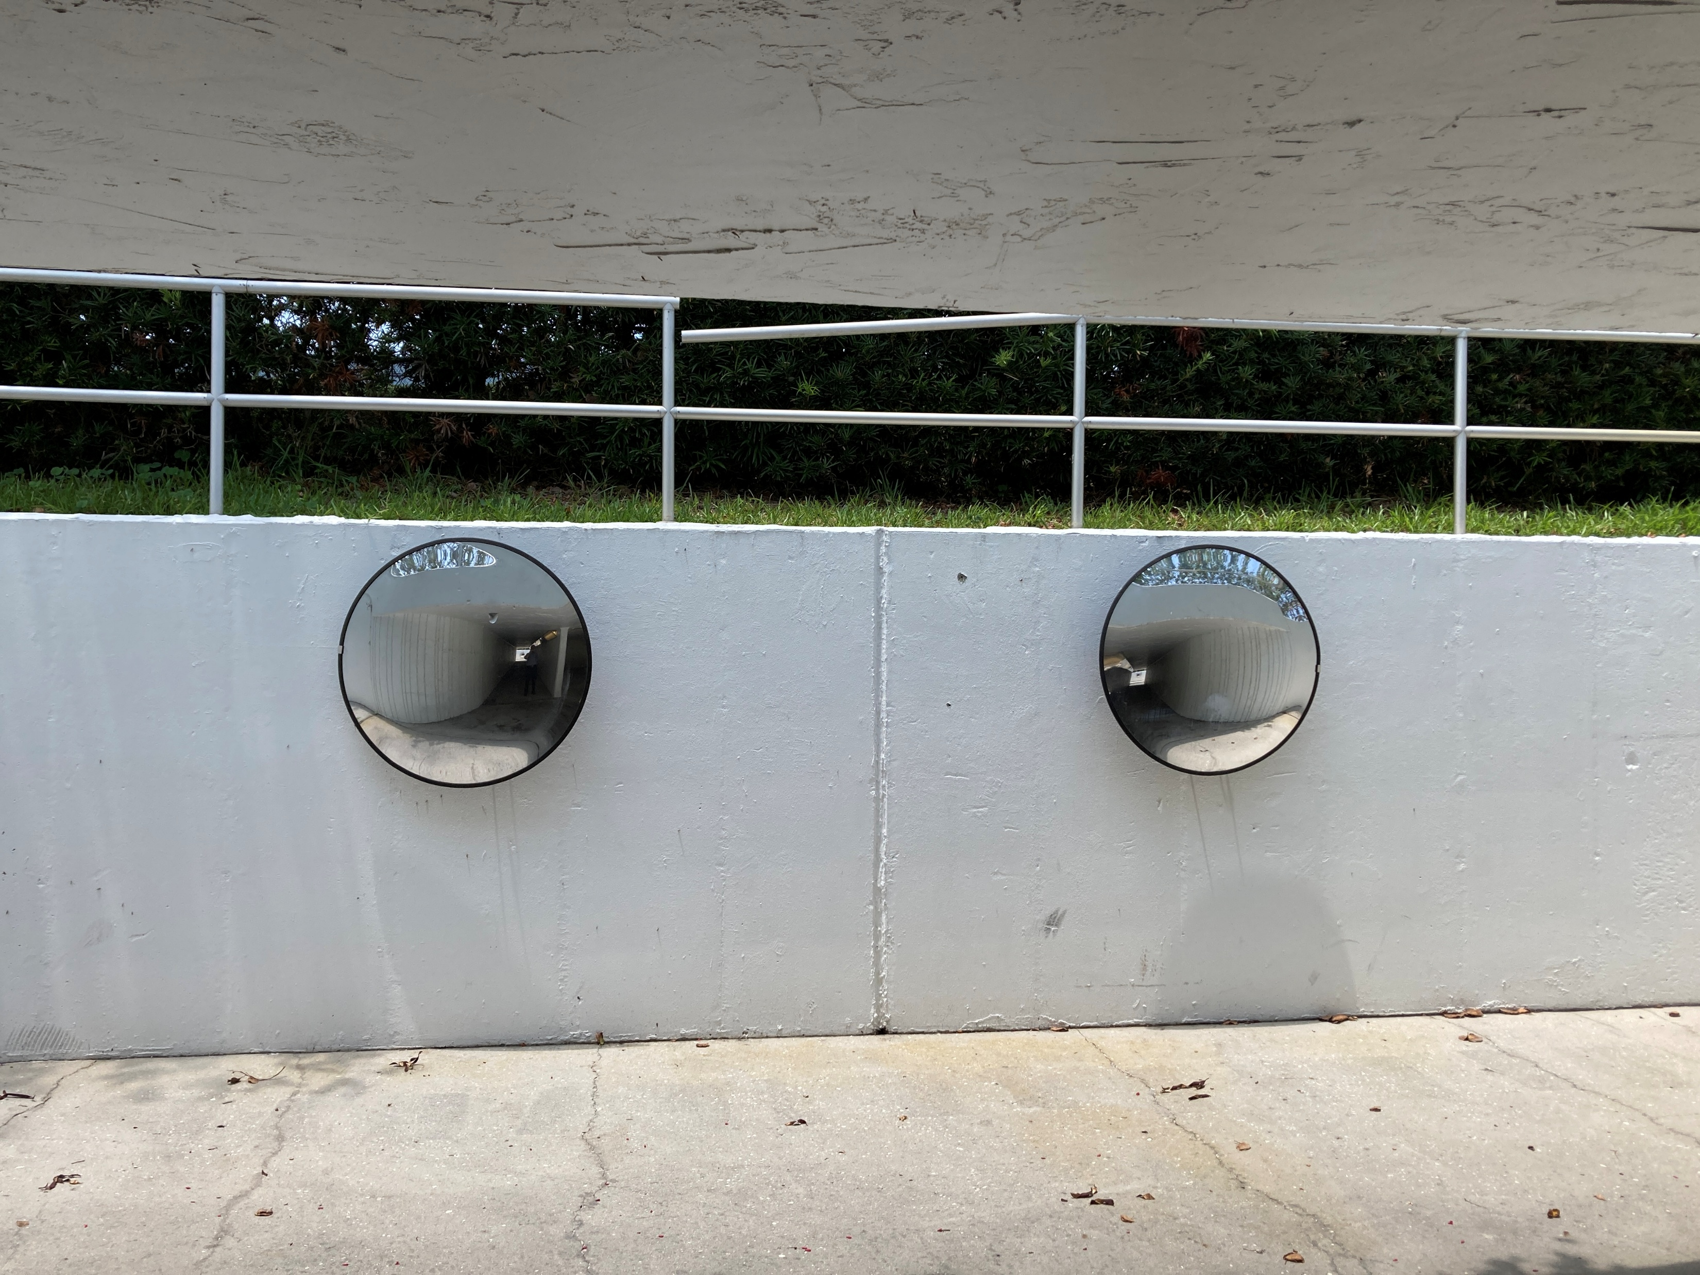
Bay Isles Association, Inc. Pedestrian Tunnel
BIA Costs:
Average cost per year: $16,164
Notables:
Landscape/Electric/General: $7,200 (annual est.)
Tunnel Pressure Washing (PW): $5,145 (annual avg.)
Painting: $13,950 (in 2021)
Replace Drainage Pump: $6,000 (in 2024)
Mirrors $500 (every 5 years)
No expenditures noted regarding handrails or lighting
Also of note, the pump electrical system serving the tunnel drainage system is co-mingled with other BIA electrical systems.
BIA has hired an electrical firm to work with FPL and separate the systems to separately meter the tunnel drainage pump and lighting.

Slide 20
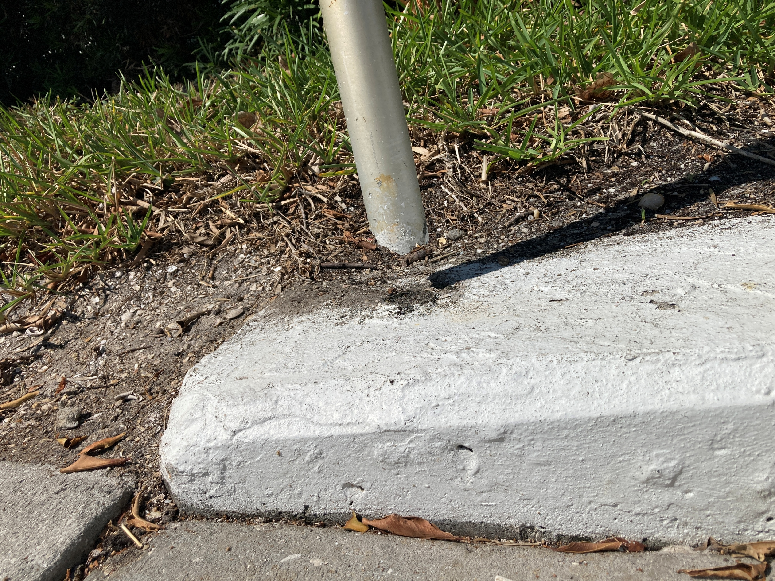
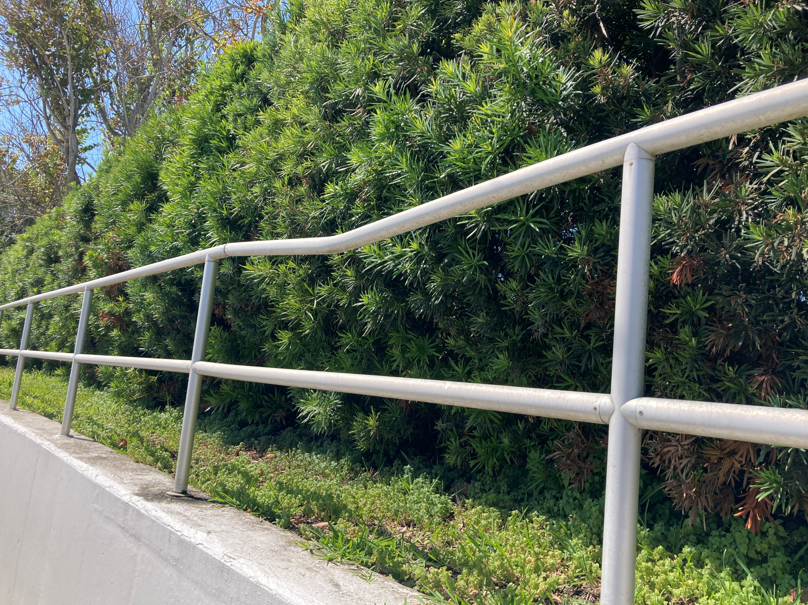
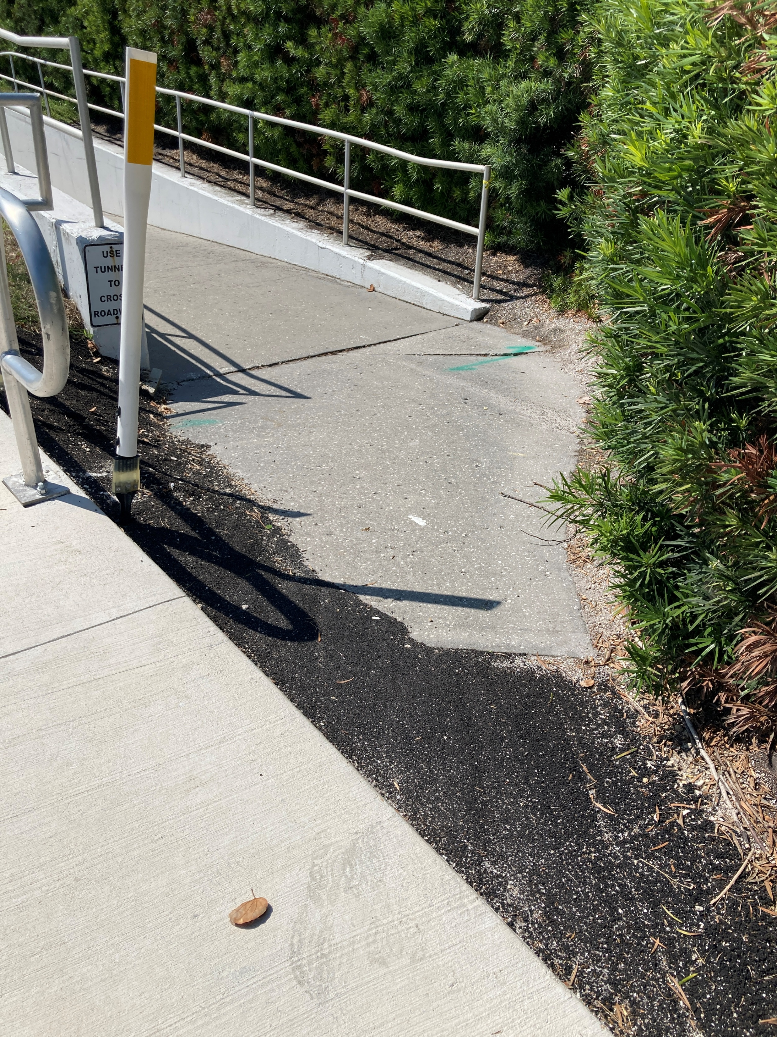
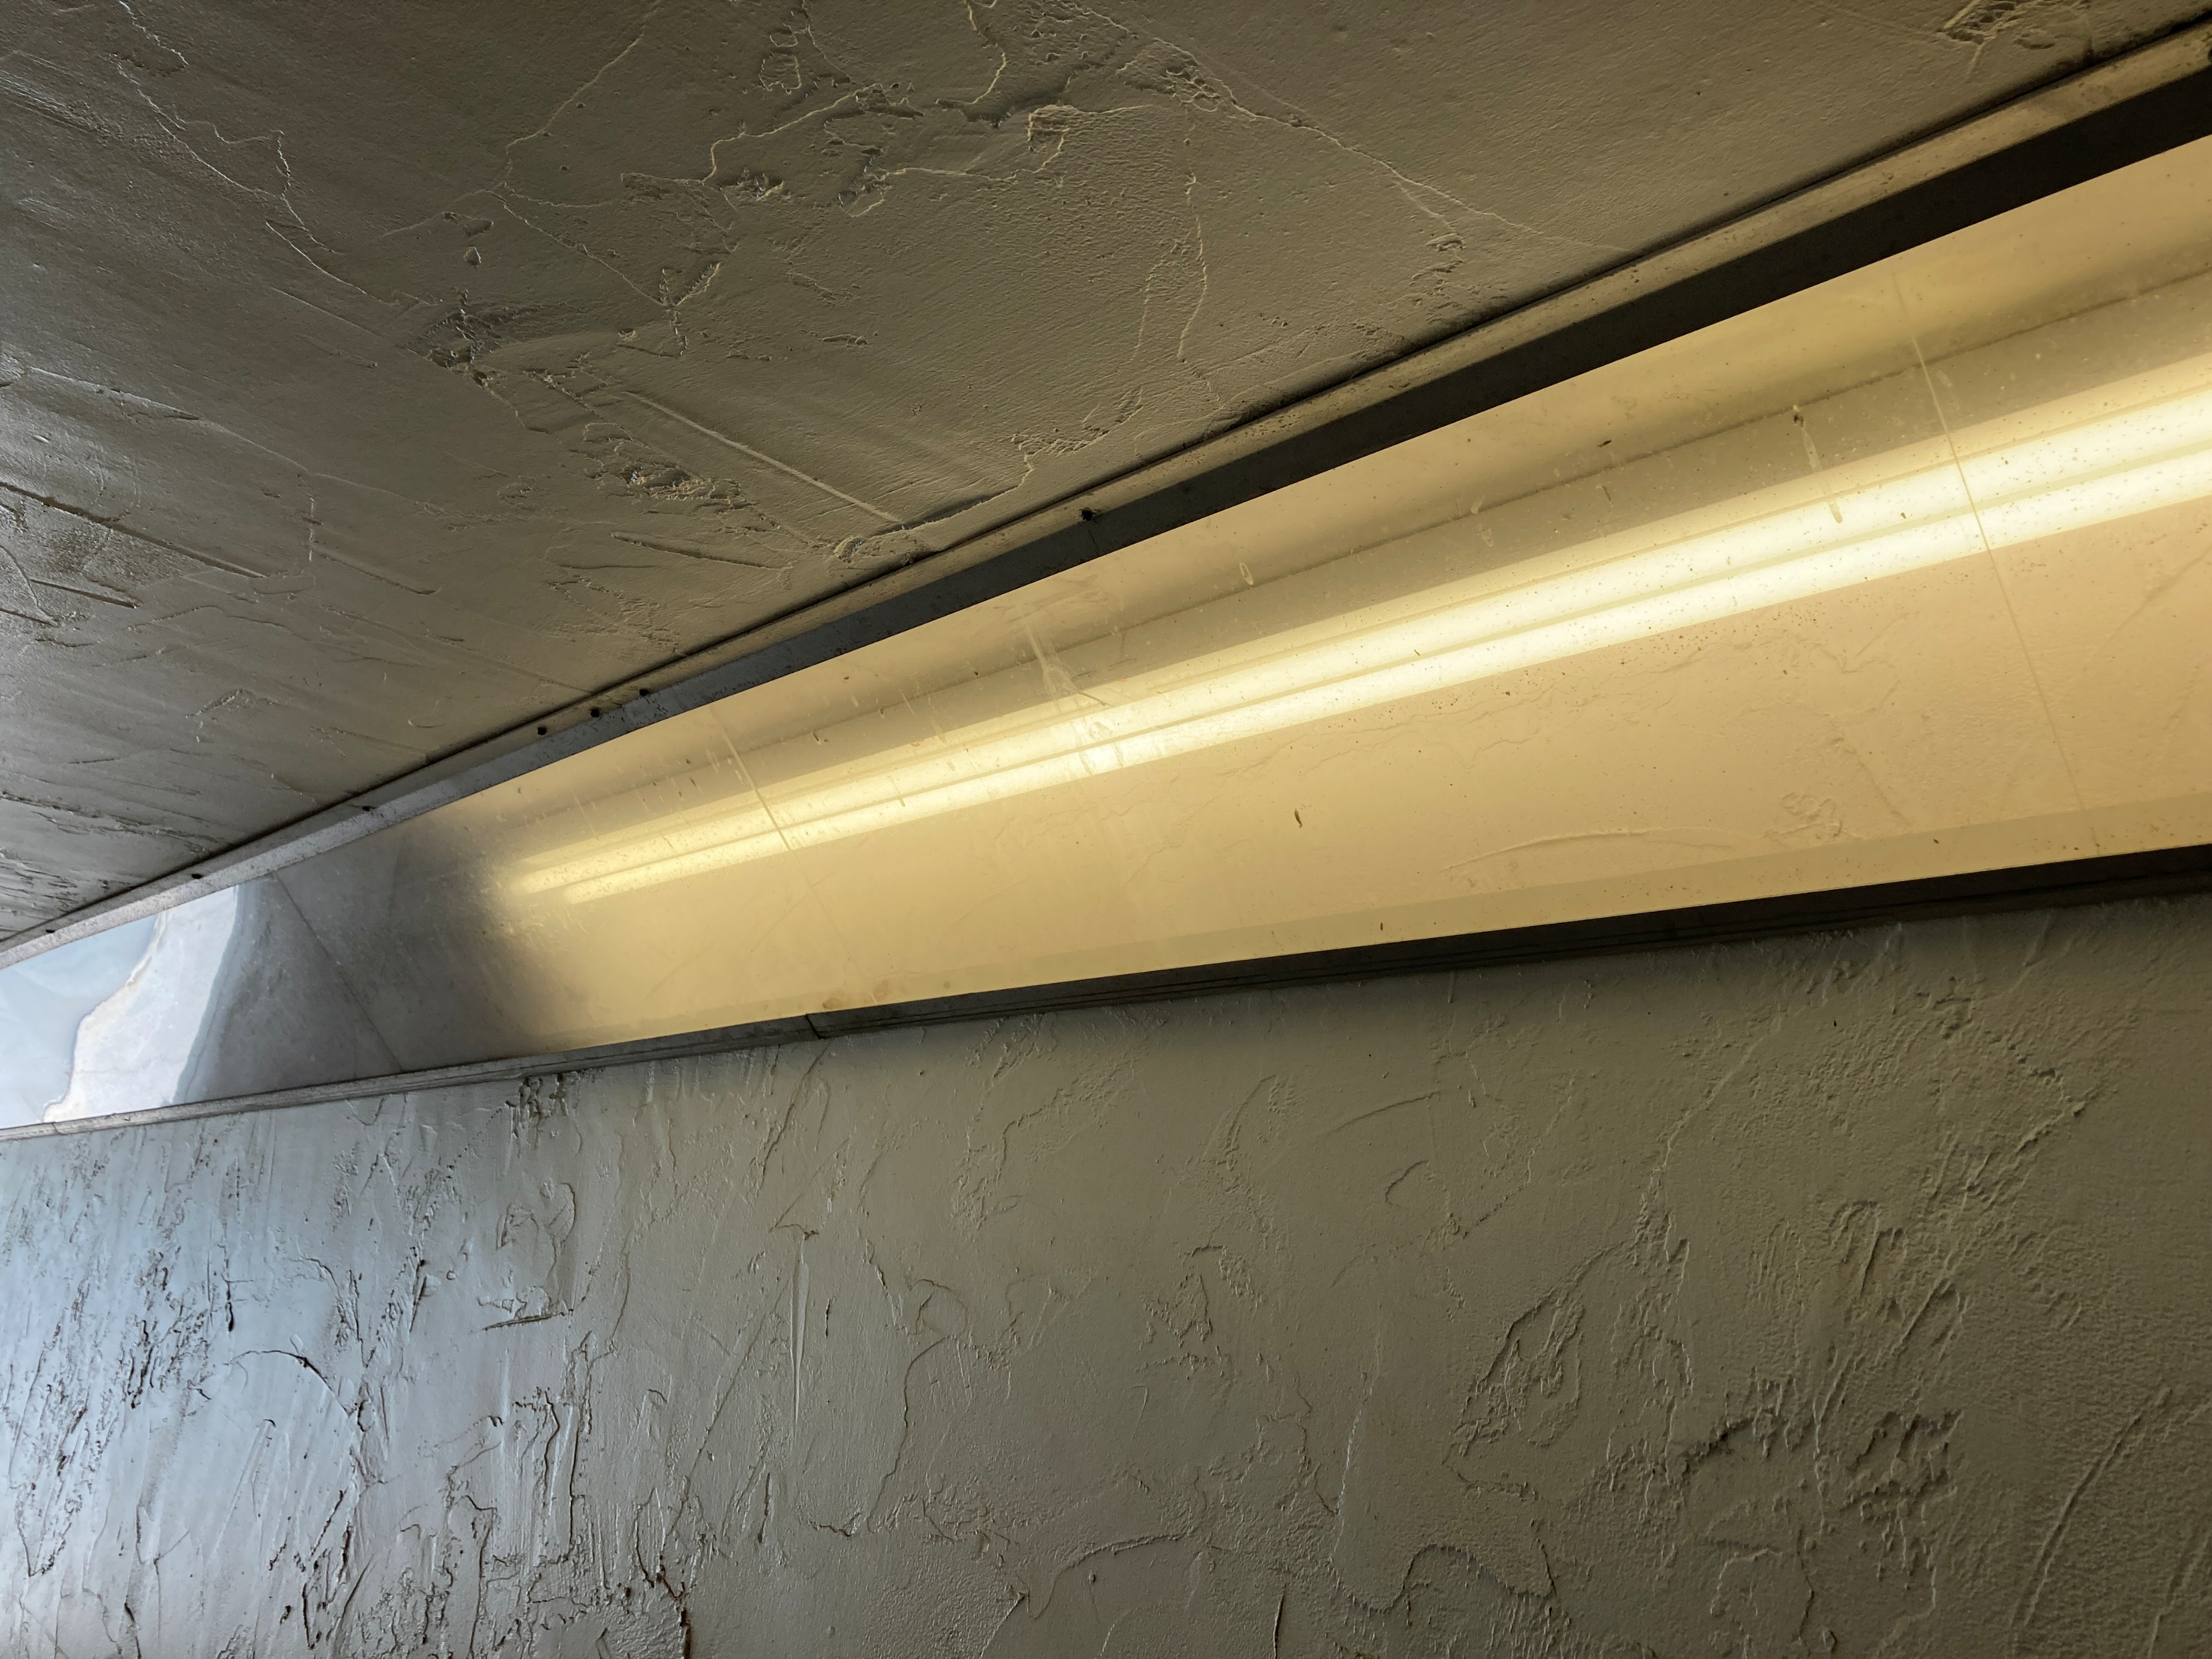
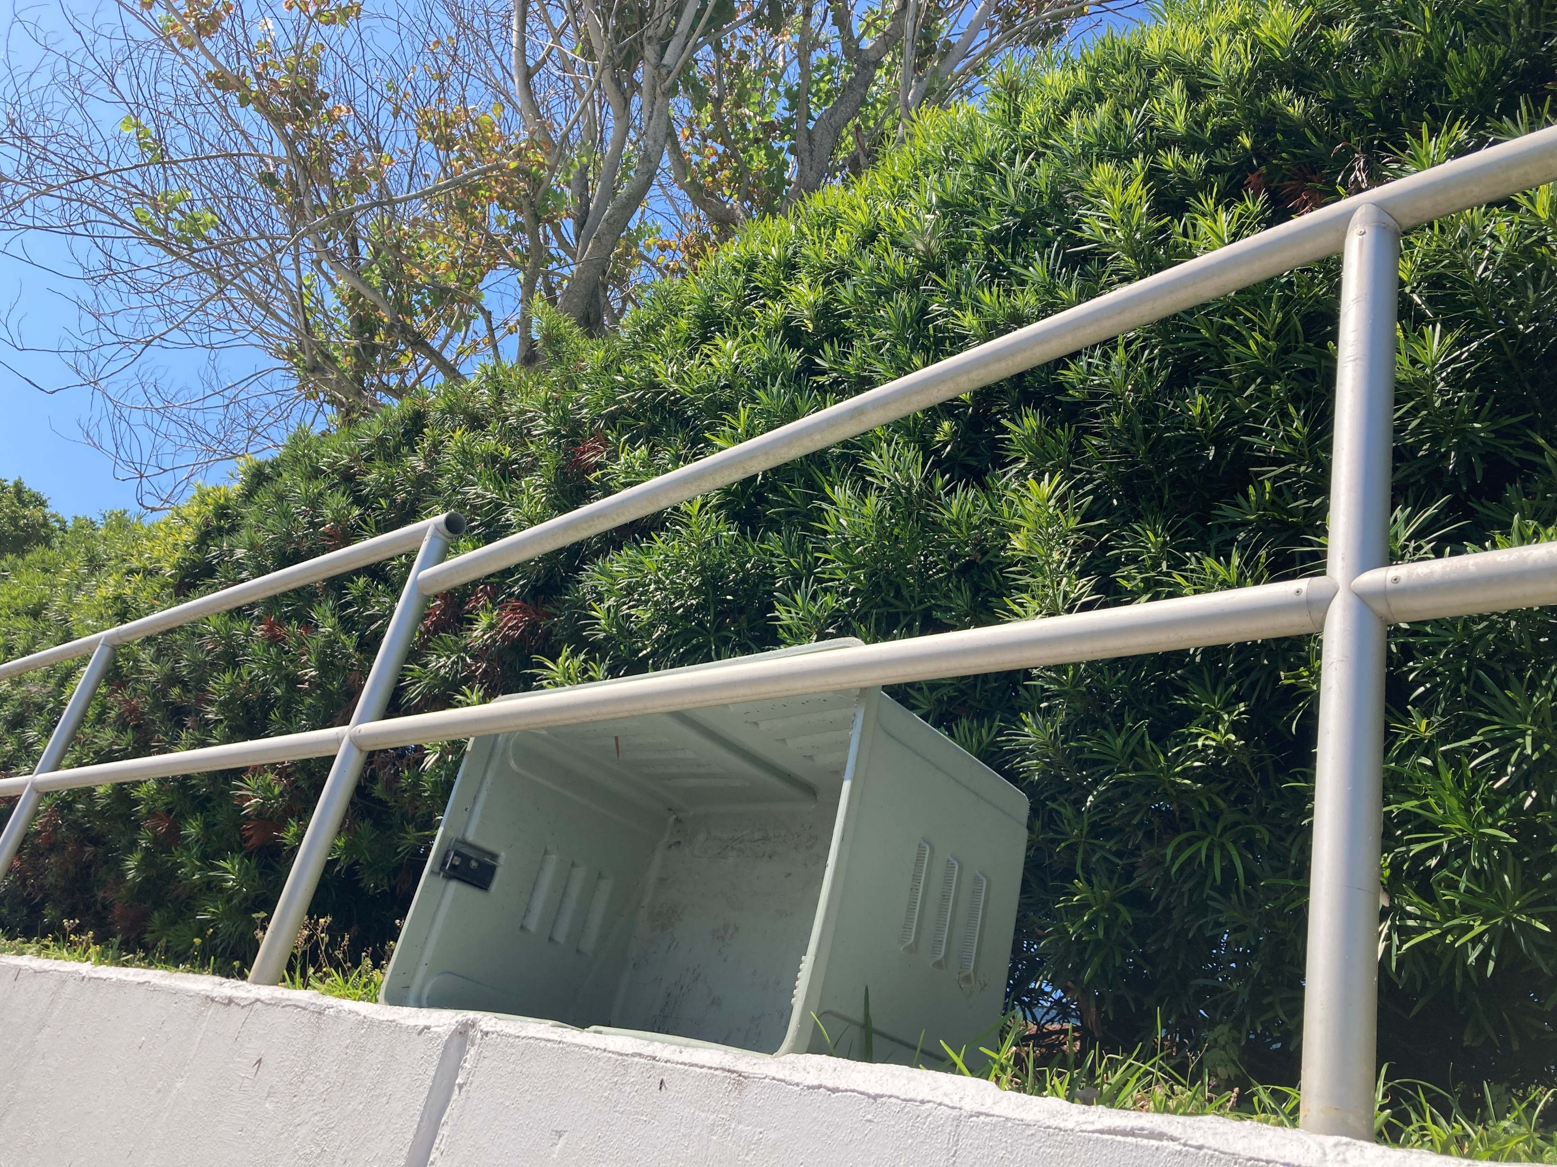
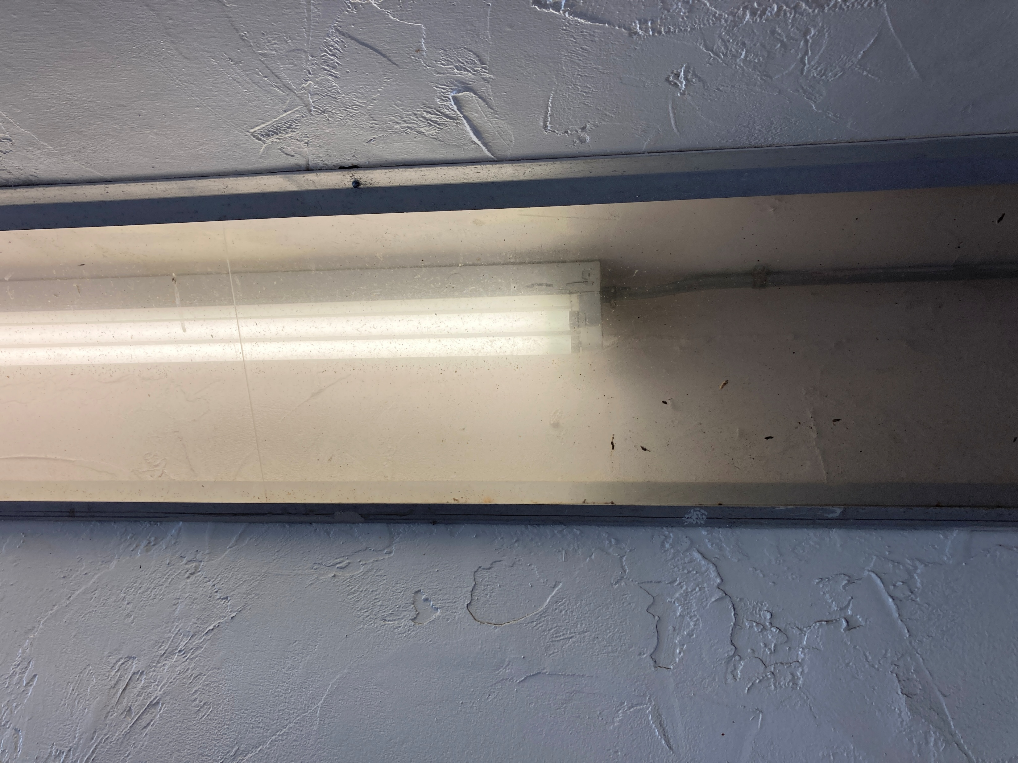
Bay Isles Association, Inc. Pedestrian Tunnel
Cost of Handrail Repairs and Lighting Upgrades?

Slide 21
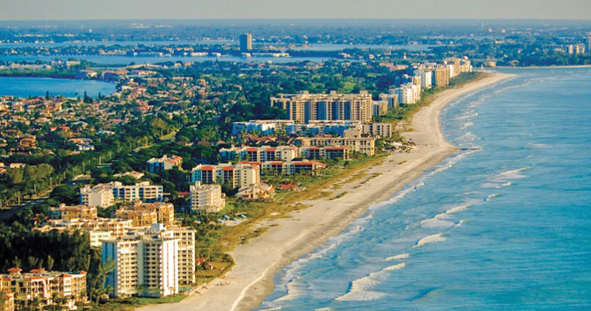
Bay Isles Association, Inc. Pedestrian Tunnel
Continue to recognize this a Longboat Key community asset? Yes.
Provides the sole safe GMD crossing between Bay Isles Harborside, Seaplace, and surrounding areas.
Robust, well-built, unique, large structure
Visually innocuous from the surface. Unless you look for it, you likely will not see it.
It is utilized.

Slide 22

Bay Isles Association, Inc. Pedestrian Tunnel
In summary, BIA:
Has taken a position that BIA does not own the asset, only maintains it.
Wishes to divest itself of its maintenance obligation.
March 4, 2025, the Bay Isles Board of Directors (“Board”) passed a resolution authorizing the Board to negotiate and/or convey right, title, and interest of all the tunnel components, including the portion of property containing the east ramp, to whomever is wiling to take over ownership and maintenance.

Slide 23
Bay Isles Association, Inc. Pedestrian Tunnel
Remaining Town Question: Can clear title be established?
  Who (whom) owns the portion of the asset within State Road 789 and can clear title be conveyed to the Town?
  BIA representatives have indicated that “no recorded title evidencing ownership of the tunnel” exists.
  BIA counsel, in conversation with the FDOT R/W Manager, has determined that FDOT would be willing to grant the Town an easement over the tunnel.
If the Town Commission is interested, Next Steps:
Establish a clear title and negotiate the terms of a conveyance, or
Accept the BIA assertion that no clear title exists and proceed alternatively:
  For example, work with the Town Attorney’s office on the merits and risks of assuming maintenance of this asset through an easement with no clear title.
If Town moves forward to accept either the Tunnel or Bay Isles Parkway, Town staff needs to amend the FY26 proposed budget to acknowledge ongoing operational costs.
At the time an agreement is reached, and contingent upon signing, both BIA and Seaplace owners would need to convey title or easement interest to the Town for each complete ramp system, respectively.

Slide 24
Thank you!!

