Slide 1
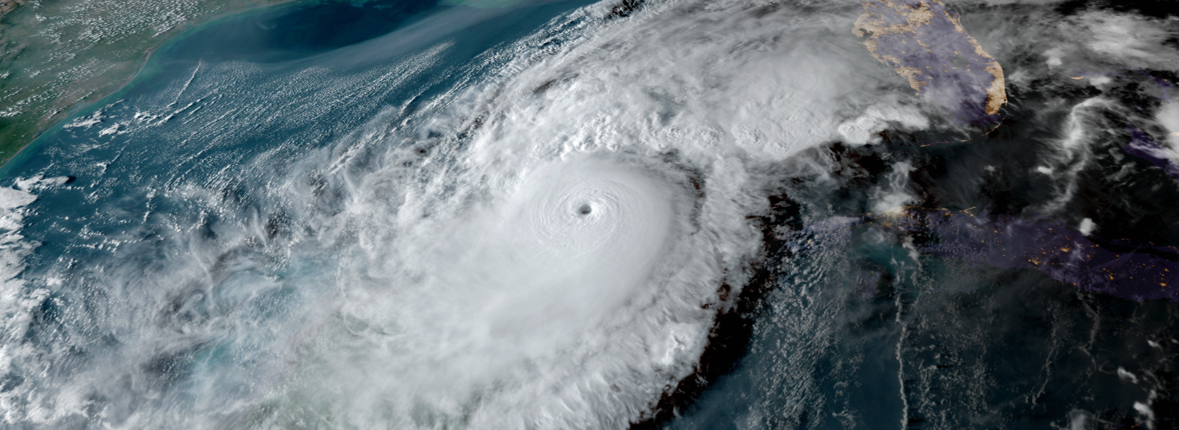

2025 Disaster Preparedness Seminar
Town Manager Howard Tipton

Slide 2
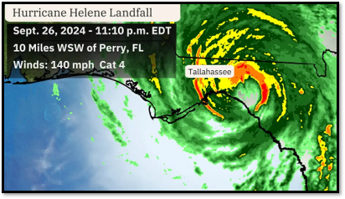
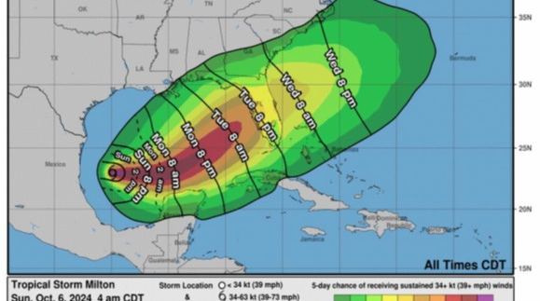
2024 Storms
  Debby
  Helene
  Milton

Slide 3
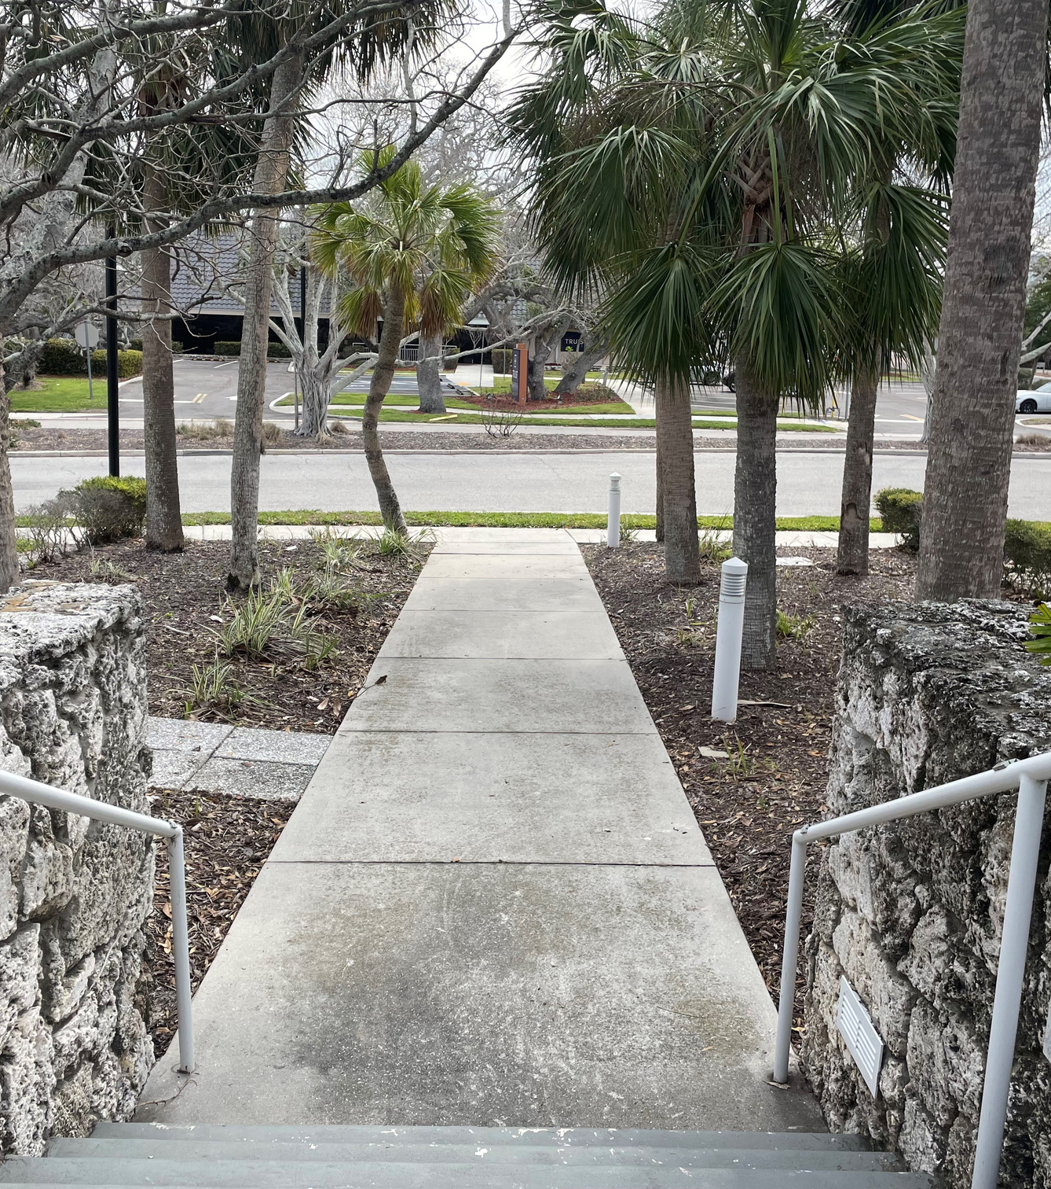
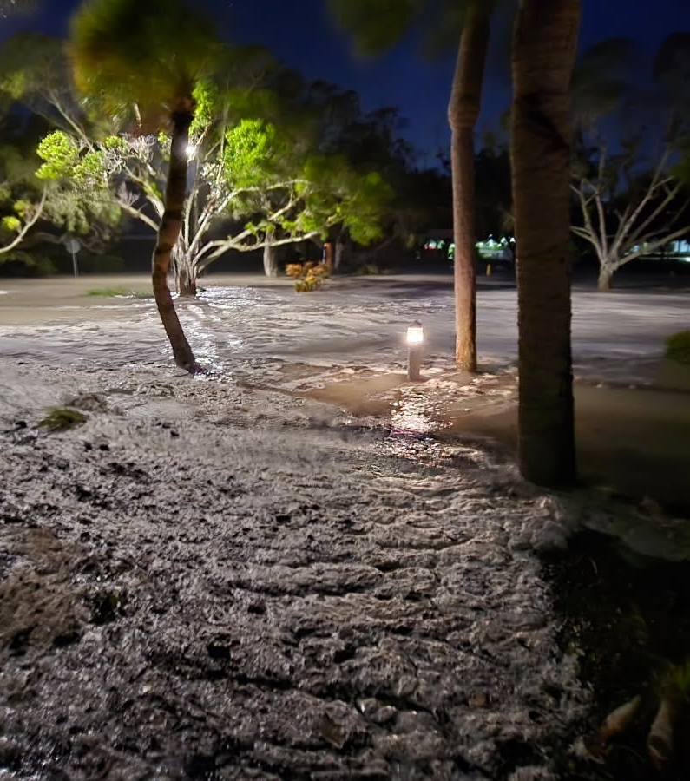

Slide 4
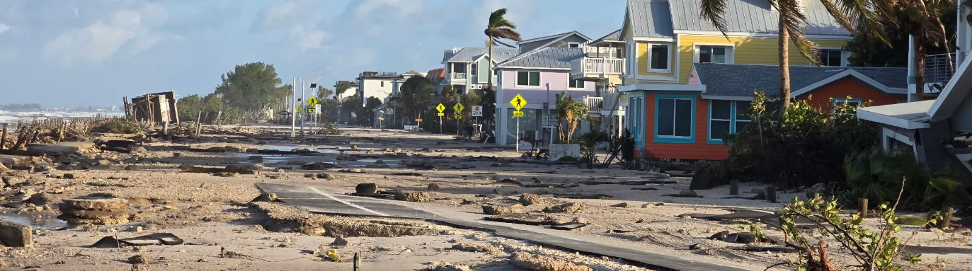
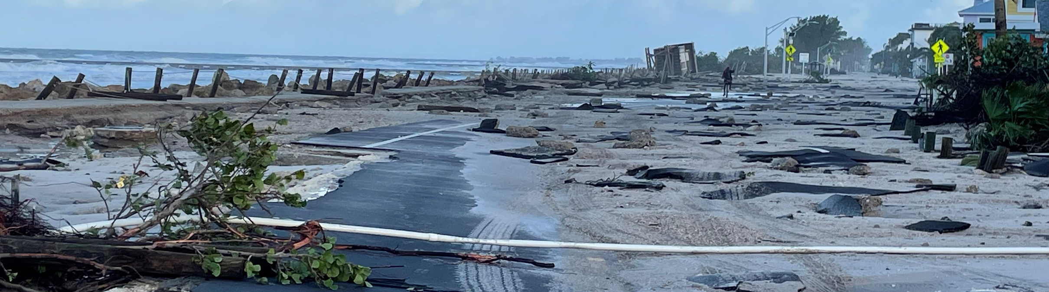

Slide 5
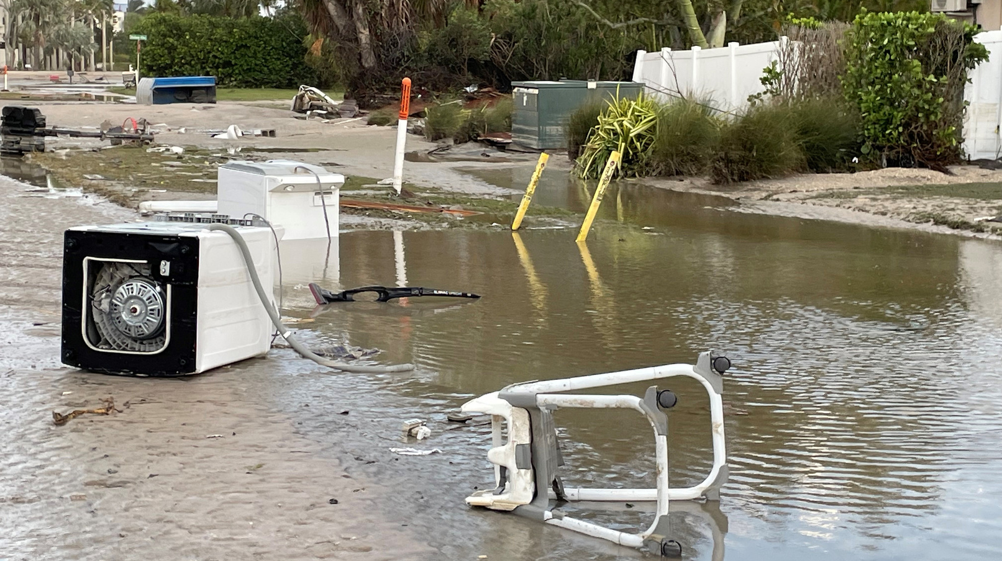
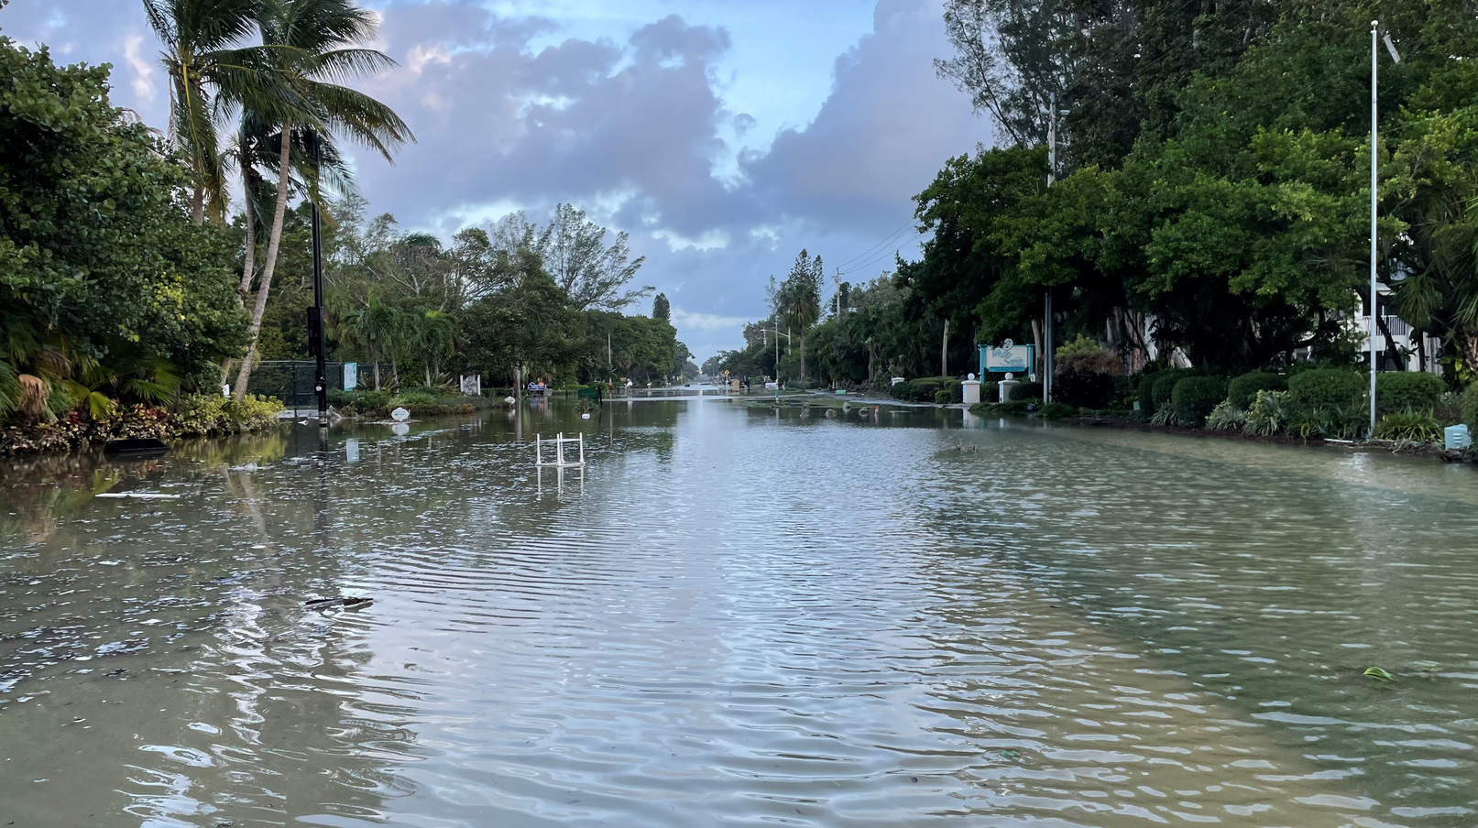
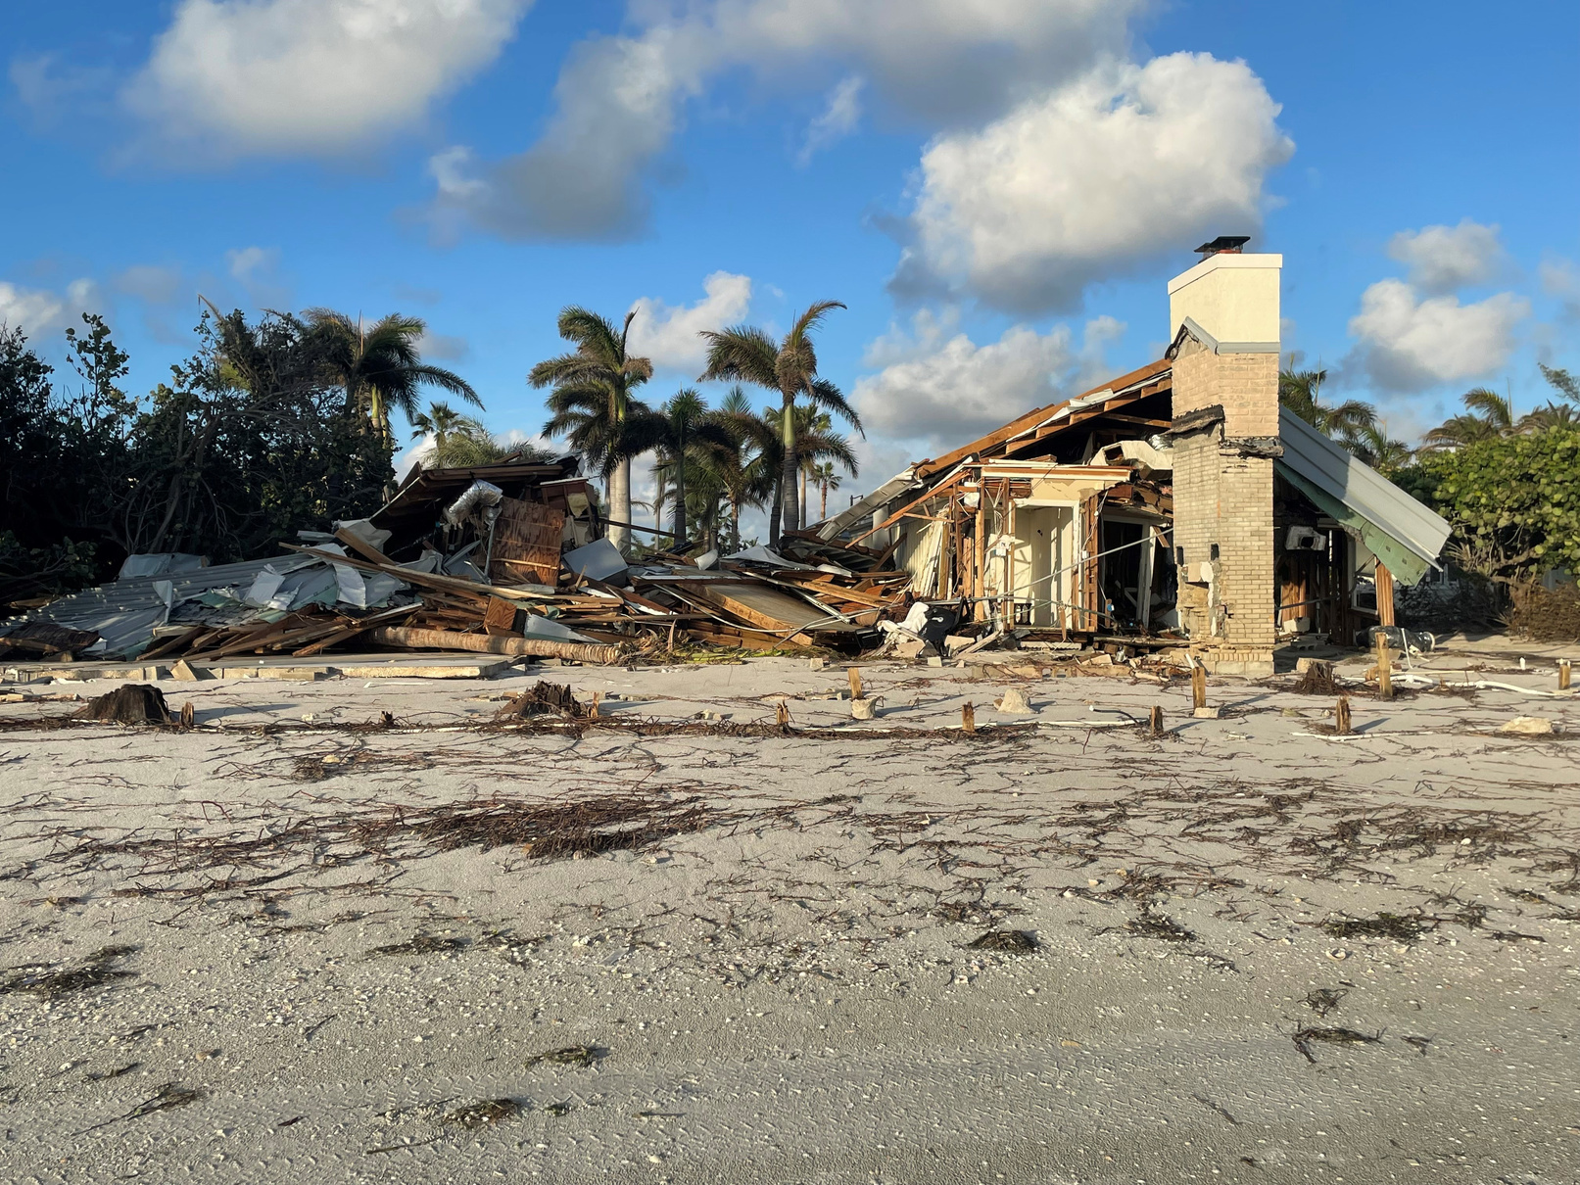
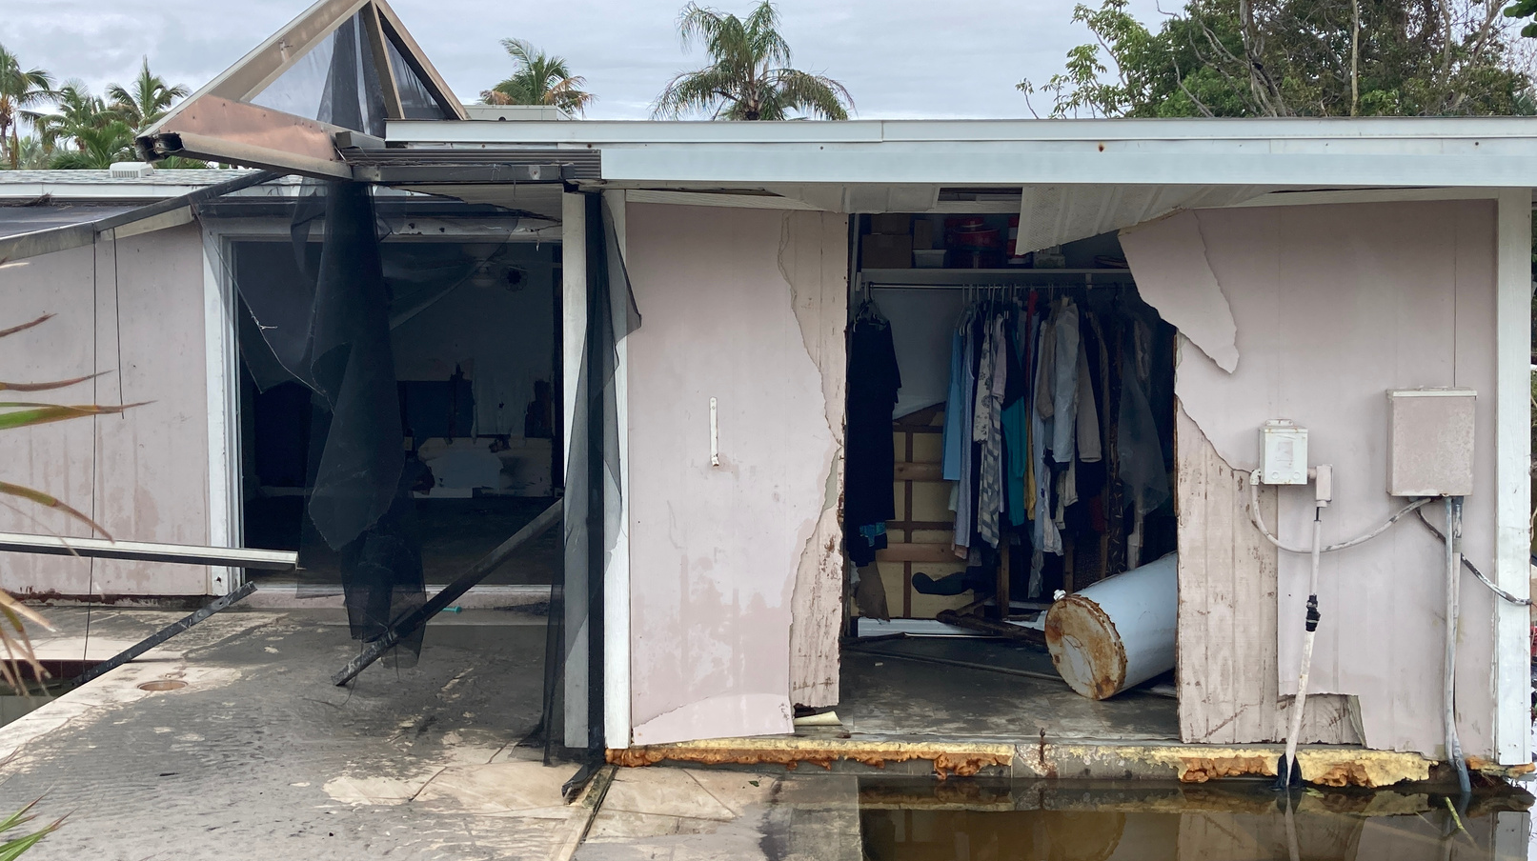

Slide 6
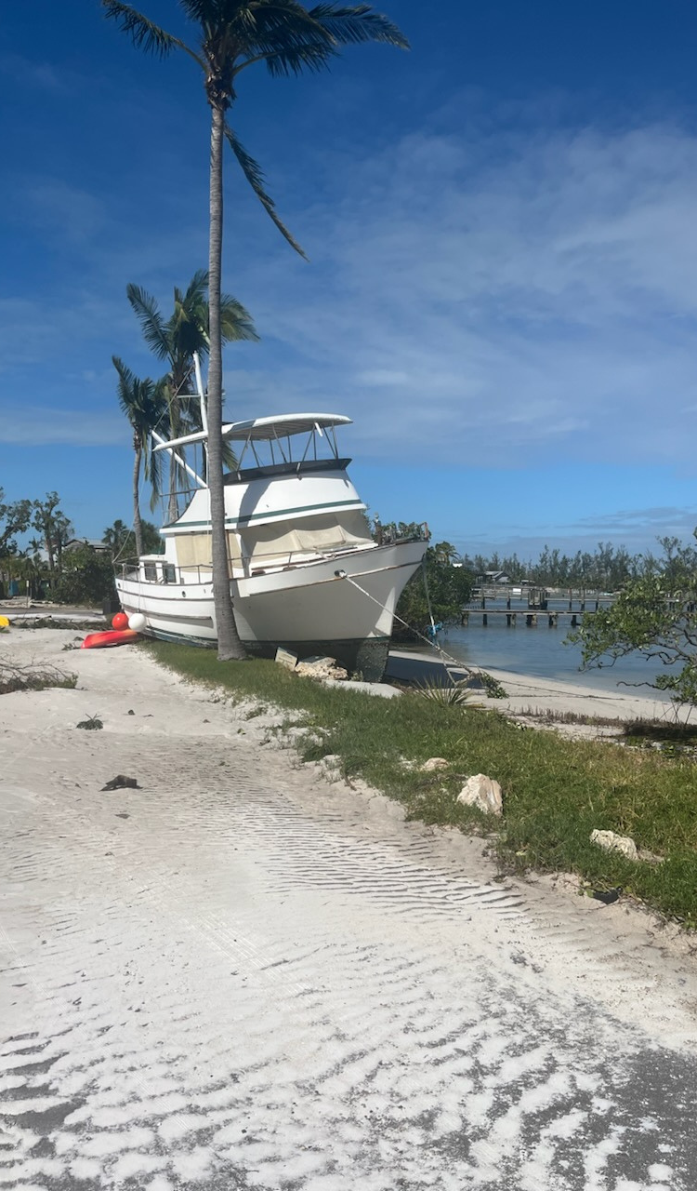
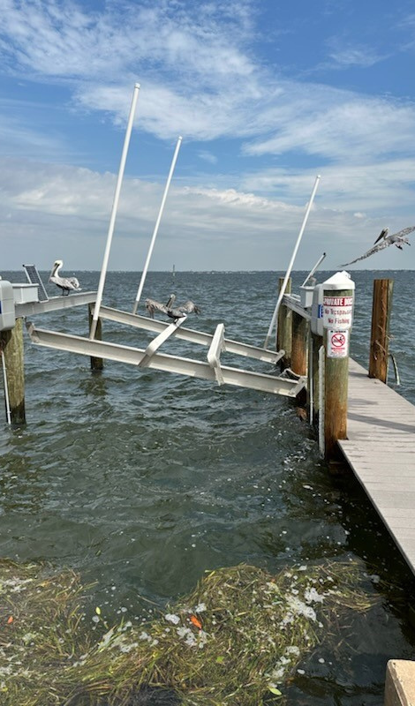
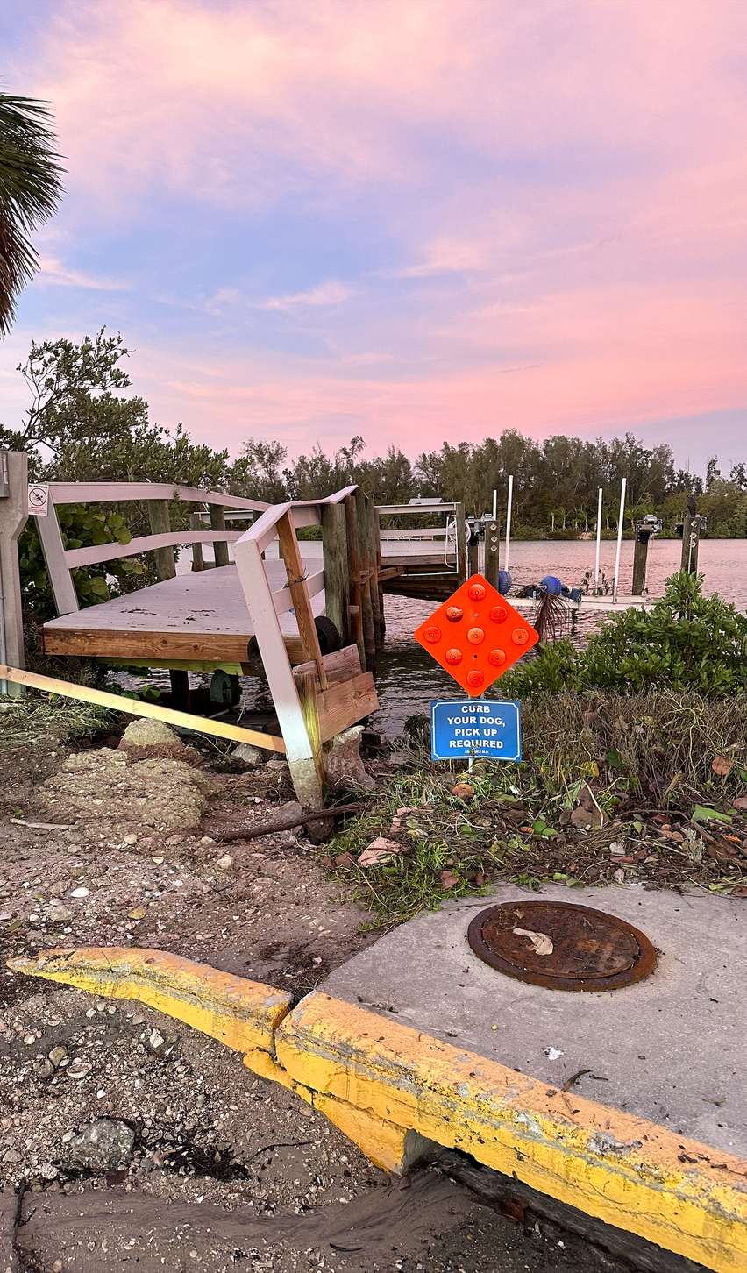

Slide 7
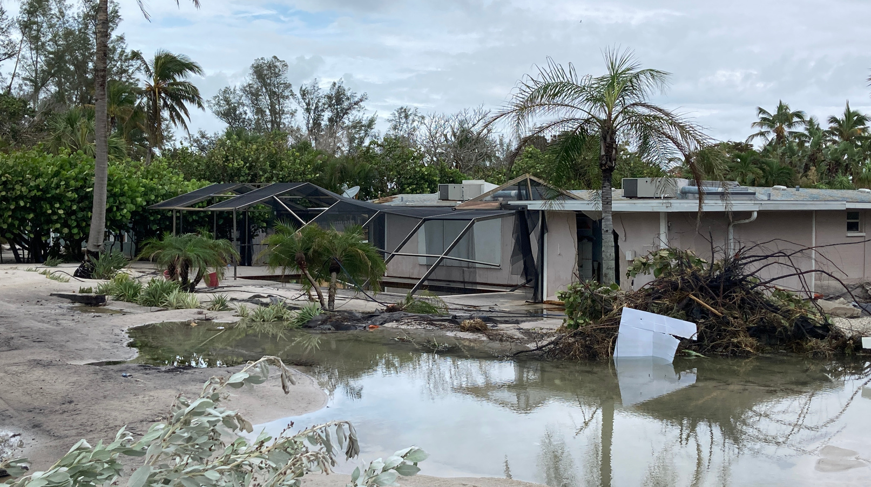
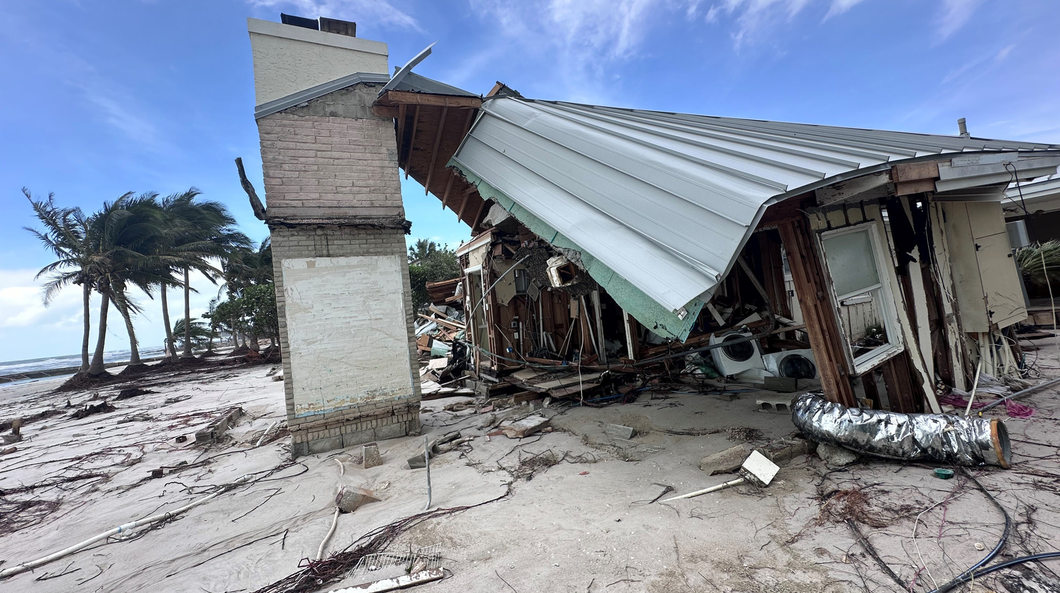
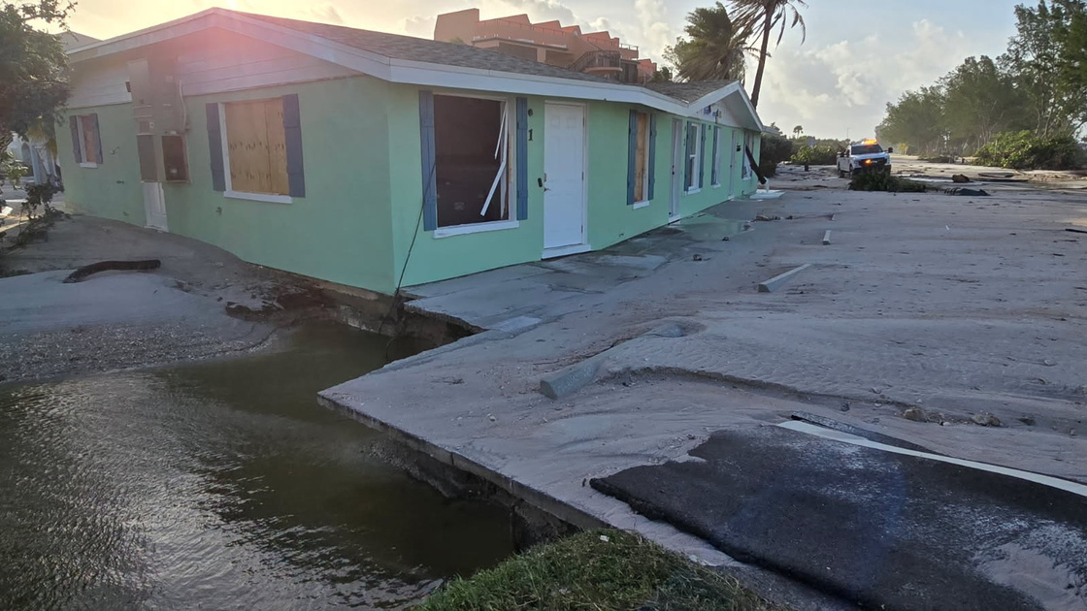

Slide 8
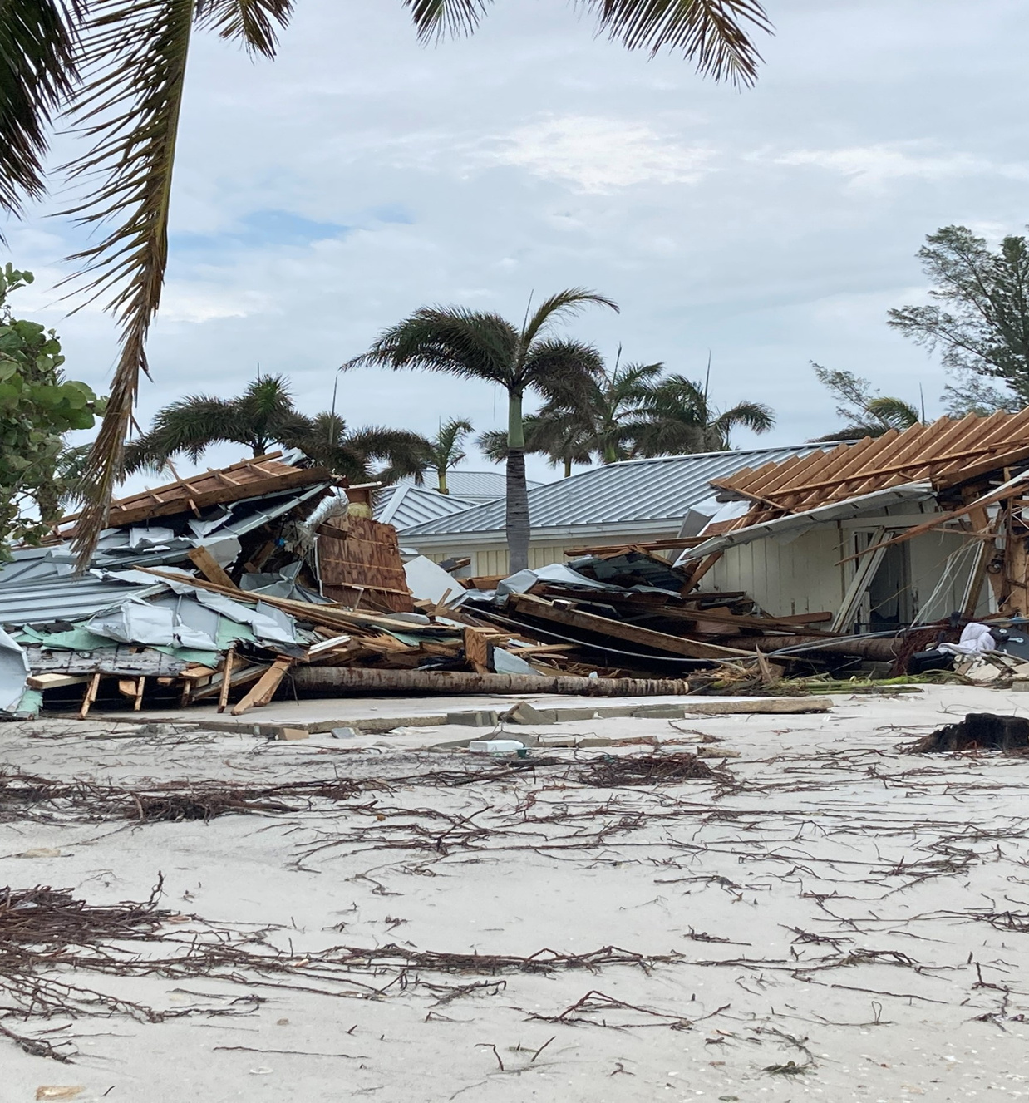
3,000 Residential Structures Assessed
1,600 damaged
  Just under 800 homes received 30-40% damage
    170 homes had at least 40-50% damage
    More than 80 properties submitted to be demolished
Structural damages to properties exceeded $200 million

Slide 9
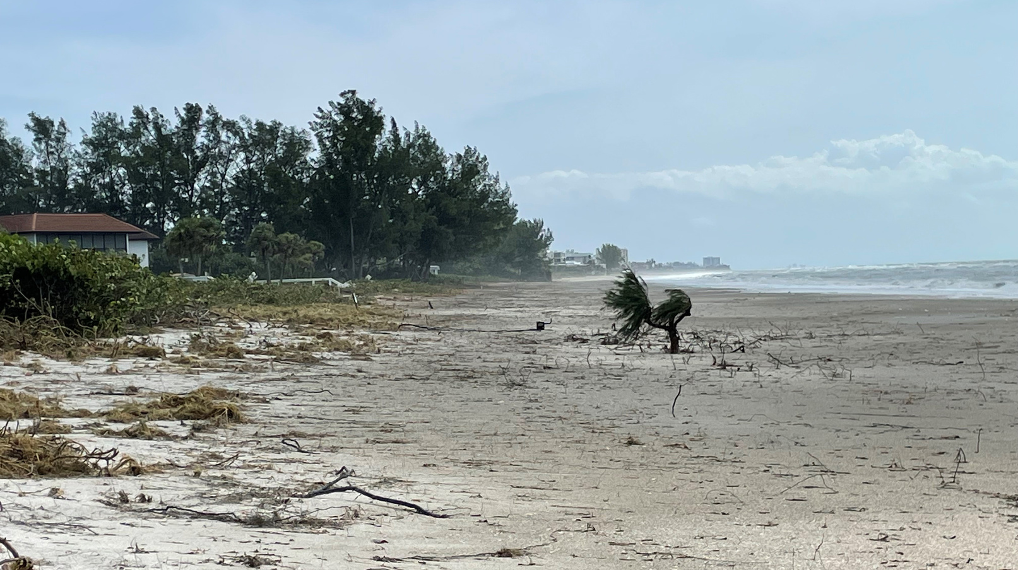
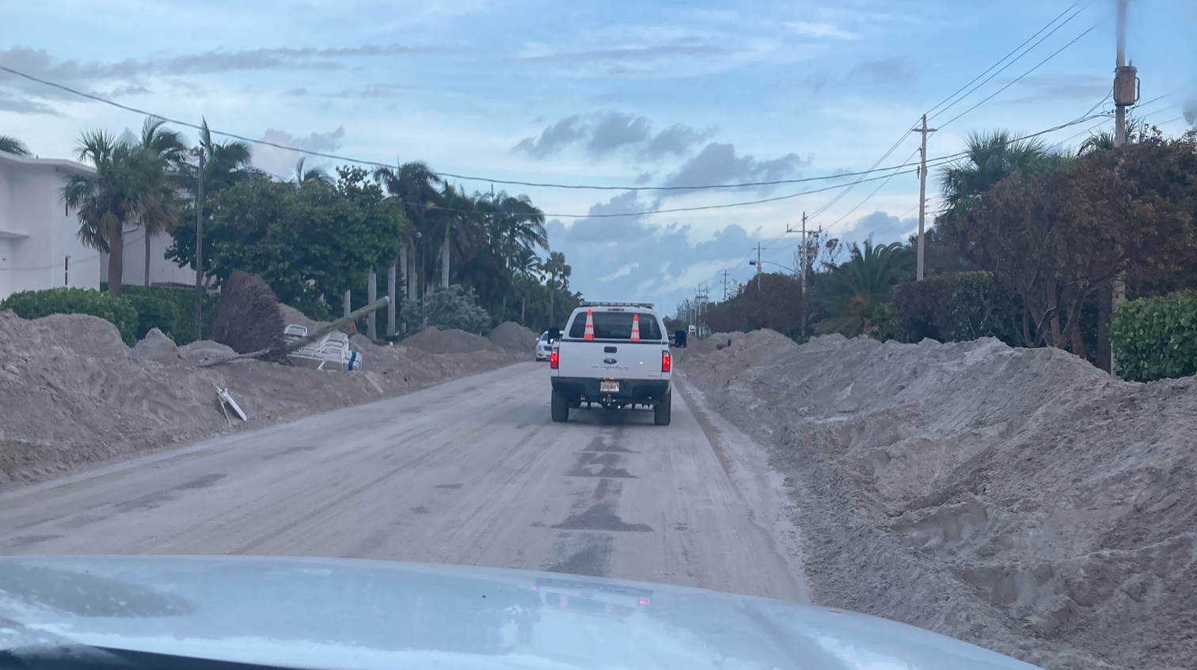
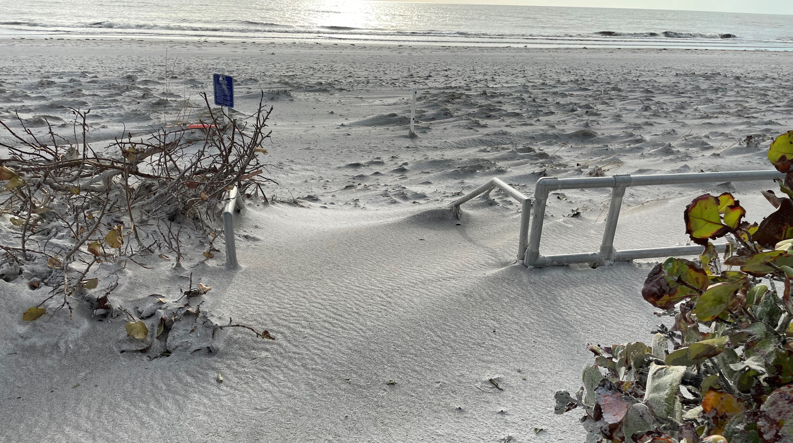
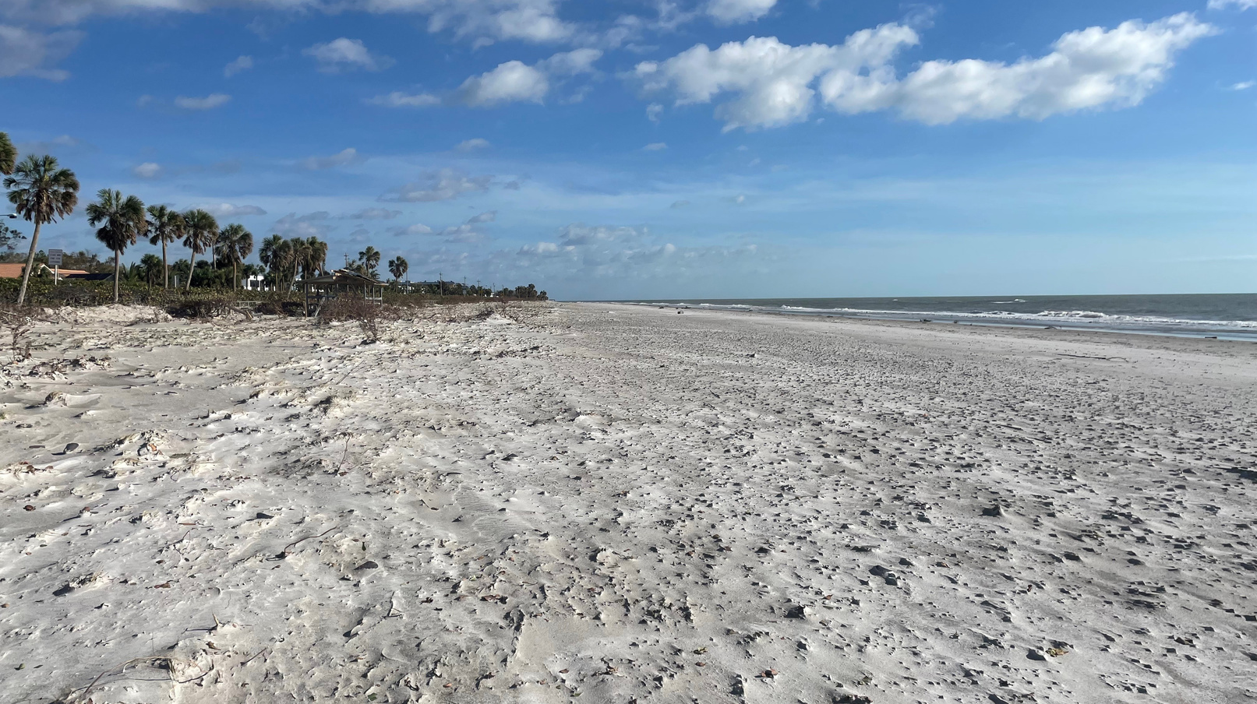

Slide 10
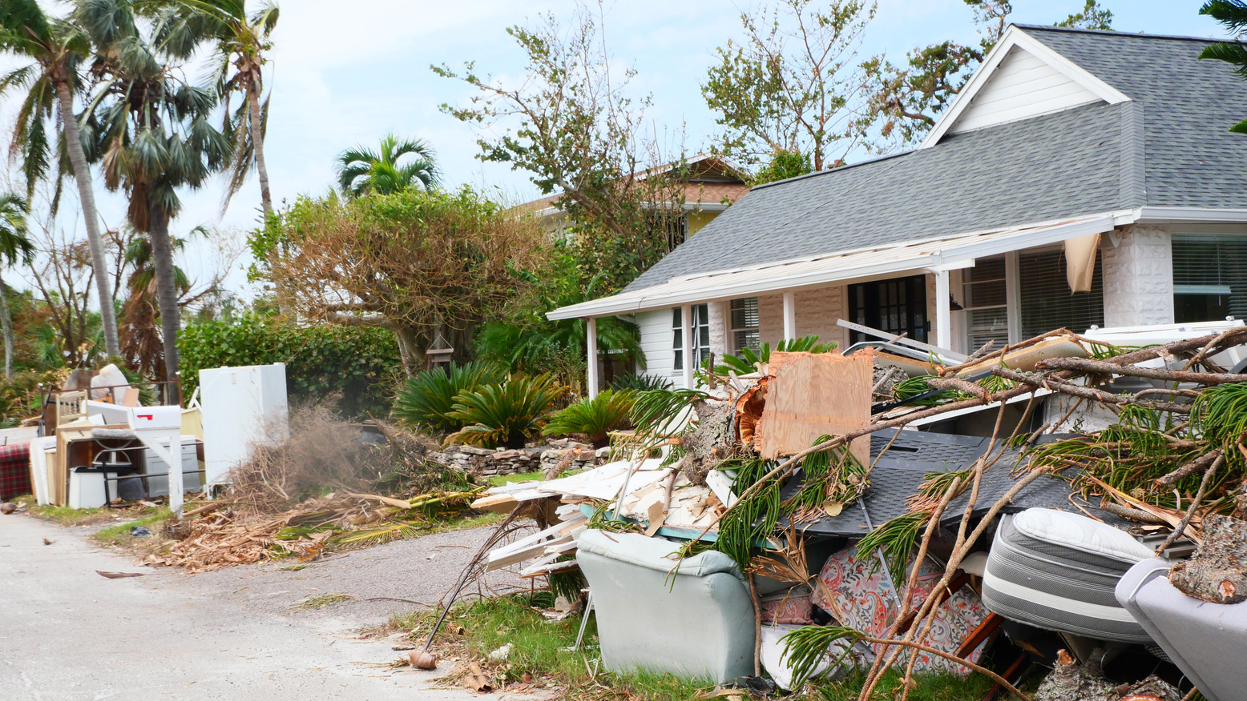
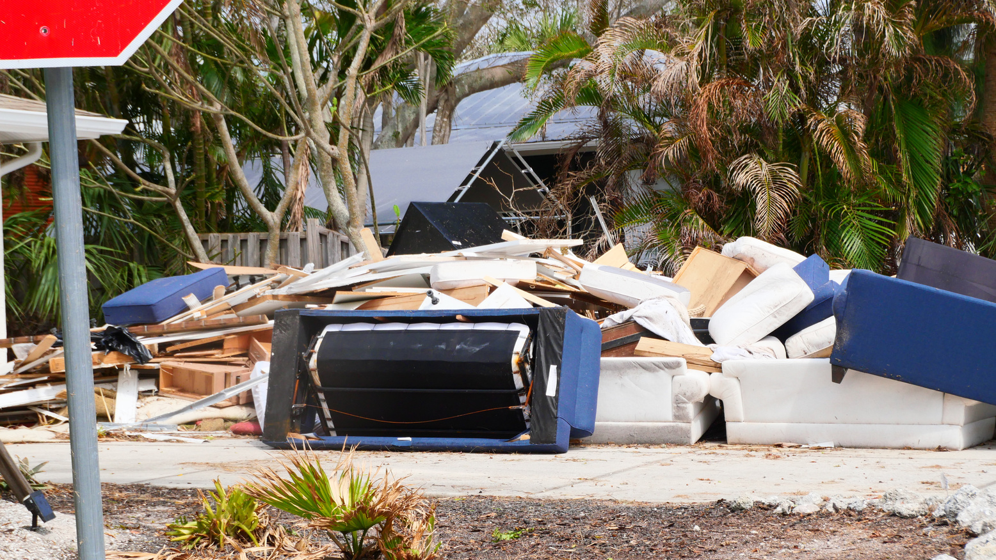
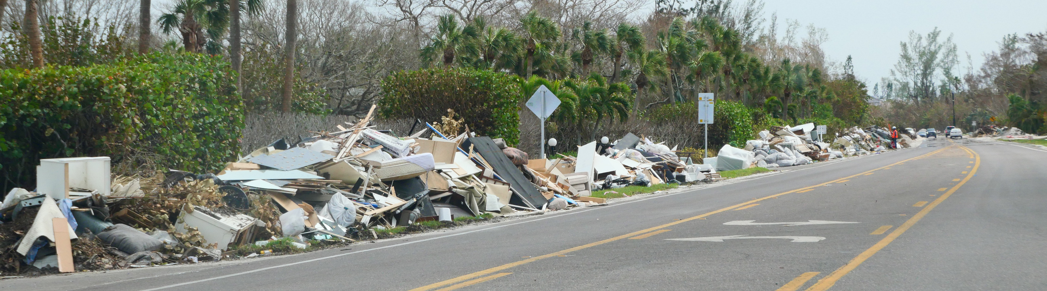

Slide 11

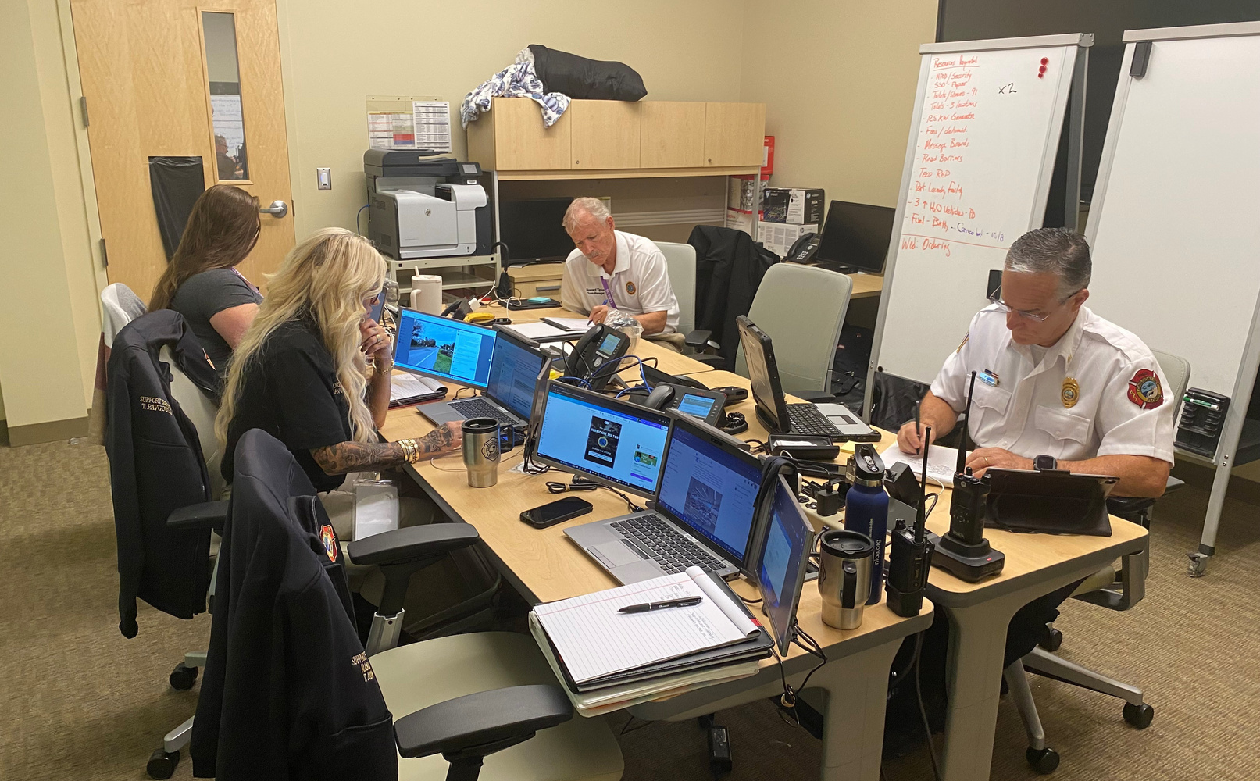
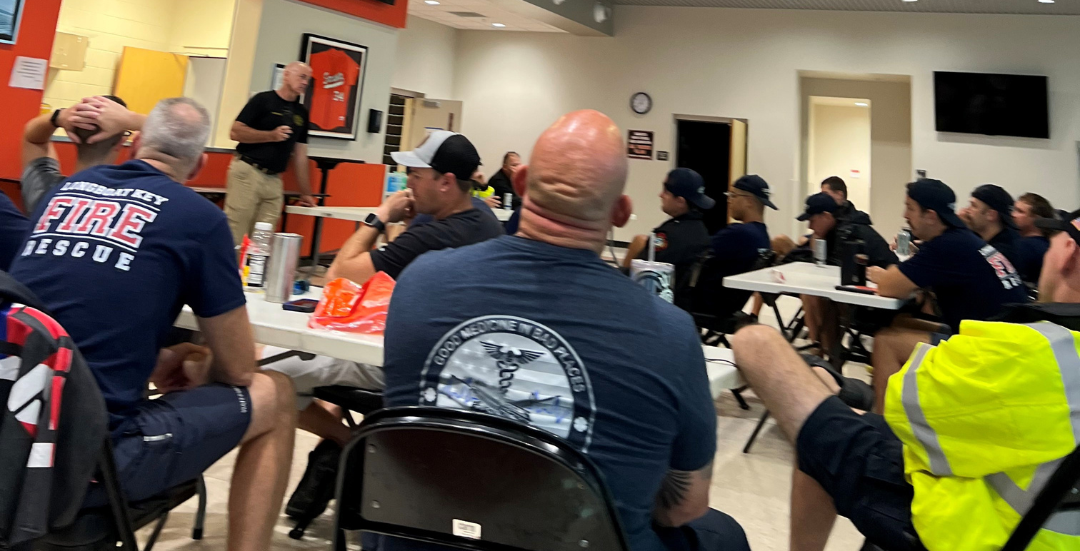
Teamwork

Slide 12


Slide 13







Relationships

Slide 14
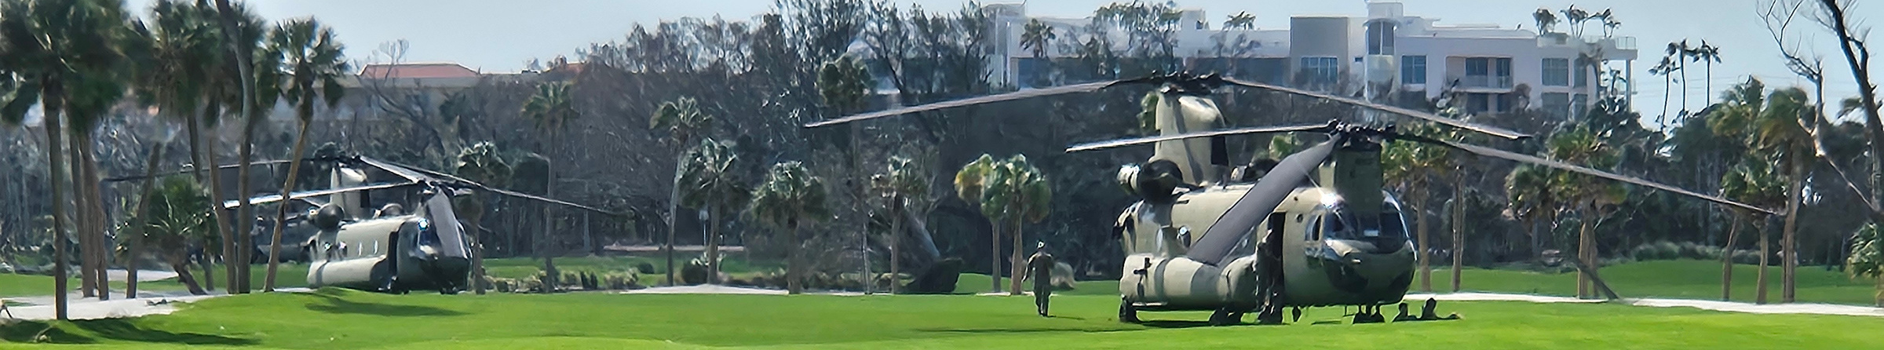
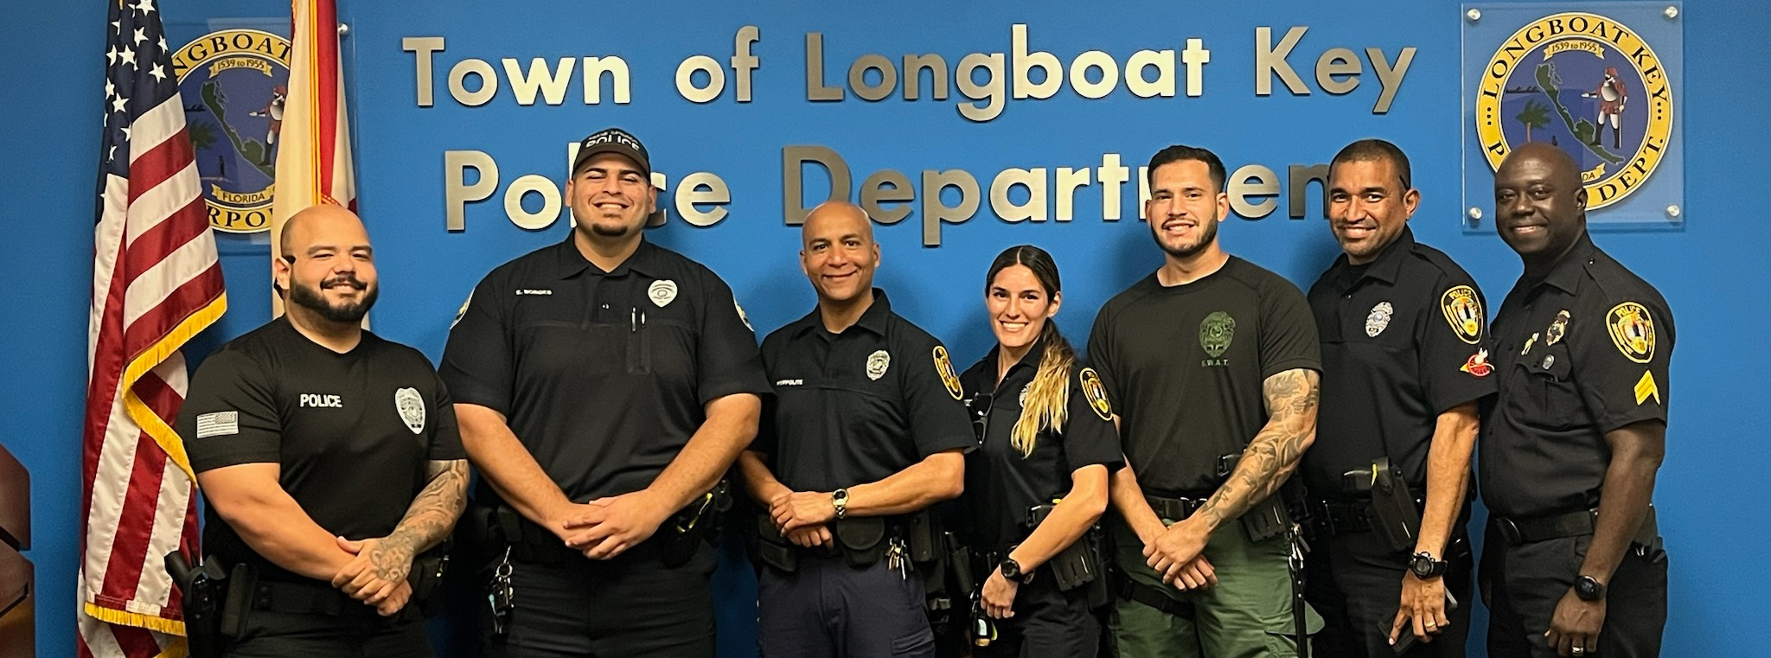

Slide 15





Communications
  Alert Longboat Key
  Daily Briefings
  Social Media
  Website
  E-Notifications
  Media Relations
Sign up for E-Notifications
TownofLBK
townoflbk
TownofLBK
@longboatkey7189

Slide 16
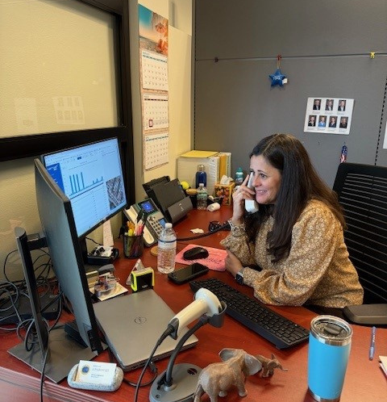
Thank you
Town Clerk’s Office
Over 7,000 calls

Slide 17
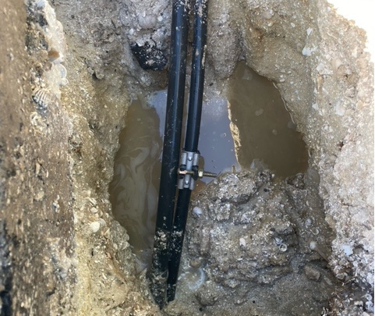
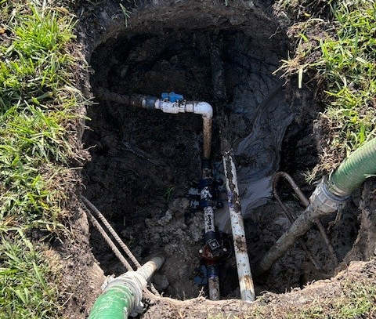
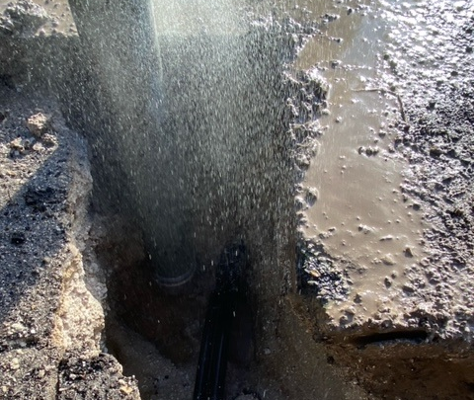

Slide 18
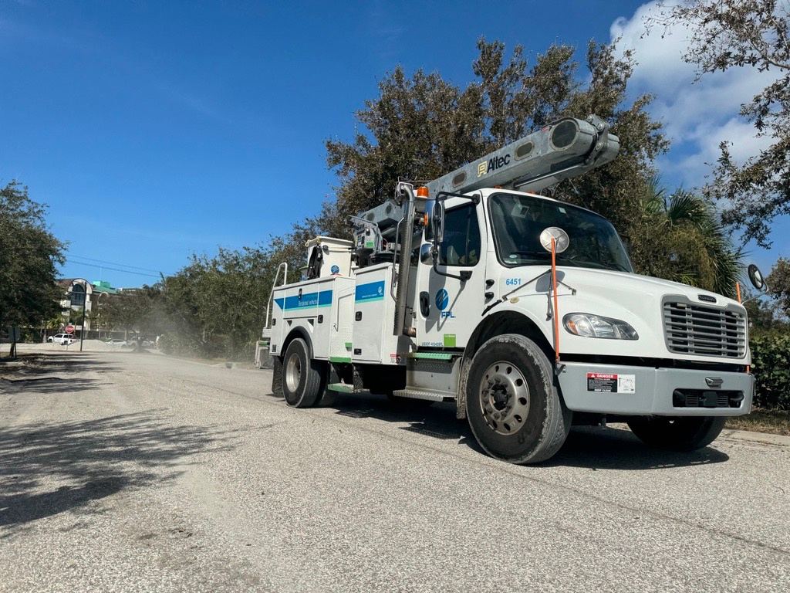

Slide 19
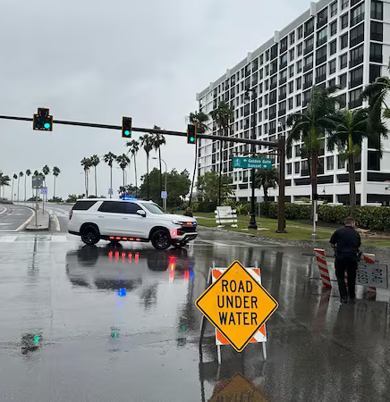
Re-entry
  Tier 1: Emergency Responders to ensure the island is safe to access
  Tier 2: Individuals from the public and private sectors who support the restoration of critical infrastructure to facilitate the re-entry of the public
  Tier 3: Town Residents and Business Owners

Slide 20
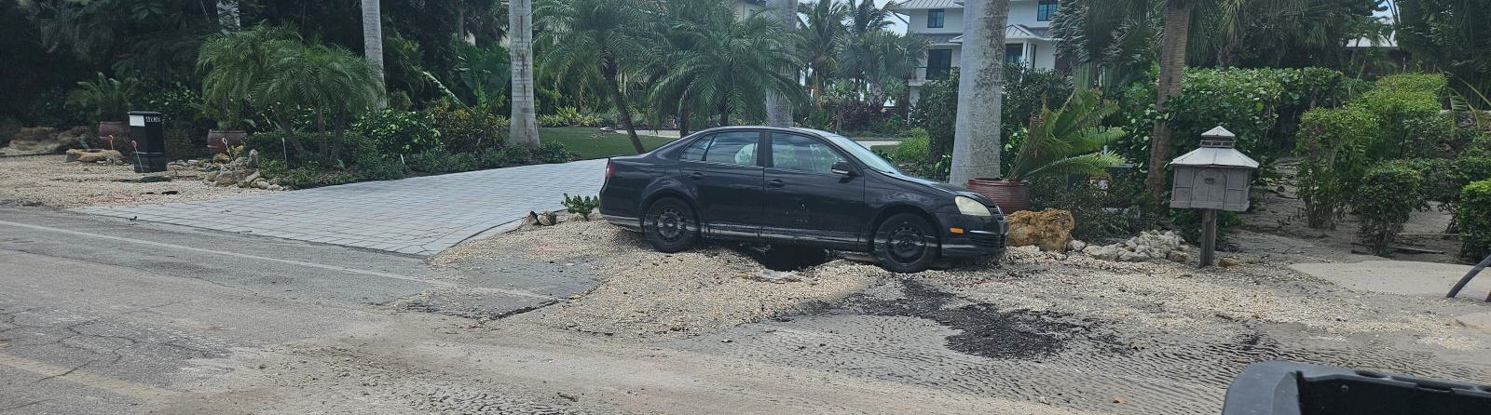
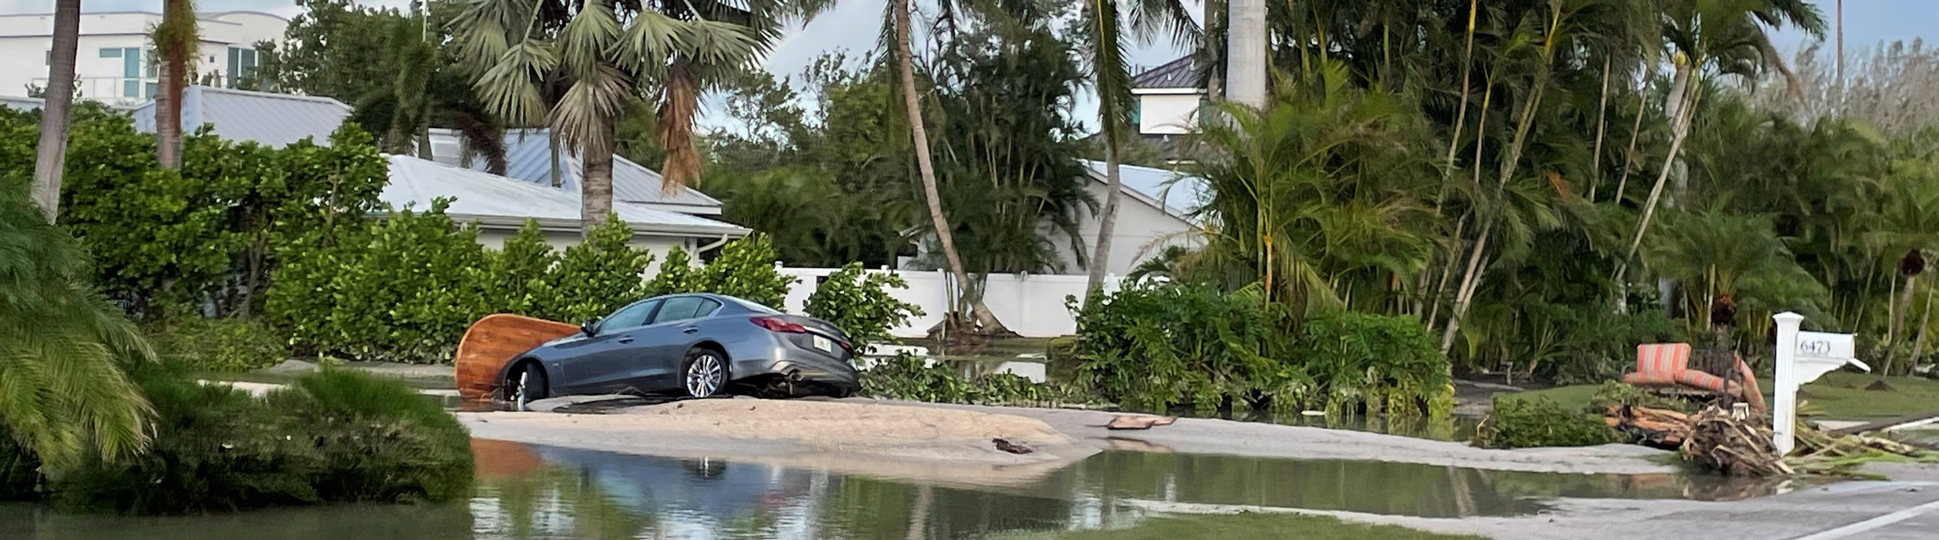

Slide 21
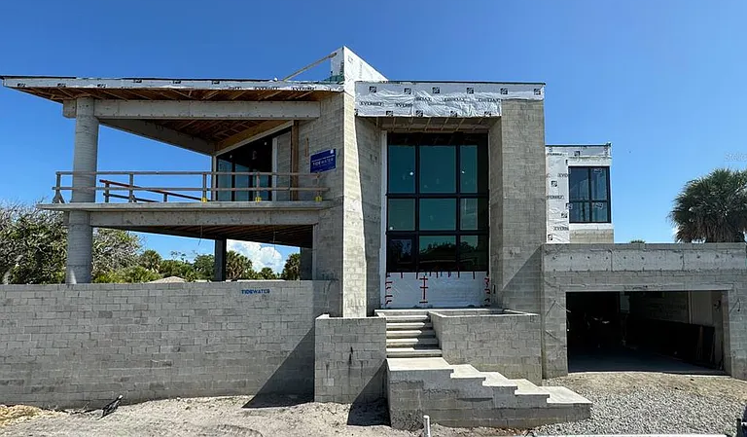
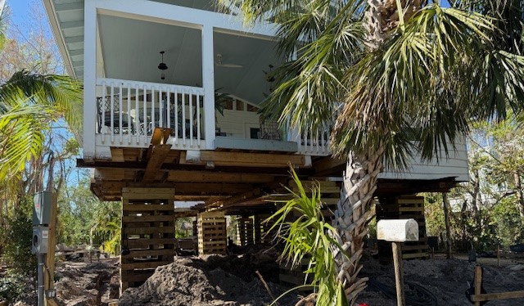
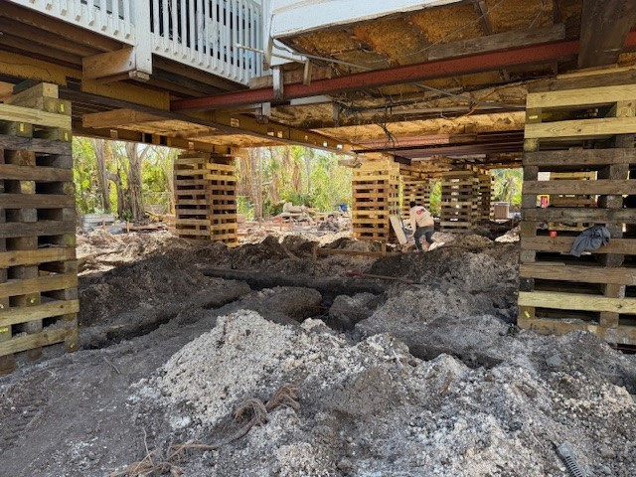
Permitting the Recovery

Slide 22
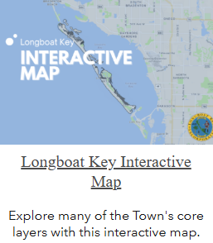
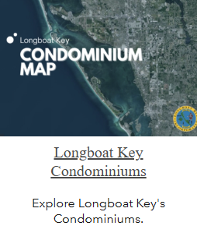
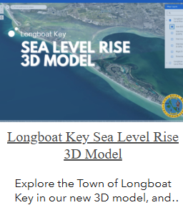
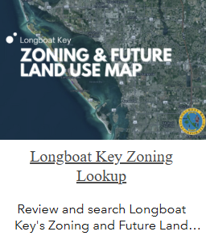
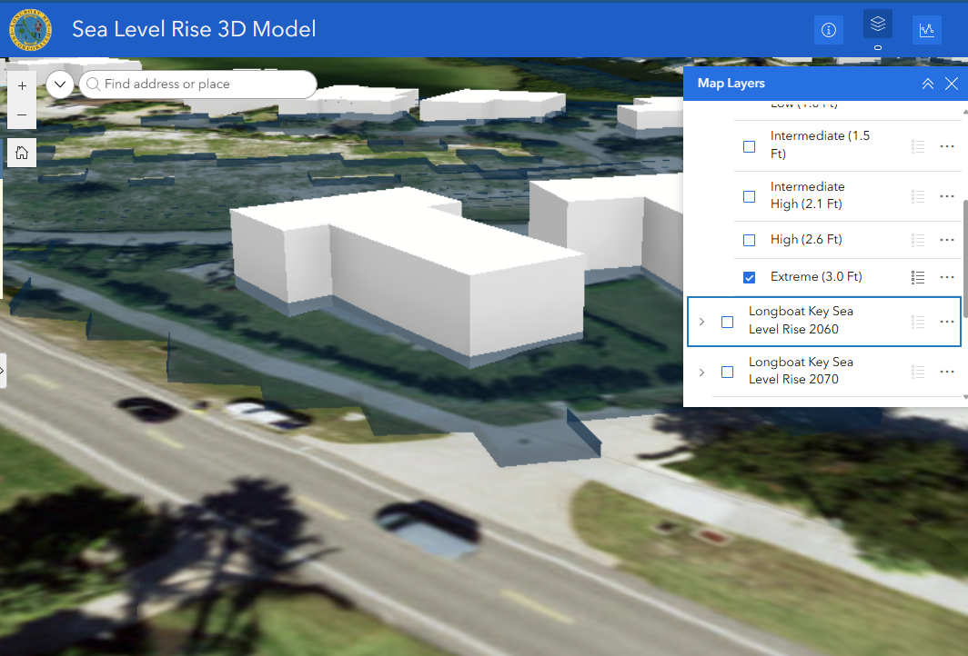
Online GIS Services
Overview
Online GIS Services Overview
Online GIS Services
Search for addresses, Town Boundaries, Facilities, Condominiums, Evacuation Routes, etc.
Find information on all structures including condominiums
Find zoning information
Sea Level 3D Modeling.

Slide 23

Pastor Pals
Thank you to our faith community

Slide 24

Lessons Learned
  Teamwork
  Review Insurance
  County and City Relationships
  Asking for Assistance Early
  Reserves
  Communications
  Evacuation Orders

Slide 25

THANK YOU

