Slide 1
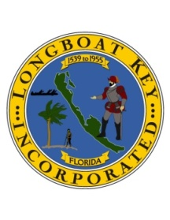
Extreme Tidal Impacts to LongboAT kEY
TOWN OF LONGBOAT KEY
Tidal Impacts have increased In historical elevations
lunar high and seasonal tides are at increased elevations
more frequent flooding experienced in streets

Slide 2
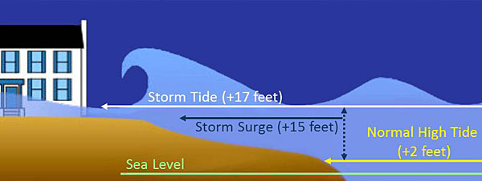
Extreme Tidal Impacts to LongboAT kEY
TOWN OF LONGBOAT KEY
Street flooding and storm sewer inundation
+ Wave Impacts
+ 7 feet
+ 5 feet
Underground storm sewer system.

Slide 3
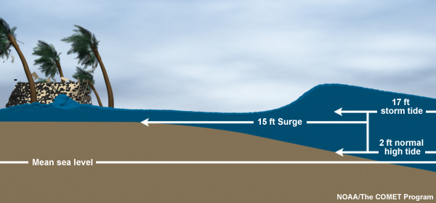
Extreme Tidal Impacts to LongboAT kEY
TOWN OF LONGBOAT KEY
+ Wave Impacts
Street flooding and storm sewer inundation
+ 7 feet
+ 5 feet
Underground storm sewer system.

Slide 4
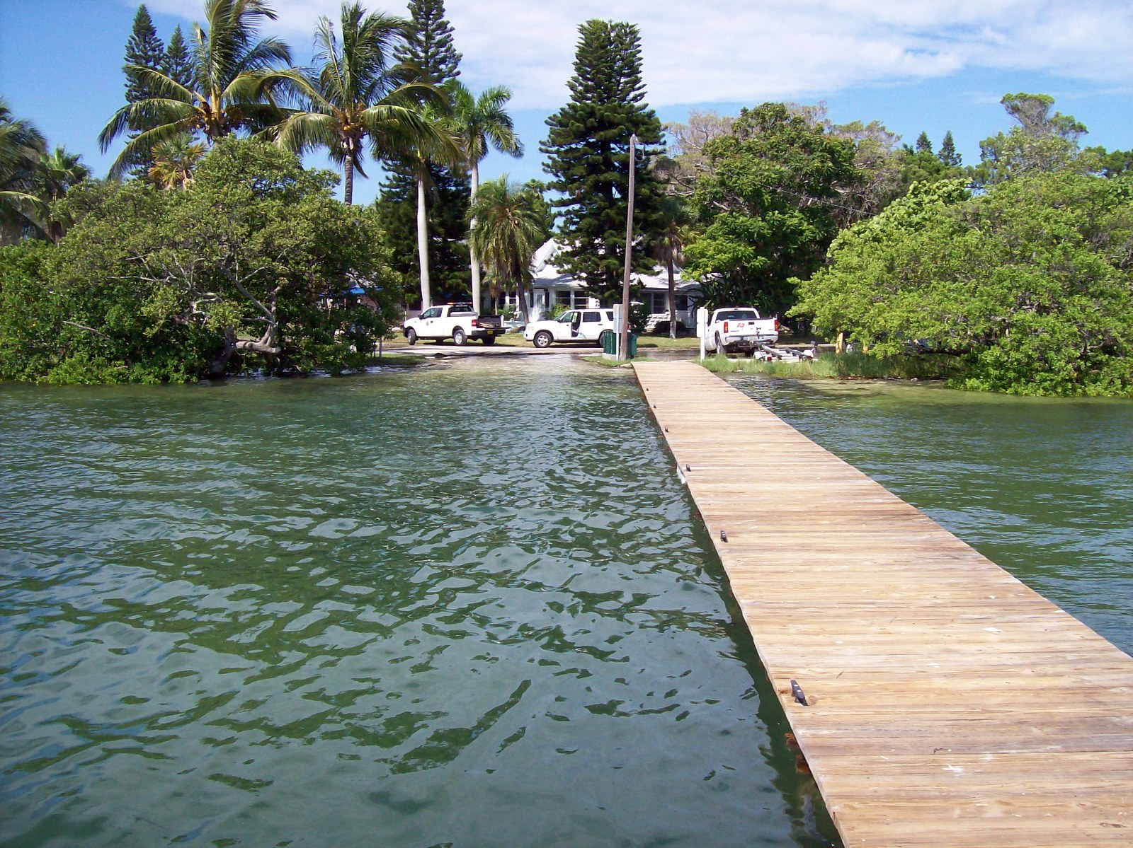
Extreme Tidal Impacts to LongboAT kEY
TOWN OF LONGBOAT KEY
Street flooding and storm sewer inundation
The following photos are from an extreme high tide event of September 2009

Slide 5
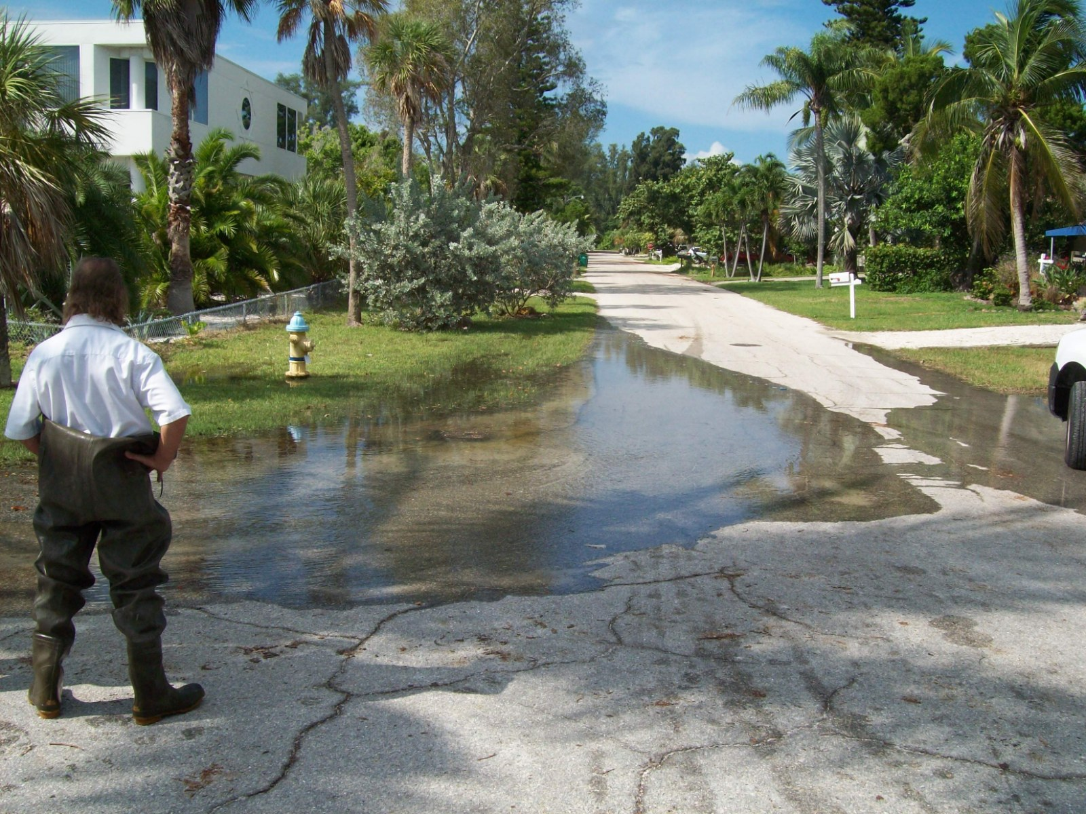
Extreme Tidal Impacts to LongboAT kEY
TOWN OF LONGBOAT KEY
Photos are from an extreme high tide event of September 2009
Street flooding and storm sewer inundation

Slide 6
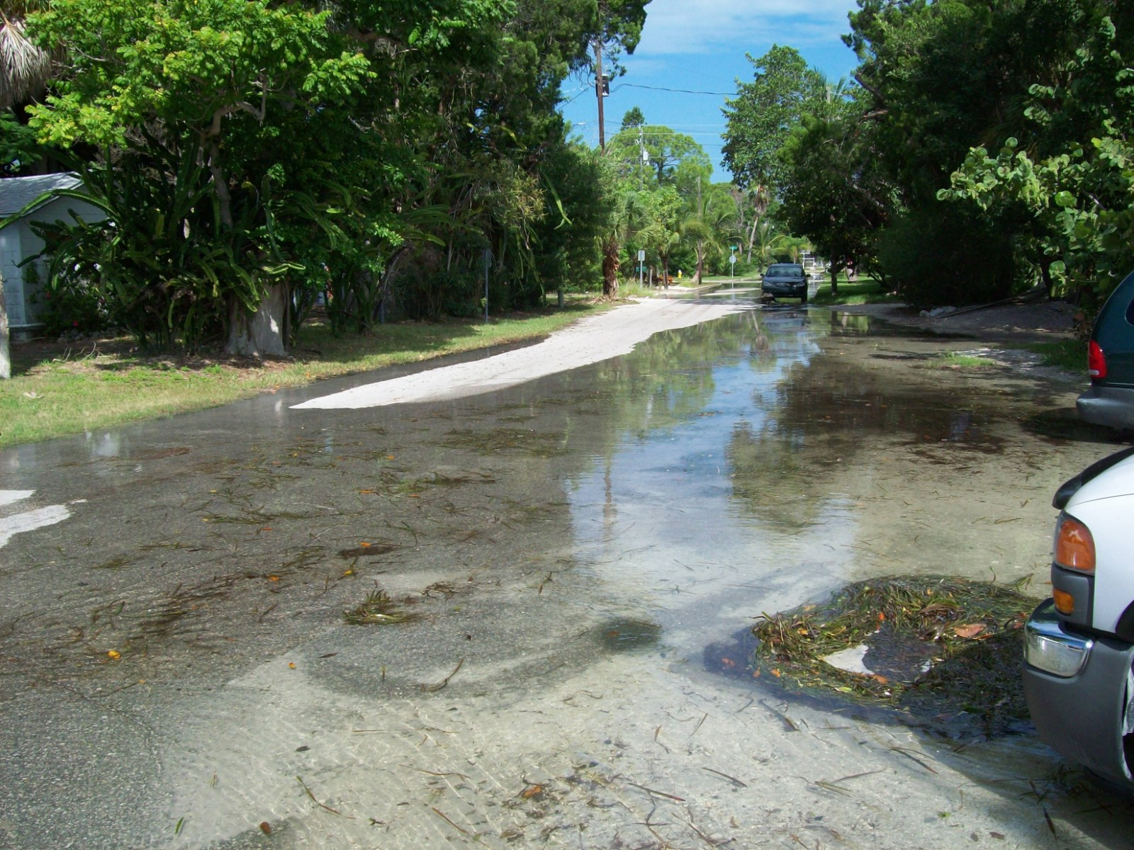
Extreme Tidal Impacts to LongboAT kEY
TOWN OF LONGBOAT KEY
The following photos are from an extreme high tide event of September 2009
Street flooding and storm sewer inundation

Slide 7
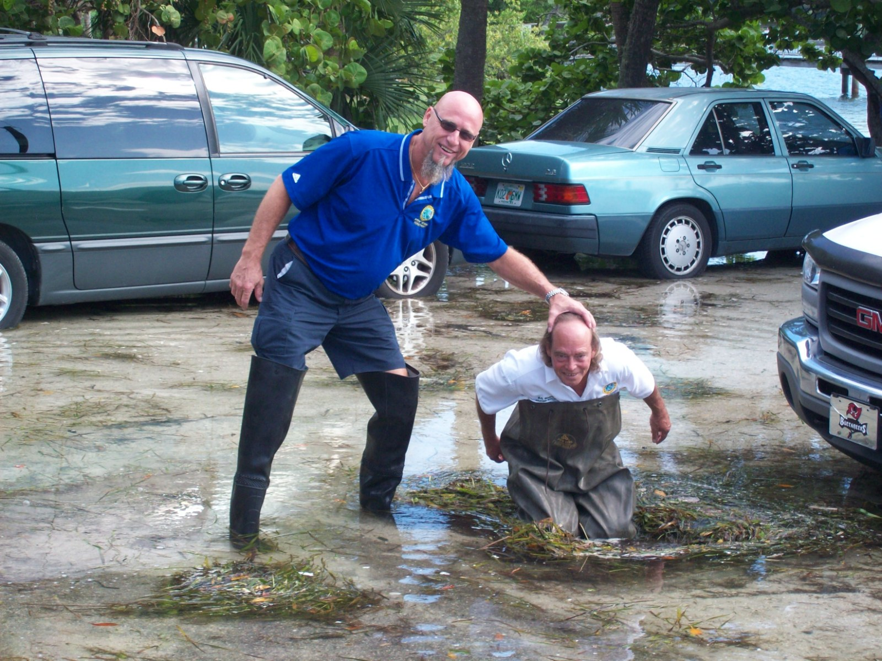
Extreme Tidal Impacts to LongboAT kEY
TOWN OF LONGBOAT KEY
Photos are from an extreme high tide event of September 2009
Street flooding and storm sewer inundation

Slide 8
Rain and Tidal Impacts to LongboAT kEY
TOWN OF LONGBOAT KEY
Installed Tide-Flex Valves can only relieve water on out going tide from storm sewer inundation
Rain / High Tide inundates storm sewer system.
Underground storm sewer system.
High Tide Level (+2.8)
Normal Sea Level (+0)

Slide 9
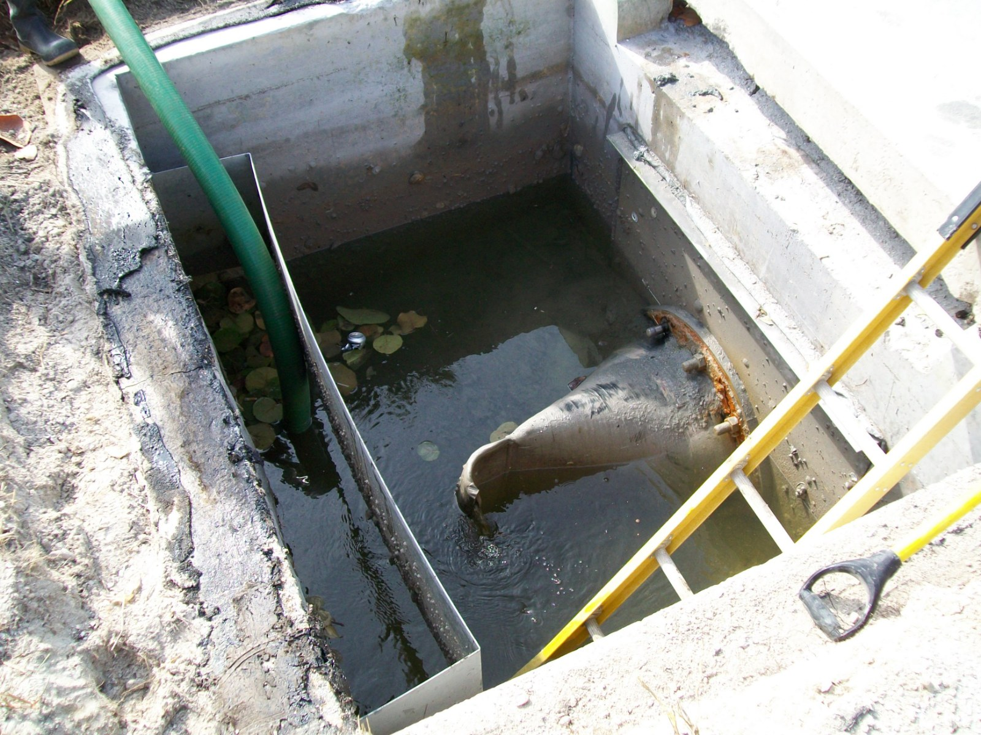
Extreme Tidal Impacts to LongboAT kEY
TOWN OF LONGBOAT KEY
Installed Tide-Flex Valves can only relieve water on out going tide from storm sewer inundation

Slide 10
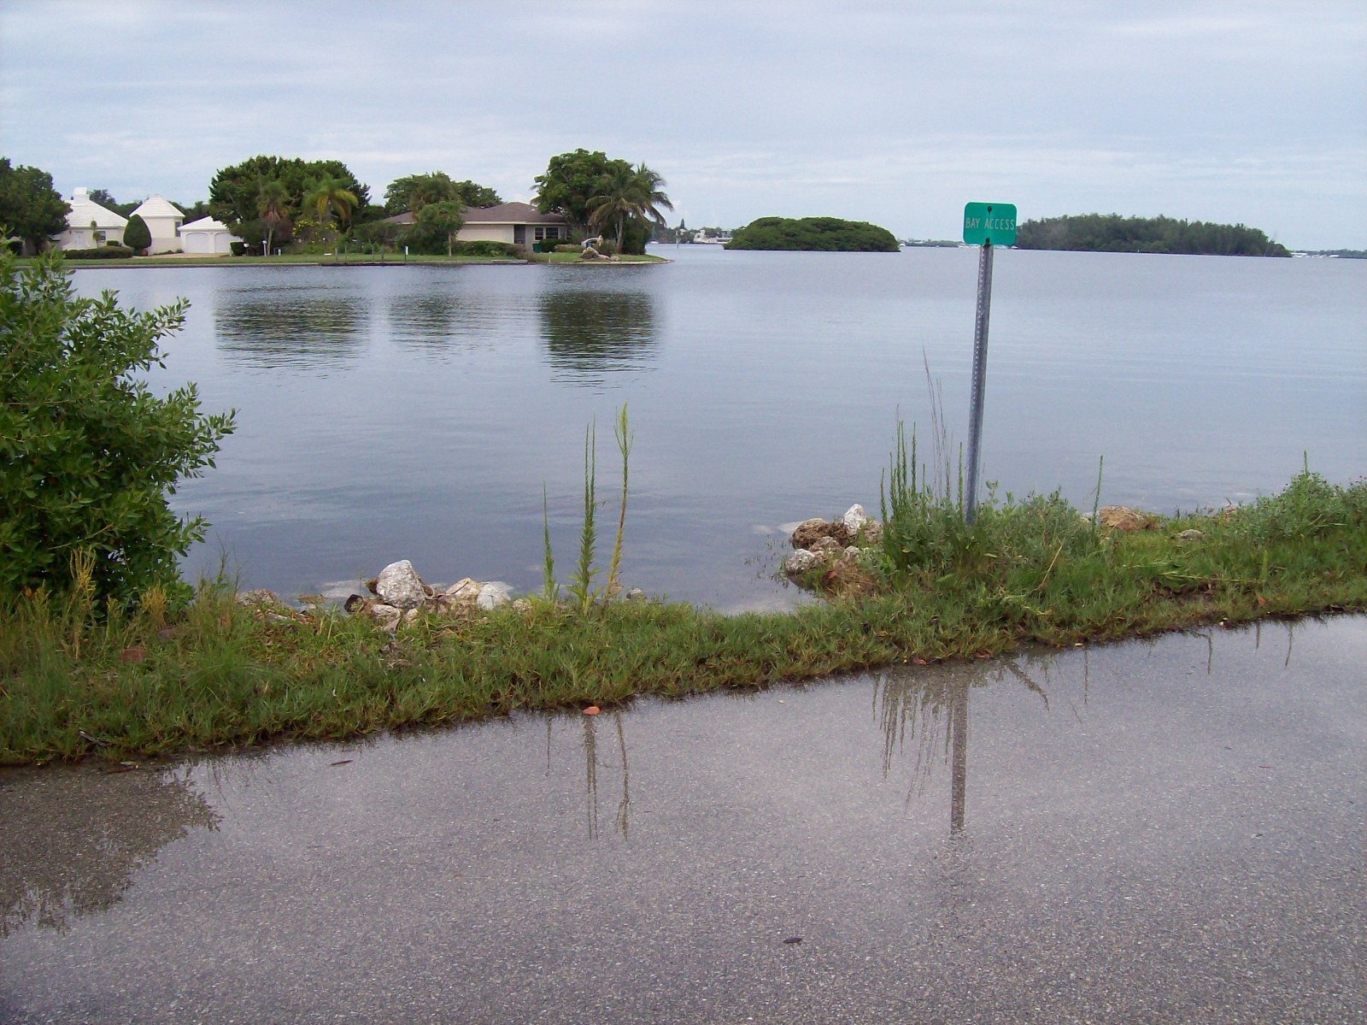
Extreme Tidal Impacts to LongboAT kEY
TOWN OF LONGBOAT KEY
Some recent and historical tide elevations match or are higher than street elevations

Slide 11
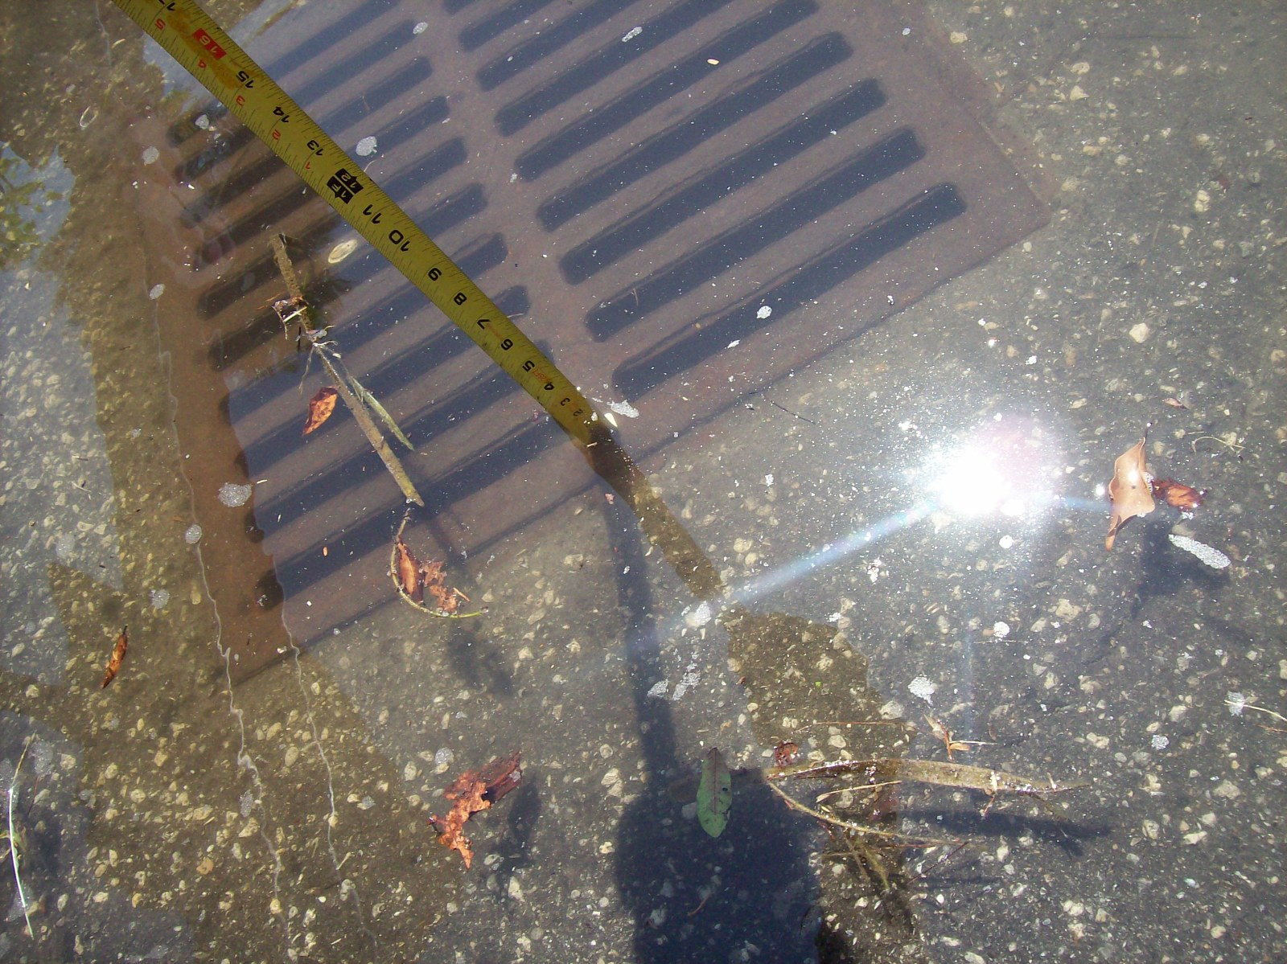
Extreme Tidal Impacts to LongboAT kEY
TOWN OF LONGBOAT KEY
Some recent and historical tide elevations match or are higher than street elevations

Slide 12
Noaa websites http://www.csc.noaa.gov/slr/viewer/# http://www.nhc.noaa.gov/surge/
TOWN OF LONGBOAT KEY
Website provides forecasted sea level rise impacts, nation wide, in one foot increments
The following slides indicate
Potential impacts to the north end of longboat key, specifically the village
Nnnnn

Slide 13
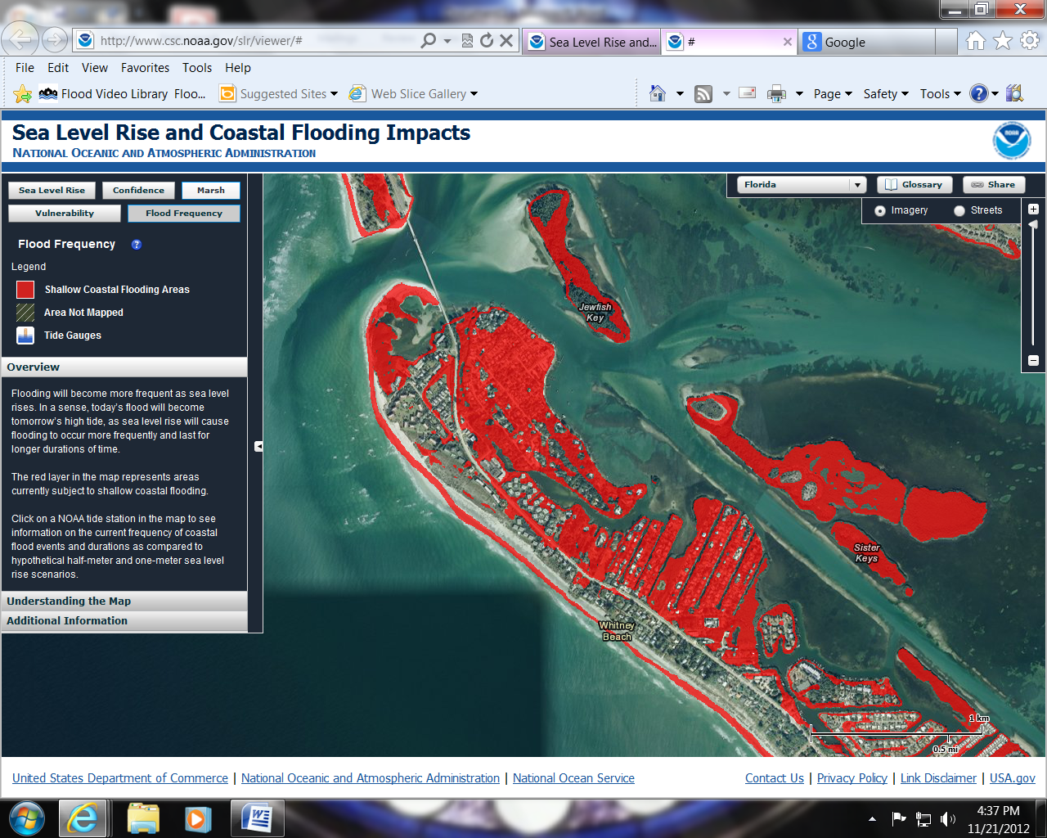
TOWN OF LONGBOAT KEY
Town Of Longboat Key North End and Village
Areas Vulnerable to Coastal Flooding

Slide 14
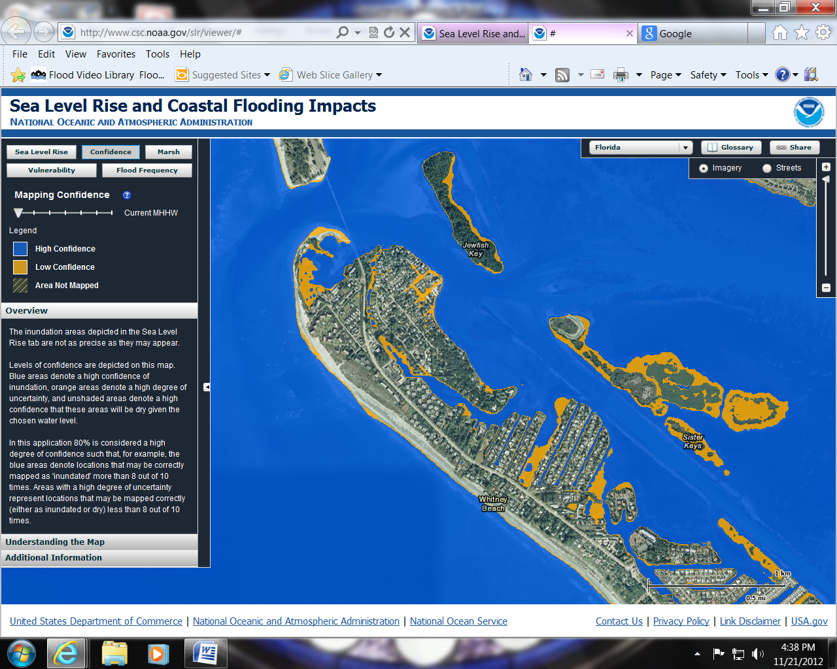
TOWN OF LONGBOAT KEY
Town Of Longboat Key North End and Village
Areas Vulnerable to a 20% chance of flooding above current Mean High Water elevations

Slide 15
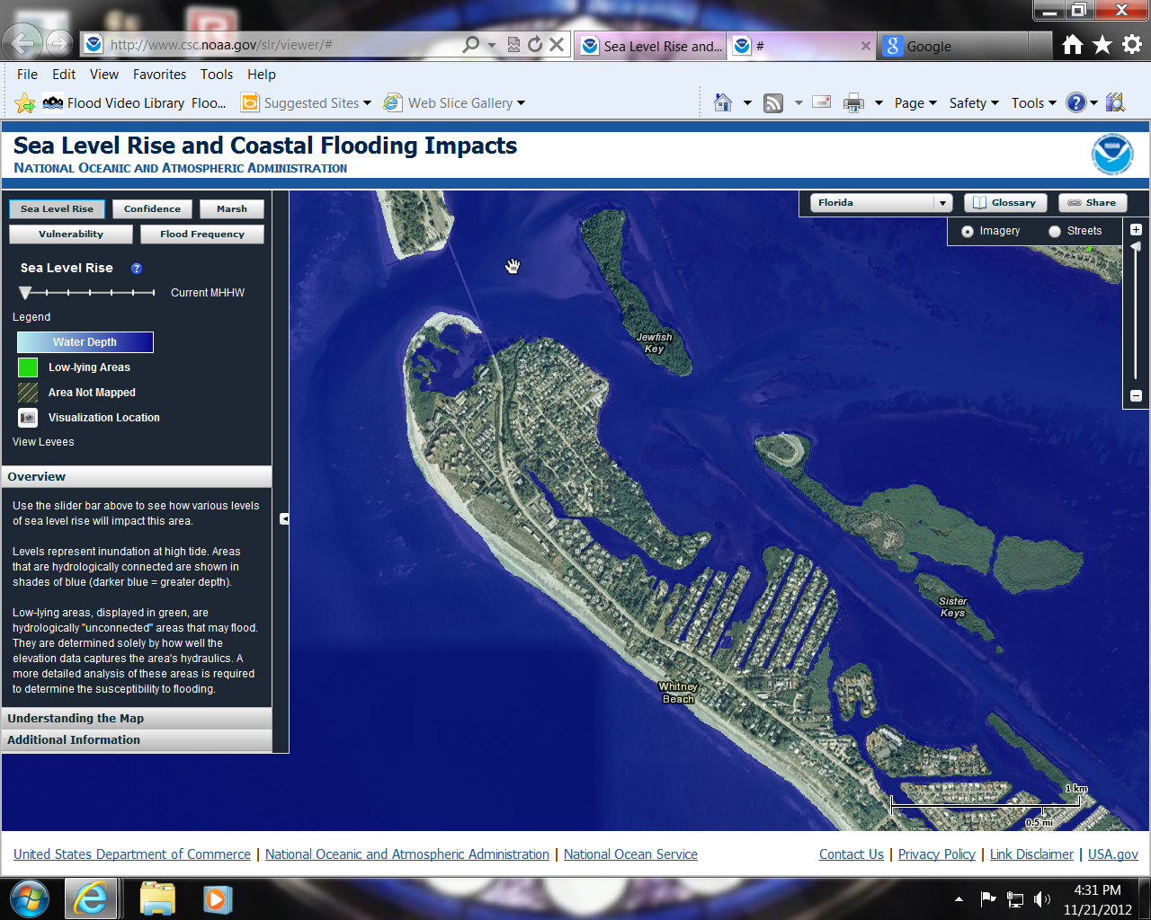
TOWN OF LONGBOAT KEY
Town Of Longboat Key North End and Village
Normal High tide and sea level

Slide 16
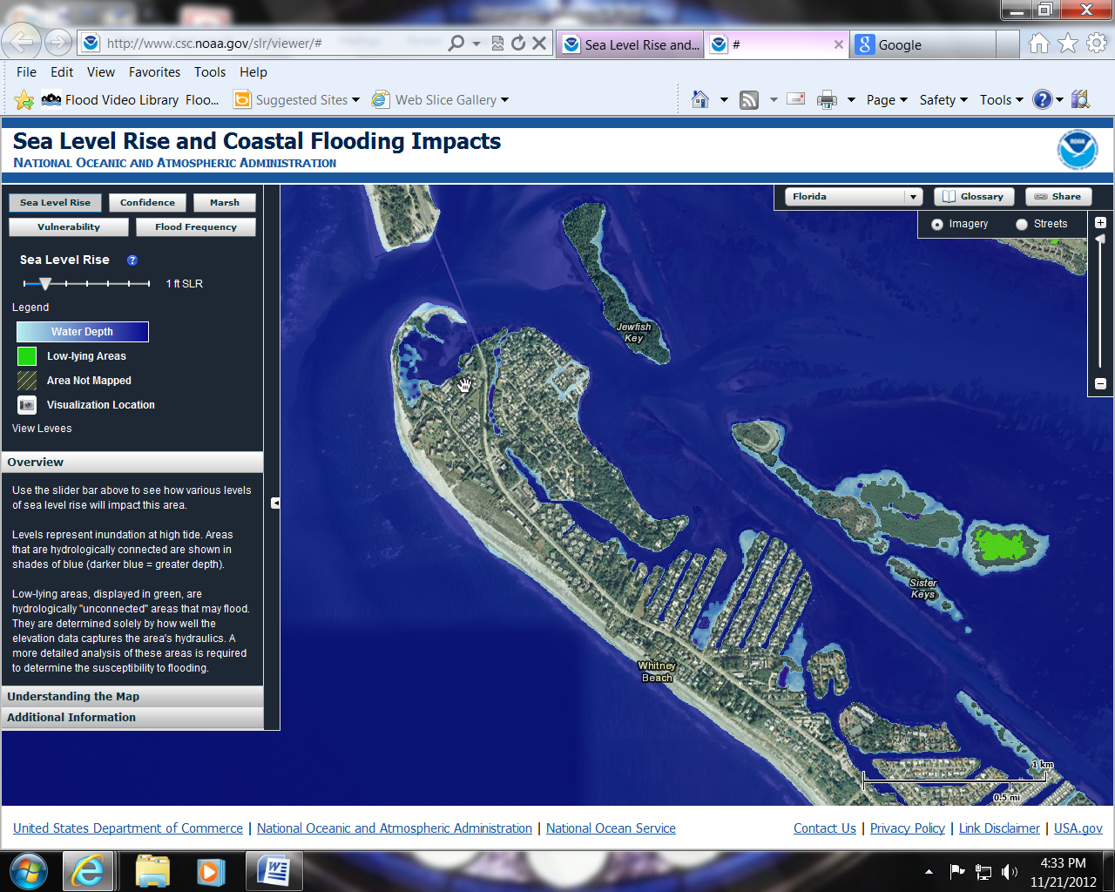
TOWN OF LONGBOAT KEY
Town Of Longboat Key North End and Village
Normal High tide and + 1 foot sea level rise

Slide 17

TOWN OF LONGBOAT KEY
Town Of Longboat Key North End and Village
Normal High tide and + 2 foot sea level rise

Slide 18
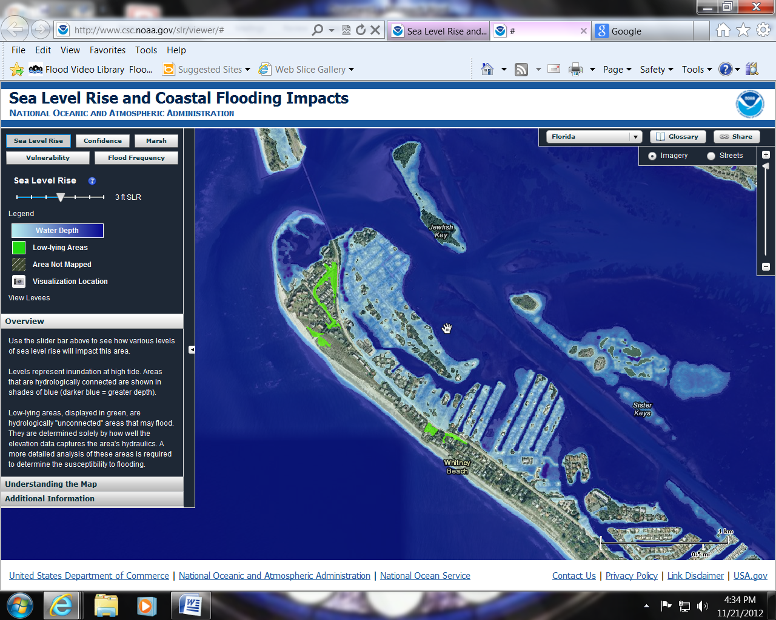
TOWN OF LONGBOAT KEY
Town Of Longboat Key North End and Village
Normal High tide and + 3 foot sea level rise

Slide 19
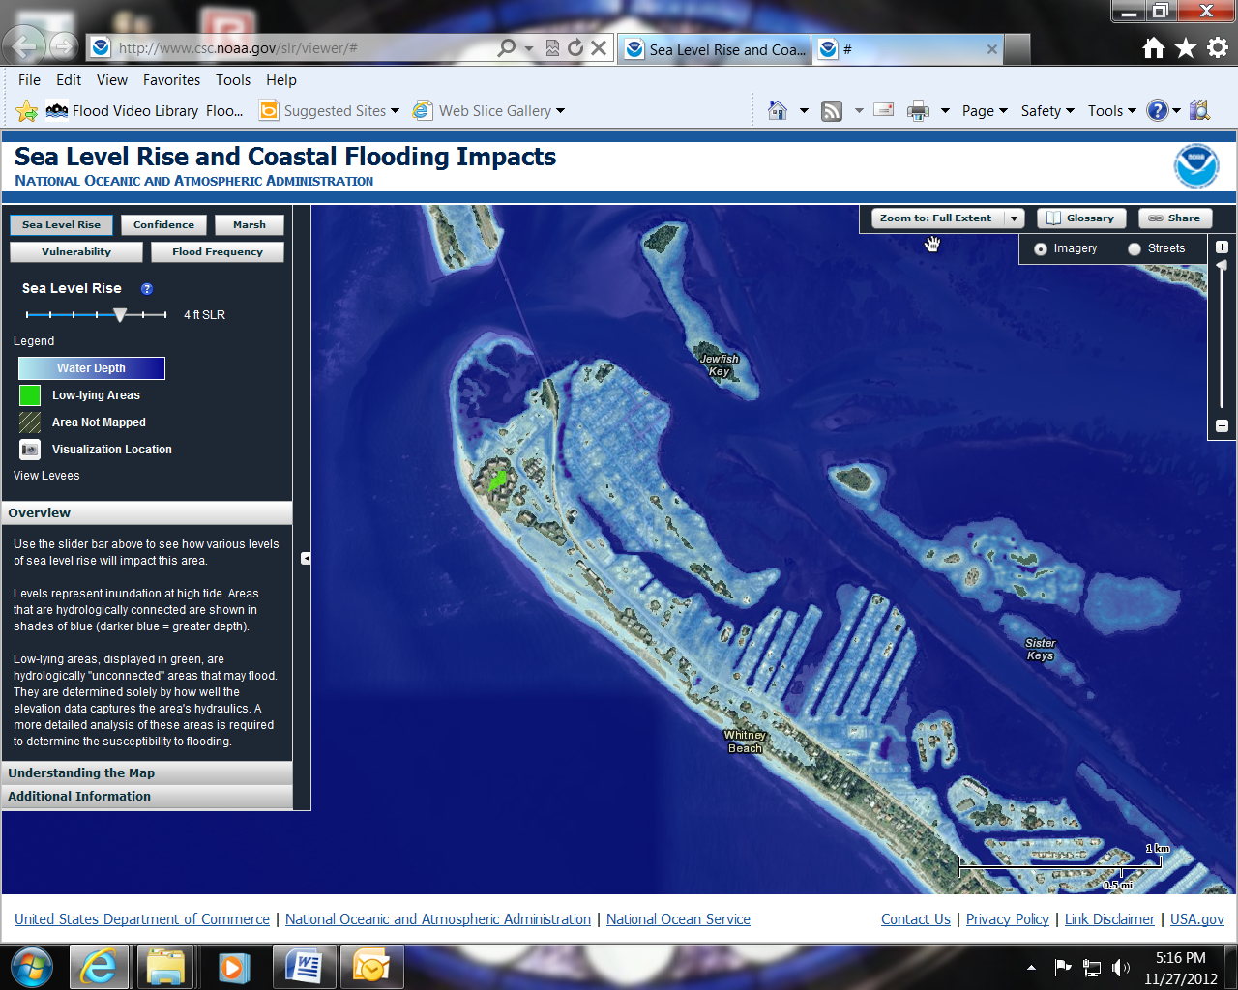
TOWN OF LONGBOAT KEY
Town Of Longboat Key North End and Village
Normal High tide and + 4 foot sea level rise

Slide 20
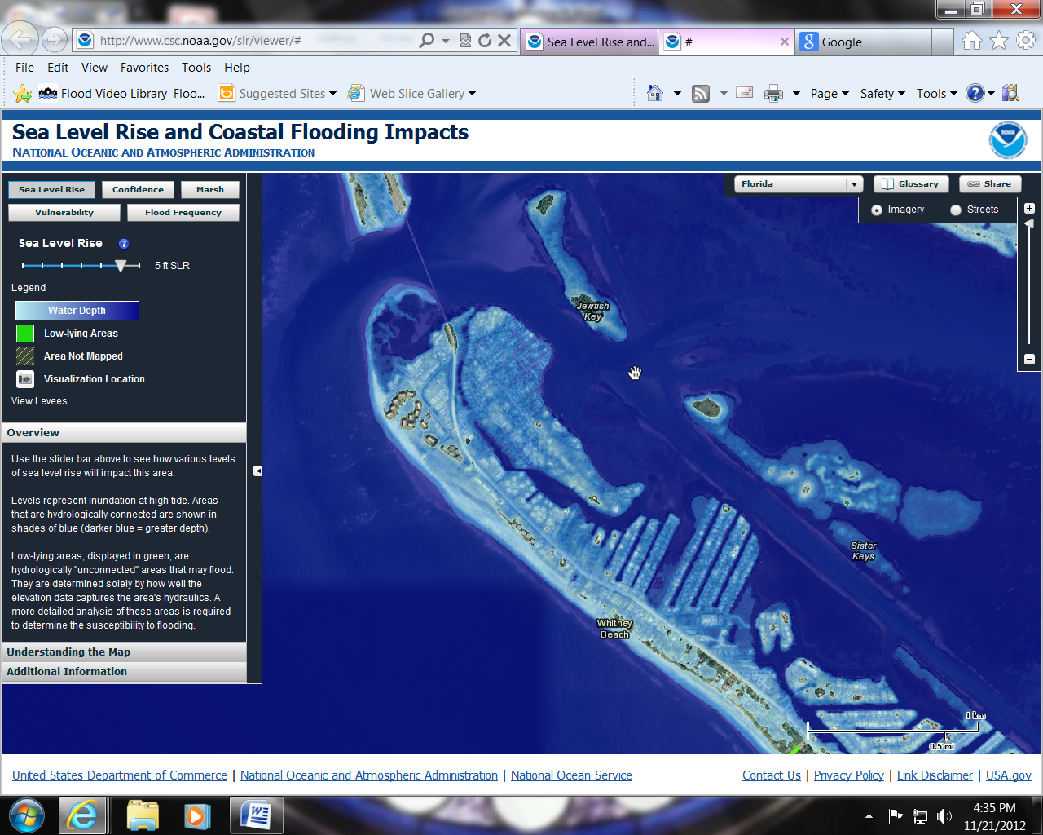
TOWN OF LONGBOAT KEY
Town Of Longboat Key North End and Village
Normal High tide and + 5 foot sea level rise

Slide 21

TOWN OF LONGBOAT KEY
Town Of Longboat Key North End and Village
Normal High tide and + 6 foot sea level rise

Slide 22
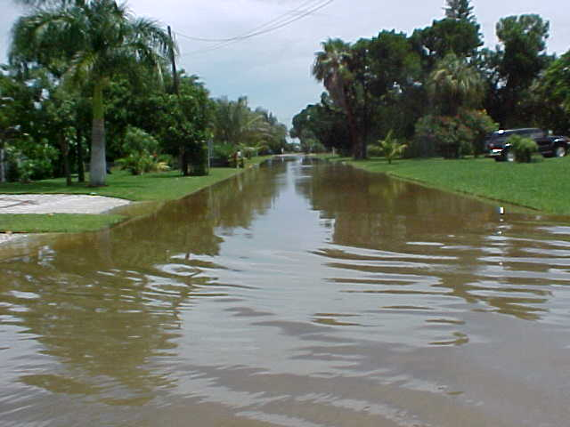
TOWN OF LONGBOAT KEY
QUESTIONS ?
RUSSEL STREET LOOKING WEST POST RAIN EVENT W/ HIGH TIDE 6/28/2003

