Slide 1
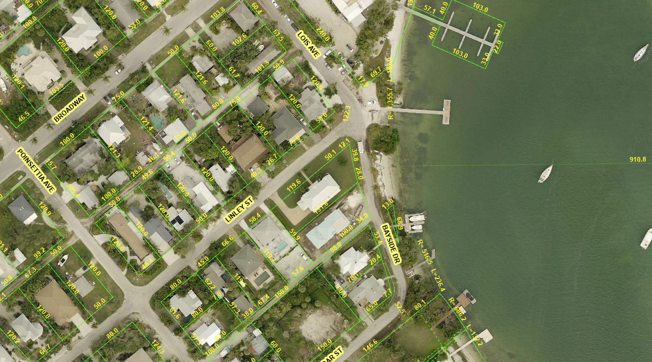
Photo Map Village Bank Stabilization Project
1
2
4
3
5
6
6
Photos of Project Area
All photos were taken on 3/25/2024 unless otherwise labeled. Arrow indicates the direction of photo and number box indicates the position.

Slide 2
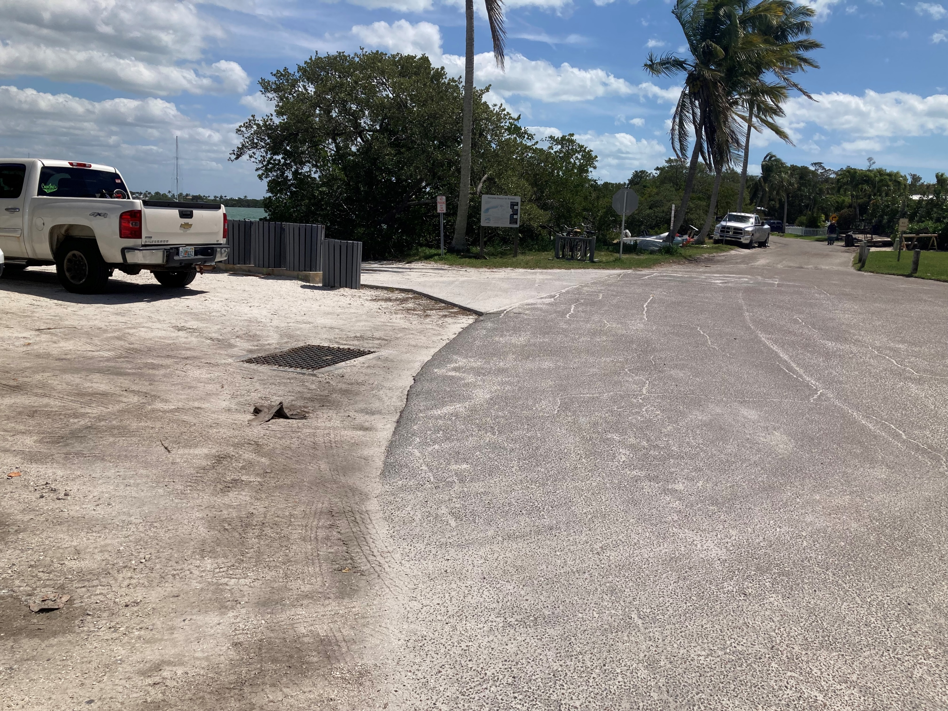
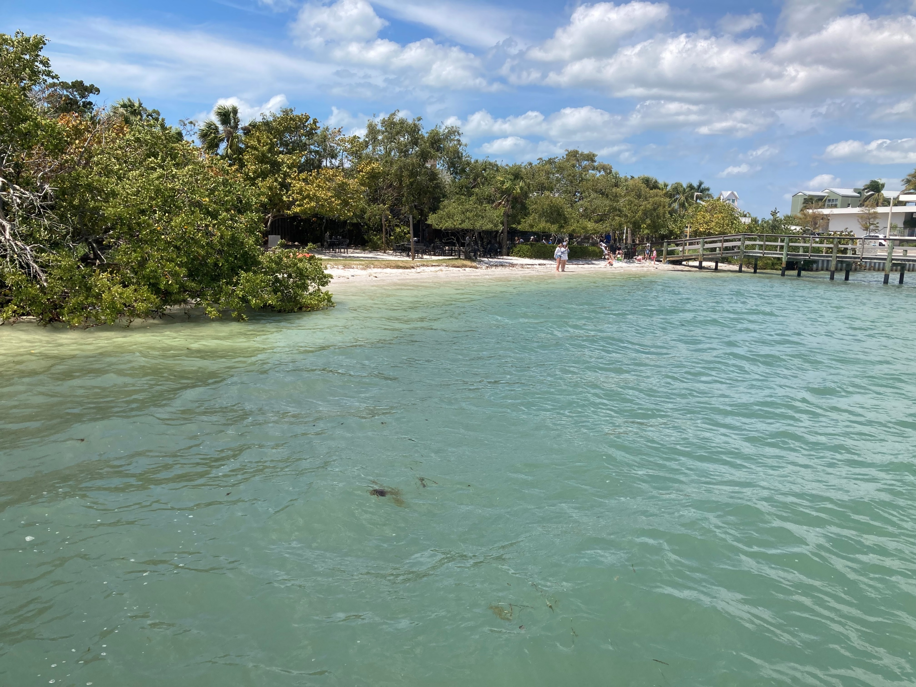
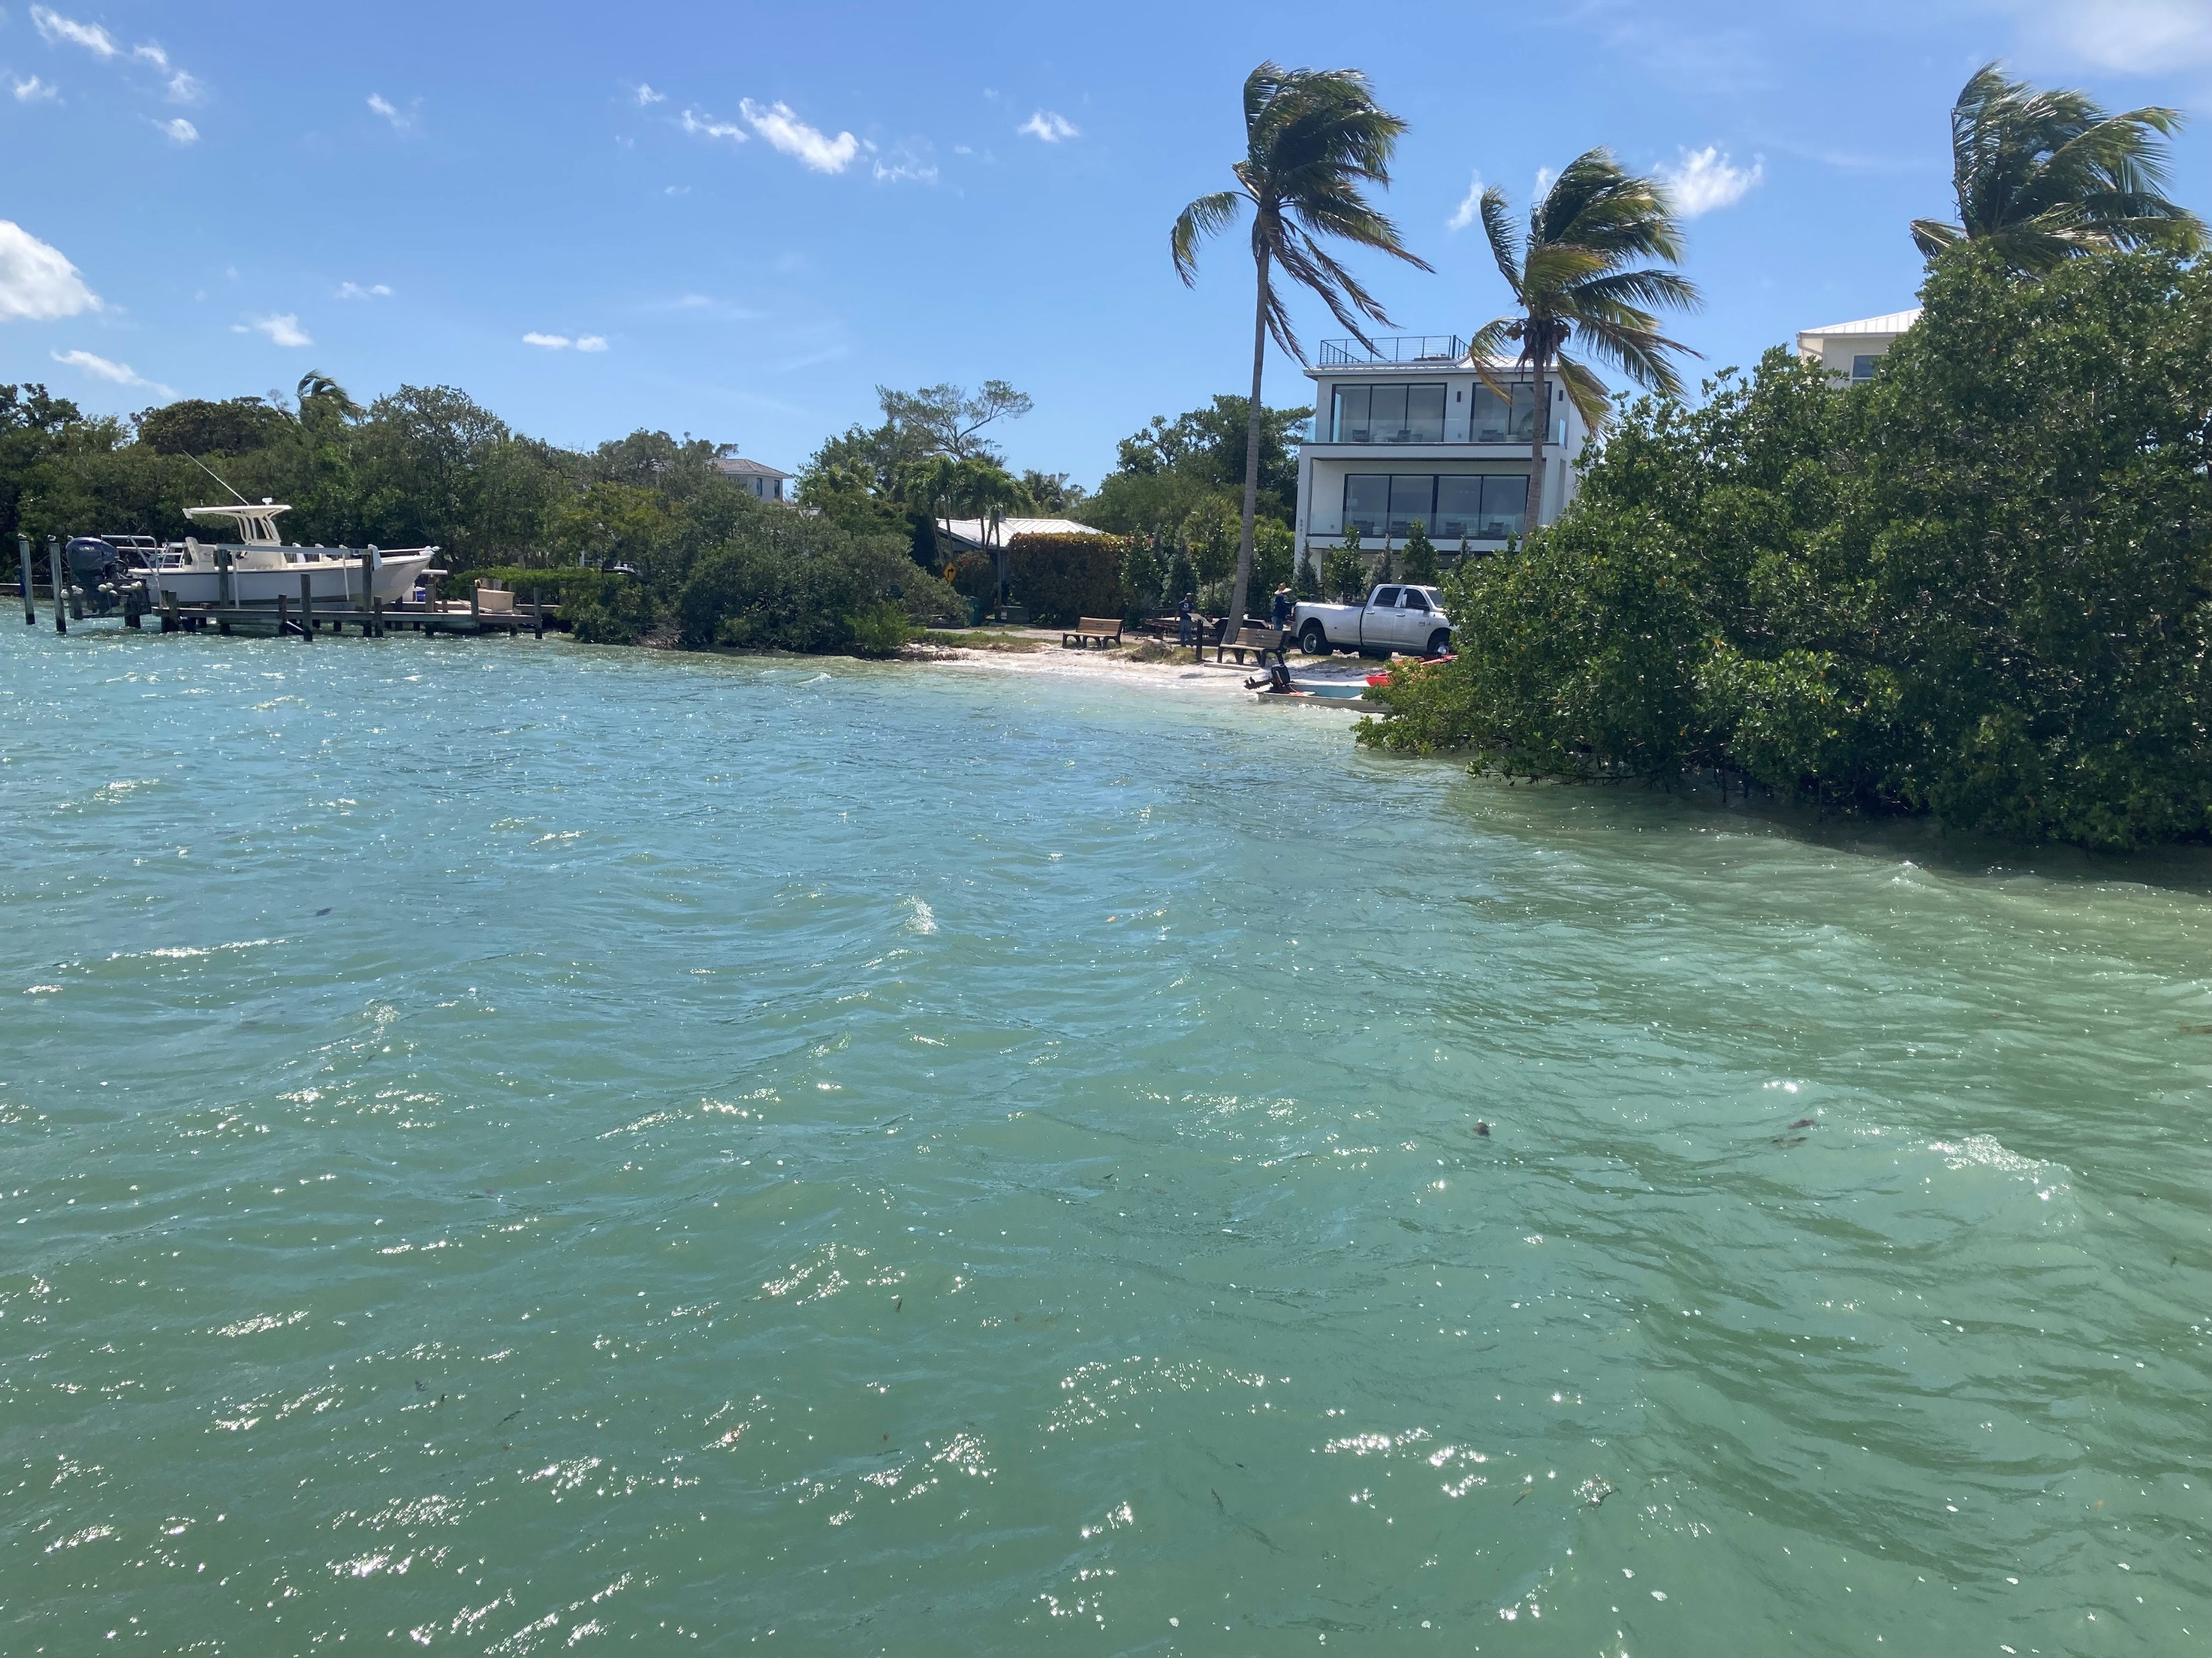
Photos Village Bank Stabilization Project
Photo 1 of Project Area Showing Parking, Drainage, Boat Ramp Apron, and Edge of Pavement (Bayside Dr.)
Photo 2 of Project Area from Town Dock Showing Bank Conditions facing N/W.
Photo 3 of Project Area from Town Dock Showing Bank Conditions facing S/W.

Slide 3
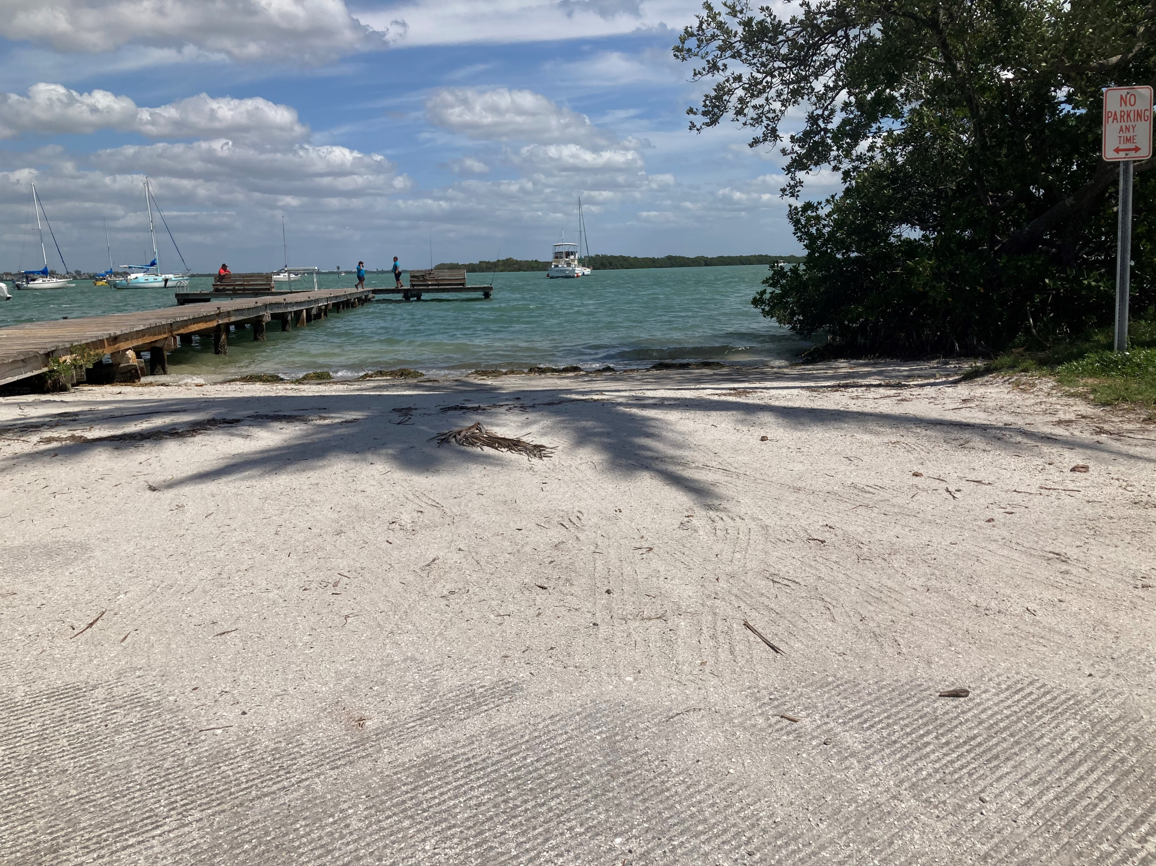
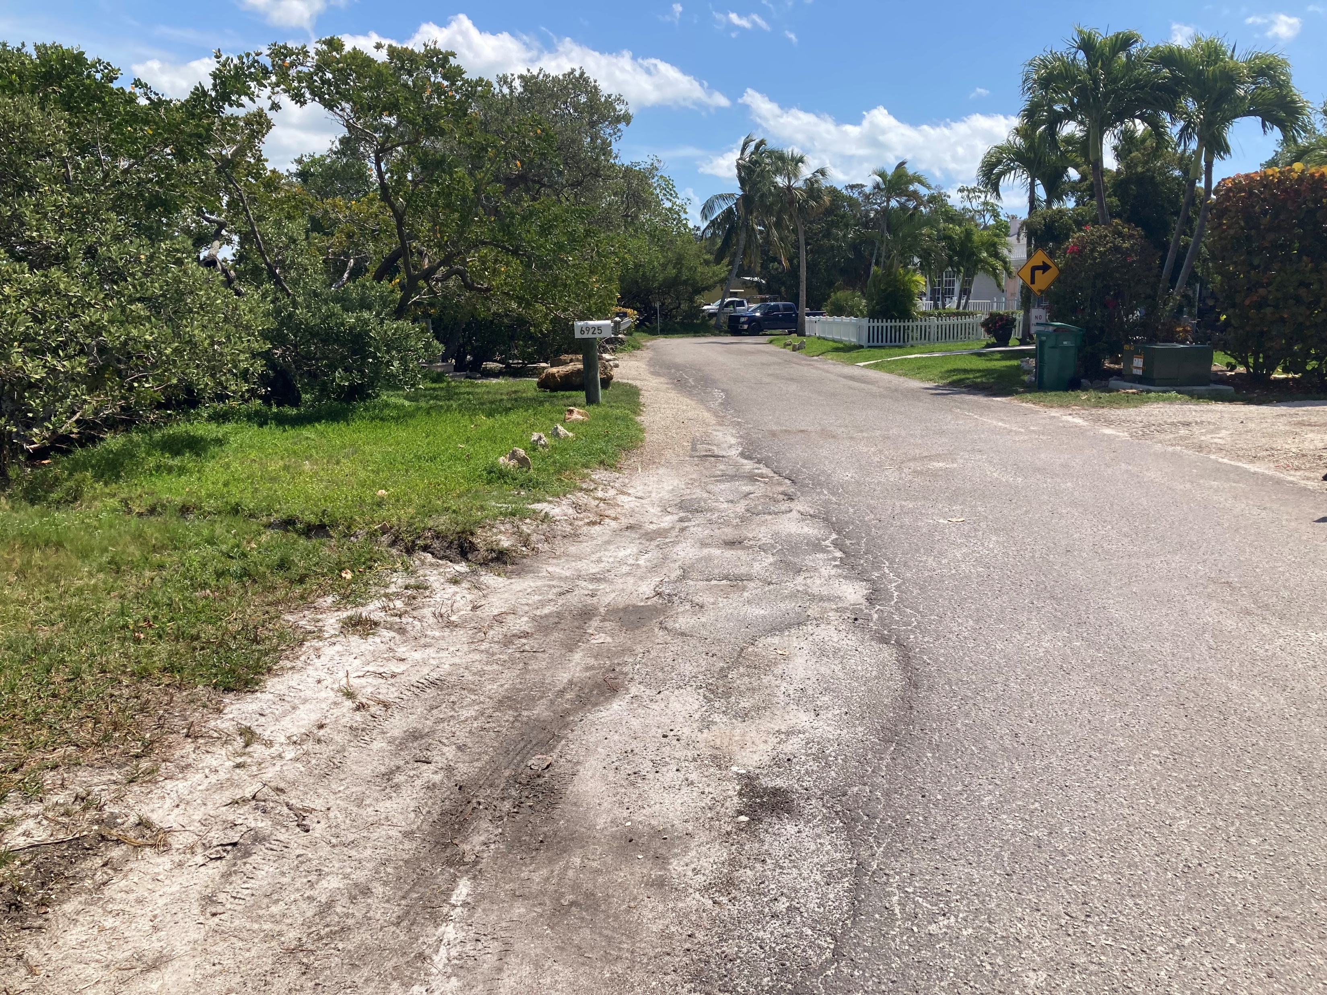
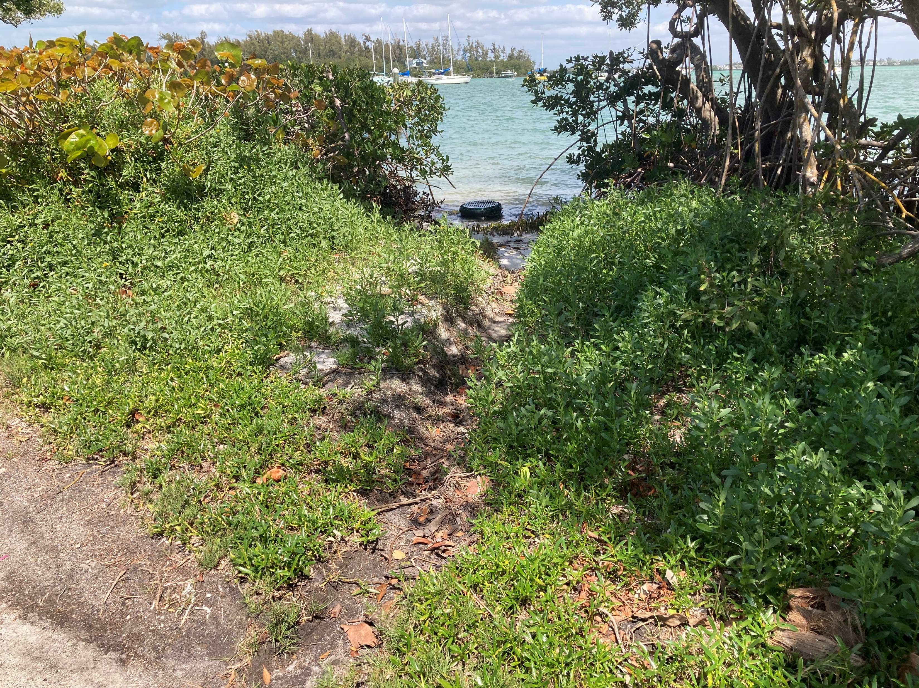
Photos Village Bank Stabilization Project
Photo 4 of Project Area Showing Boat Ramp Apron, and Town Dock.
Photo 5 of Project Area Showing Edge of Pavement (Bayside Dr.) and Bank Conditions
Photo 6 of Project Area Showing Bank Condition at Cedar St. and Bayside Dr.

