Slide 1
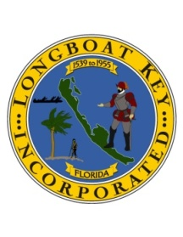
Gulf of Mexico Drive Corridor Study
TOWN OF LONGBOAT KEY
Town Commission Regular Workshop
April 17, 2017

Slide 2
Background
TOWN OF LONGBOAT KEY
Town engaged the Urban Land Institute to conduct an Advisory Services Panel Study
ULI Study identified multiple recommendations, including enhancements to Gulf of Mexico Drive (GMD)
With the Utilities Undergrounding Project moving forward, the opportunity now exists to enhance GMD
The Town Commission approved $50,000 in the FY2016-17 Budget to begin exploring conceptual design elements that might be possible for GMD

Slide 3
Phase 1: Conceptual Elements
TOWN OF LONGBOAT KEY
Phase 1 Simulation includes the following conceptual elements:
Keeping the current speed limit of 45 MPH
Roundabouts
Landscaped medians
Crosswalks with special pavement treatment and landscaped mid-road respite areas
Multi-Use paths on both sides of GMD
Bike lanes with visual separation from traffic lane
Enhanced landscaping on both sides of GMD
Low pathway lighting along multi-use path
Enhanced bus shelters
Benches along multi-use path

Slide 4
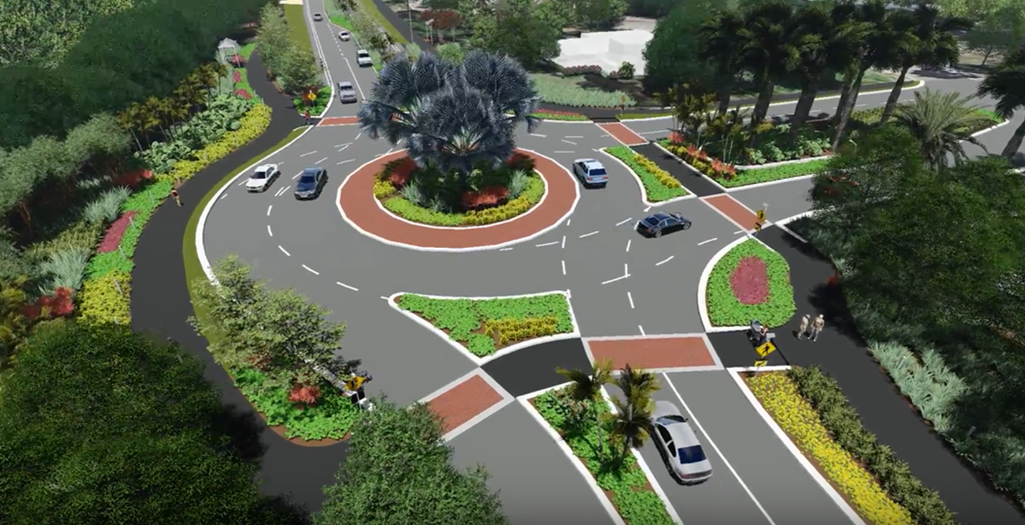
Town Entryways
TOWN OF LONGBOAT KEY
Two proposed roundabouts at north and south entrances to the Town (Longboat Club Road and Broadway) with enhanced landscaping, gateway signage, and vehicle/pedestrian circulation circulation

Slide 5
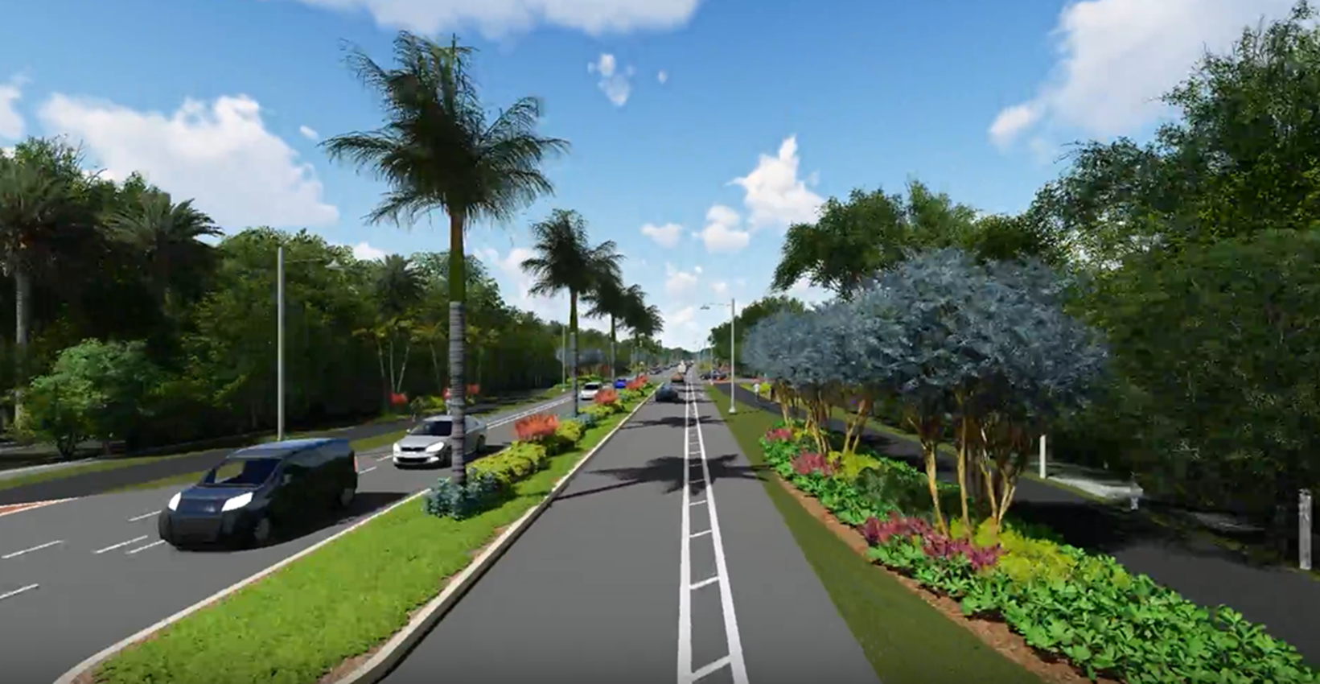
Medians and Bike lanes
TOWN OF LONGBOAT KEY
Provide wider buffered bike lanes, convert certain areas of striping to planted medians and provide enhanced landscaping along the east and west sides of GMD.

Slide 6
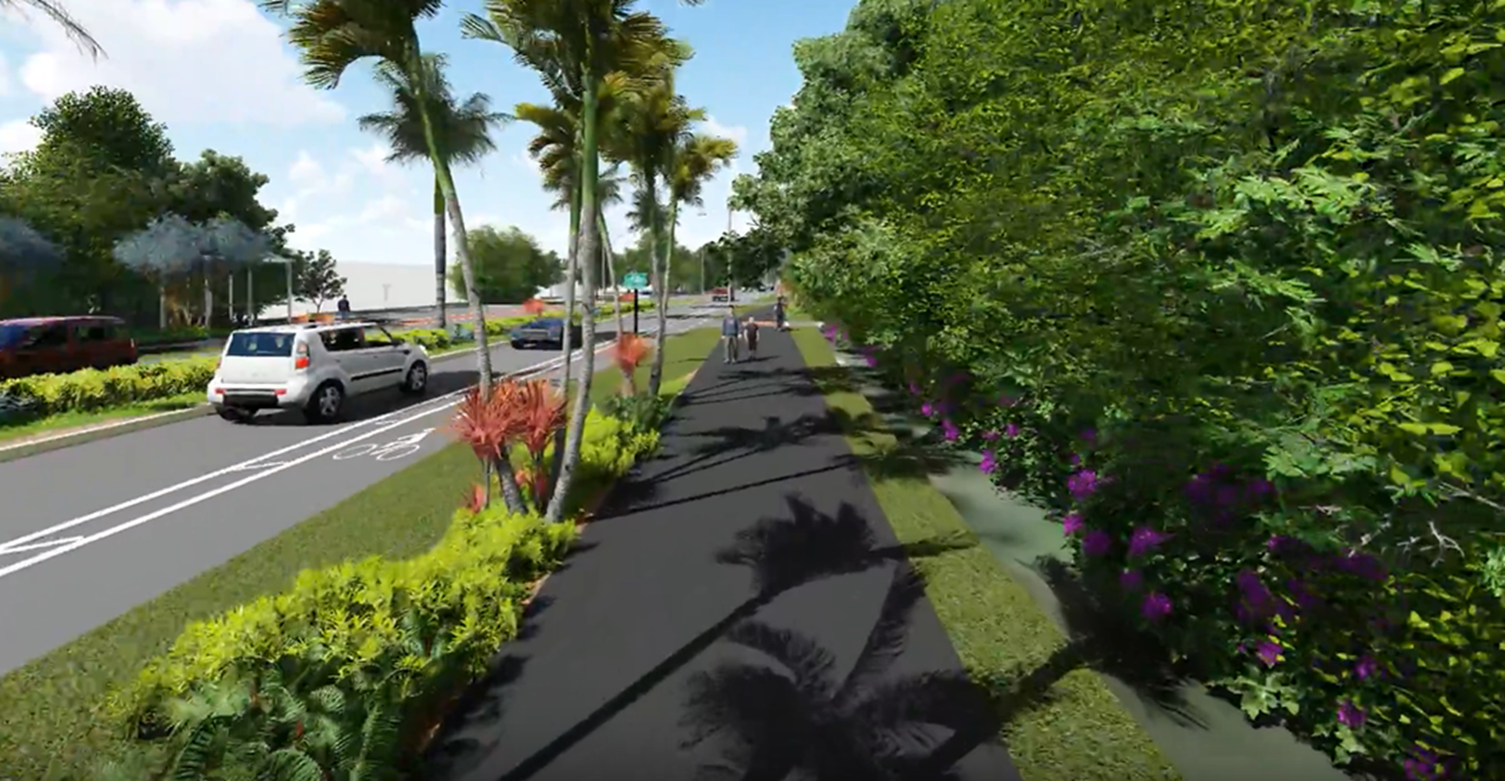
Multi-Use Paths
TOWN OF LONGBOAT KEY
Provide 10’ multi-use paths, enhanced landscaping, and pathway lighting along the east and west sides of GMD.

Slide 7
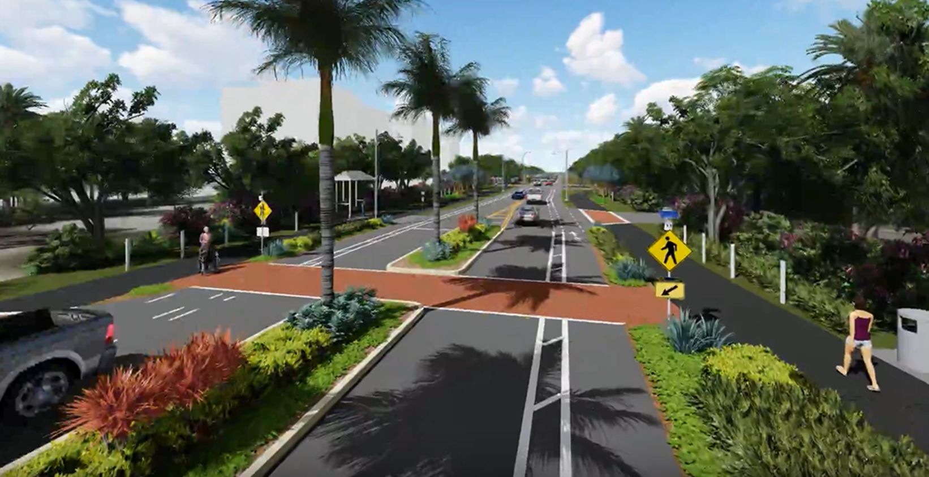
Pedestrian and Transit
TOWN OF LONGBOAT KEY
Provide 10-foot multi-use paths on both sides of GMD, enhanced crosswalks with landscaped medians, pathway lighting and bus shelters

Slide 8
Next Steps
TOWN OF LONGBOAT KEY
If the Town Commission directs Staff to move forward, next steps would include
Investigation of right-of-way sufficiency
Stormwater analysis
Additional potential design element detail
Coordination with turn lane project at Country Club Shores
Coordination with Utilities Undergrounding Project

