Slide 1
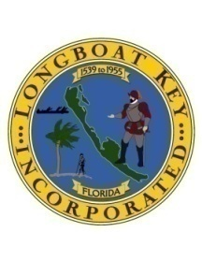
TOWN OF LONGBOAT KEY
CANAL DREDGING SURVEY REPORT
Canals Not surveyed 2013
Total of 18 Canals not Surveyed
No reports of access problems to Marine Patrol
No problems encountered by PW staff during Stormwater outfall inspections
Majority were not included in the 2003 project
(Except minor dredging @ 15S, 12, 25, & 27)

Slide 2
TOWN OF LONGBOAT KEY
CANAL DREDGING SURVEY REPORT
Canals Not surveyed 2013
2003 Project design based on 1998 Survey
&
Antonini and Box Report of 1996
Maximum draft Sailboats -4 ft.
Maximum draft Power Boats -2 ft.

Slide 3
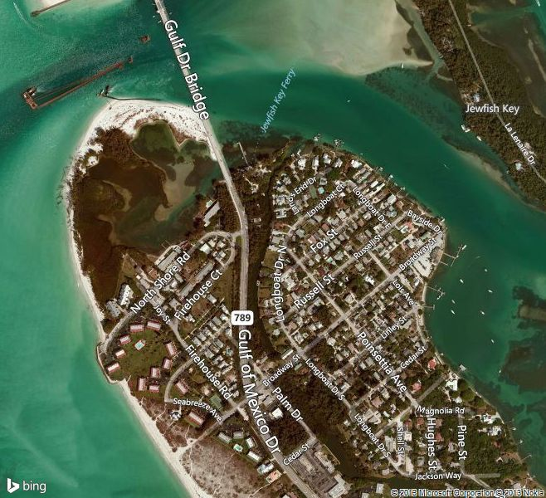
TOWN OF LONGBOAT KEY
CANAL DREDGING SURVEY REPORT
Canals Not surveyed 2013
Canal #1
Longboat Dr. N.
Lands End
1998 Survey -2.9 to -6.8
Not inc. in 2003 Project

Slide 4
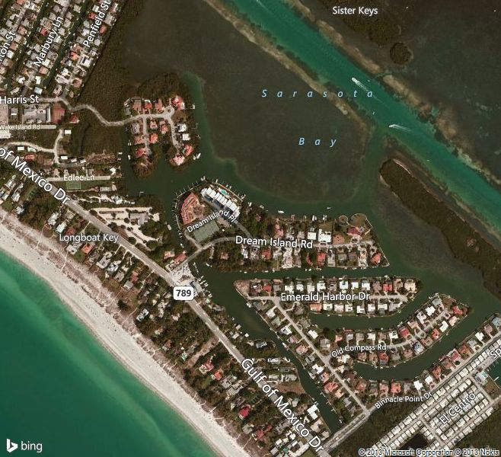
TOWN OF LONGBOAT KEY
CANAL DREDGING SURVEY REPORT
Canals Not surveyed 2013
Canals #12 -15
Hideaway Bay thru Emerald Harbor
1998 Survey -3.8 to -7.9
Minor Dredging to
-5.4 in Canals 15S and entrance to 12 in 2003 Project
15 N
15 S
12
13
14

Slide 5
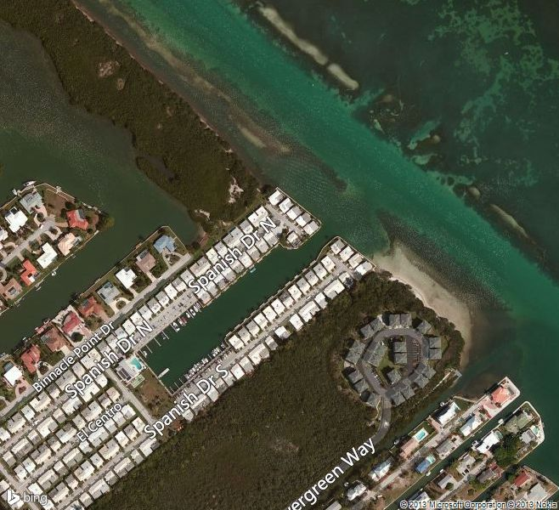
TOWN OF LONGBOAT KEY
CANAL DREDGING SURVEY REPORT
Canals Not surveyed 2013
Spanish Main Yacht Club
Not included in1998 Survey
Not inc. in 2003 Project
ICW

Slide 6
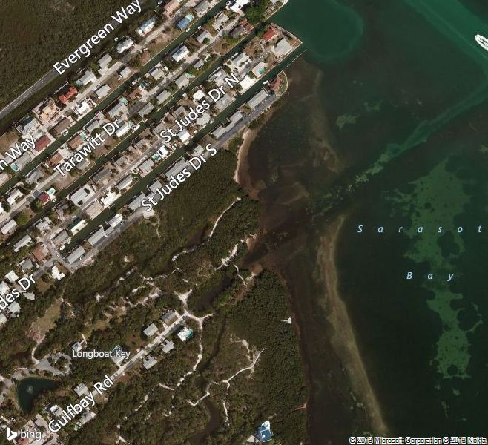
TOWN OF LONGBOAT KEY
CANAL DREDGING SURVEY REPORT
Canals Not surveyed 2013
Canals #20
Durante Park
Gulf Bay Rd.
1998 Survey -2.3 to -6.8
Not inc. in 2003 Project

Slide 7
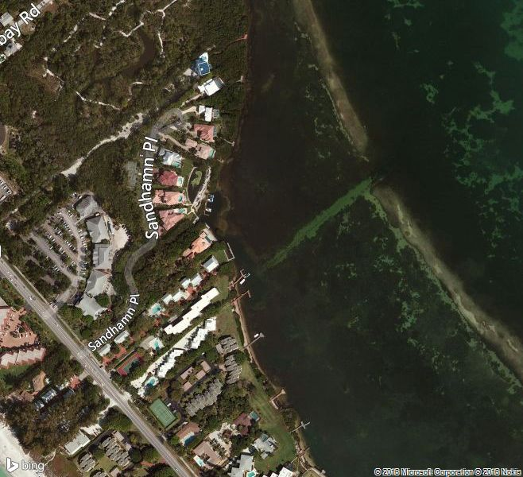
TOWN OF LONGBOAT KEY
CANAL DREDGING SURVEY REPORT
Canals Not surveyed 2013
Canals #21
Sandhamn Place
Beach Castle
1998 Survey -2.3 to -7.2
Not inc. in 2003 Project

Slide 8
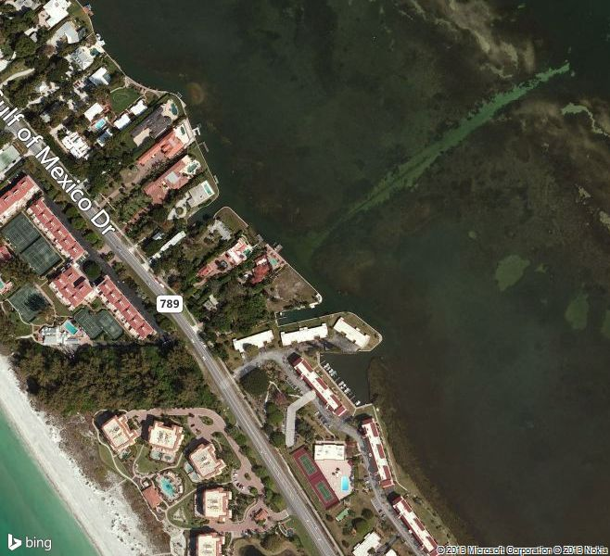
TOWN OF LONGBOAT KEY
CANAL DREDGING SURVEY REPORT
Canals Not surveyed 2013
22
23
Canals #22, 23, 24
Private Lots
and N. End of Windward Bay
1998 Survey -2.3 to -6.8
Not inc. in 2003 Project
24

Slide 9
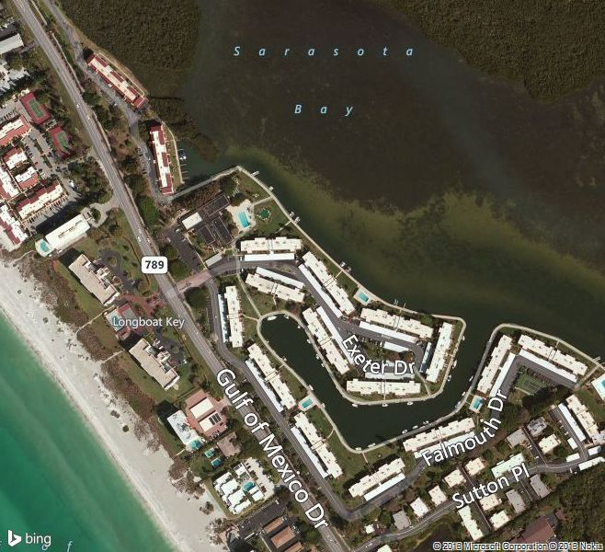
TOWN OF LONGBOAT KEY
CANAL DREDGING SURVEY REPORT
Canals Not surveyed 2013
Canals #25 and 26
S. End of Windward Bay
and Longboat Harbor
1998 Survey -2.4 to -13.5
Canal #25 Dredged to
-4.4 in 2003
Canal #26
Not inc. in 2003 Project
25
26

Slide 10
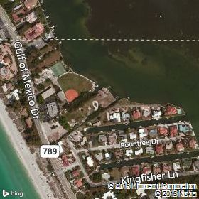
TOWN OF LONGBOAT KEY
CANAL DREDGING SURVEY REPORT
Canals Not surveyed 2013
Canals #27 and 28
Bayfront Park and Jessmyth Dr.
1998 Survey -2.2 to -6.6
Minor dredging to -3.4 by Bayfront Park seawall in 2003 Project
27
28

Slide 11
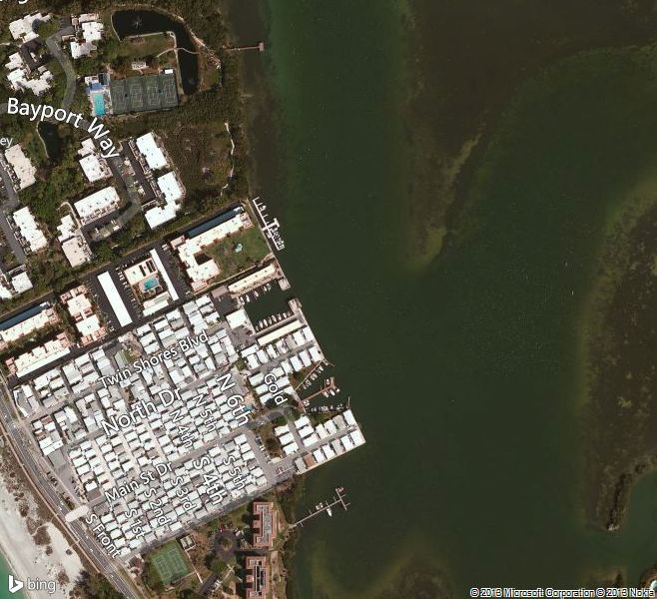
TOWN OF LONGBOAT KEY
CANAL DREDGING SURVEY REPORT
Canals Not surveyed 2013
Canal #31
Sandhamn Place
Beach Castle
1998 Survey -2.3 to -7.2
Not inc. in 2003 Project

Slide 12
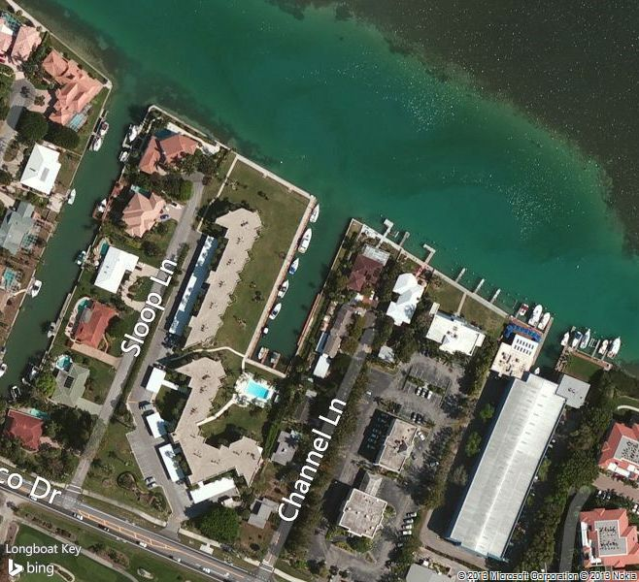
TOWN OF LONGBOAT KEY
CANAL DREDGING SURVEY REPORT
Canals Not surveyed 2013
Canal #52
Bay Harbor Apartments
1998 Survey -6.2 to -9.1
Not inc. in 2003 Project

