Slide 1
Bayfront Park Recreation Center Planning
Town Commission Regular Workshop Meeting
June 17, 2019

Slide 2
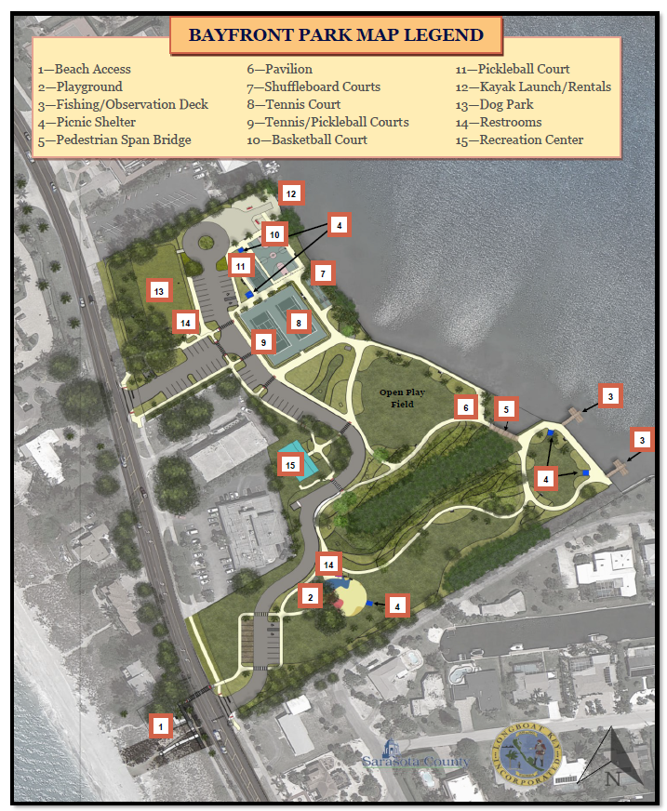
Bayfront Park Improvement Project

Slide 3
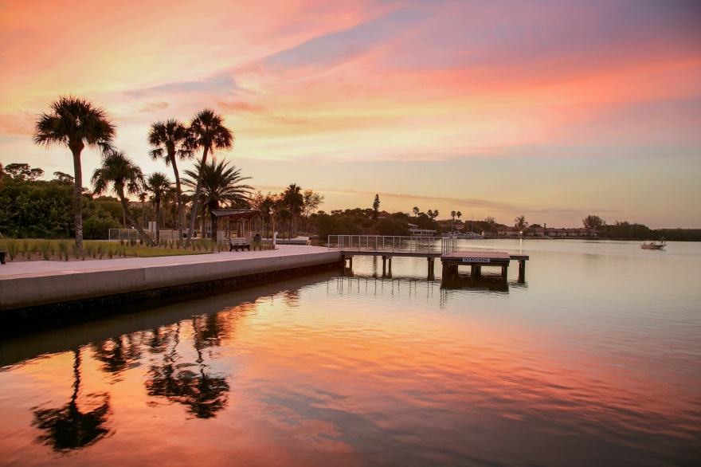
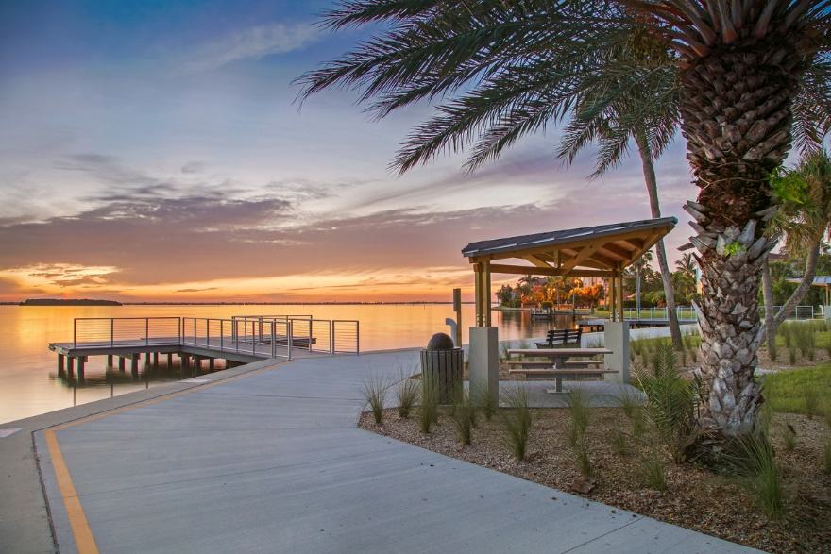
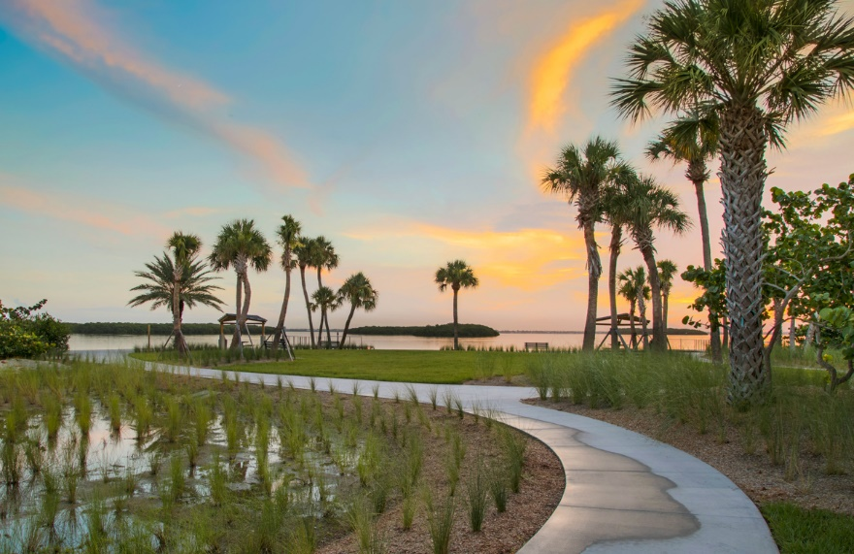
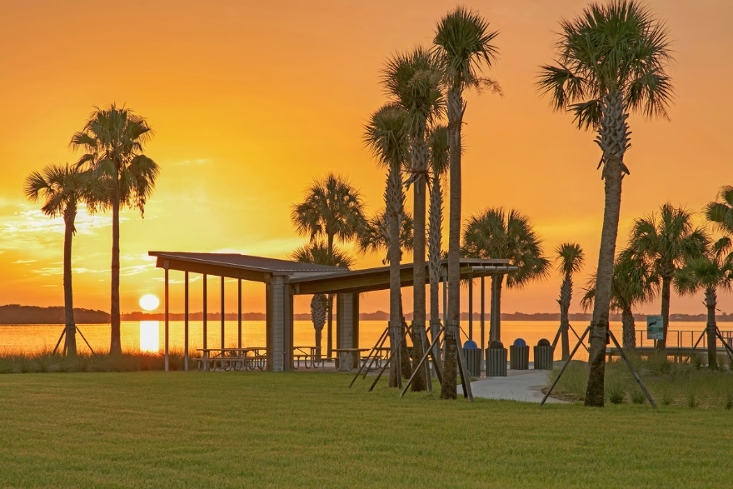
Bayfront Park Improvement Project

Slide 4
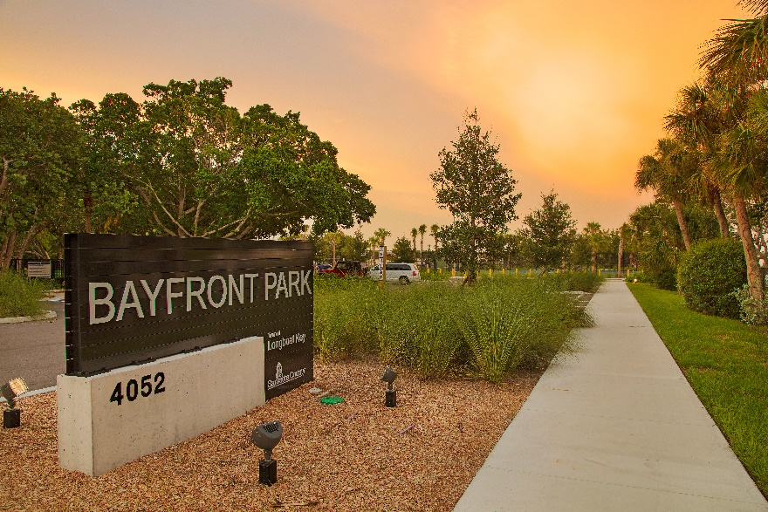
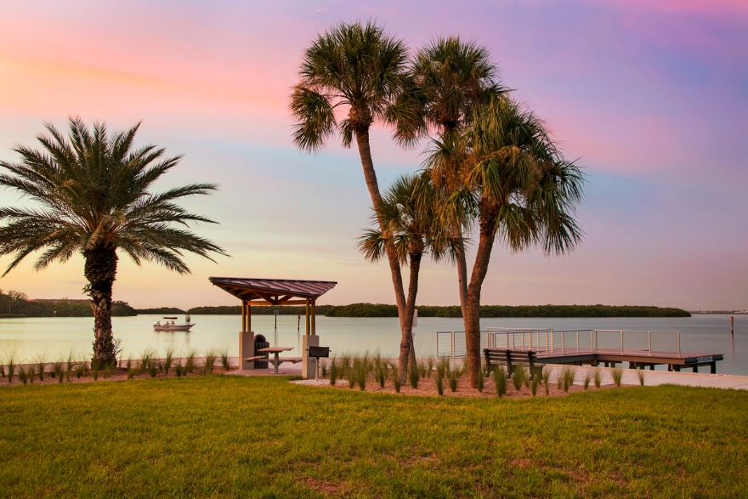
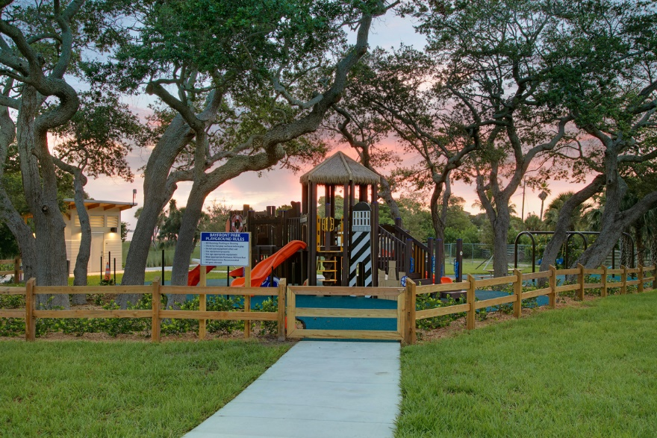

Bayfront Park Improvement Project

Slide 5
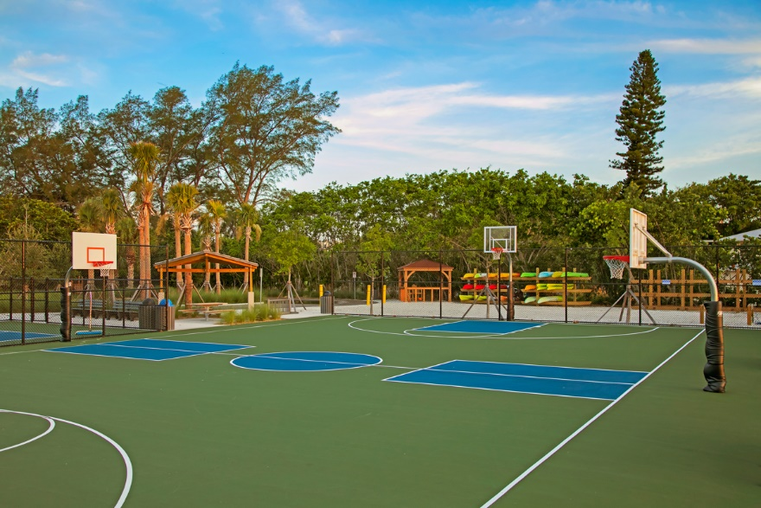
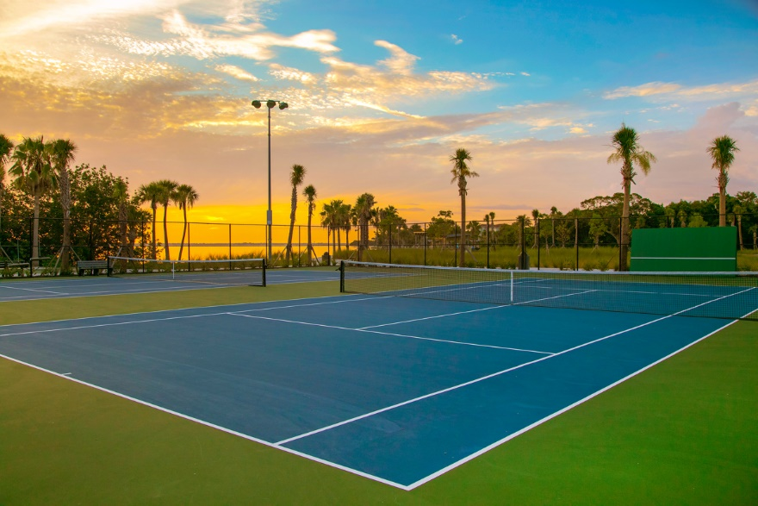
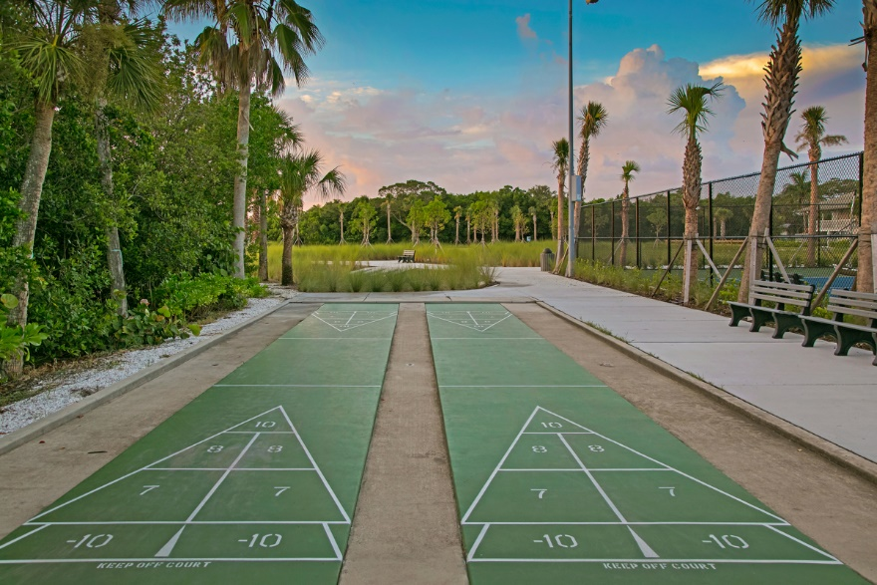
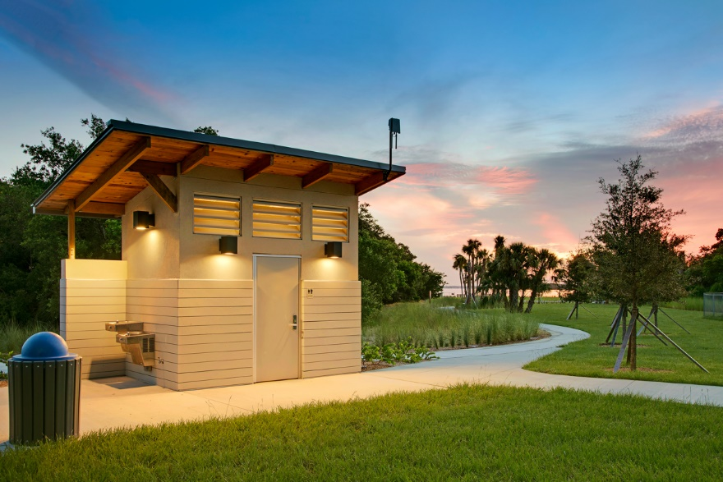
Bayfront Park Improvement Project

Slide 6
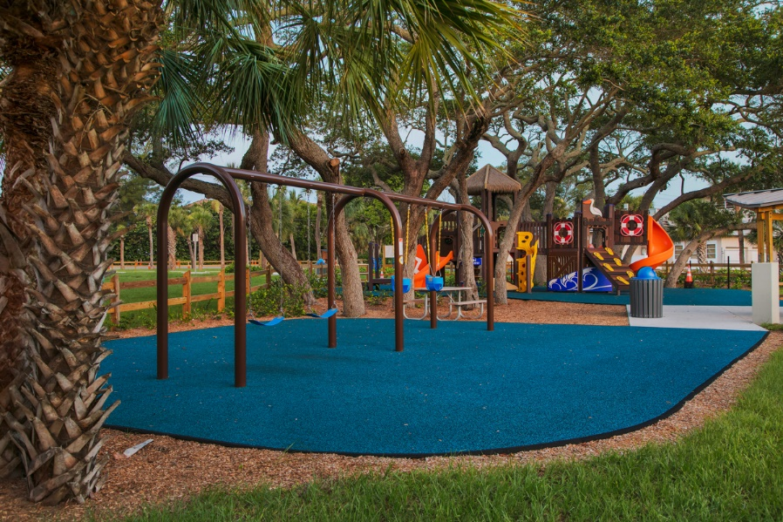
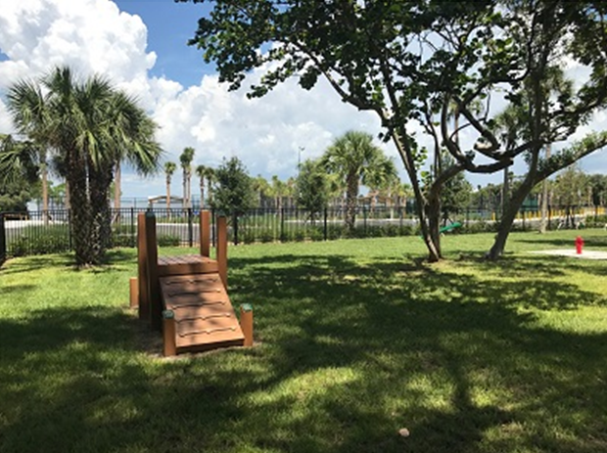
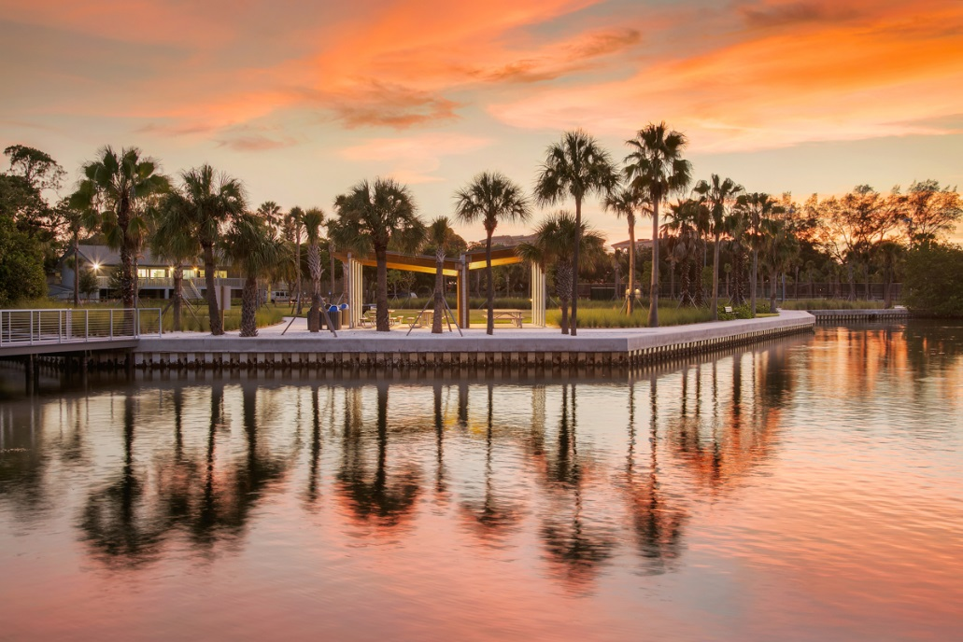
Bayfront Park Improvement Project

Slide 7


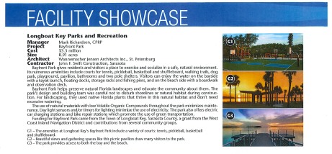
Bayfront Park Improvement Project

Slide 8
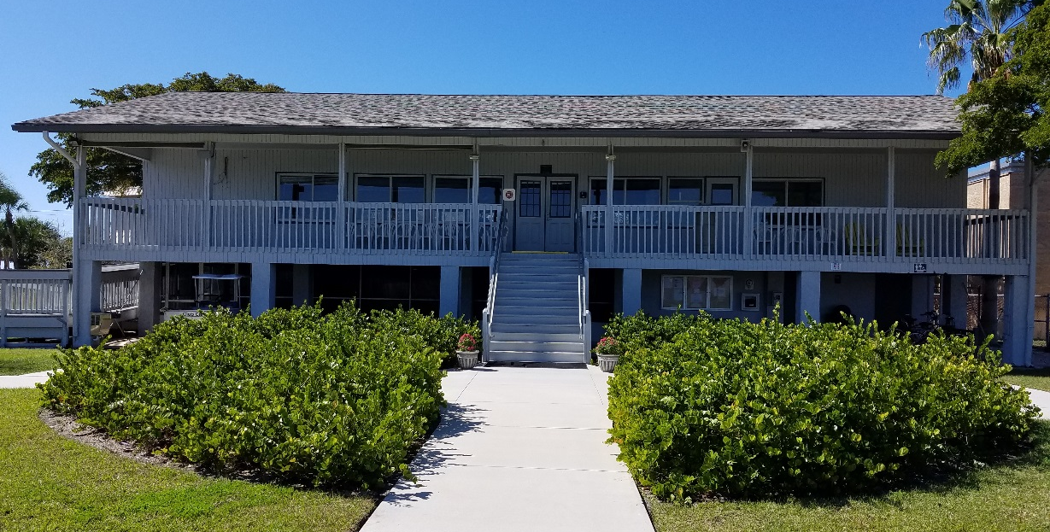
Bayfront Park
Recreation Center Concept Planning

Slide 9
Existing Recreation Center Data
Building donated by the late Dr. Murf Klauber in 1984 and transported to its current location. 2nd floor exterior totals ~2,800 sf and includes the following approximate spaces:
2nd Floor EXISTING
Multi-purpose Room 1,340 sf
Patio/Porch 690 sf
Office 180 sf
Mechanical/Storage 150 sf
Kitchen 110 sf
Restrooms (3) 150 sf
Total 2,620 sf
Multi-purpose space used for private events, fitness classes, and Town events, one at a time and with limited capacity.
Building age, available space, and current Building Code considerations influence planning for a new recreation center.

Slide 10
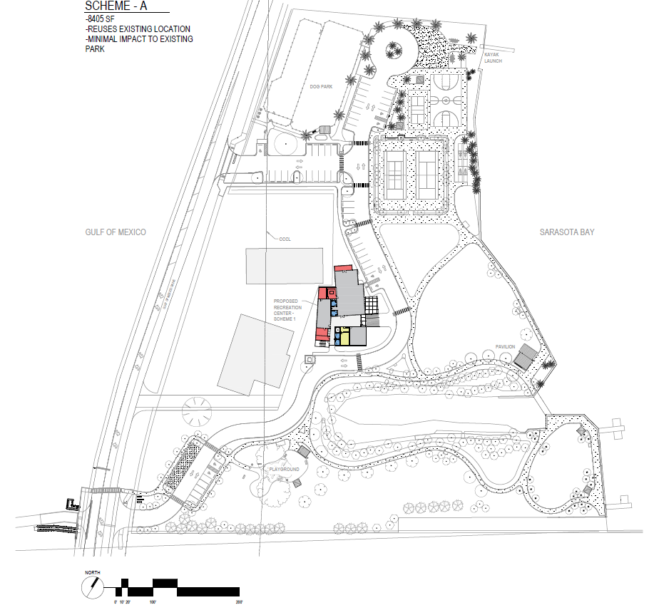
Scheme A Location

Slide 11
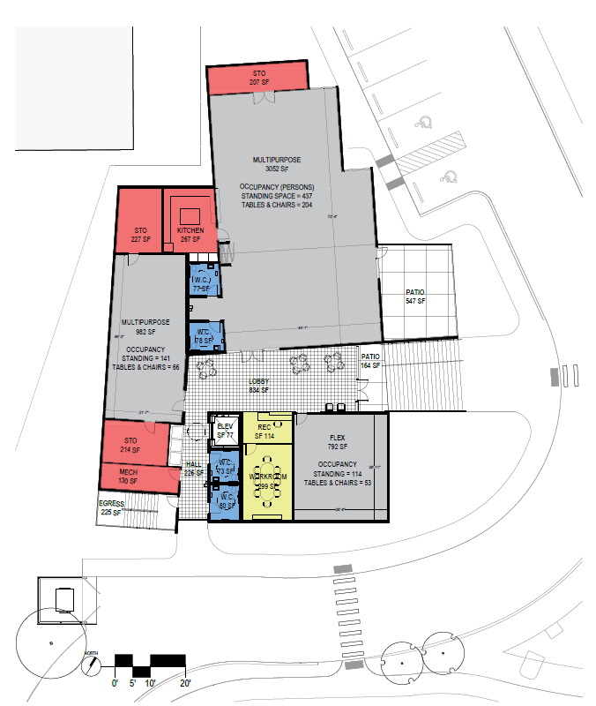
Scheme A Floor Plan
8,501 sf

Slide 12
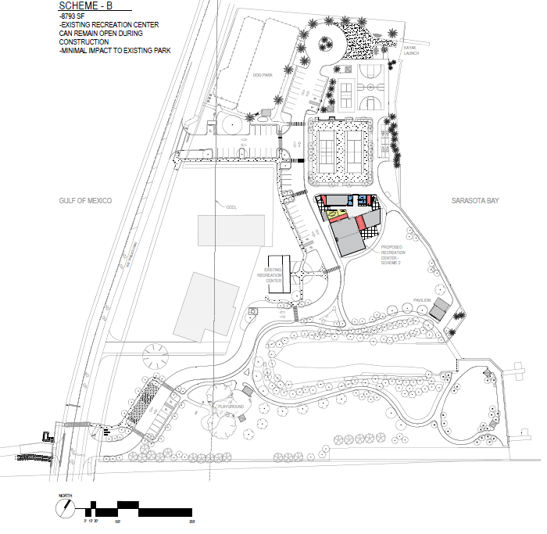
Scheme B Location

Slide 13
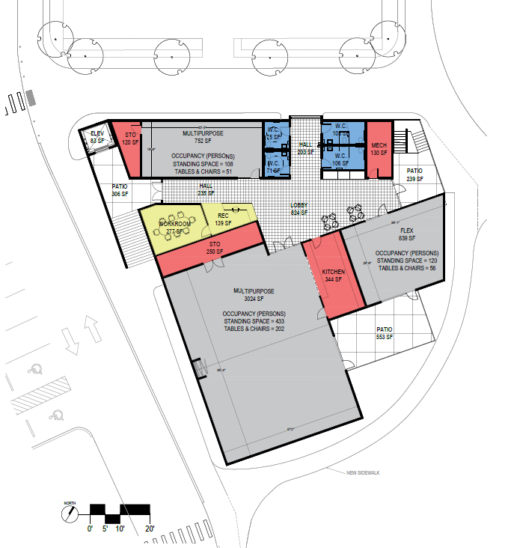
Scheme B Floorplan
8,808 sf

Slide 14
Bayfront Park
Recreation Center Concept Planning
Potential Reduction(s)

Slide 15
Scheme A Floor Plan

Slide 16
Scheme A Floor Plan
Reduction 1 -1209 SF

Slide 17
Scheme A Floor Plan
Reduction 2 -2199 SF
46’
MULTIPURPOSE
2062 SF

Slide 18
Scheme A Floor Plan
Reduction 3 -2414 SF
46’
MULTIPURPOSE
2062 SF
619 SF
6,087 sf

Slide 19
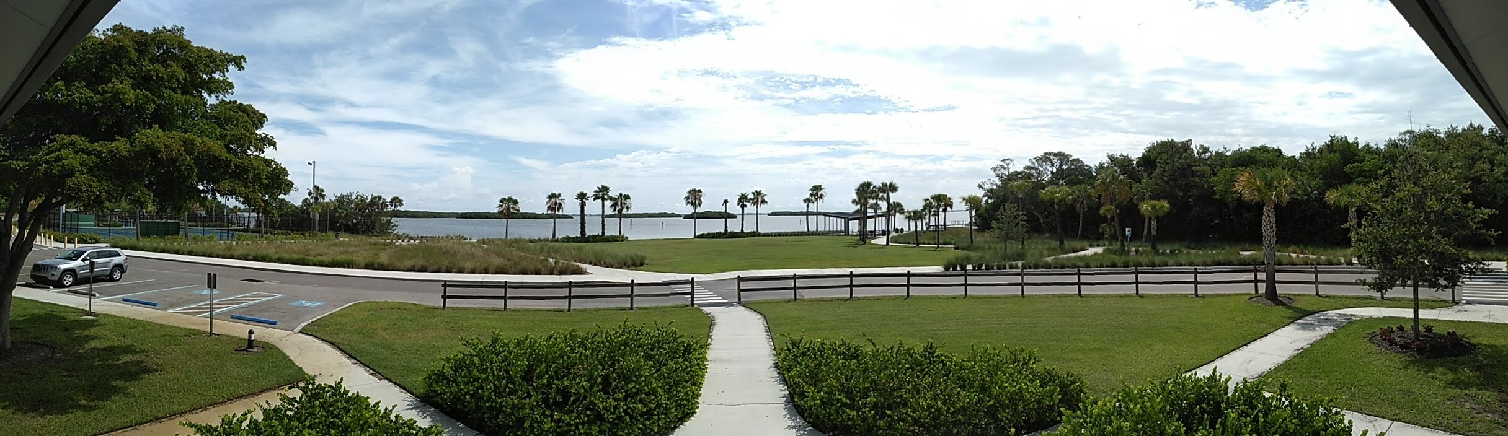
Staff Recommends Scheme A
Existing Recreation Center Location
Maintains existing park ambiance and provides for overall park and bay views.

Slide 20
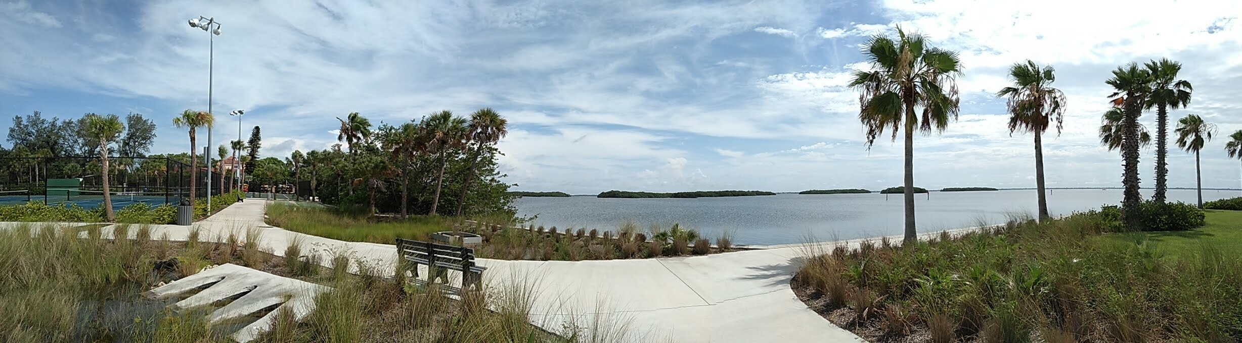
Scheme B
Potential Location
Existing Stormwater Area
May disrupt existing park character.

Slide 21
Next Steps
Public Works to proceed with finalizing a concept that includes the existing recreation center location with a conceptual program that includes the current schemes unless specific reduction(s) are requested. As part of finalizing the concept, WJA can document square foot reduction alternatives.

Slide 22
Thank You!

